Slide 1

Who’s to Blame?
Environment versus the Patient
A review of the literature attempting to ascertain the truth about where HAIs most likely come from.
Frank Edward Myers III, M.A., CIC, FAPIC
Director Infection Prevention and Clinical Epidemiology
UC San Diego Health
With Special Guest Appearance by:
Medecins Sans Frontieres/ Doctors Without Borders (MSF) Superstar
IPC Advisor
Kim Delahanty, BSN, PHN, MBA, CIC, FAPIC
Notes:
Either

Slide 2
Why is this an important topic?
If it’s the Environment
If it’s the patient
More focus on cleaning and testing of the environment
The ROI for expensive cleaning devices becomes greater
HAIs are viewed as more preventable
Patient’s with HAIs have a lot more reasons to be angry
More focus on preventing translocation of the patient’s own flora
Different interventions (cleaning the room versus antibiotic stewardship)
HAIs are fundamentally harder to prevent
Our Efforts and Resource Expenditure Look Different
Notes:
Either

Slide 3
Hasn’t this been answered?
One Review of 18 Studies
Cohen B, Cohen CC, Loyland B, Larson EL. Transmission of health care-associated infections from roommates and prior room occupants: a systematic review. Clin Epidemiol 2017;9:297–310
“Multiple studies reported positive associations between infection and exposure to roommates with influenza and group A streptococcus, but no associations were found for Clostridium difficile, methicillin-resistant Staphylococcus aureus, Cryptosporidium parvum, or Pseudomonas cepacia; findings were mixed for vancomycin-resistant enterococci (VRE). Positive associations were found between infection/colonization and exposure to rooms previously occupied by patients with Pseudomonas aeruginosa and Acinetobacter baumannii, but no associations were found for resistant Gram-negative organisms; findings were mixed for C. difficile, methicillin-resistant S. aureus, and VRE. Although the majority of studies suggest a link between exposure to infected/colonized roommates and prior room occupants, methodological improvements such as increasing the statistical power and conducting universal screening for colonization would provide more definitive evidence needed to establish causality.”

Slide 4
It’s Us, Clean the Room and Wash your Hands Dummy!
5 well done papers show that rooms are risk factors for getting an HAI even after adjusting in different ways for patient acuity
Shaughnessy MK et al Evaluation of Hospital Room Assignment and Acquisition of Clostridium difficile Infection INFECTION CONTROL AND HOSPITAL EPIDEMIOLOGY MARCH 2011, VOL. 32, NO. 3
  Shows that occupying a room previously occupied by a patient with C diff increases your hazard ratio by 2.35 (1.21-4.54 95% CI p=0.01) AFTER adjusting for patient's age, APACHE III score, exposure to proton pump inhibitors, and antibiotic use!
Notes:
KM

Slide 5
Study 2
Drees M et al. Prior Environmental Contamination Increases the Risk of Acquisition of Vancomycin-Resistant Enterococci CID 2008:46 (1 March)
Risk | Hazard Ratio | 95% CI | P value
Room with prior VRE pt | 3.8 | 2.0-7.4 | P<0.001
Room with VRE pt in last 2 weeks | 2.7 | 1.4-5.3 | P=0.01
Room with positive VRE cx prior to VRE aquisition | 4.4 | 1.49-12.75 | P=0.007
Notes:
KM

Slide 6
Study 3
Huang S et al. Risk of Acquiring Antibiotic-Resistant Bacteria From Prior Room Occupants ARCH INTERN MED/VOL 166, OCT 9, 2006
“Among patients whose prior room occupant was MRSA positive, 3.9% acquired MRSA, compared
with 2.9% of patients whose prior room occupant was MRSA negative (adjusted odds ratio, 1.4; P=.04).”
“ VRE, Among patients whose prior room occupant was VRE positive, these values were 4.5% and 2.8% respectively (adjusted odds ratio, 1.4; P=.02)”
Notes:
KM

Slide 7
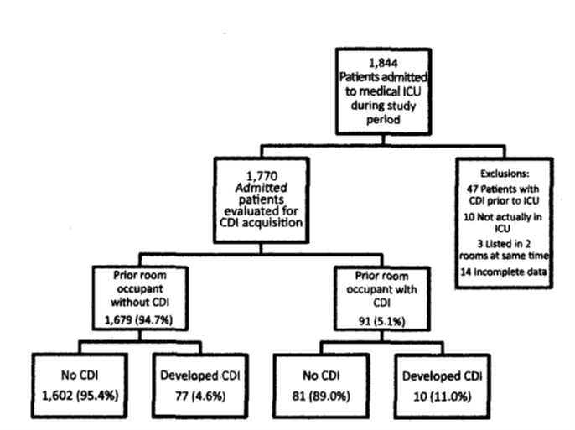
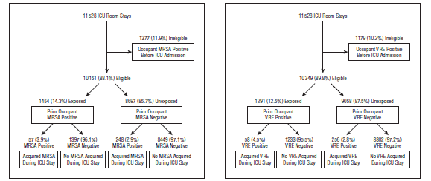
Do you believe everything you read?
Taking these three studies at face value These charts are problematic.
11.5%
18.6%
18.5%
Notes:
FM

Slide 8
The environment in these pro environment studies are showing it as a small % of the issue
From Huang: “These excess risks accounted for 5.1% of all incident MRSA cases and 6.8% of all incident VRE cases, with a population attributable risk among exposed patients of less than 2% for either organism. Acquisition was significantly associated with longer post–intensive care unit length of stay.”
Notes:
FM

Slide 9
Study 4
Chen LF, et al. (2019). A prospective study of transmission of Multidrug-Resistant Organisms (MDROs) between environmental sites and hospitalized patients—the TransFER Study. Infection Control & Hospital Epidemiology 2019, 40, 47–52. doi: 10.1017/ice.2018.275
Looked at C diff, MRSA, VRE, and A. baumannii
Results: We enrolled 80 patient–room admissions; 9 of these patients (11.3%) were asymptomatically colonized with MDROs at study entry.
Hospital room surfaces were contaminated with MDROs despite terminal disinfection in 44 cases (55%). Microbiological Bacterial Transfer events either to the patient, the environment, or both occurred in 12 patient encounters (18.5%) from the microbiologically evaluable cohort. Conclusions: Microbiological Bacterial Transfer events between patients and the environment were observed in 18.5% of patient encounters and occurred early in the admission.
No infections noted

Slide 10
Transfer rate

Slide 11
Wait!!!
An interesting change:
  18.5% to 7.5% MTE just means abx sensi was the same, 7.5% was PFGE similarity
PFGE is recognized as inferior to WGS and whole genome mapping (WGM) in identifying relatedness of bacteria

Slide 12
Study 5
Cohen B, Liu J, Cohen AR, Larson E Association between healthcare-associated infection and exposure to hospital roommates and previous bed occupants with the same organism. Infect Control Hosp Epidemiol 2018;39:541-46
“RESULTS: In total, 10,289 HAIs were identified. In a multivariable analysis controlling for both exposures and patient characteristics, the odds of cases having been exposed to a prior bed occupant with the same organism were 5.83 times that of controls (95% confidence interval [CI], 3.62–9.39), and the odds of cases having been exposed to a roommate with the same organism were 4.82 times that of controls (95% CI, 3.67–6.34).”

Slide 13
Significant associations between a number of bacteria and the previous room occupant status

Slide 14
“We all have a big but…”
-Pee Wee Herman
These significance tests did not match even on antibiotic sensitivities
“Less than 2% of cases were exposed to a previous bed occupant with the same organism and <4% of cases were exposed to roommates with the same organism.”

Slide 15
Let’s go to a far bigger C difficile study that is far more specific using whole genome sequencing
But first a brief moment to explain terms in in whole genome sequencing:
Single-nucleotide variants (SNVs) are differences between two bacteria.
0-1 SNV differences–Definitive transmission as the two organisms are functionally identical
2 SNV differences- Overwhelmingly likely transmission
3-10 SNV differences- With each SNV difference less likely the organisms are closely related
11 + SNV differences- Transmission did not occur, they are clearly different bacteria
Notes:
FM or FM and KM

Slide 16
UK health system looks at C. difficile relatedness
Eyre DW et al. Diverse Sources of C. difficile Infection Identified on Whole-Genome Sequencing NEJM September 26, 2013 vol. 369 no. 13
1250 C. difficile cases that were evaluated, 1223 (98%) were successfully sequenced.
In a comparison of 957 samples obtained from April 2008 through March 2011 with those obtained from September 2007 onward, a total of 333 isolates (35%) had no more than 2 SNVs from at least 1 earlier case (definitive transmission), and 428 isolates (45%) had more than 10 SNVs from all previous cases (clearly unrelated).
Of the 333 patients with no more than 2 SNVs (consistent with transmission), 126 patients (38%) had close hospital contact with another patient, and 120 patients (36%) had no hospital or community contact with another patient. So of 1223 CDI cases sequences only 126 patients had some spatial relationship with another patient and a clear genetic link (10.3% of all cases)
Notes:
FM

Slide 17
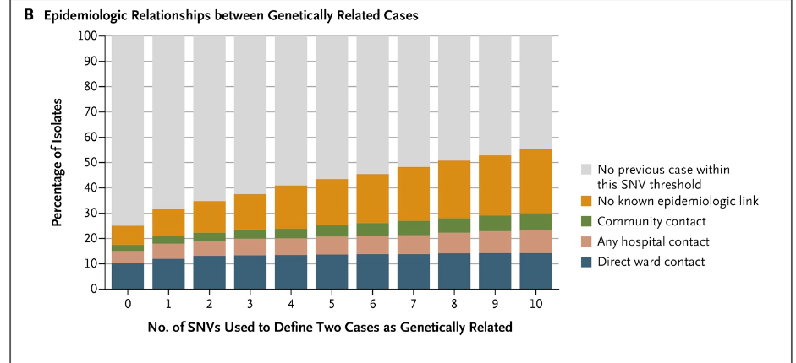
It ain’t me!!
While transmission is occurring it is not the majority of cases
Notes:
FM

Slide 18
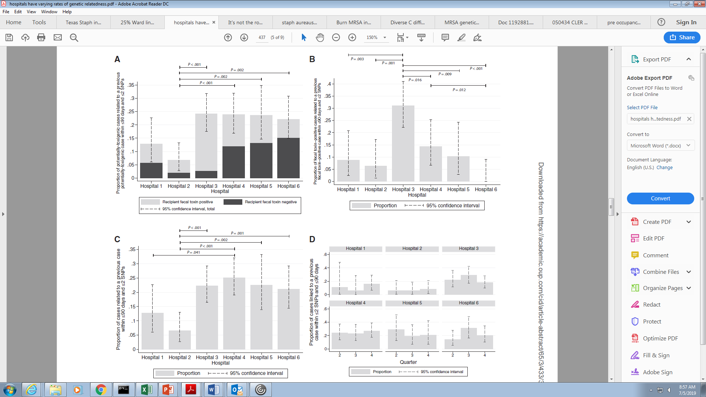
Wait A Minute!
DW Eyre et al. Comparison of Control of Clostridium difficile Infection in
Six English Hospitals Using Whole-Genome Sequencing CID 2017:65 (1 August)
Notes:
KM

Slide 19
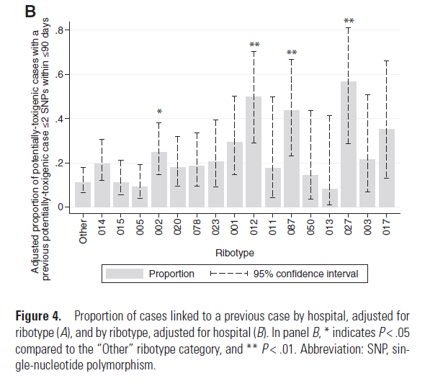
Strain transmission rates vary (but could be due to local dominance of certain strains)
Notes:
KM

Slide 20
Not so Fast!
Hongbing J Nosocomial transmission of Clostridium difficile ribotype 027 in a Chinese hospital, 2012–2014, traced by whole genome sequencing BMC Genomics (2016) 17:405
Notes:
KM

Slide 21
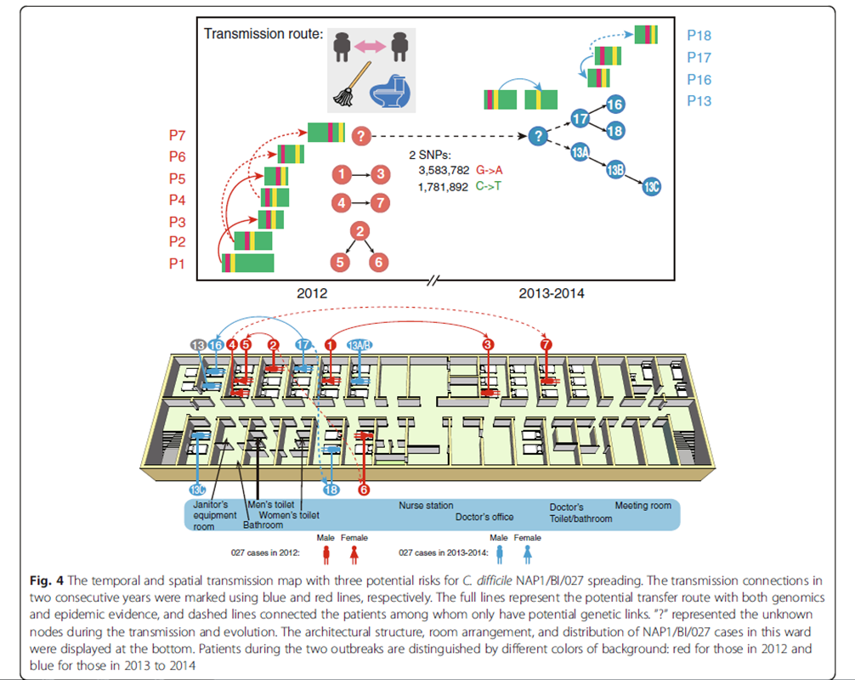
Hmmm
1♂-3♀
4♀-7♂
2♂-5♀, 6♀
Notes:
KM & FM

Slide 22
Clostridiodes difficile it is the Environment!
The authors review a series of WGS data around C. difficile and come to the conclusion that it is the environment! The authors note many WGS studies finding C. difficile in the environment and then finding identical isolates in patients with C. difficile.
However, many of these studies found C. difficile on community benches or in pigs and then subsequently found them in sick patients suggesting that the community may play a significant role in acquisition of C. difficile colonization that may then result in infection when an antibiotic insult to the gut biome occurs. So when we say the environment plays a role that does not appear to always or the majority being the healthcare environment.
Turner NA, Smith BA, Lewis SS (2019) Novel and emerging sources of Clostridioides difficile infection. PLoS Pathog 15(12): e1008125. https://doi.org/10.1371/journal.ppat.1008125

Slide 23
Think of other organisms!
Lewis T, High-throughput whole-genome sequencing to dissect the epidemiology of Acinetobacter baumannii isolates from a hospital outbreak JHI 75 (2010)
6 patient outbreak in a hospital
“Our analyses support transmission of MDR-Aci from the wound of a military patient M2 to the respiratory tract of a civilian patient C2. As MDR-Aci was not isolated from C2 until several weeks after M2 left the adjacent bed, however, we cannot determine when and how transmission occurred. One possibility is that C2 became colonised when the two patients were nursed together, but that colonisation did not reach detectable levels in the sputum until much later. Another possibility is that M2 contaminated the local environment and C2 acquired the organism from the environmentonly (sic) after M2 had left the ward. This latter option would be consistent with a significant role of the environment in transmission of MDR-Aci, as suggested by others.”
Notes:
KM

Slide 24
Quick, J Seeking the source of Pseudomonas aeruginosa infections in a recently opened hospital: an observational study using whole-genome sequencing BMJ Open 2014;4:e006278. doi:10.1136/bmjopen-2014-006278
Results: “WGS (Whole genome sequencing) for 141 P. aeruginosa isolates were obtained from patients, hospital water and the ward environment. Phylogenetic analysis revealed eight distinct clades, with a single clade representing the majority of environmental isolates in the burns unit. Isolates from three patients had identical genotypes compared with water isolates from the same room. There was clear clustering of water isolates by room and outlet, allowing the source of acquisitions to be unambiguously identified. Whole-genome shotgun sequencing of biofilm DNA extracted from a thermostatic mixer valve revealed this was the source of a P. aeruginosa subpopulation previously detected in water. In the remaining two cases there was no clear link to the hospital environment.”
Conclusions: That acquisition of PSA can be traced to a specific source within a hospital ward.
Notes:
KM

Slide 25
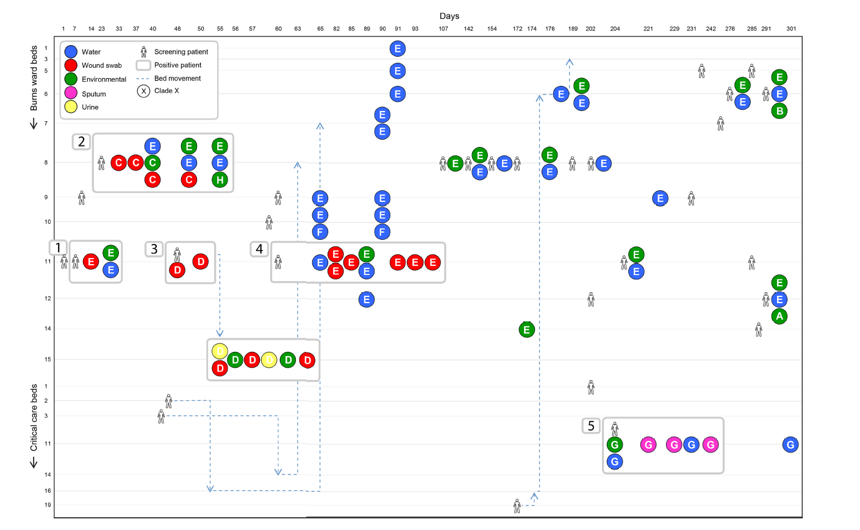
Notes:
KM

Slide 26
Let’s talk about what we care about
Sampled 198 health-care workers, 40 environmental locations, and 1854 patients (386 were positive, 357 of those on admission); 1819 isolates were sequenced. Median nasal carriage rate of S aureus in health-care workers at 4-weekly time points was 36.9% and 115 (58%) health-care workers had S aureus detected at least once during the study. S aureus was identified in 8–50% of environmental samples. 605 genetically distinct subtypes were identified at a rate of 38 (IQR 34–42) per 4-weekly cycle. Only 25 instances of transmission to patients (seven from health-care workers, two from the environment, and 16 from other patients) were detected. So only 8% of HAI cases were from the environment, 92% weren’t
Price JR Transmission of Staphylococcus aureus between health-care workers, the environment, and patients in an intensive care unit: a longitudinal cohort study based on whole-genome sequencing The Lancet Infectious Diseases VOLUME 17, ISSUE 2, P207-214, FEBRUARY 01, 2017
Notes:
FM

Slide 27
That Means…..
“In the presence of standard infection control measures, health-care workers were infrequently sources of transmission to patients. S aureus epidemiology in the ICU and HDU is characterised by continuous ingress of distinct subtypes rather than transmission of genetically related strains.”
“Many acquisitions might be attributable to recrudescence of cryptic carriage and should not be routinely ascribed to transmission and breached infection control.”
Notes:
FM

Slide 28
Replication of Findings
398 S. aureus isolates from sterile-site infections. The S. aureus strains were collected from four hospitals over a 6-month period. No evidence of transmission of S. aureus between patients with sterile-site infections. “The lack of intrahospital transmission may reflect a fundamental difference between day-to-day transmission events in the hospital setting and the more frequently studied outbreak scenarios.”
Long SW, Beres SB, Olsen RJ, Musser JM. 2014. Absence of patient-to-patient intrahospital transmission of Staphylococcus aureus as determined by whole-genome sequencing. mBio 5(5):e01692-14. doi:10.1128/mBio.01692-14
Notes:
FM

Slide 29
But wait there is something newer!!!!
“We demonstrated frequent spread of MRSA USA300 and USA100 strains among patients, environment, and HCWs. WGS identified possible spread within and even between ICUs. Future analysis with detailed contact tracing in conjunction with genomic data may further elucidate pathways of MRSA spread and points for intervention.”
There were 413 MRSA isolates sequenced (38% USA300, 52% USA100) from 66 patient encounters. Six of 66 HCWs were contaminated with MRSA prior to room entry. Isolates from a single patient encounter were typically either USA100 or USA300; in 8 (12%) encounters both USA300 and USA100 were isolated. WGS demonstrated that isolates from patients, HCWs, and environment often were genetically similar, although there was substantial between-encounter diversity. Strikingly, there were 5 USA100 and 1 USA300 clusters that contained similar strains within the cluster despite coming from different encounters, suggesting intra- and inter-ICU spread of strains, that is, 4 of these genomic clusters were from encounters in the same ICU; 5 of 6 clusters occurred within 1 week.
J Popovich, Stefan J Green, Koh Okamoto, Yoona Rhee, Mary K Hayden, Michael Schoeny, Evan S Snitkin, Robert A Weinstein, MRSA Transmission in Intensive Care Units: Genomic Analysis of Patients, Their Environments, and Healthcare Workers, Clinical Infectious Diseases, , ciaa731, https://doi.org/10.1093/cid/ciaa731

Slide 30
Hmmmm, something didn’t get mentioned
Strikingly, there were 5 USA100 and 1 USA300 clusters that contained similar strains (<22 single-nucleotide variants [SNVs], with most <10 SNVs) within the cluster despite coming from different encounters, suggesting intra- and inter-ICU spread of strains, that is, 4 of these genomic clusters were from encounters in the same ICU; 5 of 6 clusters occurred within 1 week.
No one uses 22 SNVs to claim similar strains and as was noted earlier 2 SNVs is the point where expert consensus on WGS being “proof” of the same strain being involved begins to fall apart.

Slide 31
A year in the ICU can teach you a lot
“Surprisingly, although potential nosocomial transmission of actively surveilled pathogens was rare, 8.7% of isolates belonged to genomically related clonal lineages that were present among multiple patients, usually with overlapping hospital admissions, and were associated with clinically significant infection in 62% of patients from which they were recovered. Multi-patient clonal lineages were particularly evident in the neonatal care unit, where seven separate Staphylococcus epidermidis clonal lineages were identified, including one lineage associated with bacteremia in 5/9 neonates. Our study highlights key differences in the information made available by conventional microbiological practices versus whole genome sequencing, and motivates the further integration of microbial genome sequencing into routine clinical care.”
Roach DJ, Burton JN, Lee C, Stackhouse B, Butler-Wu SM, et al. A Year of Infection in the Intensive Care Unit: Prospective Whole Genome Sequencing of Bacterial Clinical Isolates Reveals Cryptic Transmissions and Novel Microbiota. PLOS Genetics 13(4): e1006724. July 2015

Slide 32
Lastly Bloodstream Infections
Tamburini, FB Precision Identification of Diverse Bloodstream Pathogens in the Gut Microbiome Nat Med. 2018 Dec; 24(12): 1809–1814 (Nature Medicine- Stanford)
Population BMT patients, “We find that patients with Escherichia coli and Klebsiella pneumoniae bloodstream infections have concomitant gut colonization with these organisms, suggesting that the gut may be a source of these infections. We also find cases where classically non-enteric pathogens, such as Pseudomonas aeruginosa and Staphylococcus epidermidis, are found in the gut microbiome, thereby challenging existing informal dogma of these infections originating from environmental or skin sources.”
Notes:
FM

Slide 33


Slide 34
Review of the Evidence
1) WGS is a valid tool of identifying relatedness of strains and is much more specific than old technologies of PFGE or traditional descriptive epidemiology
2) In outbreaks WGS has confirmed that there are true outbreaks where the environment plays a role
3) Studies using standard epidemiologic approaches have shown rooms (the environment presumably) are a risk factor for acquisition of bacteria
4) WGS Studies over time have shown that transmission of microbes from patient to patient or from the environment in many cases are rare
Notes:
KM & FM

Slide 35
Evidence part II
5) For some organisms like PSA the environment may play a larger role
6) In an outbreak, the environment may play an important role
7) For most of the organisms studied, environmental interventions will only reduce rates by 0%-40%

