Slide 1
Business Meeting March 9, 2022

Slide 2
Introductions & Recognitions
New Members or Visitors
New CIC certifications or re-certifications

Slide 3
Board of Directors 2022 https://sdapic.org/chapter-board-members-2022/
Past President Karin I. Pardoel
President Maggie Turner
President-Elect Jarrod Becasen
Leg. Representative Lisa Kilgore
Secretary Sondra Lintz
Treasurer Cindy Chambers
Treasurer-Elect Viviana Parra
Membership Chair Liz Jefferson
Education Chair & Committee Jessica Alicdan
Nominating Committee Claudia Sanchez Goad & Rowena Okumura
Social Chair & Committee Will Cardona, Palak Patel, & Latrice Jackson-Washington
Vendor Liaison: Diego Davila

Slide 4
Minutes Review and Approval Sondra Lintz
February 2022 Minutes

Slide 5
Chapter Goals for 2022 Maggie Turner
Maintain or increase CIC certification among members 5%
Promote Education
Vendor-sponsored monthly chapter meeting
Annual Fall Conference
Nationally known speakers through vendor sponsorship if available
Notify non-APIC member attendees if information is applicable
Long Term Care Conference
ACIC – junior IP program
“Newbie/CIC prep” class prior to SDIC meeting restart
EVS “Training Wheels” for EVS supervisors
Outreach
Local Health Department
Inland Empire representative
Reach out to IE to establish a contact person
Community
Toiletry collection – re-establish? If so, how to function in a virtual world
Long Term Care Infection Prevention Mentorship

Slide 6
New Business Maggie Turner
CA APIC Member Approvals – Goals and Budget
Board Meeting
March Member Poll – Please complete by next meeting
Annual Conference
Community Service

Slide 7
Membership Report Liz Jefferson
125 Members as of 03/06/22
87 Full/Active Members (36 CIC, 41%)
38 Associated Members (vendors, 30%)
Update your Designation in APIC by adding CIC after your name.

Slide 8
How do I update my designation?
Step 1.
Select Renew Membership
Step 2. (click on pen to modify and add CIC after your name)

Slide 9
Membership Drive Coming Soon!

Slide 10
Treasurer’s Report Cindy Chambers (Viviana Parra)
March 6, 2022
Treasurer meeting to begin hand-off to incoming Treasurer Cindy Chambers and Treasurer-Elect Viviana Parra
Review of Treasurer position and documents
Update of treasurer reports
Define role of Treasurer-elect and Treasurer for ongoing training

Slide 11
Education Report Jessica Alicdan

Slide 12
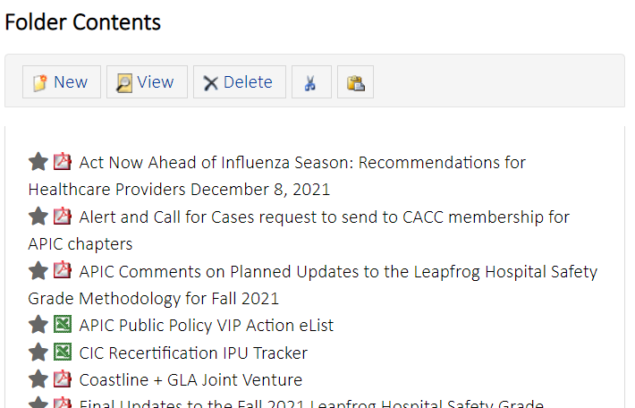
Legislative Report Lisa Kilgore
https://cqrcengage.com/apic/home

Slide 13
Nominating & Awards Committee Claudia Sanchez Goad & Rowena Okumura
Cheryl Richardson Leg Day APIC Award 2022
Term of award: May 10, 2022 CA APIC Meeting Hosted by Sierra Chapter, Sacramento
Award Amount: $750.00
Number of awards: 2
Due date: April 10, 2022
https://forms.gle/1S6dSfB3bMKfvyoL8
Standard APIC Educational Support Award 2022
Term of award: one year (January – December 2021)
Award Amount: $500
Number of Awards: 3
Due date: N/A
https://forms.gle/cN5heCBs6UgWm5ML8

Slide 14
Nominating & Awards Committee Claudia Sanchez Goad & Rowena Okumura
National APIC Conference Award 2022
Term of award: APIC Annual Conference 2022, Indianapolis June 13-15
Award Amount: $2000.00
Number of awards: 1
Due date: May 15, 2022
https://forms.gle/z6ra7d97eQjgFxMg8

Slide 15
Social Committee Will Cardona-Santos, Palak Patel, & Latrice Jackson-Washington
Summer Event Poll Results

Slide 16
Social Committee Will Cardona-Santos, Palak Patel, & Latrice Jackson-Washington

Slide 17
HAI Liaison Report Tracy Lanier, Maggie Turner, Deweese Quigley

Slide 18
HAI Advisory Committee Tracy Lanier

Slide 19
CA APIC Coordinating Council Lisa Kilgore, Maggie Turner, Jarrod Becasen
2022 Meeting Calendar
Foundations https://community.apic.org/cacc/events/foundationscourse
Educational Support Award https://community.apic.org/cacc/events/educational-award-application

Slide 20
GERM Report Frank Myers

Slide 21
Long Term Care Israel Sanchez

Slide 22
Ambulatory Care Vacant

Slide 23
Pediatric Care Sondra Lintz & Megan Medina

Slide 24
County Epidemiology Grace Kang & Mara Rauhauser

Slide 25
Announcements, Questions, & Comments
Surveys (The Joint Commission, CDPH, etc.)
Acknowledgments
New Positions in San Diego or Imperial County
Questions/Discussion

