Slide 1
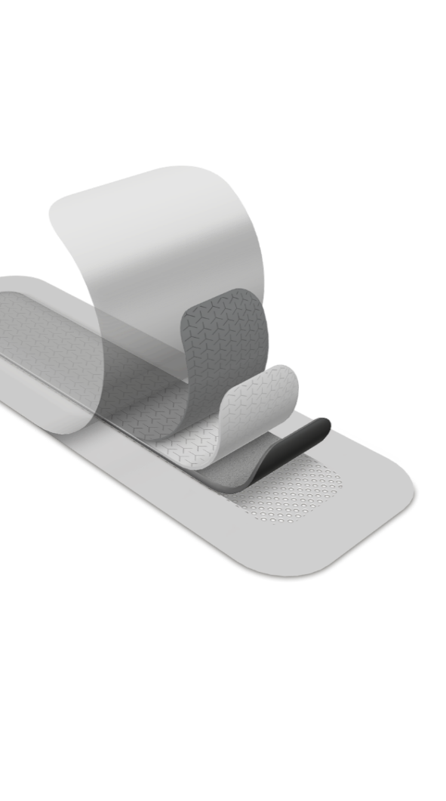
Mepilex Border Post-Op AG
Diego Davila: Territory Sales Manager
Clinical Specialist: Lindsey Lown, MSN, RN, CNOR

Slide 2

Set healing
in motion
It’s all about the outcome
• Manage Costs
• Support Patient Mobility
• Improve Patient Satisfaction
• Help Prevent Surgical Site Infection

Slide 3
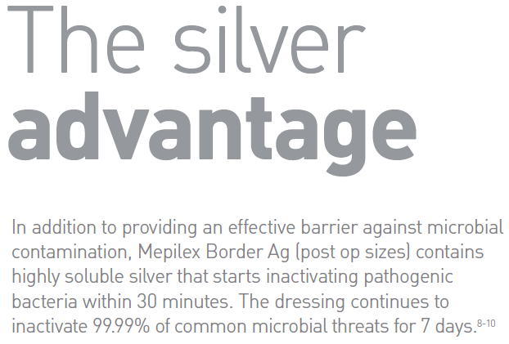
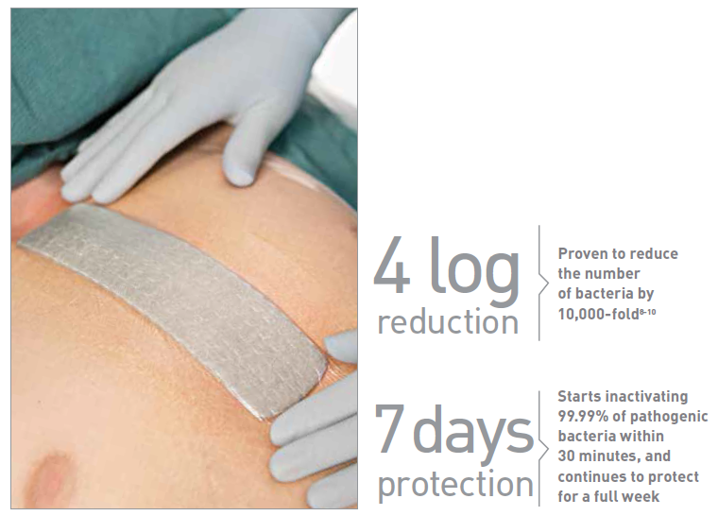
Help Prevent SSIs
8. Data on file. Laboratory test 20151026-005. 9. Data on file. Laboratory test 20151109-002. 10. Data on file. Laboratory test 20151110-007
Notes:
Mepilex Border Post-Op Ag contains highly soluble silver which is proven to start inactivating 99.99% of pathogenic bacteria within 30 minutes and continue to protect for a full week

Slide 4
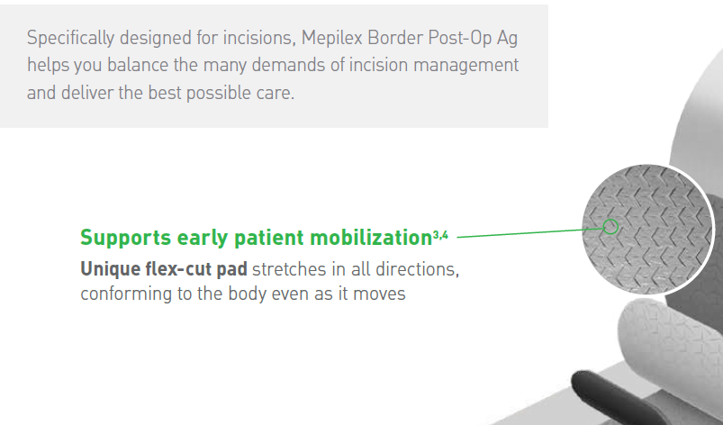
Support Patient Mobility
3. Johansson C et al. Preventing post-operative blisters hip and knee arthroplasty. Wounds International, 2012. 4. Bredow, J. et al. Randomized clinical trial to evaluate the performance of a flexible self-adherent afollowingbsorbent dressing coated with a soft silicone layer compared to a standard wound dressing after hip, knee or spinal surgery in comparison to standard wound dressing. Poster presentation at 5th Congress of WUWHS, Florence, Italy 2016.
Notes:
Mepilex Border Post-Op Ag supports early patient mobilization with unique flex-cut pad that stretches in all directions, conforming to the body even as it moves.

Slide 5

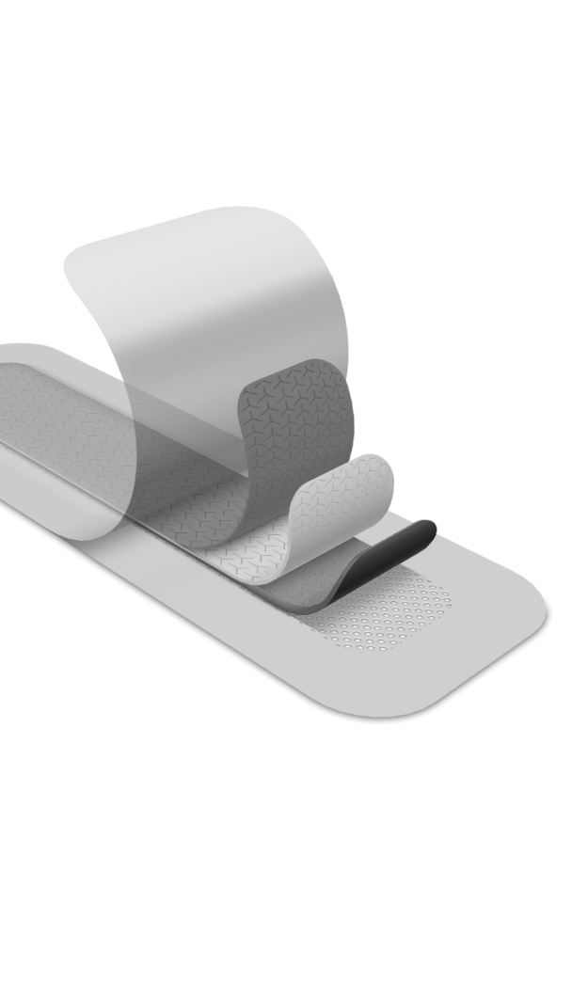
Mepilex® Border Post-Op Ag
The dressing for surgical-wound management without compromise
Mepilex Border Post-Op Ag is a self-adhesive highly flexible and absorbing dressing designed for surgical wounds.
The dressing has layers:
5
1. Backing film
Bacteria and viral barrier and shower proof backing film (microbes >25nm)*
2. Spreading layer with flex-formation
Spreads the exudate to optimize breathability
3. Retention layer with flex-formation
Retains and locks away exudate, keeping it away from the wound, reducing risk of maceration.
4. Silver foam
A unique compressed foam with silver
5. Wound contact layer
A Safetac layer that adheres gently to the skin, but not to the moist wound.
* Data on file
Notes:
Mepilex Border Post-Op Ag is a self-adhesive highly flexible and absorbing dressing designed for surgical wounds.
It’s construction consists of a backing film, spreading layer with flex-formation, retention layer with flex formation, silver foam and wound contact layer

Slide 6
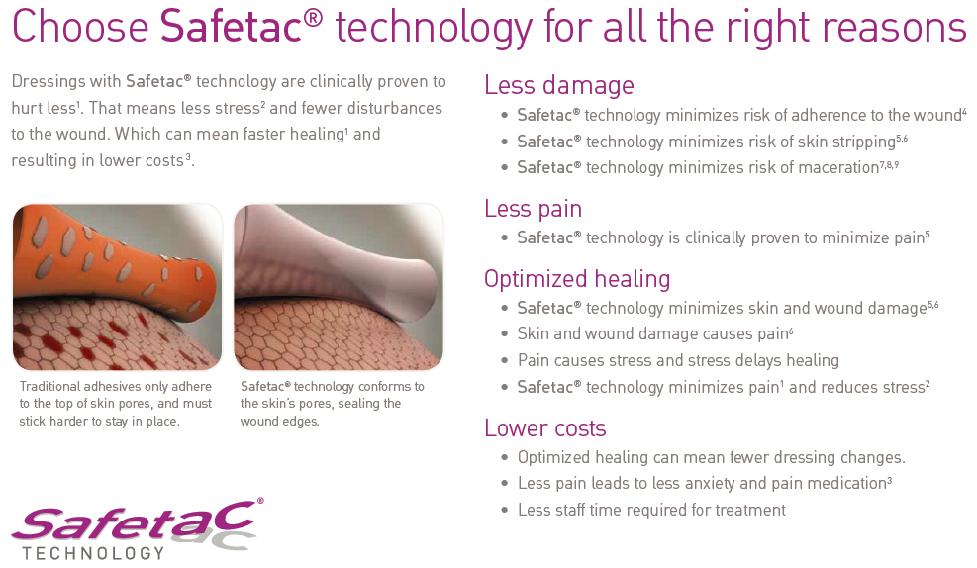
Improve Patient Satisfaction
White R. et al. Evidence for atraumatic soft silicone wound dressing use. Wounds UK, 2005. 2. Waring P. et al. An evaluation of the skin stripping of wound dressing adhesives. Journal of Wound Care, 2011. 3. Dykes P.J. et al. Effect of adhesive dressings on the stratum corneum of the skin. Journal of Wound Care, 2001. 4. Meaume S. et al. A study to compare a new self adherent soft silicone dressing with a self adherent polymer dressing in stage II pressure ulcers. Ostomy Wound Management, 2003. 5. Wiberg A.B. et al. Preventing maceration with a soft silicone dressing: in-vitro evaluations. Poster presented at the 3rd Congress of the WUWHS, Toronto, Canada, 2008. 6. Feili F et al. Retention capacity. Poster presentation at the EWMA conference, Lisbon, Portugal 2008 7. Johansson C. et al. An assessment of a self-adherent, soft silicone dressing in post operative wound care following hip and knee arthroplasty. Poster presentation at EWMA, Brussels, Belgium 2012. 8. Upton D. et al. Pain and stress as contributors to delayed wound healing. Wound Practice and Research, 2010. 9. White R. A multinational survey of the assessment of pain when removing dressings. Wounds UK, 2008.

Slide 7
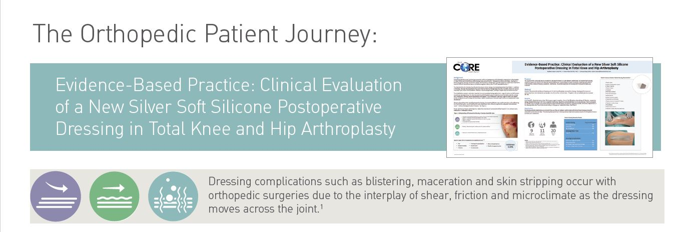
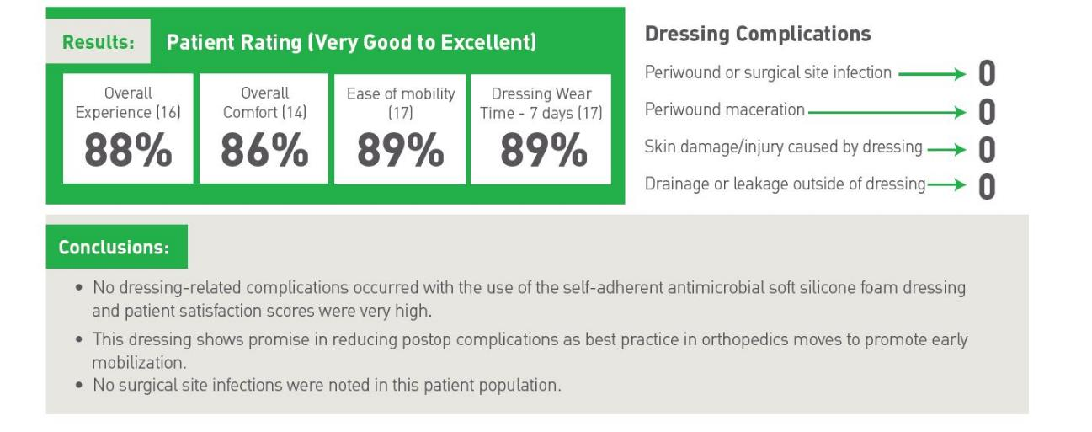

Slide 8
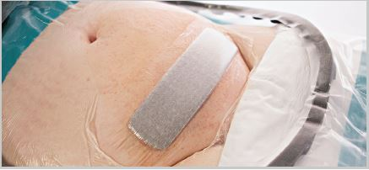
Managing Costs
Underhill Study: Texas Health, Harris Methodist Hospital (a Magnet Facility) – Fort Worth, TX – Decreasing Cesarean SSI Infections
SSI rate for C-sections had reached 3.5-4% from 2012 - 2015
Implemented Mepilex Border Post Op Ag Feb. 2015
Erickson: CentraCare St Cloud Hospital (a Magnet Facility) – St Cloud, MN
Wood: Tucson Medical Center – Working together, The Power of Teamwork in Preventing C-section SSI’s
2018 – 18 SSIs
Multidisciplinary team developed an SSI reduction pathway for all patients covering pre-hospital to discharge
SSI Rates reached 2.84% in 2014 (National Average is 1.84%)
Their post implementation SSI rate dropped to 0.94%
Possible cost savings of $1.47 million based on their SSI rate from 2012 to Q1 of 2015
Implemented Mepilex Post Op AG for ALL c-sections in 2015
53% SSI reduction and over $250K in savings
Interventions included:
Hibiclens CHG bath night before c-section
Mepilex Post Op AG applied to incision (left on for 7 days)
Post delivery Hibiclens CHG shower or bedbath
88% SSI reduction in 2019

Slide 9

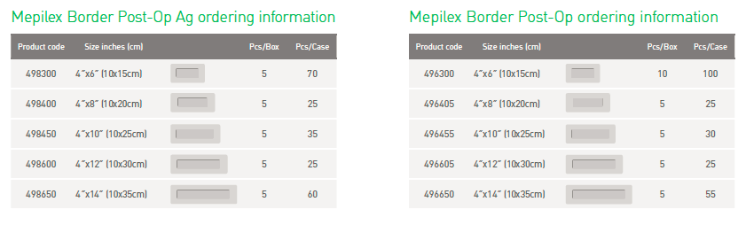
Mepilex Border Post-Op Ag

Slide 10
Flex Technology:
Higher conformability, creating an increased stay-on ability
Allow dressing to absorb and retain higher amounts of exudate, as the cuts in the ultra-absorbent foam will more efficiently spread exudate throughout the dressing.
7 Day Showerproof Seal:
Patients can shower all week without worry
Surgeons do not have to cover the dressing with a secondary film like a Tegaderm to seal the incision.
Transparent Borders:
Clear borders provide visibility around the peri-incision area for surgeons and floor staff, meaning staff will not have to peel back or change dressings prematurely.
Silver Advantage:
Contains highly-soluble silver that starts inactivating pathogenic bacteria within 30 minutes. The dressing continues to inactivate 99.99% of common microbial threats for 7 days.

Slide 11
Flex Technology:
Higher conformability, creating an increased stay-on ability
Allow dressing to absorb and retain higher amounts of exudate, as the cuts in the ultra-absorbent foam will more efficiently spread exudate throughout the dressing.
7 Day Showerproof Seal:
Patients can shower all week without worry
Surgeons do not have to cover the dressing with a secondary film like a Tegaderm to seal the incision.
Transparent Borders:
Clear borders provide visibility around the peri-incision area for surgeons and floor staff, meaning staff will not have to peel back or change dressings prematurely.
Silver Advantage:
Contains highly-soluble silver that starts inactivating pathogenic bacteria within 30 minutes. The dressing continues to inactivate 99.99% of common microbial threats for 7 days.
Notes:
Mepilex Border Post-Op Ag helps reduce SSIs, supports early mobilization and reduces dressing-related costs. Available in 5 sizes from 4” x 6” to 4” x 14”
Also availabe in a non Ag Mepilex Border Post-Op in the same 5 sizes

Slide 12
Q&A

Slide 13
Thank you!

