Slide 1
Business Meeting October 12, 2022

Slide 2
Introductions & Recognitions
New Members or Visitors
New CIC certifications or re-certifications

Slide 3
Board of Directors 2022 https://sdapic.org/chapter-board-members-2022/
Past President Karin I. Pardoel
President Maggie Turner
President-Elect Jarrod Becasen
Leg. Representative Lisa Kilgore
Secretary Sondra Lintz
Treasurer Viviana Parra
Treasurer-Elect Cindy Chambers
Membership Chair Liz Jefferson
Education Chair & Committee Jessica Alicdan
Nominating Committee Claudia Sanchez Goad & Rowena Okumura
Social Chair & Committee Will Cardona, Palak Patel, & Latrice Jackson-Washington
Vendor Liaison: Diego Davila

Slide 4
Minutes Review and Approval Sondra Lintz
June 2022 Minutes deferred – will email to members for review

Slide 5
Chapter Goals for 2022 Maggie Turner
Maintain or increase CIC certification among members 5%
Promote Education
Vendor-sponsored monthly chapter meeting
Annual Fall Conference
Nationally known speakers through vendor sponsorship if available
Notify non-APIC member attendees if information is applicable
Long Term Care Conference
ACIC – junior IP program
“Newbie/CIC prep” class prior to SDIC meeting restart
EVS “Training Wheels” for EVS supervisors
Outreach
Local Health Department
Inland Empire representative
Reach out to IE to establish a contact person
Community
Toiletry collection – re-establish? If so, how to function in a virtual world
Long Term Care Infection Prevention Mentorship
MPH/RN Student Outreach

Slide 6
New Business Maggie Turner
LTCF Conference “Virtually Yours” – Registration Open
https://sdapic.org/2022-ltcf-conference-2/
Education Award Schedule
2019 award recipients = expired, if not used
2020 award recipients = expires December 31, 2022
2021 award recipients = expires December 31, 2022
2022 award recipients = expires June 30, 2023

Slide 7
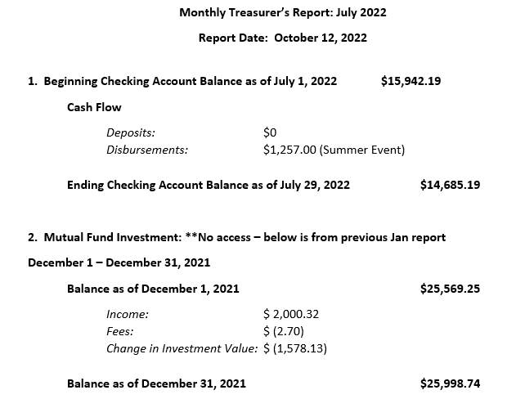
Treasurer Report Viviana Parra

Slide 8
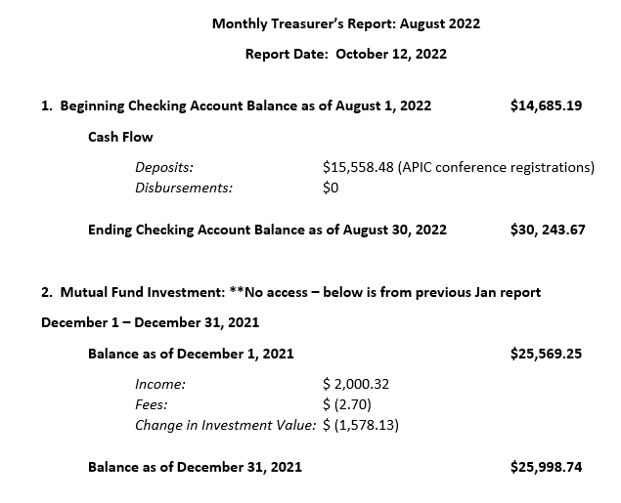
Treasurer Report Viviana Parra

Slide 9
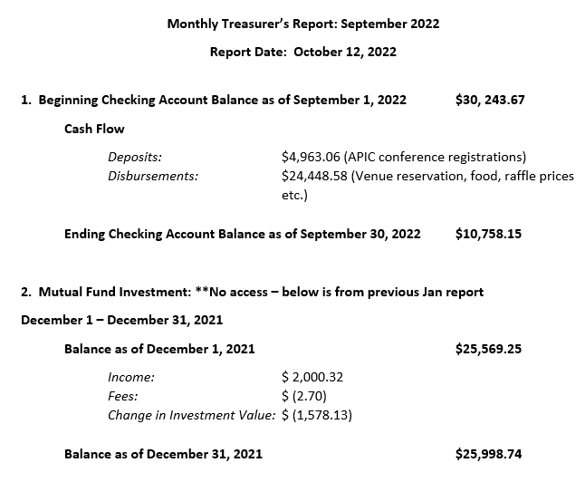
Treasurer Report Viviana Parra

Slide 10
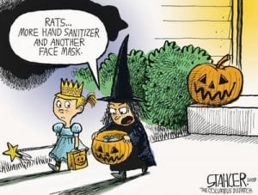
Membership Report – October Liz Jefferson
126 Members as of 10/04/22
91 Full/Active Members
36 CIC
35 Associate Members (vendors)
10
5
Update your Designation in APIC by adding CIC after your name.

Slide 11
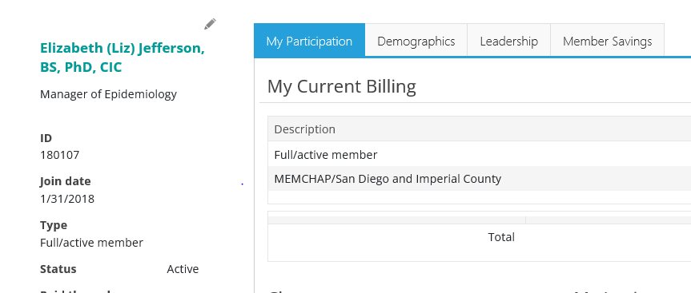
How do I update my designation?
Step 1.
Select Renew Membership
Step 2. (click on pen to modify and add CIC after your name)

Slide 12
Education Report Jessica Alicdan
November Speakers Topic: ICRA 2.0

Slide 13
Nominating & Awards Committee Claudia Sanchez Goad & Rowena Okumura
Call for Nominations
2023 SD APIC Open Positions:
President-Elect 1
Secretary 1
Treasurer-Elect 1
Education Chair 1
Social Committee 2
Leg Representative 1
Nominating Committee 1
Vendor Liaison 1
10/5/22 Open Board Position Descriptions sent to Chapter with Link for nominations 10/6/22
Nominations deadline Oct 31st
Estimate voting to Start Nov.1st deadline for responses Nov 31st
Positions will be formally announced at the December Christmas Party

Slide 14
Nominating & Awards Committee Claudia Sanchez Goad & Rowena Okumura
President-Elect Term of Office: 1 Year – Elected by membership.
Assist the president in the discharge of the duties of the president as may be directed by the President, and shall perform such other duties as may be prescribed from time to time by the President or the chapter board of directors (board).
One of these duties is to plan/coordinate the Chapter’s Annual Conference in September of each year.
Prepare to assume the office of president.
Fills the office of president, should that office become vacant, and subsequently fills the office of president for a regular term, as is entitled to the president-elect.
Serve as a communication link with APIC HQ on matters as designated by the president. Further, the president elect must respond to APIC requests, notices, and other communications in a timely manner or by the designated deadline.
Become familiar with the president’s duties, as well as the organizational system structure.
Become familiar with the bylaws of the chapter.
Become familiar with various committees within the chapter.
Maintain communication with the president.
Maintain chapter’s meeting and event calendar facilitated and populated by the Educational Chair. (see example attached)
Perform presidential duties in the absence of the president as delegated by the president

Slide 15
Nominating & Awards Committee Claudia Sanchez Goad & Rowena Okumura
Secretary Term of Office: 2 Years - Elected by membership
This position reports to the chapter President Elect.
The Secretary is responsible for:
Serve a 2-year term and participate as a member of the Board of Directors for APIC Ch 057.
Be responsible for the accurate recording and transcribing of the minutes of all meetings.
Submit all minutes to the Board in accord with established procedure before the next meeting.
At least weekly, check Gmail account for correspondence that needs to be answered and answer or direct to President or appropriate Board member for answer.
Check Gmail account for additions to chapter Gmail distribution list and add them to appropriate contact list – these notices are generated by chapter website.
Be responsible for all official chapter correspondence as directed by the President or P-elect

Slide 16
Nominating & Awards Committee Claudia Sanchez Goad & Rowena Okumura
Treasurer-Elect Term of Office: 3 years - Elected by membership
The Treasurer maintains, manages, and accounts for all records related to the finances for APIC San Diego and Imperial County Chp. 057 and submits reports in a timely manner, and follows the SDIC and APIC bylaws as stipulated.
The Treasurer role has heavy responsibility and has many tasks, all under the scrutiny of the SDIC Board, Membership, and APIC. To assist in the smooth transition of the role from novice to Treasurer, the Treasurer-elect position is created to overlap the third year of the Treasurer.
The Treasurer-elect is a three (3) year position, the first year being of increasing training and responsibility, and two (2) years acting as Treasurer, so the volunteer must be aware of the time commitments, level of expectation, and the impact of accepting this role.
At year 3, another treasurer-elect position will be open for election by the Membership.

Slide 17
Nominating & Awards Committee Claudia Sanchez Goad & Rowena Okumura
Education Chair Term of Office: 2 Years – Elected by membership.
This position reports to the chapter President Elect.
The Education Chair is responsible for:
Planning, developing and implementing the monthly chapter educational courses and programs that address identified educational needs related to infection prevention and control for APIC Chapter 057. Guidance for chapter education will be provided by the membership and the Chapter Board of Directors.
Maintaining the chapter Educational Offering Calendar for the year and assuring the next year’s calendar is started and passed on to the incoming Educational Chair.
Confirming with speakers (and, if applicable, their vendor sponsor) and obtain their educational presentation one month in advance of their presentation date. Distribute to the Board for review of the presentation for product or company bias.
~If bias is found, immediately contact President Elect for decision of next steps.

Slide 18
Nominating & Awards Committee Claudia Sanchez Goad & Rowena Okumura
Social Committee – 2 open positions
Volunteers (minimum 2 preferably 3-4) from membership who will
commit to working with the informal “chair” of the committee.
Purpose: To plan, organize and coordinate social events for the local chapter
Committee members: Volunteers (minimum 2 preferably 3-4) from membership who will
commit to working with the informal “chair” of the committee.
Events to plan: Annual Christmas Party: (December meeting)
Solicit donations of prizes
Identify and secure venue
Notify and coordinate with vendors: sponsorship, gifts
Plan and identify membership awards/recognitions
Obtain/create awards
2. Ad hoc events: as agreed upon by membership
3. September Annual Conference: Coordinate with conference planning team to help

Slide 19
Nominating & Awards Committee Claudia Sanchez Goad & Rowena Okumura Nominating Committee 1 Position
This position reports to the chapter President.
The Nominating Committee is responsible for:
Obtaining a list of active members of SD APIC Chapter 057 from Membership Chair from which to consider candidates.
Selecting qualified candidates for each office, taking into consideration the attendance and participation of nominees.
Informing each nominee, in writing, of specific duties of the nominated office.
Prepare a ballot for voting.
Distribute the ballot to the membership, via online survey access, for voting prior to the annual meeting.
Attend chapter board meetings and vote as required.

Slide 20
Nominating & Awards Committee Claudia Sanchez Goad & Rowena Okumura
Legislative Representative Term of Office: 1 Year
This role is usually performed by the chapter’s Past President
This position reports to President and other board members.
The Legislative Representative is responsible for:
Staying informed about current legislative developments, including pending and recently enacted legislation that directly or indirectly impacts the infection preventionist’s role and responsibilities.
Serving as CACC representative for the local APIC chapter.
Attending, or sending an appropriate chapter designate, to all CACC meetings (4 CACC meetings per year and the annual “Leg day” in Sacramento).
Summarizing and communicating regarding legislative updates at each monthly APIC SD meeting. This includes local, State and National legislation that are IP-related or of interest
Attending, or sending appropriate chapter designate to CLR luncheon at annual APIC conference.

Slide 21
Social Committee Report Will Cardona-Santos, Palak Patel, & Latrice Jackson-Washington
Chapter Holiday Party
WHO: Complimentary to chapter participant - Sponsored by the Chapter!
WHERE: 94th Aero Squadron, 8885 Balboa Ave, SD, CA 92123
WHEN: December 14, 2022, 11:30 AM – 2:00 PM
Looking for vendor support and participation
RSVP will be sent to chapter, please response before November 15, 2022

Slide 22
Legislative Report Lisa Kilgore
https://cqrcengage.com/apic/home

Slide 23
CA APIC Coordinating Council Lisa Kilgore, Maggie Turner, Jarrod Becasen
https://community.apic.org/cacc/events/meetings
WHO: All APIC Members
WHEN: November 18 Meeting
WHERE: hybrid at Seton Medical Center, San Francisco (host chapter)
Call for nominations for CA APIC Board positions
Survey sent to all APIC Members

Slide 24
IDAC Lisa Kilgore
IDAC 37th Annual Southern California Fall Symposium
WHO: https://idac.org/event-4811341
Non-Member Early Registration – $100.00
WHEN: November 4 and 5, 2022
WHERE: Hyatt Regency Long Beach

Slide 25
HAI Liaison Report & Advisory Committee Tracy Lanier, Maggie Turner, Deweese Quigley
Internal Validation
External Validation

Slide 26
GERM Report Frank Myers

Slide 27
Long Term Care Izzy Sanchez

Slide 28
Ambulatory Care Maggie Marlatt & Janessa Esteban

Slide 29
Pediatric Care Radys Children Hospital

Slide 30
County Epidemiology Grace Kang & Mara Rauhauser
San Diego SNF IP Collaborative

Slide 31
Announcements, Questions, & Comments
Surveys (The Joint Commission, CDPH, etc.)
Acknowledgments
New Positions in San Diego or Imperial County
Questions/Discussion

