Slide 1
Is it time to move beyond the SIR in evaluating the impact of HAI?
Frank Myers, MA, CIC, FAPIC
Director Infection Prevention and Clinical Epidemiology
UC San Diego Health

Slide 2
Objectives
Identify how the pSIR is calculated
List one way the pSIR will help in addressing the hospital onset bacteremia rate
Describe one case where a pSIR should not be used

Slide 3
The SIR
Observed/expected with 1.0 being a similar rate than the reference period for that unit
Can be updated compared to the “Annual Report”
You could even rebaseline to one knowing the median SIR for the year
Probably too confusing for many
“But my SIR was 0.8 and you are saying it is 1.4”

Slide 4
Still using 1.0 as your SIR baseline? HAI Progress Reports https://www.cdc.gov/nhsn/datastat/progress-report.html#anchor_1700850695274

Slide 5
SIR current importance
Linked to funding from CMS
Used in insurance negotiations
Universal language of HAI performance

Slide 6
SUR (the poor cousin of SIR) Standardized Utilization Ratio
Observed line days/expected line days
Again comparison is against the reference period
Can be outdated very quickly
External female catheter
Regional adoption rates
Measure for utilization of lines
Prompts facilities to evaluate whether they are:
Overutilizing lines
Not pulling lines
How many people are you putting in harms
way?

Slide 7
The big SUR question (It isn’t “how is the weather?”)
Is it related to acuity ?
SIR is already related to acuity:
Academic teaching hospital surgical ICU
One with cancer and transplant
One without cancer and transplant
Both get the same SIR

Slide 8
The future (Hint: it isn’t flying cars)
Hospital onset bacteremia (HOB)
Rate per 1000 admissions (Pushes LOS to be lower- Also makes sense if LTACs or SNFs are the first goals)
Observed/expected
Unit type
Blood cultures done
Blood culture contamination rate

Slide 9
Causes of HOB and preventability
https://www.aha.org/system/files/media/file/2023/04/BD_HospitalBacteremia_ebook_040523.pdf

Slide 10
SO CLABSI is part of HOB
HOB avoids the pitfalls of CLABSI:
Gaming (It’s not a central line, it’s a midline!)
PIV (peripheral IV bloodstream infections)
More likely to result in serious outcomes
Post OP-Sepsis
Do we only care if the infection was caused by a central line or do we care about all infections?

Slide 11
Is HOB less work?
Automated-Yes
Investigation as to source- More work
No longer binary yes CLABSI/No CLABSI
Where to improve- More work, if doable?
No benchmark for PIV, post op sepsis, urosepsis, hospital pnuemonia and with bacteremia, IVAC+ bacteremia

Slide 12
Improve what you can now! CLABSI, CAUTI ,IVAC+

Slide 13
Is the SIR enough? Understanding the SIR Means stripping it and taking a hard look
SIR for device days measures (CAUTI, CLABSI, VAE, IVAC+) is basically a comparison of your rate compared to the expected rate
Like a Standardized Mortality Ratio (SMR) the, the SIR for a hospital is weighted based its unit types and lines the same way an SMR is adjusted by the population age and distribution
But unlike the SMR and age, the hospital has some control on the number of device days

Slide 14
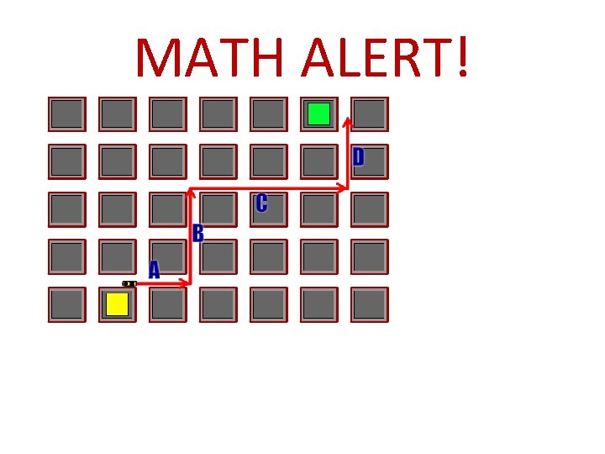
The big problem of the SIR Regardless of whether you are worried about HOB
Let’s say hospital A is a community hospital made up of only med/surg floors Hospital B has the same exact population and census
Let’s pretend the national CLABSI rate per 1000 line days is 2/1000 line days
For the year Hospital A had 6 CLABSI and 3000 line days
6/3000=2/1000 = SIR 1.0
Hospital B had 1 CLABSI and 500 line days
1/500=2/1000= SIR1.0
Both of these look identical in their SIRs

Slide 15
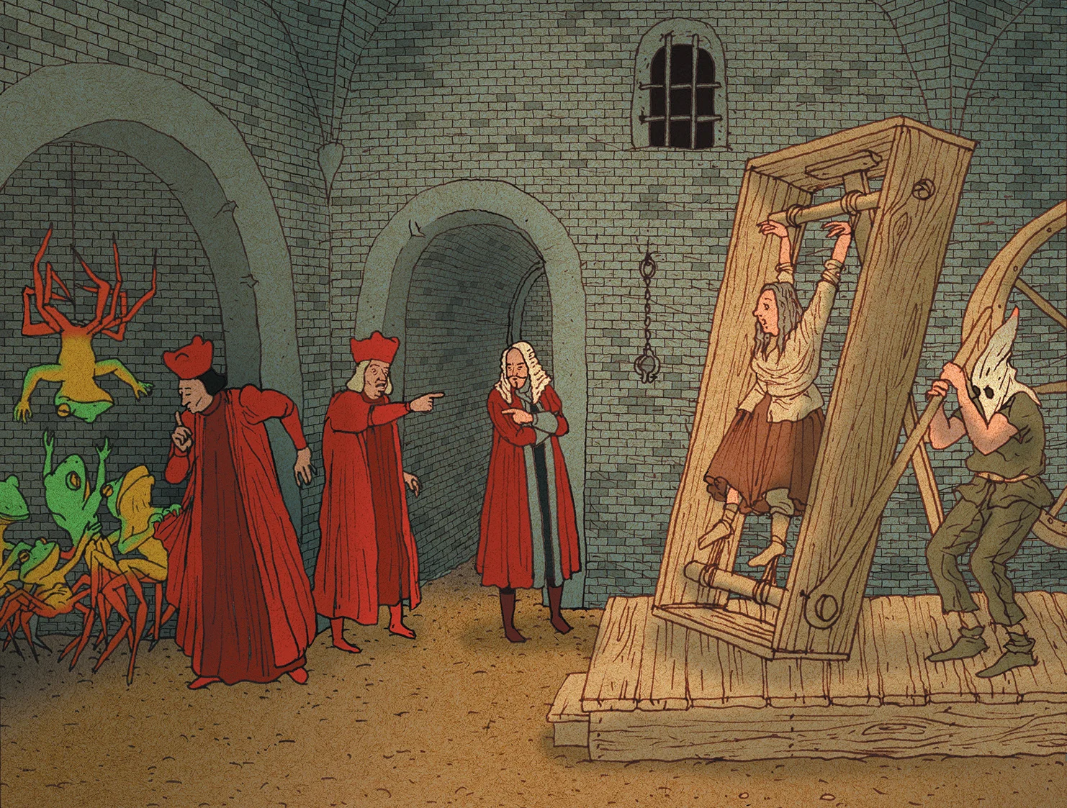
What the SIR doesn’t tell you Even under torture
For the year Hospital A had 6 CLABSI and 3000 line days
Hospital B had 1 CLABSI and 500 line days
Hospital A had 5 more CLABSI (6-1=5) than Hospital B despite having the same census and CLABSI rate and SIR
Who is doing a better job preventing CLABSI?
Who will look worse with HOB?
SIR
Still not talking

Slide 16
pSIR IT ISN’T JUST FOR CAUTI
The pSIR (population SIR)
SIR x SUR
Idea has been kicked around by the CDC
Concerns about the SUR being a marker for patient acuity
The Case-mix index might be a way to adjust for this
SIR has always been a marker for acuity
UCI no BMT, no transplant, no oncology-UCSD BMT, transplant, oncology
Compare academic med surg units
If I make devices rarer does the lack of familiarity make outcomes worse? AKA lower SUR results in higher SIR

Slide 17
Publications for you to know
The case for a population standardized infection ratio (SIR): A metric that marries the device SIR to the standardized utilization ratio (SUR)
https://pubmed.ncbi.nlm.nih.gov/31232260/#:~:text=Conclusion%3A%20Population%20SIR%20accounts%20for,interventions%20to%20reduce%20device%20use
Population Standardized Infection Ratio (pSIR): A More Meaningful Reflection of Performance With Reduction in Device Use
https://www.cambridge.org/core/journals/infection-control-and-hospital-epidemiology/article/population-standardized-infection-ratio-psir-a-more-meaningful-reflection-of-performance-with-reduction-in-device-use/1764734C29581354DE5CA6C69F8A9496

Slide 18
pSIR FORCES FOCUS ON THE SUR CAUTI DATA
Number of infections different than if SUR had been 1.0

Slide 19
pSIR UNIT based
CAVEATS
Do not try pSIR with units that have less than 1 expected infection
Example why, 1 infection expected 0.1 SIR=10 so even if you have a great SUR 0.25 you’ll still end up with a 2.5 pSIR which amplifies random variation.
Do a scatterplot of SIR and SUR and see if they correlate
Do units with good SIR have:
Low SUR because they provide great care
High SUR because they are padding their line days with low risk patients
Same distribution as poor SIR

Slide 20
Comparing
Maybe high acuity
Concern Lots of line days, high SIR
Praise worthy
Good maintenance, good management
Looks good now but with HOB won’t
For CAUTI IVAC still too many people getting sick

Slide 21
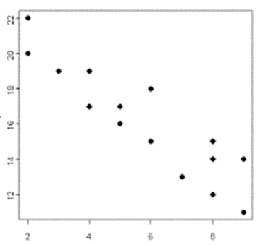
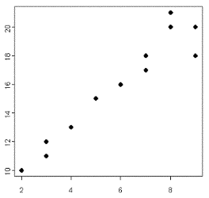
What to look for in your scatterplots
A trend downward
Probable that as you reduce lines only your highest risk patients remain so you end up with a high SIR SUR
An upward trend SUR People who do poor line care also do a poor job pulling the line
SIR
SIR
SUR

Slide 22
Where lives need most protected Or you Could just be lazy and look at your pSIR
SIR
SUR

Slide 23
CAUTI
SIR
SUR

Slide 24
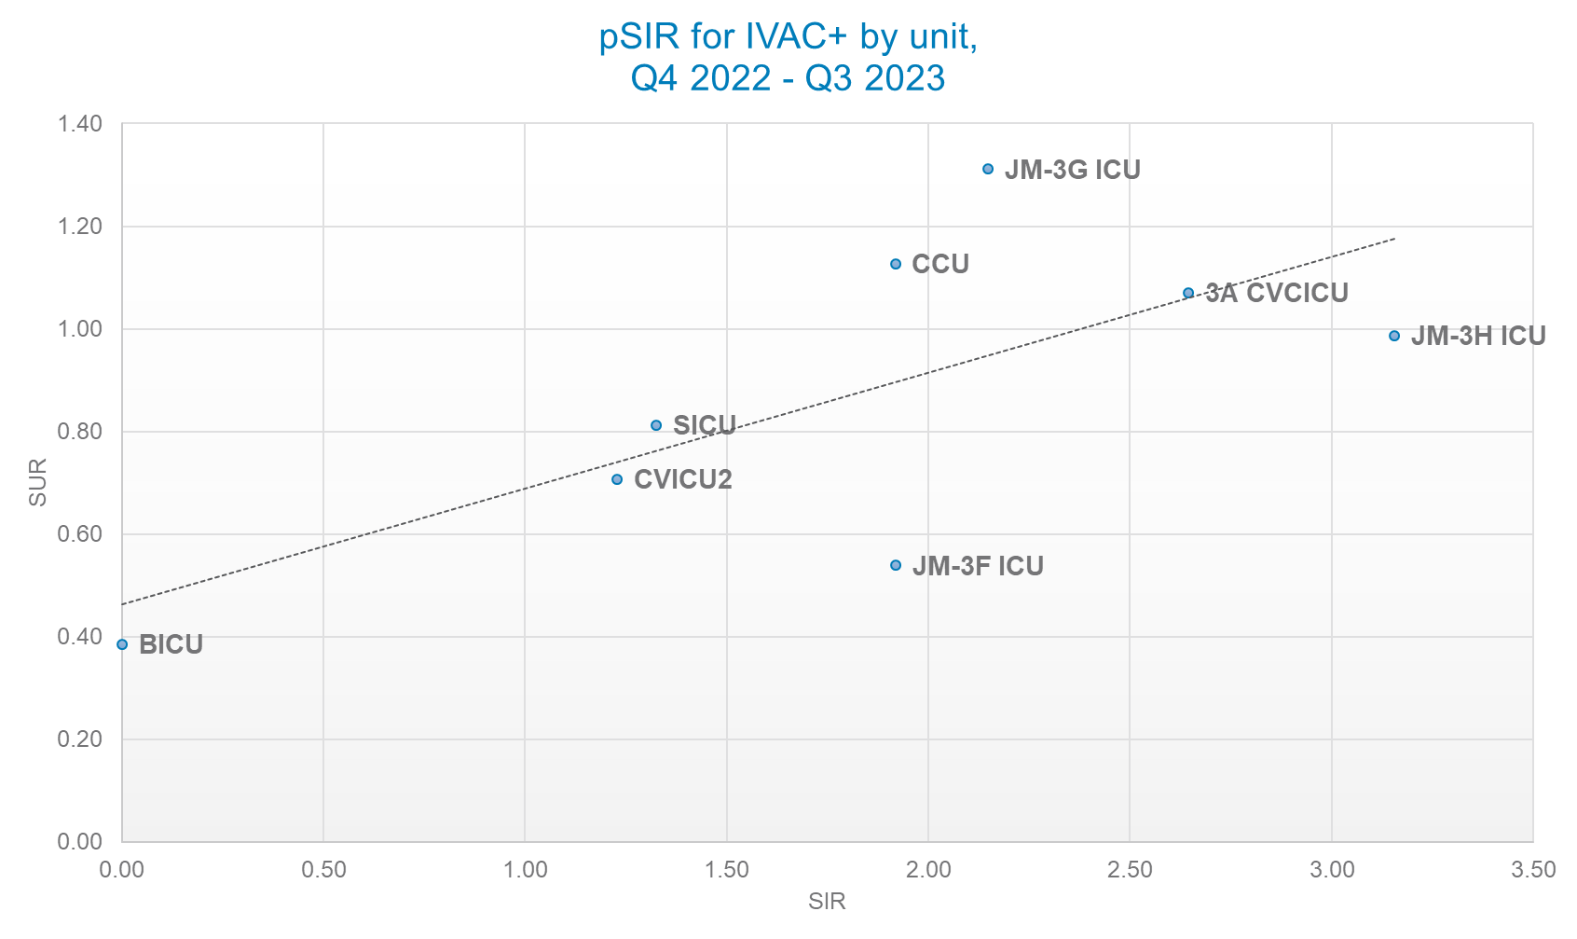
Thanks Loriel Magsino, MPH, CIC!

Slide 25
pSIR CHALLANGES
You don’t want the pSIR with CLABSI to drive you to using more PIVs and midlines
Not an issue with CAUTI or IVAC+

Slide 26
So if my SIR should be below 0.869 for my ICU clabsi and 0.676 for my wards what should MY pSIR BE?
?
Where is the median?
Wards and ICU combo’ed?

Slide 27
Normalizing the SIR to 2022
Pretty easy math take the 2022 SIR 0.869 and your current SIR (using 10 East’s SIR 2.033 compared to the 2015 baseline) and divide them so 2.033/0.869= 2.34 SIR when using the 2022 baseline

Slide 28
So What DOES THE pSIR Do to my FOCUS 25 Units never make the list
Units (# CLABSI) | SIR>1 2015 | SIR> CA (0.869) | pSIR> 1.0 | pSIR 2015 | pSIR >CA(0.695) 2022 (# CLABSI) | pSIR 2022
10 EAST (3) | 2.033 | 10 EAST | JMC 6G PCU | 2.296446 | JMC 6G PCU (4) | 3.304239
7 WEST IMU (2) | 1.371 | 7 WEST IMU | 3A CVCICU | 2.010357 | 3A CVCICU (5) | 2.8926
8EHCS (1) | 1.271 | 8EHCS | 10 EAST | 1.793106 | 10 EAST (3) | 2.580009
3A CVCICU (5) | 1.251 | 3A CVCICU | 7 WEST IMU | 1.571166 | 7 WEST IMU (2) | 2.260671
JMC 6G PCU (4) | 1.103 | JMC 6G PCU | 8EHCS | 1.21855146 | 8EHCS (1) | 1.753311
SICU-T (4) | 1.069 | SICU-T | JMC 4F PCU | 1.212948 | JMC 4F PCU (1) | 1.745249
 |  |  | 2 WEST | 1.162686 | 2 WEST (2) | 1.672929
 |  |  | CVC 4B PCU | 1.001232 | CVC 4B PCU (1) | 1.440622
 |  |  |  |  | CVC 3B PCU (1) | 1.43034
 |  |  |  |  | 11HCEW PCU (2) | 1.270688
 |  |  |  |  | JMC 3H ICU (2) | 1.192858
 |  |  |  |  | CVICU2 (2) | 1.176449
 |  |  |  |  | JMC 3G ICU (2) | 1.168
 |  |  |  |  | SICU-T (4) | 1.145906

Slide 29
A Wag on the CLABSI pSIR
0.9205*0.869= 0.7999 For ICU CLABSI
0.9205*0.676= 0.6223 For Ward CLABSI

Slide 30
Where the psir shines- how many patients did we infect over the expected numbers (Units with SIR Greater than 1)
 | 2015 SIR | 2022 SIR | 2015 pSIR | 2022 pSIR
All outlier units | 3.9 | 5.9 | 7.5 | 13.1
Just top 6 units | 3.9 | 5.9 | 7.2 | 9.9

Slide 31
FOR MATH GEEKS ONLY!!!!! (Not really, a 6th grader can do this)
To calculate the number of expected infections you need the # of infections on the unit and SIR (or pSIR) of unit
Then # Infected/SIR (or pSIR)
Example 10 East had 3 Infections and a 2015 SIR of 2.033 so 3/2.033=1.48 expected infections
Excess infections is # of infections minus expected infections
So 10 East had 3 infections with 1.48 infections expected or 3-1.48=1.52

Slide 32
LESSONS LEARNED FROM THE pSIR AT THE UNIT LEVEL
At UC San Diego Health bad units get worse and good units get better and a little visa versa
Maybe an acuity issue
Prioritize high pSIR over high SIR
pSIR does a better job looking at the total number of patients we harm above “expected”

Slide 33
Proposed next steps
pSIR for the county reporting
pSIR through Metrics Committee
Regression on CMI and SUR
Will it make a difference since money isn’t linked?

