Slide 1
Lisa Marie Kilgore, MBA-HCM, BSBM, CIC
Lisa Kilgore has worked for Scripps Health as the Corporate Director of Epidemiology and Infection Control for the past 14.5 years and has lived in San Diego since 1973. Upon joining the Army in 1984, Lisa became a Satellite Communications Operator. After numerous years of active duty and reserve time in the Army and Navy, Lisa completed her service to our country in 2004. She then returned to her studies and discovered her true calling, Healthcare. Lisa has been practicing infection prevention and control since 2007 and is certified in infection control (CIC). She has worked in healthcare for over 23 years. She has been a part of Emergency Management and Disaster Preparedness for over 18 years with extensive training through FEMA, CDC and the Center for Disaster Preparedness (CDP) in technical emergency response training for chemical, biological, radiological, nuclear, or explosives (CBRNE) and is a part of the DECON team at Scripps Health.

Slide 2
Infection Control Risk Assessment Training (ICRA)
Lisa Kilgore, MBA-HCM, CIC
Corporate Director Epidemiology, Infection Control and Quality
Scripps Health

Slide 3
Disclosure
Advisory Board Independent Contractor – Medline
KOL - Adibot

Slide 4
Definition of Implicit Bias
“Implicit bias” means the attitudes or internalized stereotypes that affect nurses’ perceptions, actions, and decisions in an unconscious manner, that exist and often contribute to unequal treatment of people based on race, ethnicity, gender identity, sexual orientation, age, disability, and other characteristics that contribute to health disparities.”
California Board of Registered Nurses, 2020

Slide 5
Implicit Bias
Implicit bias: our attitudes and beliefs that affect how we see others
Race
Gender
Age
Income
Where others live and work
Goal: to deliver health care with equity
Building a just culture
Equally distribute opportunities and resources

Slide 6
Learning Objectives
Hospitals and clinics, like any other buildings require repair, maintenance, and new construction. However, in a clinical setting, we have to pay special attention on how to keep patients safe who are vulnerable to infection.
Implement the proper infection control risk assessment (ICRA) process
Know what activities require an infection control permit
Understand the ICRA Matrix
Know how to select the correct construction project type

Slide 7
Activities Requiring an Infection Control Permit
All inspections and repairs above ceiling in critical and sterile procedural areas.
Activities that will generate dust
Disruption of HVAC system (>4 Hours)
Demolition or repair of walls, ceramic tile, ceiling tile and ceilings

Slide 8
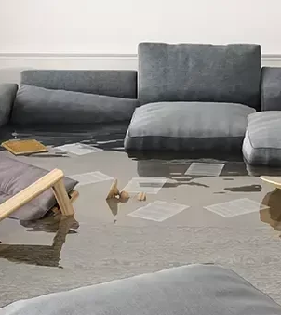
Activities Requiring an Infection Control Permit
Removal of flooring, carpeting, windows, casework
Water damage and or Mold Remediation
Demolition, construction or repair of elevator shafts
Any project that requires cutting of building materials or sanding (dry or wet) in patient care areas.

Slide 9
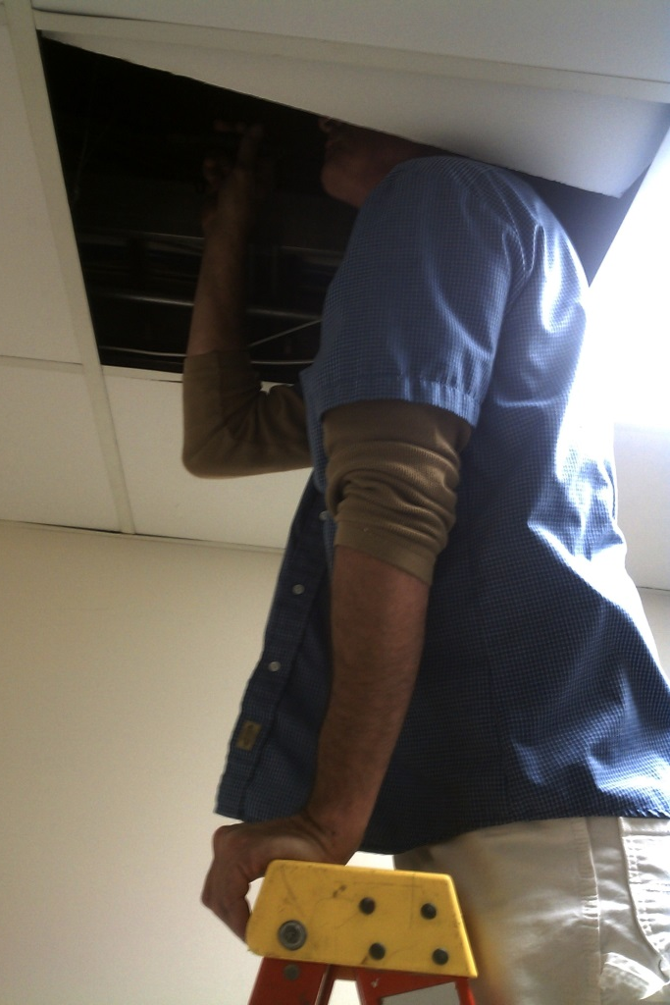
Activities Exempt from the Permitting Process
Non dust generating activities
Removal of 1 ceiling tile per 50sqft only in noncritical areas. Only applies to work in noncritical areas

Slide 10
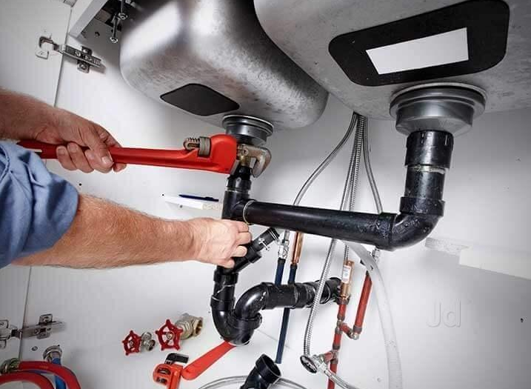
Activities Exempt from the Permitting Process
Medical office buildings, administrative spaces, 3rd party physician offices
Painting & placement of wallcovering
Electrical trim work where dust and debris can be captured quickly
Minor plumbing and electrical repairs that do not generate dust

Slide 11
Introduction to ICRA Matrix
Now that you have determined that the proposed work will require a permit, you will need to refer to the ICRA Matrix for requirements.

Slide 12
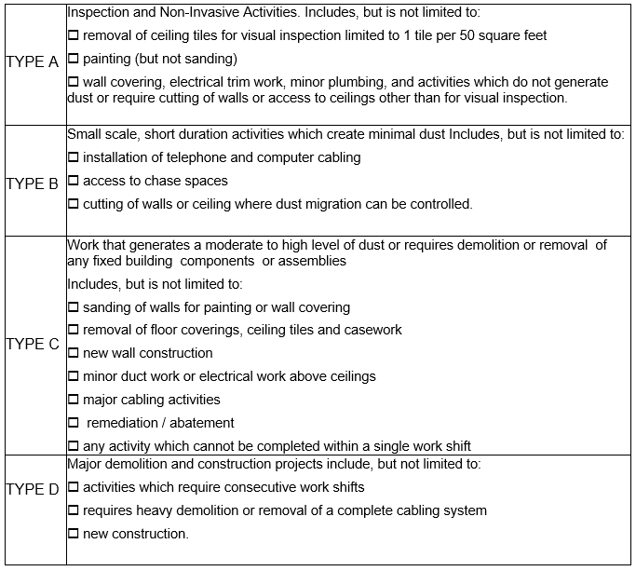
ICRA Matrix
Step 1 – Type of Construction
Identify the scope of work you will be performing Type A, B, C, or D
Place this information on the Construction Activity section of the Permit (ICRA).

Slide 13
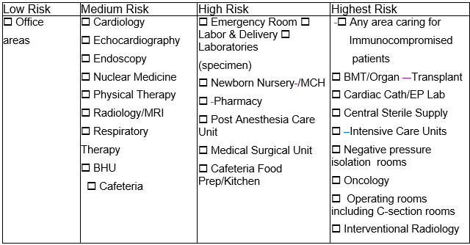
ICRA Matrix
Step 2 – Identify the Patient Risk Groups
Identify the risk groups where the construction renovation will occur.
Place this information on the infection control risk group of the Permit (ICRA).

Slide 14
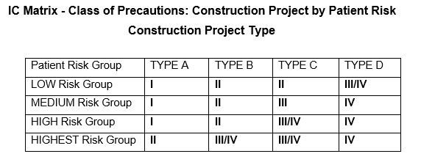
ICRA Matrix
Step 3 – Construction Project by Patient Risk
Once Step (1) and Step (2) have been assessed. Use the matrix below to identify the required infection control precautions. (Next slide will include an example).

Slide 15
ICRA Matrix Example
Example: A flood occurs in the ICU caused by a domestic water line fracture. The walls are saturated, and it has been determined demolition is required.

Slide 16
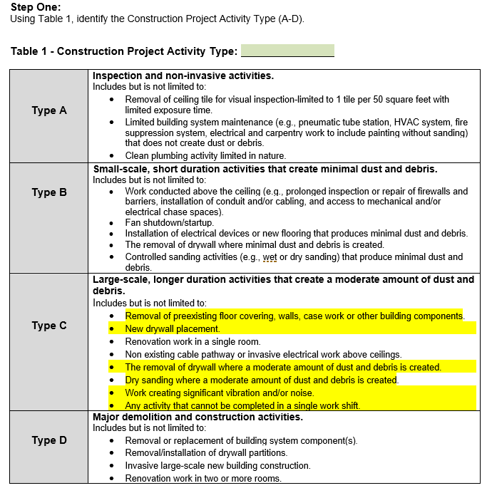
ICRA Matrix
Next Step: Review Types of Construction (Step1)
(Located on ICRA Template)
Notes:
A Flood has occurred in ICU and will require wall demolition and replacement; the work activity is expected to entail multiple shifts.
The highlights represent items expected to be impacted.

Slide 17
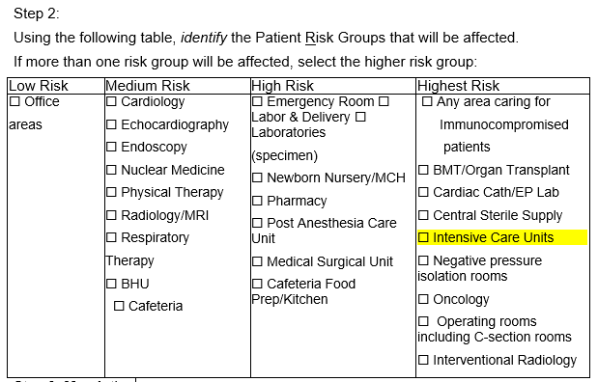
ICRA Matrix
Next Step: Identifying Patient Risk Groups (Step 2)
(Located on ICRA Template)
Notes: The incident occurred in ICU (highlighted)

Slide 18
ICRA Matrix
Next Step - Class of precautions: Final requirements by patient risk and types of construction (Step 3)
(Located on ICRA Template)
Notes: We have determined this project meet the construction requirements listed as type C and occurs in highest patient risk group.

Slide 19
ICRA Process Finalization
Now that you have determined the elements of the ICRA Matrix, here are the final steps:
Our previous example of the ICU flood indicated that this project was categorized as a Class III/IV containment. This type of project requires a signature by your infection preventionist.
(Note: Class I&II ICRA’s will not require an IC signature. These only require the project managers signature).
Work with your infection preventionist to determine PPE Requirements for Class III/IV containments

Slide 20
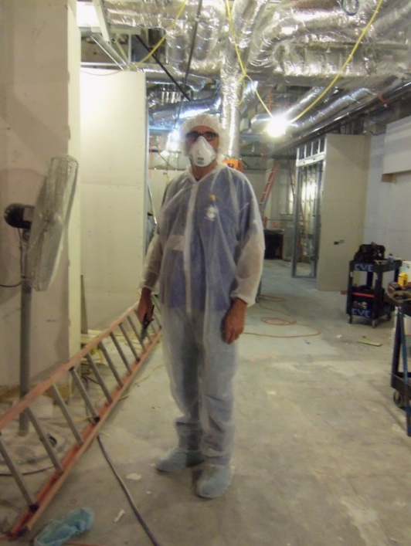
ICRA Process Finalization
Selecting Personal Protective Equipment:
Class III & IV Containments may consist of the following PPE requirements.
Shoe Covers
Head Covers
Bunny Suits
Tyvek Suits
Gloves
P-100
N-95
Note: All personnel entering Class IV containments are required to wear shoe covers. Work with your Infection preventionist to determine PPE Requirements.

Slide 21
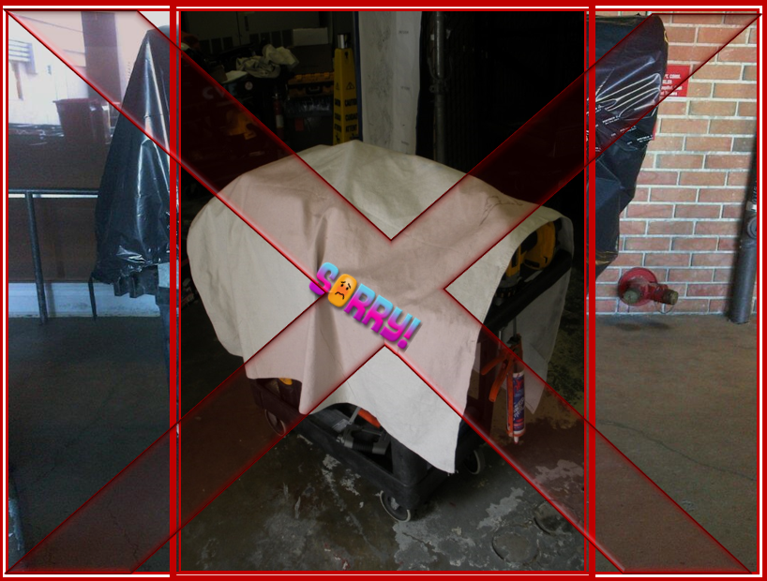
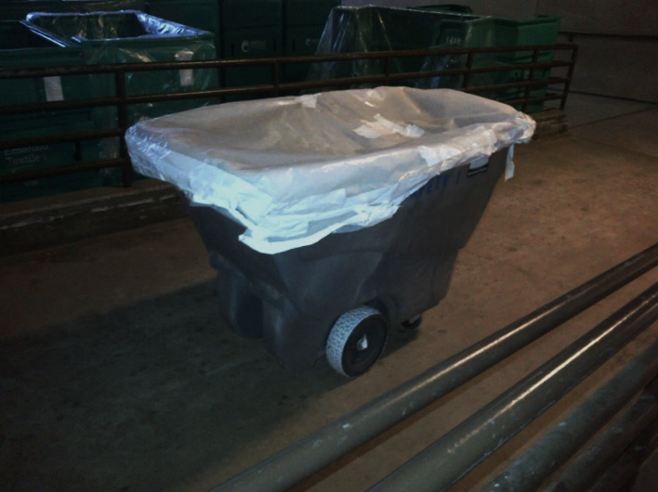
ICRA Process Finalization
Transportation of Debris in the Healthcare Environment:
The project planning team should discuss the following expectation of debris removal from the worksite:
All transport receptacles should be covered when transporting debris through the healthcare environment.
Ensure trash bags are closed and gooseneck taped
Wet mops with disinfectant should be utilized to minimize dust dispersal
Provide a vacuum for the Anteroom

Slide 22
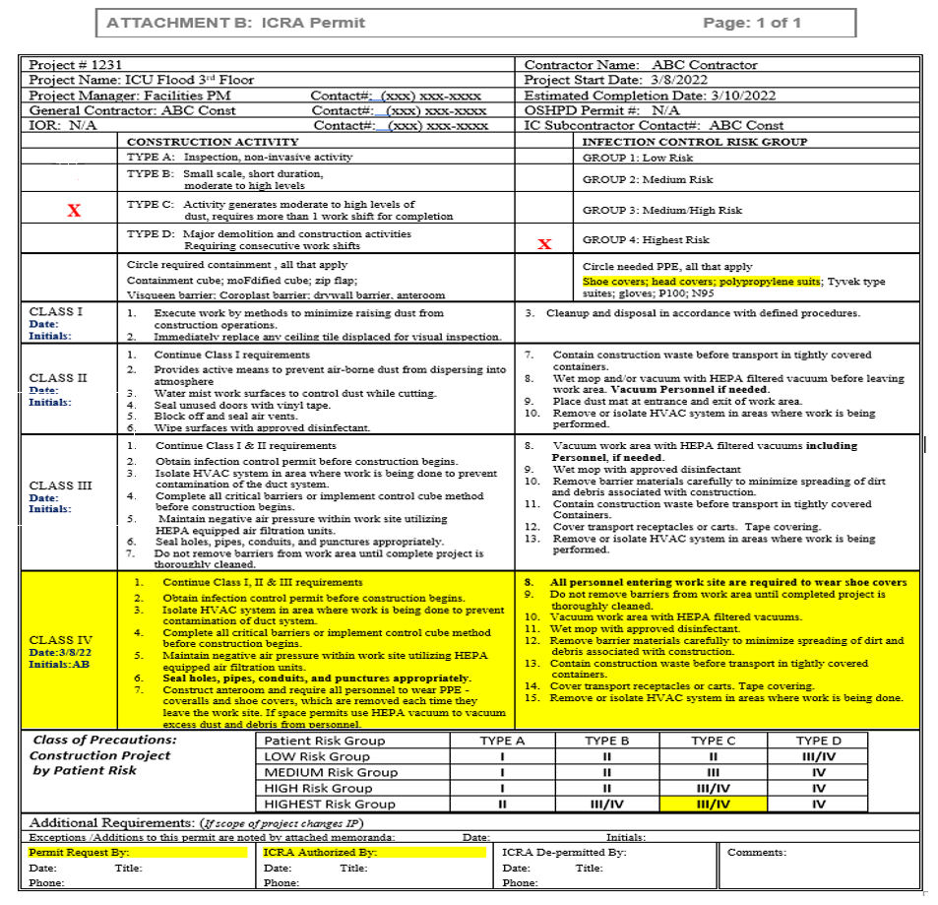
ICRA Process Finalization
The picture on the right represents the finalized ICRA for our ICU flood example
Post copy of signed ICRA on Containment and include additional signage that may be necessary.
Note: Possible additional signage may include the following:
ILSM
Pardon our dust
Altered floor plans
Directional Signage
___

Slide 23
Work Practice Requirements for Class I,II,III & IV Containments
After going through the matrix to develop individual permits there will be steps which must be followed for each specific class.
Class I&II Project Classifications
Execute work by methods to minimize raising dust
Immediately replace any ceiling tile displaced for visual inspection
Provide active means to prevent airborne dust from dispersing into atmosphere
Water mist surfaces to control dust while cutting
Seal unused doors with tape
Place Tacky Mat at entrance
Remove or isolate HVAC system in areas where work is being performed

Slide 24
Work Practice Requirements for Class I,II,III & IV Containments
Class III & IV Project Classifications
Isolate HVAC system in the area where work is being performed (Vinyl tape or coroplastic)
Ensure all critical barriers i.e., sheetrock, plywood, visqueen, & coroplastic are in place to segregate and seal from all non construction related space.
Maintain negative pressure within the worksite utilizing HEPA equipped filtration.

Slide 25
Work Practice Requirements for Class I,II,III & IV Containments
Ensure proper signage is posted. (May need to incorporate Safety Officer or Safety Technician for assistance)
Ensure proper PPE is being worn as described on the Infection Control Risk Assessment (ICRA). This can be found on the right-hand side of the Permit
Tacky mats and floor covering may be used as a form of dust compliance and or protection during construction renovation.

Slide 26
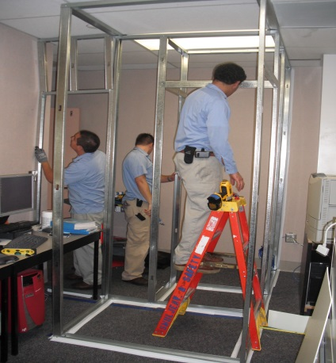
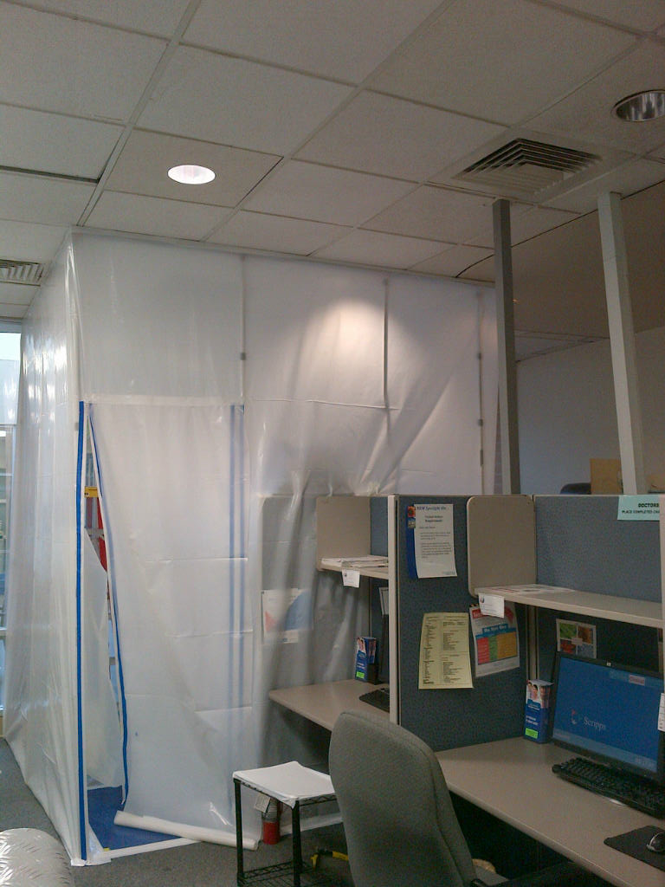
Containment Construction
At this point the ICRA has been developed and the contractor is aware of all construction requirements, and the containment can be built

Slide 27
Engineering / Designee Roles & Responsibilities
Now that the containment has been built, Engineering / Designee plays an important role in the infection control process: Their duties will include the following:
Conduct periodic visual inspections of all construction barriers and record your finding
Immediately report any discrepancies or deficiencies to the points of contact listed on the ICRA (PM, IP, Safety)
Authority to suspend project if there is an infection risk, loss of containment or noncompliance with IPC policies. Take immediate action to correct all deficiencies (i.e., loss of negative pressure, breach of containment, contractors not abiding by PPE requirements

Slide 28
Visual Inspections
Rounding on containments is conducted on a routine on a basis. The rounds are broken down into (3) categories. Below is what you should look for when conducting your site inspection.
Barrier Configuration
Barrier is intact [tape secure, holding, breach, no damage]
Barrier should match the permit graphics
Negative Pressure
Pressure reading should be negative
Visual inward pull is appropriate
Flex duct connected securely and properly, free of damage
HEPA unit in functioning acceptable condition
Ante-Room
Clean dust free and organized
Trash bag available in ante-room
Walk off mats available and properly maintained
The actual round sheet used by to perform the visual inspections appears on the next slide

Slide 29
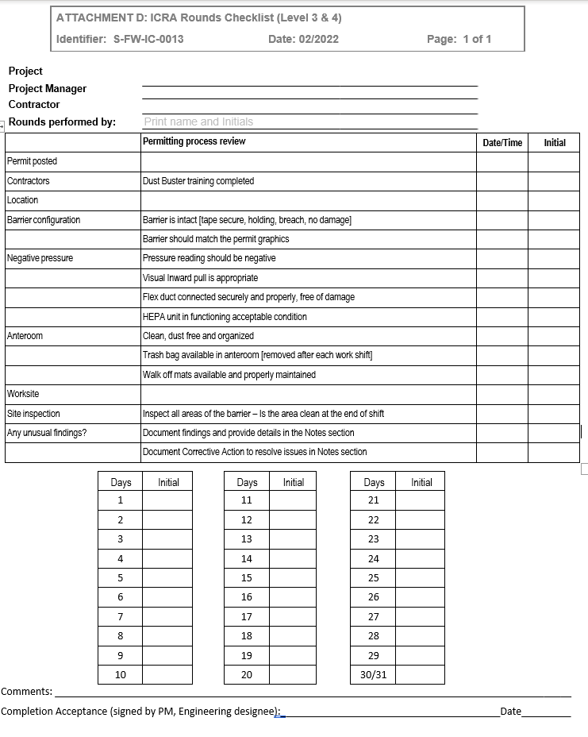
Visual Inspections Round Sheet (Class III&IV)
Rounds should be conducted periodically throughout the duration of the project.

Slide 30
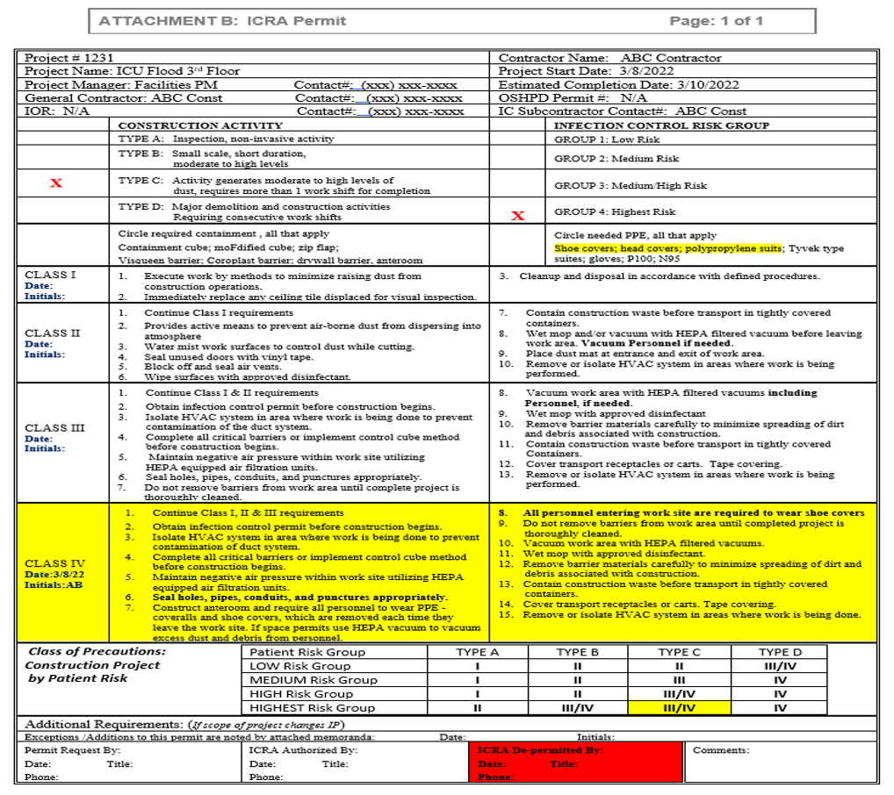
Depermit
The ICU flood project is now complete. All the drywall has been freshly painted and repaired.
Next Step: Infection prevention and or designee will need to visually review the containment for cleanliness.
The contractor or EVS will provide a terminal clean prior to removal.

Slide 31
Depermit
A final job walk should be performed by Infection Prevention and or Engineering to ensure the following:
No penetrations
All debris has been removed
Ceiling tiles reinstalled
Plumbing fixtures tested for leaks (toilets, drains, faucets)
All surfaces are dust free and disinfected
Once terminal clean has been performed and visually inspected, Infection Prevention and or Designee can sign off the permit. These documents will need to be archived.
A record of all approved ICRA’s will be maintained for a period of 3 years

Slide 32
YOUR TURN

Slide 33
Question #1
Which one of these activities would require an ICRA?
Removal of a ceiling tile to inspect an HVAC motor in a non- critical area
Painting a wall
Non dust generating removal of wallpaper
Removal of carpeting
Notes:
The answer is “D”

Slide 34
Question #2
Which one of these activities would require an ICRA?
Removal of a ceiling tile to inspect an HVAC motor in a non- critical area
Painting a wall
Non dust generating removal of wallpaper
Removal of carpeting
Notes:
The answer is “B”

Slide 35
Question #3
True or False
Inspection above the ceiling in an O.R. will always require a permit
True
False
Notes:
Answer is “A”

Slide 36
Question #4
Which of the following is not an acceptable condition observed during the containment visual inspection rounding?
Containment visqueen is pushing outward slightly
Walk off mats have been recently changed
Trash bag is present in ante-room
HEPA unit flex hose is intact and functional
Notes:
Answer is “A”

Slide 37
Question #5
Which of the following is not a component of the ICRA Matrix development?
Type of construction
Area of the hospital where work is being performed
Contractor performing the work
Duration of the project
Notes:
Answer is “C”

Slide 38
Question #6
How often should rounding be conducted on containments?
Twice a day
Daily
Periodically
Never
Notes:
Answer is “C”

Slide 39
Question #7
Engineering has the ability to suspend work?
True
False
Notes:
Answer is “True”

Slide 40
Question #8
The ICRA’s should be retained for _____ ?
The duration of the project
3 Years
Calendar Year
Fiscal Year
Notes:
Answer is 3 years

Slide 41
Question #9
When should the designee sign off the ICRA to authorize containment removal?
Visually Inspected by Designee & Terminally Cleaned
Terminally Cleaned
Construction Cleaned
After The Work is Complete
Notes:
Answer is “A”

Slide 42
Question #10
True of False?
An ICRA is required if the HVAC system is shut down for more than 4 hours?
Notes:
Answer is “True”

Slide 43
References
Infection Control Risk Assessment 2.0 (ICRA 2.0) | ASHE
ASHE publishes revised infection control risk assessment guide | Health Facilities Management (hfmmagazine.com)

Slide 44
Questions?

