Slide 1
Disinfection in Healthcare: Pitfalls Challenges and Getting it Right
The Impact of Biofilms on Patient Infection and Environmental Disinfection
“If you are Disinfecting for Biofilm you are not Disinfecting.”
Mark Hodgson
Vice president - Healthcare
UMF PerfectCLEAN

Slide 2
Mark Hodgson, LRSC, CMIP
Mark Hodgson has worked in healthcare and infection prevention for over 30 years, a chemist with a strong background in environmental microbiology and the impact of fomites on patients. He has been a leader in developing programs driven by quality and sound scientific principles. Mr. Hodgson has also been a regulatory liaison and provided litigation support and expert witness in the states of New York, New Jersey, Ohio and Florida. Mr. Hodgson has performed water quality and indoor air quality evaluations in Europe, North America, South America, North Africa, Australia, Southeast Asia and Sub-Saharan Africa.
With broad-based knowledge of the disinfectant industry, he has conducted outbreak investigations and risk assessments as well as prepared protocols for the control of Legionellosis, conducted research on Clostridoidies outbreaks, and developed prevention programs. Mr. Hodgson has completed numerous investigations of fungal contamination, and outbreaks of multi drug resistant bacteria. He has managed remediation projects of Microbial-contaminated hospitals, including developing work protocols and monitoring of work practices and has investigated over 500 buildings for fungal contamination.
Mr. Hodgson was a lead instructor for courses on Microbial Evaluation of Buildings for the Texas Department of Health, New Jersey State Department of Health and Human Services, Pennsylvania State Department of Health, New York City Department of Health, United States Housing and Urban Development Agency, the United States Navy and the United States Air Force. Mr. Hodgson is the coauthor of Healthcare Mold Management a Prevention, Assessment, and Remediation Training Guide.

Slide 3

Terri Goodman & Associates is an approved provider by the California Board of Registered Nursing, Provider Number XXXXXXXX. *
This activity has been approved for 1.2 contact hours. *
This activity was developed with an unconditional education grant from
umfcorporation

Slide 4
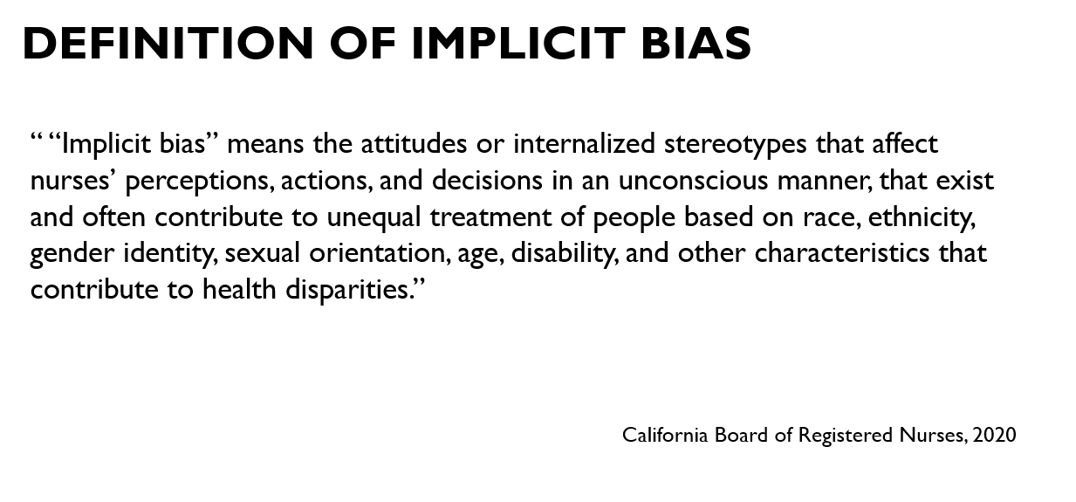

Slide 5
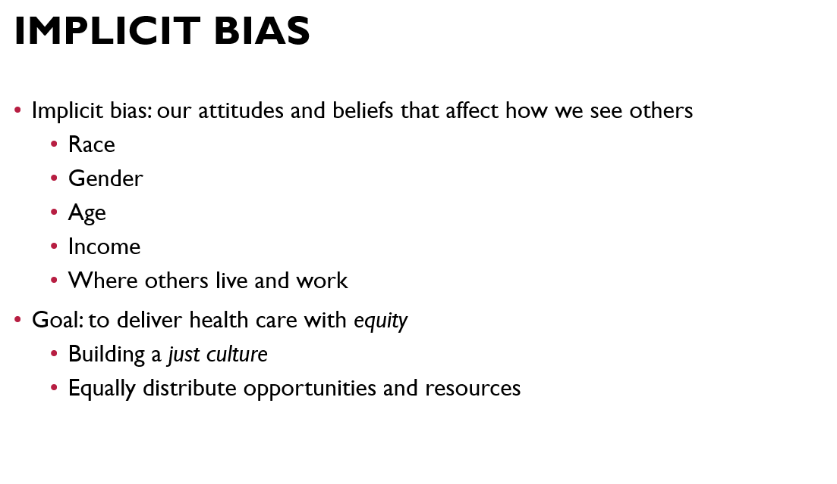

Slide 6
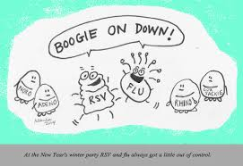
Objectives
1. Explain how biofilms develop
2. Describe the function of persister cells
3. How do dry biofilms differ from traditional biofilms
Discuss the risk that dry biofilms pose in the hospital environment
Discover the best antibacterial chemistries to address biofilms

Slide 7
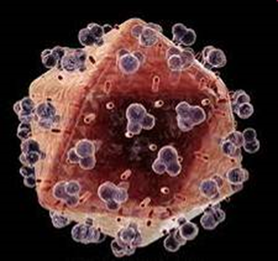
From The Director General Of The World Health Organization
“The emergence and spread of drug-resistant pathogens has accelerated. More and more essential medicines are failing. The therapeutic arsenal is shrinking. The speed with which these drugs are being lost far outpaces the development of replacement drugs. In In fact, the R&D pipeline for new antimicrobials has practically run dry”
So disinfection is last line of defense
We can predict the probability of Hospital Acquired Infection from a specific pathogen based on the status of the prior room occupant. We are not eliminating fomites as a source of infection. ¹
Huang et al. 2006 Risk of Acquiring Antibiotic-Resistant Bacteria From Prior Room Occupants Arch Intern Med 2006; 166: 1945-51.

Slide 8
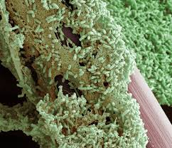
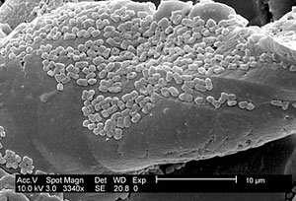
The next big challenge in Infection Prevention
Biofilm
Part 1: What, Where, How, and, Why
Notes:
8

Slide 9

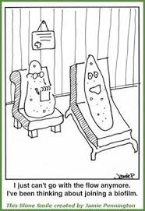
Biofilms in a Healthcare Setting
We study bacteria on a culture plate. In a liquid suspension, or in isolation.
That is not how they behave and interact in the real world.

Slide 10

Biofilms
60% of human infection arise from pathogens in biofilm
(mainly in wounds and implants)
Biofilms can act as a reservoir of pathogens in the hospital and offer favorable environment for pathogens to persist over extended periods.
The biofilm structure protects embedded pathogens against biocides
Biofilms increase patient exposure and provide higher infectious dose
Typically we look at biofilms in a wet or damp environment (prosthetics, catheters, tracheotomy tubes)
Notes:
10

Slide 11
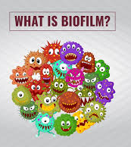
Biofilm?
A biofilm is a community of microorganisms attached to a substrate which produce
Extracellular Polymeric Substances (EPS)
EPS includes proteins, genetic material, polysaccharides (not required)
  Bacteria
  Fungi
  Algae
  Yeasts
  Protozoa
One or typically more species in a biofilm
  Most common form of growth for microorganisms
  Protected form of growth : KEY SURVIVAL FACTOR

Slide 12
Why do microorganisms form biofilms?
      Biofilm provides a protective layer from environmental stress
      (e.g. can be >1500 less susceptible to certain biocides)
        Allows interaction opportunities for microorganisms
        Access to nutrients
        Protects from Amoebae/Neutrophils
Antimicrobial agents
UV
Metal toxicity
Protection
Phagocytosis
Acid stress
Dehydration

Slide 13
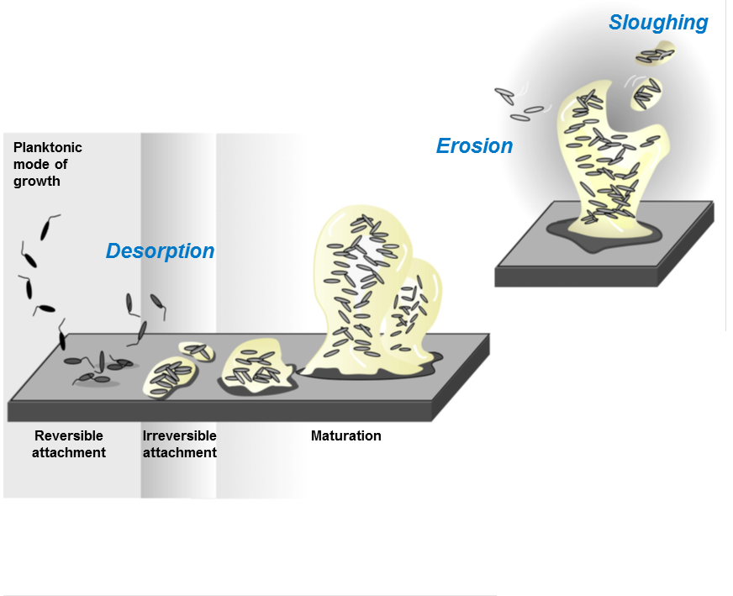


Formation of Biofilm
Initial attachment improved by presence of flagella (for some species, Listeria, this makes formation temperature dependent)
Initial growth rate dependent on available nutrient and temperature
Once you get to 10⁵ to 10⁶ cfu you have a strong biofilm that will demonstrate resistance factors
Notes:
You are going to be hearing a lot about dry biofilm in healthcare, wet biofilms are well studies and researched, look at trachea tubes or vent patients, they will happily grow a biofilm in 3 to 5 days.. Biofilms are highly complex. 60 percent of infections are known to be associated with biofilm sourced organisms, the assumption was that wet biofilms were the problem, that may no longer be the case.

Slide 14
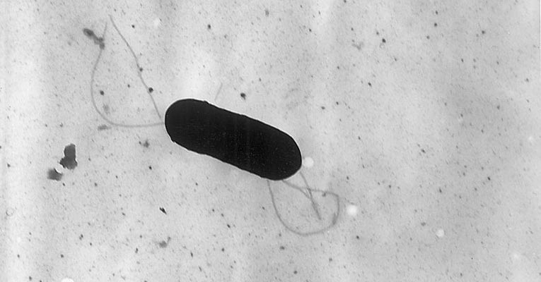
There are variations
The common morphology of Listeria is ……
Under environmental stress the pathogen can change to a filamentous bacteria and form a free floating biofilm matrix
Remove the environmental stress and the bacteria reverts to typical morphology.

Slide 15
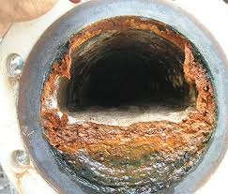
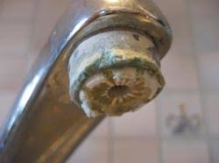
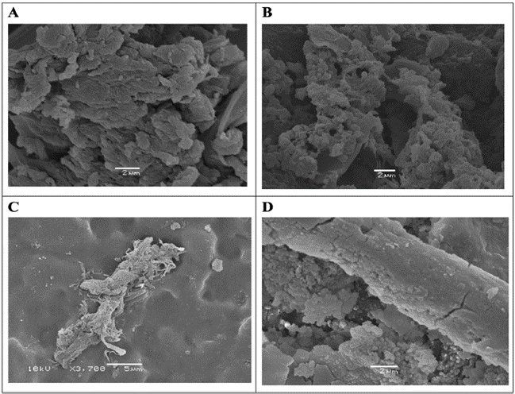

Types of biofilms found in Healthcare
Hydrated biofilms
One of the most commonly studied types of biofilm
Formed in wet environments (pipes, water cooling towers, sewage treatment)
Over 90% water, bacteria are growing and multiplying
The present EPA test protocol for disinfectants is based on wet bioiflm
Build up biofilm
Occurs on areas which may be regularly exposed to a cycle of wet/dry conditions
Examples: faucets, drains, waste pipes
Considered to be hydrated due to their high moisture content
Dry surface biofilm
Exist on normally dry surfaces (handrails, floors, privacy curtains)
Contain less than 61% water, these guys are dormant¹
Present on >90% of surfaces in ICU²
Hu,H. et al. 2015. J. Hos. Infect. 91:35-44
¹Almatroudi, A et al. 2018. J. Hosp. Infect. 98:161-167. ²Hu, H et al. 2015. J. Hosp. Infect. 91:35-44

Slide 16
Wet-Dry what is the difference?
The extent of biofilm growth on “Normally Dry” surfaces was Unexpected when first observed.¹
All biofilms initially grow as hydrated biofilm, in the lab it takes 24 to 48 hours to dehydrate a wet biofilm.²
A dry biofilm starts to rehydrate after 4 to 8 min and can be completely rehydrated after 36 to 40 min.³
Why would a “dry” surface grow biofilm
High humidity (63 percent or above)
Localized high humidity (location of vents, lack of insulation)
Incidental spills
Condensation
Cleaning and disinfection
  What if our disinfectant is the cause of biofilm growth?
  If you apply a 10 min quat with a wiper then you just added water to the surface to keep the surface wet for 10 min.
Presence of biofilm containing viable multiresistant organisms despite terminal cleaning on clinical surfaces in an intensive care unit. Vickery, K.; Deva, A.; Jacombs, A.; Allan, J.; Valente, P.; Gosbell, I.B. J. Hosp. Infect. 2012, 80, 52–55.
A rapid model for developing dry surface biofilms of Staphylococcus aureus and Pseudomonas aeruginosa for in vitro disinfectant efficacy testing Carine A. Nkemngong1, Maxwell G. Voorn1, Xiaobao Li2, Peter J. Teska2 and Haley F. Oliver1*Antimicrobial Resistance and Infection Control (2020) 9:134
³Dependency of hydration and growth conditions on the mechanical properties of oral biofilms J. Pattem1,6,7*, M. Davrandi2,7, S. Aguayo3, B. Slak4, R. Maev4, E. Allan2, D. Spratt2 & L. Bozec1,5 Scientific Reports (2021) 11:16234

Slide 17
Interesting things happen in Biofilm

Slide 18
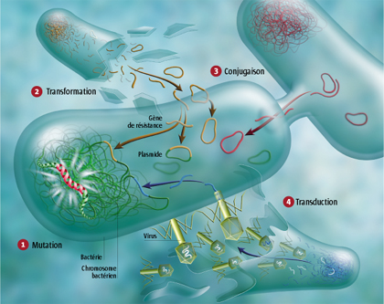
Plasmids and DNA Exchange In Biofilm
Pm
Bacteria swap plasmids in Biofilm, including the CRE plasmid
It may not have been a resistant organism when it joined the community but it will be soon
Plasmid transfer in biofilms: a perspective on limitations and opportunities Thibault Stalder & Eva Top npj Biofilms Microbiomes 2, 16022 (2016).
Notes:
Plasmids are small circular chromosomes positioned at the periphery of the bacterial cell and transferable.
Thus, we can see a change in the characteristics of a mature biofilm bacterial population which is generally more resistant to external conditions (physical and chemical) and endowed with infectivity and increased resistance to disinfectants and antibiotics (cross resistance).
18

Slide 19
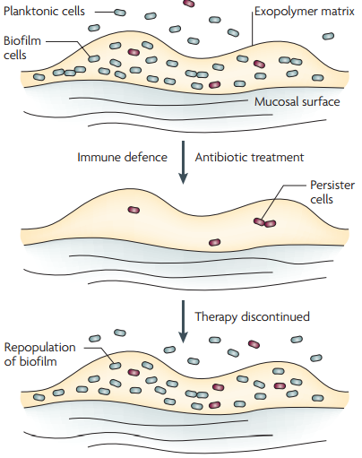
Protection and Stress Resistance
Persister cells
Small dormant sub-population of biofilm which can remain viable after treatment with an antimicrobial
Lose tolerance upon re-growth
Specialized survivor cells, completely dormant so no cellular membrane transport
Allows quick regrowth of biofilms making them extremely difficult to eradicate, biofilm can reform in as little as 40 min, up to twice as thick.
Lewis, K. (2007) Nature. Rev. Microbiol. 5:48-56
Lewis, K. (2007) Nature. Rev. Microbiol. 5:48-56
Bacterial Persister Cell Formation and Dormancy Thomas K. Wood, Stephen J. Knabel,^{c} and Brian W. Kwan^{a,}* Appl Environ Microbiol. 2013 Dec; 79(23): 7116–7121.

Slide 20
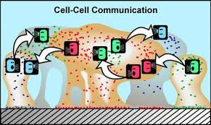
Bacteria Communicate in Biofilm
Quorum Sensing: Bacteria communicates to one another through chemical signals
Use of chemical signals to indicate:
    Flee
    Eat
    Become dormant
    Multiply
    Die
And probably a bunch of stuff we have not yet identified
Sociomicrobiology:theconnections betweenquorumsensingandbiofilms MatthewR.ParsekandE.P.Greenberg TRENDSinMicrobiology Vol.13No.1January2005
Notes:
Quorum Sensing:

Slide 21
Special Circumstances
A fully hydrated Biofilm in Every Patient Room

Slide 22
Deadly drains…
New research is beginning to highlight the risk of infection from sink drains
Adding a nutrient source (blood, foodstuffs, beverages, surplus medication) down the sink drain could allow biofilm to grow up the drain at a rate of 2.54 cm per day¹
Disruption of these sink/drain biofilms can transfer viable organisms up to 1 m to surrounding area²
  Dispersal of organisms from the tap had been attributed to previous outbreaks^{3,4}
Pseudomonas aeruginosa and Carbapenem resistant Enterobacteriaceae (CRE) are frequently associated with hospital sinks
  Disinfection of sinks has been shown to dramatically decrease level of CRE colonization⁵
  Resistant pathogens have been shown to colonize drains for over 6 years
¹Kotay, S. et al. 2017. Appl. Environ. Microbiol. 83:1-12.
²Aranega-Bou, P. et al 2019 J. Hosp. Infect 102:63-69.
³Kotsanas, D. 2013, Med. J. Aus. 198:267-269.
⁴Leitner, E. 2015. Antimicrob. Agents Chemother 59:714-716.
⁵Smolders, D. 2019 J. Hosp. Infect 102:82-88.

Slide 23
SHEA/CDC/APIC
Recently Published Guidelines on Hand Hygiene
Focus on the risk of hand contamination during hand hygiene
Risj is identified as contaminated drainlines with biofilm in p-traps harbouring resistant organisms
Recomends disinfectants that have passed the US EPA biofilm test method present best solution⁶
Applied to the drain line in a foam
⁶Glowicz et al Infection Control & Hospital Epidemiology (2023), 44, 355–376

Slide 24
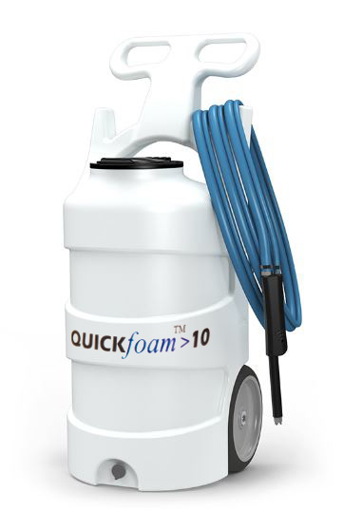
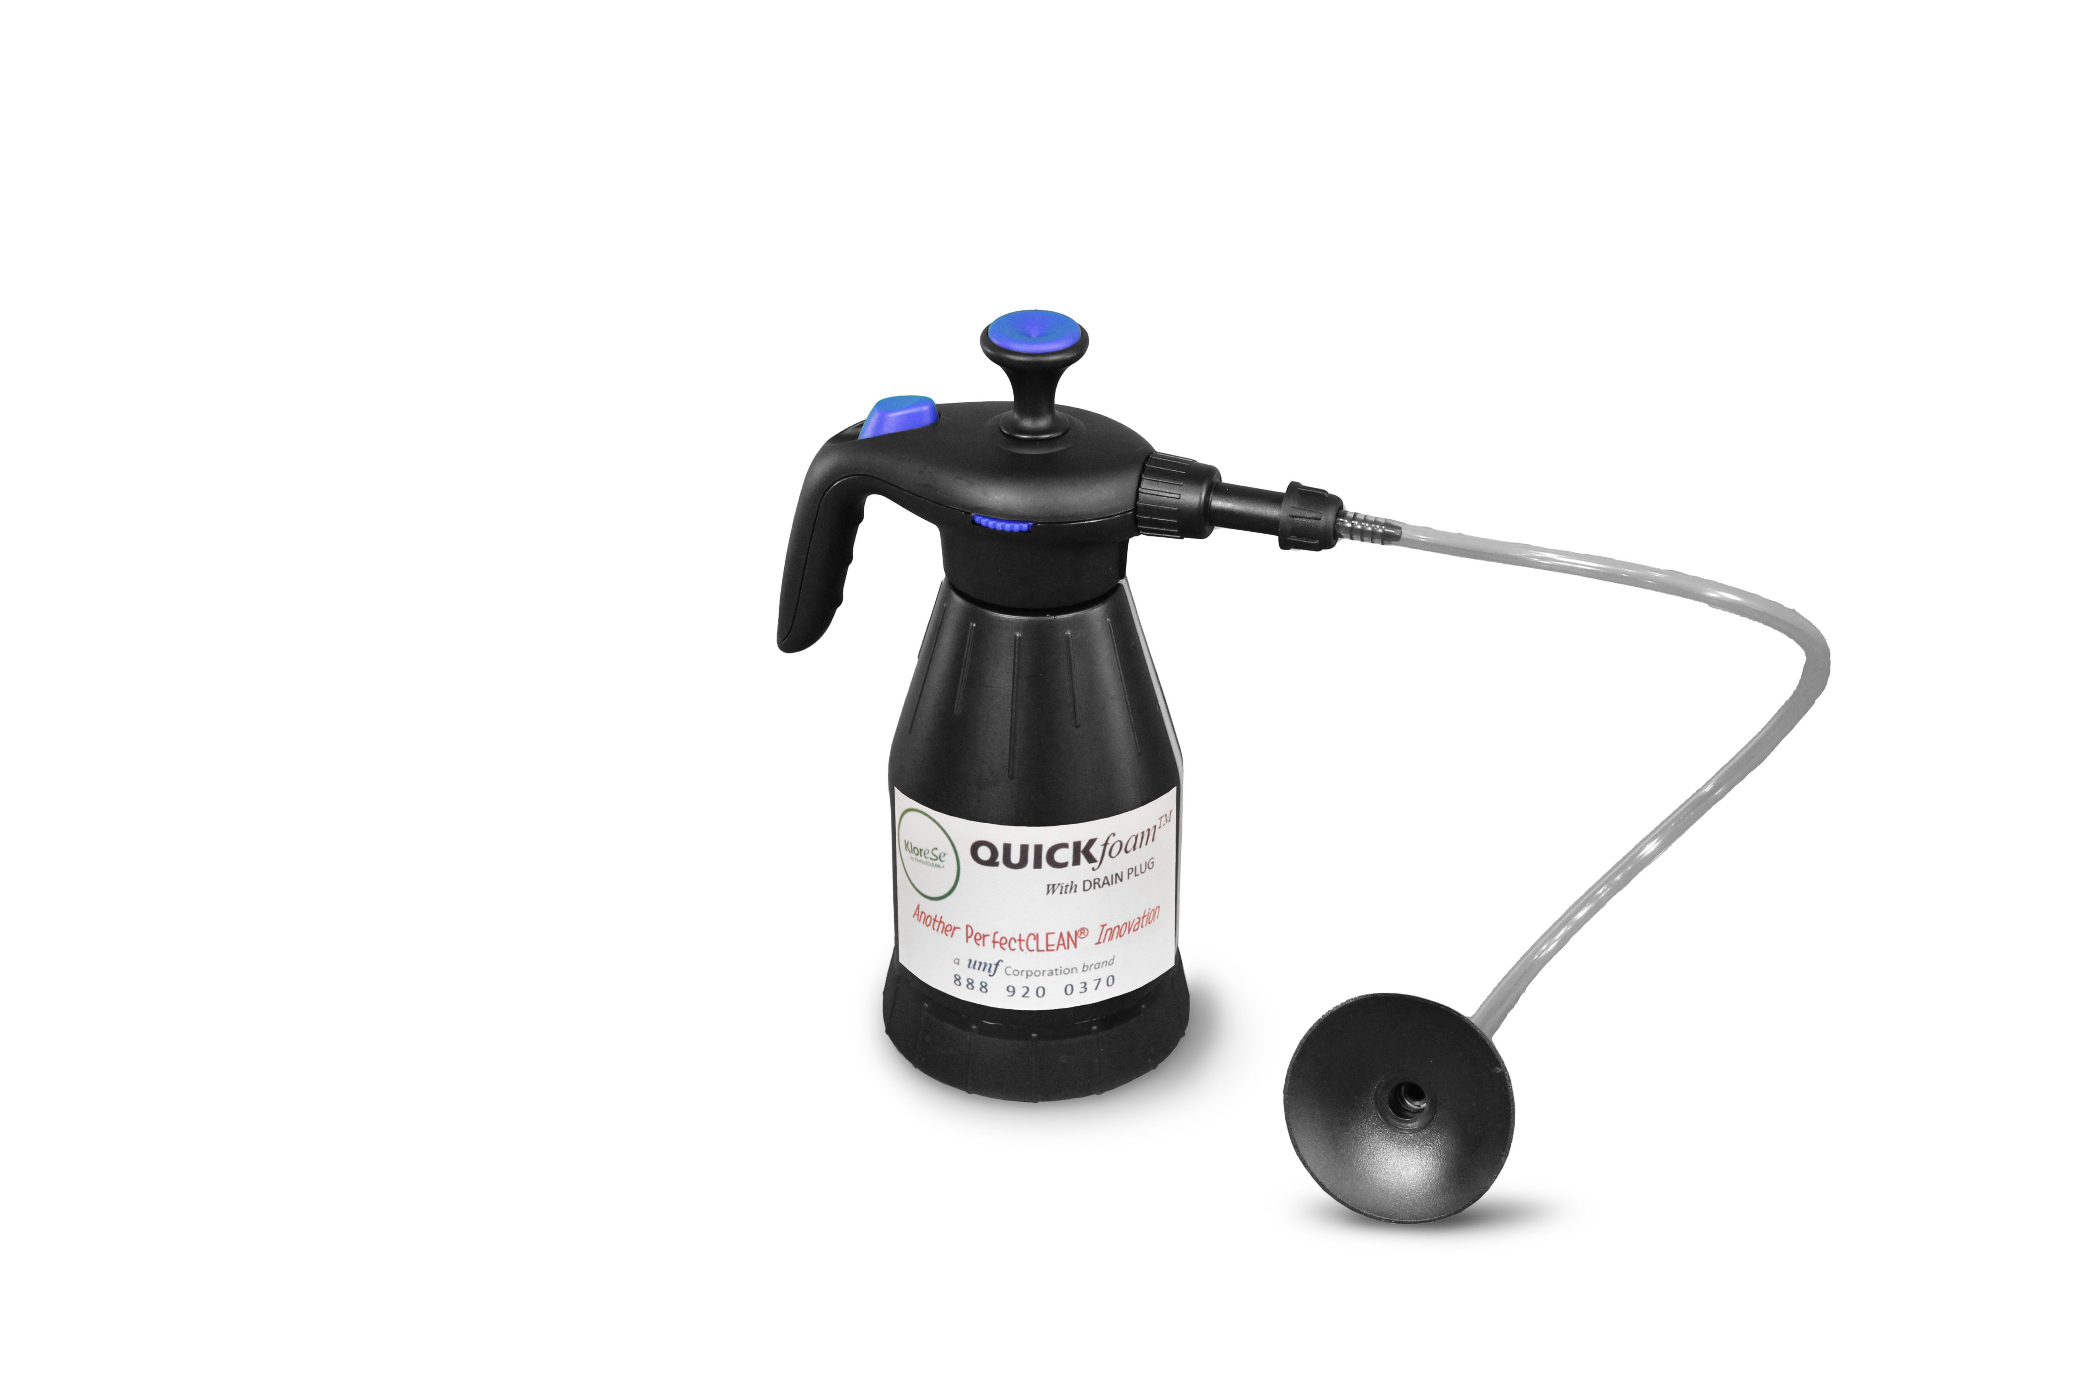
Disinfecting Drain Lines
Make sure your disinfectant has an EPA registered claim as effective against bacteria in biofilm.
Use a foaming device to displace the water in the P-Trap with foamed disinfectant.
Do not use the sink for the required contact time of the disinfectant.
Make sure the disinfectant has a pH greater than 5 – otherwise it is illegal to discharge to sanitary sewer under 40CFR403.

Slide 25
Biofilms on Normally Dry Surfaces
The unexpected challenge

Slide 26
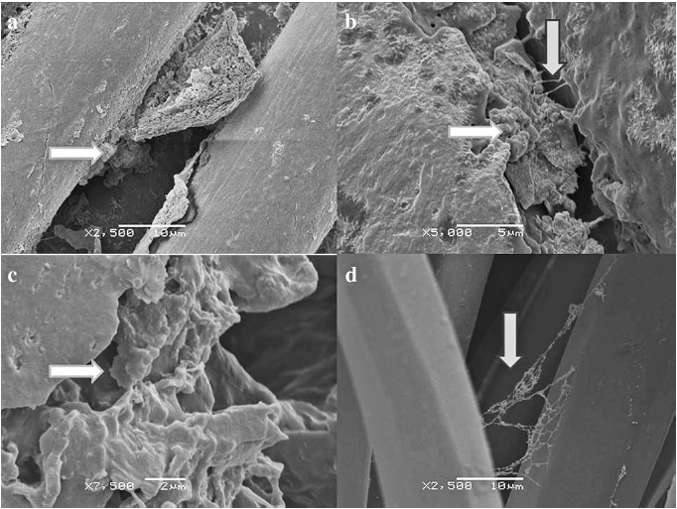
Biofilms – New Research
First characterized by Vickery et al. after destructive sampling of an ICU
Evidence of biofilms on:
    Blind chord
    Opaque ward door
    Reagent box
    Privacy Curtains
Hypothesis: surface condensation or high relative humidity allowed biofilms to form. Or just the wrong disinfectant incorrectly applied. Once formed EPS protected the microbes form desiccation & made them difficult to remove
K. Vickery et al. 2012. Presence of biofilm containing viable multi resistant organisms despite terminal cleaning on clinical surfaces in an intensive care unit. J. Hos. Infect. 80:52-55. https://www.journalofhospitalinfection.com/article/S0195-6701%2811%2900319-7/abstract
Notes:
So embedded that normal swab sampling may not have detected the biofilms. That is why destructive sampling was carried out.

Slide 27

Biofilms – New Research
Hu et al. also found dry surface biofilms on 93% of surfaces in an ICU, 52% had MDROs
    Privacy curtain
    Ward entry door
    Mattress
    Wire note clip
    All these biofilms were found after 2 rounds of terminal cleaning!
    Are the cleaning processes in place truly effective?
Hu,H. et al. 2015. Intensive care unit environmental surfaces are contaminated by multidrug-resistant bacteria in biofilms: combined results of conventional culture, pyrosequencing, scanning electron microscopy, and confocal laser microscopy. J. Hos. Infect. 91:35-44, https://www.ncbi.nlm.nih.gov/pubmed/26187533
Notes:
Hu,H. et al. 2015. Intensive care unit environmental surfaces are contaminated by multidrug-resistant bacteria in biofilms: combined results of conventional culture, pyrosequencing, scanning electron microscopy, and confocal laser microscopy. J. Hos. Infect. 91:35-44
https://www.ncbi.nlm.nih.gov/pubmed/26187533

Slide 28
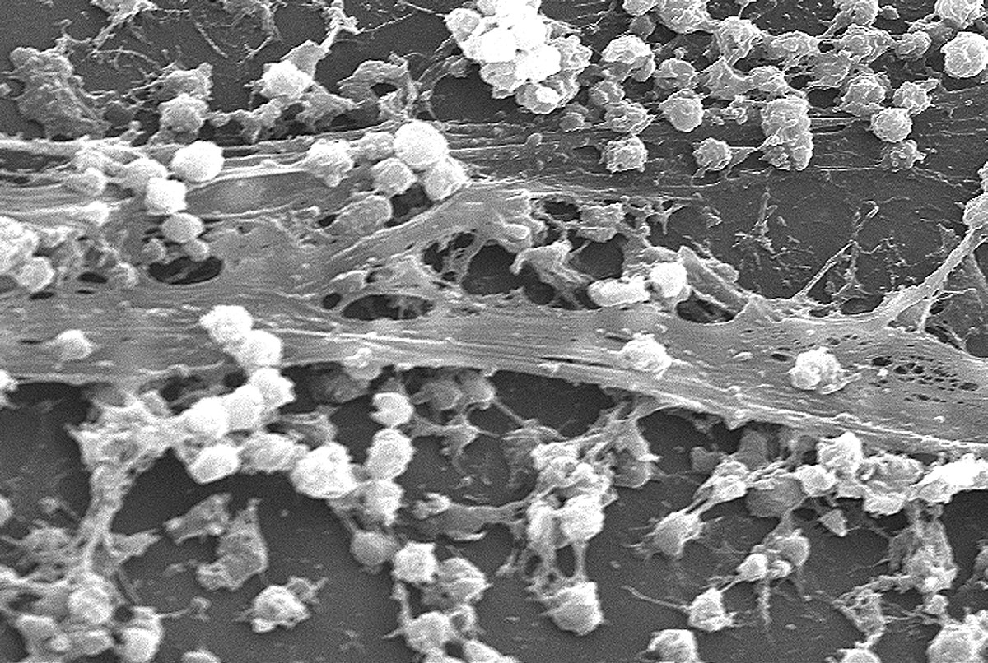
Biofilms
Hu et al. investigated what species were present in these biofilms
All were multi-species
Staphylococcus aureus present in 50% of biofilms
Most common species overall:
  Faecalibacterium prausnitzii
  Massilia timonae
  Stapylococcus aureus
  Coagulase-negative staphylocci
  Pseudomonas species
  Propionibacterium acnes
Hu,H. et al. 2015. Intensive care unit environmental surfaces are contaminated by multidrug-resistant bacteria in biofilms: combined results of conventional culture, pyrosequencing, scanning electron microscopy, and confocal laser microscopy. J. Hos. Infect. 91:35-44
https://www.ncbi.nlm.nih.gov/pubmed/26187533
Notes:
Hu,H. et al. 2015. Intensive care unit environmental surfaces are contaminated by multidrug-resistant bacteria in biofilms: combined results of conventional culture, pyrosequencing, scanning electron microscopy, and confocal laser microscopy. J. Hos. Infect. 91:35-44
https://www.ncbi.nlm.nih.gov/pubmed/26187533

Slide 29
Its Not Just Australia
Others have repeated the studies and found the same thing
Otter JA, et al., Surface-attached cells, biofilms and biocide susceptibility: implications for hospital cleaning
and disinfection, Journal of Hospital Infection (2014), http://dx.doi.org/10.1016/j.jhin.2014.09.008
K. Ledwoch et al. / Journal of Hospital Infection 100 (2018) e47ee56
65 Samples from 3 UK hospitals
Multi-species dry biofilms were recovered from 95% of 61 samples.
Abundance and complexity of dry biofilms were confirmed by SEM.
All biofilms harboured Gram positive bacteria including pathogens associated with HCAI;
58% of samples grew meticillin-resistant Staphylococcus aureus.
Dry biofilms had similar physical composition regardless of the type of items sampled or the ward from which the samples originated.

Slide 30
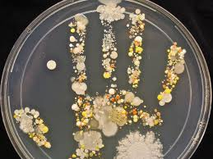
Bacteria in Biofilm Transfers to Healthcare Workers Hands
  Biofilm grown on test strips and allowed to dry
  Biofilm touched with index finger and transferred to agar.
  5.5 and 6.6% of the bacteria were transferred to hands with one touch
  20% were then transferred to agar with one touch
  Overall transfer rate of 1.04 to 1.26%.
  Large numbers of bacteria were transferred by bare hands to multiple fomites
  Sufficient bacteria to cause infection were transmitted up to 19 times following one touch of the Dry Surface Biofilm.
Chowdhury D, et al., Effect of disinfectant formulation and organic soil on the efficacy of oxidizing disinfectants against biofilms, Journal of Hospital Infection (2018), https://doi.org/10.1016/j.jhin.2018.10.019D

Slide 31
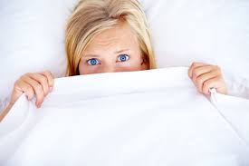
The Sheet is Not a Barrier to Transmission
Cotton sheets act as vehicles of transmission from dry surface biofilm on mattresses.
Between 100 - 1000 bacterial colonies transferred for up to 20 touches.
Thicker sheets transferred less bacteria than thin sheets with less than 100 colonies transferred/touch.
Wetting the Dry Surface Biofilm increased the number of colonies transmitted to ≥1000 bacteria/touch.
Chowdhury D, et al., Effect of disinfectant formulation and organic soil on the efficacy of oxidizing disinfectants against biofilms, Journal of Hospital Infection (2018), https://doi.org/10.1016/j.jhin.2018.10.019D
Notes:
Chowdhury et al, 2018, Transmission of dry surface biofilm (DSB) by and through cotton bed sheets, APIC conference

Slide 32
Registering Disinfectants and Making Efficacy Claims
What works and what does not
Remember : “It is a violation of Federal law to use this product in a manner inconsistent with its labeling. Read the entire label and use strictly in accordance with precautionary statements and directions.”

Slide 33
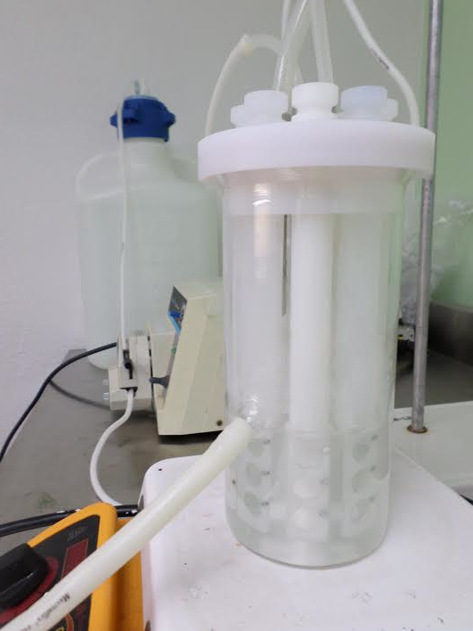
US EPA testing based on ASTM E2871
ASTM E2871 “Evaluating Disinfectant Efficacy Against P. aeruginosa Biofilm Grown in CDC Biofilm Reactor Using Single Tube Method”
Two clinically relevant species
          Staphylococcus aureus
          Pseudomonas aeruginosa
Emphasis on Repeatability & Reproducibility
Biofilms grown in low nutrient and high sheer in a CDC Bioreactor (seen here) to ensure strong biofilms
To qualify: product will need to be a hospital grade disinfectant, and will need to demonstrate efficacy against both S. aureus and P. aeruginosa
The level of efficacy: ≥ 6 Log10 Reduction

Slide 34
Not many disinfectants have passed the EPA Biofilm test to date (October 2023)
The EPA has not yet published a convenient list of products
A ready to use Peroxy acetic acid (PAA) based product that contains four percent hydrogen peroxide (pH 2.5 to 3.0)
A concentrate PAA/H2O2 blend used at 4 oz per gallon for a 10 min kill claim (diluted pH 3.0)
A ready to use 1.4 percent hydrogen peroxide product, spray apply only (pH 2.5)
A ready to use Bleach based product that contains 13,000 ppm of bleach, ~2.5 times the typical 5,250 ppm strength (pH 12.0).
A liquid concentrate that is a combination of quaternary ammonium compounds and hydrogen peroxide, a two part product that is mixed on site generating a final concentration of hydrogen peroxide of 3.1 percent and a quaternary ammonium concentration of 3 percent
A tablet form of sodium dichloroisocyanurate (NaDCC) that contains a surfactant, when dissolved in water the tablet produces a solution of 4306 ppm of hypochlorous acid (pH 6.0 to 7.0).
Products that have not been registered in accordance with the EPA test:
  Bleach at 10:1 dilution (ie 5,250ppm)
  Quaternary ammonium compounds (Quats) concentrates
  Quat Alcohol products
  Alcohol
  Thymoil
  Citric acid products
  Chlorine dioxide
  NaDCC without surfactant
  Phenolic based products

Slide 35
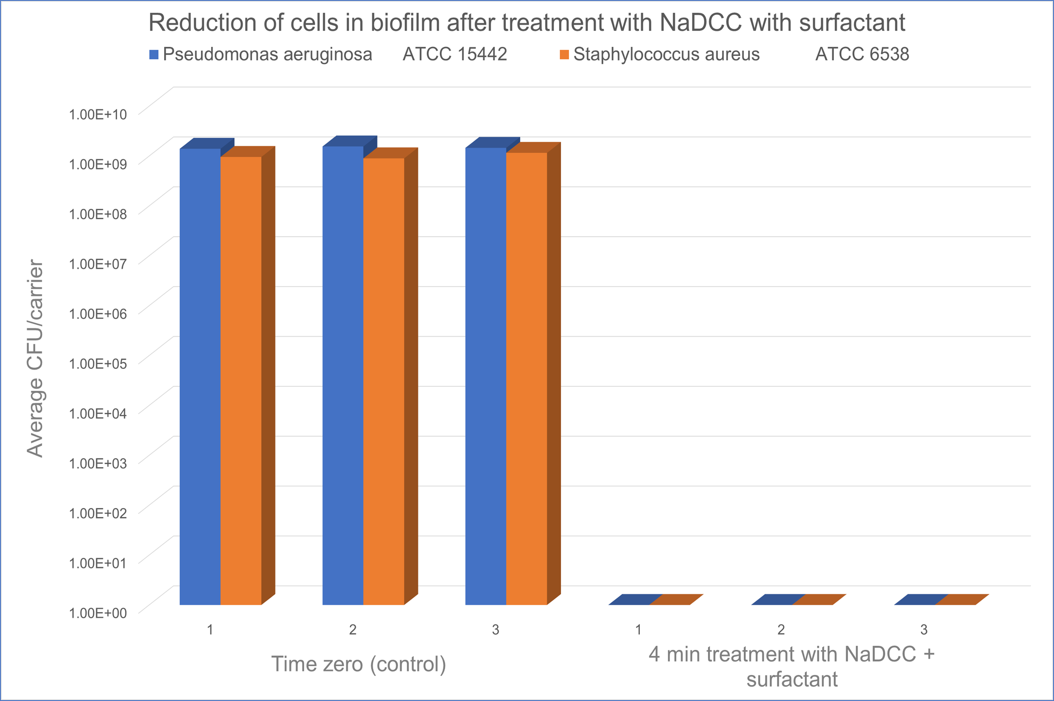
NaDCC plus 2% Surfactant EPA Testing Against Biofilm
Pseudomonas aeruginosa: >8.97 Log₁₀ reduction
Staphylococcus aureus:
>7.79 Log₁₀ reduction

Slide 36
Testing against biofilm 4300 ppm NaDCC + 2% surfactant
Test microorganism | Contact time | Test | Average Log₁₀ CFU/carrier¹ | Average % reduction | Average Log₁₀ reduction
Pseudomonas aeruginosa ATCC 15442 | Time zero | Control | 9.27 | N/A
 | 4 minutes | NaDCC + surfactant | <0.3 | >99.999986% | >8.97
Staphylococcus aureus ATCC 6538 | Time zero | Control | 8.25 | N/A
 | 4 minutes | NaDCC + surfactant | <0.46 | >99.99999% | >7.79
Notes:
¹ The limit of detection for P. aeruginosa was 200 CFU/ml and for S. aureus the limit of detection was 20 CFU/ml. Values below the limit of detection are noted as “not detected” in the table

Slide 37
Dry-surface biofilms and the EPA
No standardised test method available for the evaluation of disinfectants against dry surface biofilms.
The EPA test method looks at Hydrated Biofilm.
Chowdhury et al evaluated disinfectants against simulated DSB (article in press)
          At 1000 ppm NaDCC nearly 3 Log₁₀ reduction
          At 5000 ppm hydrogen peroxide, <1 Log₁₀ reduction
        Its harder to kill bacteria in dry surface biofilm than in hydrated biofilm (the bacteria are not active), if you can’t pass the EPA test for hydrated biofilm the product will not be effective on dehydrated biofilm
        This is not a static situation, add water and dry biofilm becomes hydrated biofilm, we do that once a day in most hospitals.
Notes:
Still see patches of live green cells after treatment

Slide 38
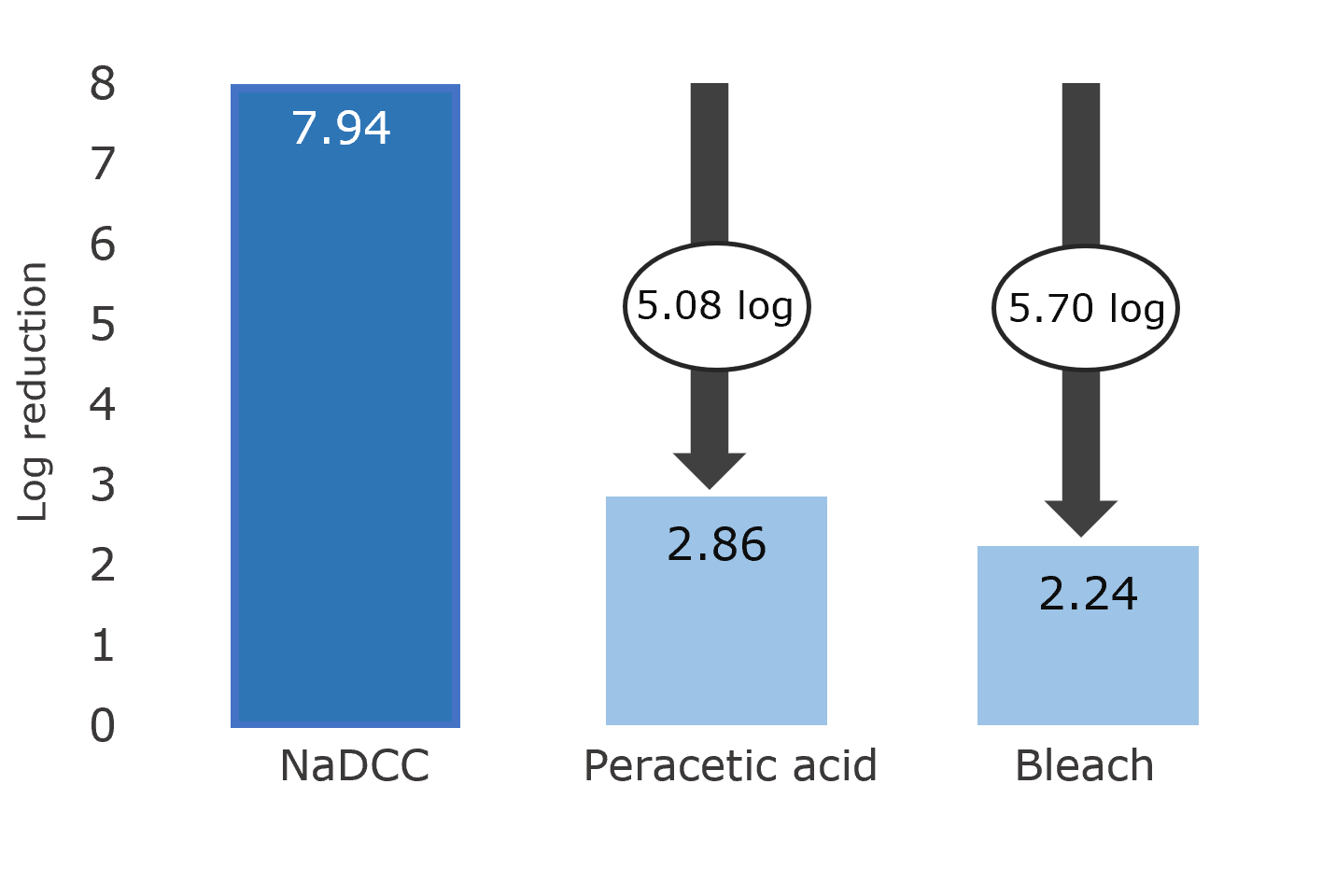
Comparison of Chemical Efficacy Dry Biofilm
At one min NaDCC with surfactant is more effective than 5000 ppm bleach or PAA/H2O2.
Initial Inoculum of Pseudomonas aeruginosa grown in Bioreactor in accordance with ASTM E2562-22 then dried for 48 hours. Dried sample tested to show the presence of 7.94 log, Disinfectants prepped in accordance with EPA registration One min exposure. then neutralized and remaining bacteria counted.
Lalancette C, Charron D, Laferrière C, Dolcé P, Déziel E, Prévost M, Bédard E. Hospital Drains as Reservoirs of Pseudomonas aeruginosa: Multiple-Locus Variable-Number of Tandem Repeats Analysis Genotypes Recovered from Faucets, Sink Surfaces and Patients. Pathogens. 2017 Aug 9;6(3):36. doi: 10.3390/pathogens6030036.

Slide 39
Special Circumstances

Slide 40
2019 novel coronavirus (2019-nCoV).
Von Borowski RG, Trentin DS. 2021. Biofilms and coronavirus reservoirs: a
perspective review. Appl Environ Microbiol 87: e00859-21. https://doi.org/10.1128/AEM.00859-21
Viruses colonize biofilms, phages will attack bacteria and grow, human viruses simply survive within the biofilm.
SARS CoV-2 survival on a dry surfaces increases from 3 to at least 30 days
Biocides and UV are less effective against viruses Including SARS CoV in biofilms
Biofilms present a reservoir of viral particle that can result in patient infection for a period of time after the final case has resolved.
SARS CoV -2 can survive protected in Biofilms for prolonged periods of time > 30 days, protected from environmental stressors and remaining infectious.

Slide 41
Candida auris and biofilm
C. auris produces biofilm on hard surfaces.
Experiment
  Grow C. auris biofilm in bioreactor
  Dehydrate biofilm 24 hours
  Regrow hydrated biofilm 3 times
  Produce a 7 to 8 log dry biofilm
  Expose dry biofilm to 1000 ppm of bleach , neutralize after 5 min exposure
  Regrow biofilm
  Expose dry biofilm to 1000 ppm of bleach neutralize after 5 min exposure
  Regrow biofilm
  Expose dry biofilm to 1000 ppm of bleach neutralize after 5 min exposure.
When the biofilm is first exposed to 1000 ppm of bleach a 5 to 6 log reduction is obtained
The second exposure to 1000 ppm of bleach a 3 to 4 log reduction is obtained
When the same biofilm is treated with 1000 ppm of bleach the third time it produces only a 1 to 2 log reduction C. auris concentration.
Your disinfectant may have an EPA claim against C. auris but unless it also has an efficacy claim against biofilm you will not address the outbreak.
Dry surface biofilm formation by Candida auris facilitates persistence and tolerance to sodium hypochlorite. Alicia Ware, William Johnston, Christopher Delaney, Mark Butcher, Gordon Ramage, Lesley Price, John Butcher, Ryan Kean. /doi.org/10.1101/2023.10.02.560537;

Slide 42
Summary
Prevalent in the hospital environment (Even “Dry” Surfaces)
More resistant to biocides than planktonic cells
Current cleaning and disinfection procedures may not be sufficient to remove/kill dry-surface biofilms
Source of multiple drug resistant organisms
Dry-surface biofilms adds a level of difficulty to risk management of environmental contamination that was not previously recognized
Bacteria in Dry Surface Biofilm can transfer to patients via healthcare workers hands
Dynamic conditions: a dry biofilm can become a hydrated biofilm, just add water
If your disinfectant does not work on bacteria in biofilms you are not Disinfecting

Slide 43
Additional References
Dr Margaret Chan. Combat drug resistance: no action today means no cure tomorrow. World Health Day 2011. World Health Organization: https://www.who.int/mediacentre/news/statements/2011/whd_20110407/en/
Biofilms in medicine. Patients threatened by highly organized militant pathogens. Webinar. 2011. Infection Control Today: http://www.infectioncontroltoday.com/webinars/2011/12/biofilms-in-medicine--patients-threatened-by-highly-organized-militant-pathogens.aspx
Kim H. et al. 2007. Effectiveness of disinfectants in killing Enterobacter sakazakii in suspension, dried on the surface of stainless steel, and in a biofilm. Appl Environ Microbiol. 1256-65 : https://www.ncbi.nlm.nih.gov/pubmed/17172461
Almatroudi A et. al. 2016. Staphylococcus aureus dry-surface biofilms are not killed by sodium hypochlorite: implications for infection control. J Hosp Infect. 93(3):263-70, https://www.ncbi.nlm.nih.gov/pubmed/27140421
Miller MB et al. 2001. Quorum sensing in bacteria. Annu Rev Microbiol. 55:165-99. https://www.ncbi.nlm.nih.gov/pubmed/11544353
K. Vickery et al. 2012. Presence of biofilm containing viable multi resistant organisms despite terminal cleaning on clinical surfaces in an intensive care unit. J. Hos. Infect. 80:52-55. https://www.journalofhospitalinfection.com/article/S0195-6701%2811%2900319-7/abstract
Hu,H. et al. 2015. Intensive care unit environmental surfaces are contaminated by multidrug-resistant bacteria in biofilms: combined results of conventional culture, pyrosequencing, scanning electron microscopy, and confocal laser microscopy. J. Hos. Infect. 91:35-44, https://www.ncbi.nlm.nih.gov/pubmed/26187533
Chowdhury D, et al., Effect of disinfectant formulation and organic soil on the efficacy of oxidizing disinfectants
against biofilms, Journal of Hospital Infection (2018), https://doi.org/10.1016/j.jhin.2018.10.019D

Slide 44
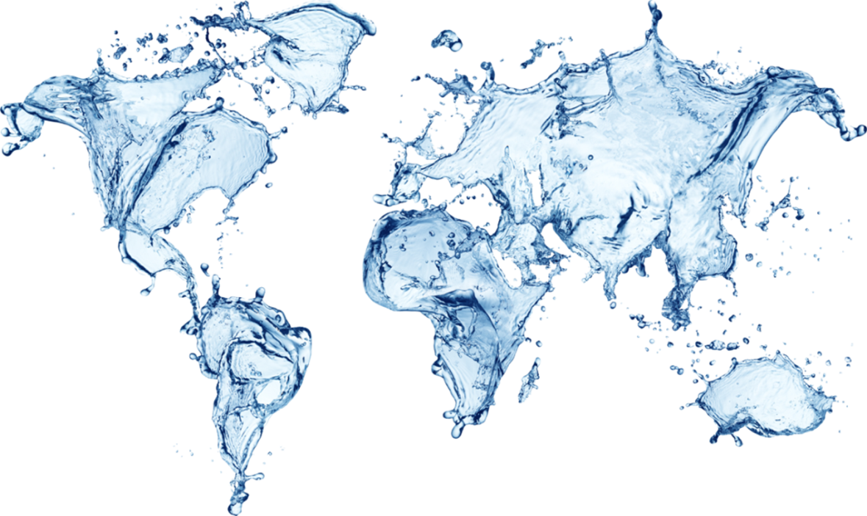
Thank You

