Slide 1
April 10, 2024 – 12:00 PST

Slide 2
Meeting Sponsored by:
Steve Jensen
sjensen@perfectclean.com
In-Person Lunch Networking… Will return at 1:00pm PST

Slide 3
Introductions & Recognitions
New Members or Visitors
New CIC certifications or re-certifications

Slide 4
Old Business Jarrod Becasen
‼
March minutes
Community Outreach w/ Team Aryeh
Volunteers <12
Vendor fundraiser goal $500
AB draft amendment language (not currently sponsored)

Slide 5
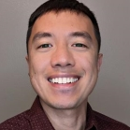
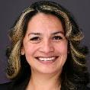
Tina Foudy (3M) Vendor Liaison
Margaret “Maggie” Turner, M.Ed., FAPIC (CIC), PHN, BSN, RN Immediate Past President
Fernando Ipanaque (Kurin, Inc.) Vendor Liaison
Kim Delahanty, BSN, PHN, MBA/HCM, CIC, FAPIC Legislative Representative
Kristyn Schumacher BSN, RN, PHN, CIC, VA-BC Treasurer
Frank Edward Myers III, M.A., CIC, FAPIC President Elect
Claudia Sanchez Goad, RN, CCM, CIC Nominating & Awards Chair & Committee
Margaret ”Maggie” Marlatt, BSN, RN, PHN Secretary
Lisa Mattia, BSN, RN, CIC Nominating & Awards Committee
Jarrod Becasen, MPH, CIC President
Kyle Mataya, RN, CIC, LTC-CIP, CRCST Education Committee
Latrice Jackson-Washington, MPA, BSHS Social Chair & Committee
Kai A. Bryant, MPH, CLS, CIC, CHSP, LSSBB Education Chair & Committee
Heidi Campas-Higgins, RN, BSN Social Committee
Christian B. Andaya, RN, BSN, CIC Social Committee
Liz Jefferson, B.S., Ph.D., CIC Membership Chair

Slide 6
2024 Chapter Goals
Elevate Infection Preventionists as essential advocates, leaders, and experts
Increase member certification (CIC®, a-IPC™, LTC-CIP) by 5% from December 2023 within 1 year
Foster development of the next generation infection prevention and control workforce
Improve LTC IP membership and engagement through educational outreach and chapter representation
Host a infection prevention educational conference to provide continuing education and network with industry partners by September 2024
Host a virtual infection prevention educational webinar geared towards California SNF & LTCF IPs by November 2024

Slide 7
New Business Jarrod Becasen
APIC Strategic Partners Leadership Forum Member Survey – April 25
Chapter Conference Planning Committee
Theme: “Beat the Odds Against Infections”
SAVE-THE-DATE: September 20, 2024
Pechanga Resort Casino Temecula, CA
Board voted brokerage acct. withdrawal $13k for ESAs, Summer, and Conference Deposit
Health Advisory Updates
Candida auris in San Diego County
Measles
Tuberculosis
Healthcare Sterile Processing Association (HSPA) Conference [register]
DATES: April 21-23, 2024 (Pre-Conference Events starting April 20)
LOCATION: Las Vegas, Nevada, Caesars Forum

Slide 8
Membership Report Liz Jefferson - excused
Membership Update (4/4/24)
Total Members | 153
Active Members | 110
Associate Members | 43
CIC Certified | 54
Welcome New Member:
Shane Sullivan – VP of Sales at Nephros Inc.

Slide 9
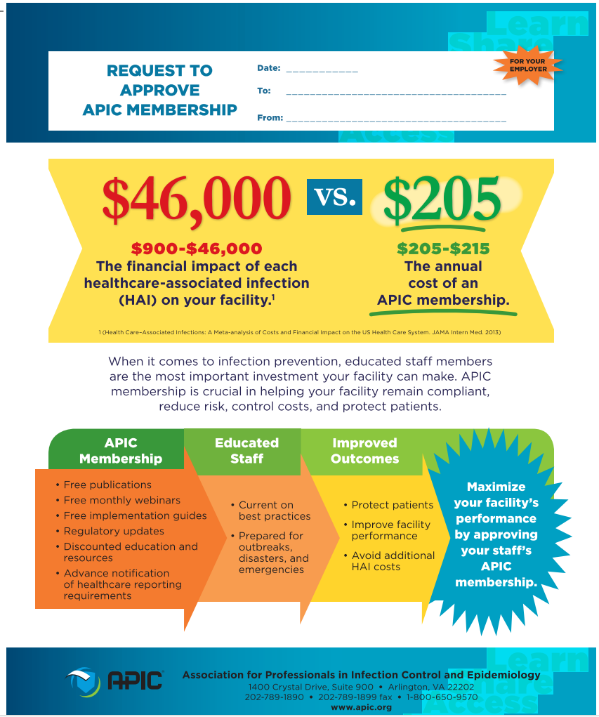
Membership Justification Document

Slide 10
Treasurer Report Kristyn Schumacher

Slide 11
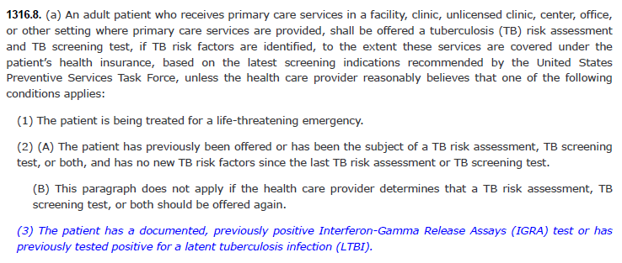
Legislative Report Kim Delahanty - Excused
CLR reports in new website location
AB 2132 (blue = added language)

Slide 12
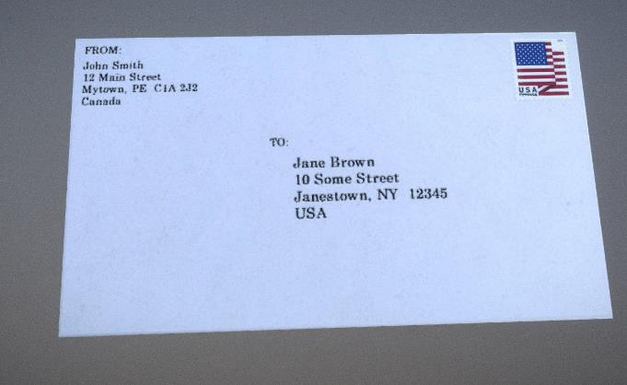
APIC Advocacy
Coalition Letters:
Letter supporting the Public Health Loan Repayment Program and the Bio-Preparedness Workforce Pilot Program.
American Statistical Association letter supporting increased funding for the National Center for Health Statistics
Data: Elemental to Health letter supporting the Data Modernization Initiative and the Center for Forecasting and Analytics.
CDC Coalition letter supporting $11.6 billion in topline funding for the CDC.

Slide 13
Become an APIC Virtual Advocate!
Virtual Advocacy
Scan QR code to access the virtual advocacy network!
APIC is searching for new virtual advocates!
Should take less than 2 minutes to fill out.
Opportunity for meetings with your legislative members to influence change on the state and local level!
APIC staff will provide talking points throughout the process and be available for any questions!

Slide 14
Invite Us to a Chapter Meeting!
Chapter Meetings
APIC Public Policy staff would love an opportunity to update your chapter on the lasting policy items
Reach out to Rosha (rchowdhury@apic.org) or Rich at (rcapparell@apic.org) to learn more
Thank you to the chapters that have reached out so far this year

Slide 15
State Update

Slide 16
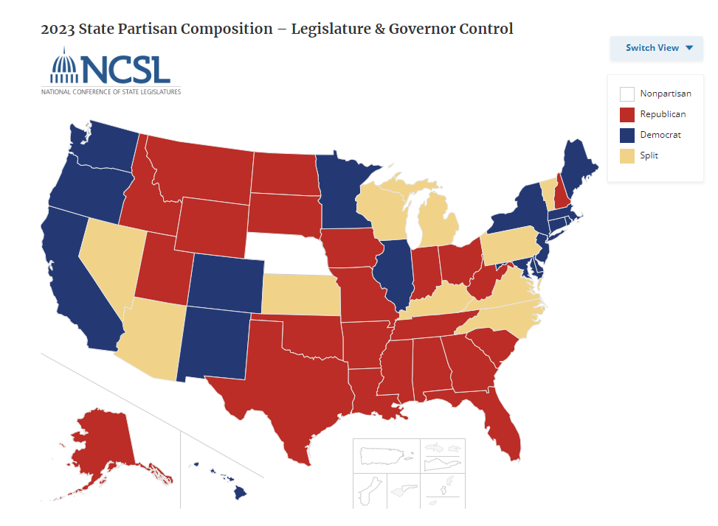
State Advocacy
State legislative sessions coming to an end:
Florida – 3/8
Georgia – 3/28
Idaho – 3/29
Indiana – 3/8
Iowa – 4/16
Kentucky – 4/15
Maine – 4/17
Maryland – 4/8
Nebraska – 4/18
New Mexico – 2/15
Oregon – 3/7
South Dakota – 3/25 (ENDS TODAY)
Utah – 3/1
Virginia – 3/9
Washington – 3/7
West Virginia – 3/9
Wisconsin – 3/12
Wyoming – 3/8

Slide 17
Federal Update

Slide 18
Current State of Appropriations – FY 2024
Federal Environment
Finally passed all bills for FY 2024
March 9 - VA, Transportation, State etc.
March 23 – 70% of discretionary spending including Defense and Labor-HHS
Most of our priorities were flat funded
One of the latest budgets in the modern era – this was supposed to be in place October 1st of last year
On to FY 2025!

Slide 19
FY 2024 Appropriations
Funding Level | FY 2025 President Budget | FY 2024 | FY 2023
Advanced Molecular Detection | $40M | $40M | $40M
Agency for Healthcare Research and Quality | $387.3M | $369M | $373.5M
Antibiotic Solutions Resistance Initiative | $207M | $197M | $197M
Center for Forecasting and Outbreak Analytics | $50M | $50M | $55M*
Centers for Disease Control and Prevention | $9.683B | $9.2B | $9.2B
Department of Health and Human Services | $130.7B | $127.3B | $117.5B
Epidemiology and Laboratory Capacity | $40M | $40M | $40M
Healthcare-Associated Infections | $12M | $12M | $12M
National Healthcare Safety Network | $24M | $50M | $24M
Federal Environment

Slide 20
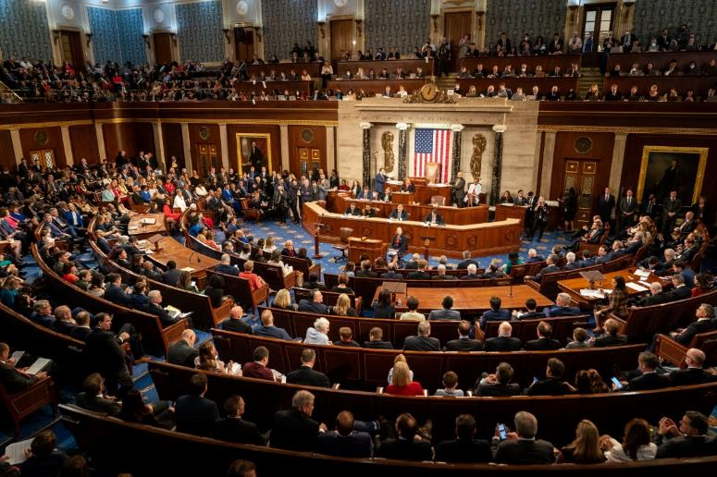
118th Congress
Government Affairs and Practice Guidance Update
APIC Federal Priorities
Representative Kay Granger is stepping down from the Appropriations Committee
Representatives Mike Gallagher (April 19) and Ken Buck (March 22) departures make an even thinner majority
Senate Minority Leader McConnell leaving leadership
Representative Marjorie Taylor Greene filed a motion to vacate the Speaker

Slide 21
Nominating & Awards Report Claudia Sanchez Goad & Lisa Mattia
Chapter Standard Award
The Chapter Standard Award recipient receives up to $500 in reimbursement for registration, travel, lodging and other event related expenses following attendance, including educational material for infection prevention.
Awards cannot be used for CIC exam or recertification fees. May be used for study guides or preparation expenses.
Eligibility:
Active participant in the chapter for at least 1 year
Term of award: January 1, 2024 to June 30, 2025
Award Amount: $500.00
Number of awards: 3
Application due date: December 31 2024

Slide 22
Nominating & Awards Report Claudia Sanchez Goad & Lisa Mattia
National APIC Conference Award
The National APIC Conference Award recipient receives up to $2,000 in reimbursement for registration, hotel, and travel expenses for the National APIC Conference.
Eligibility:
Active participant in the chapter for at least 1 year
An APIC member for at least 1 year preceding application and must be an active or lifetime member for the application year.
Certified in Infection Prevention by the Certification Board of Infection Control and Epidemiology (CBIC) unless certification has lapsed following retirement.
Term of award: APIC Annual Conference 2024, San Antonio, Texas June 3-5.
Award Amount: $2000.00
Number of awards: 1
Application due date: May 26, 2024
*Recipient will be notified a week after deadlines or as soon as administratively possible.

Slide 23
Education Report kai Bryant & Kyle Mataya

Slide 24
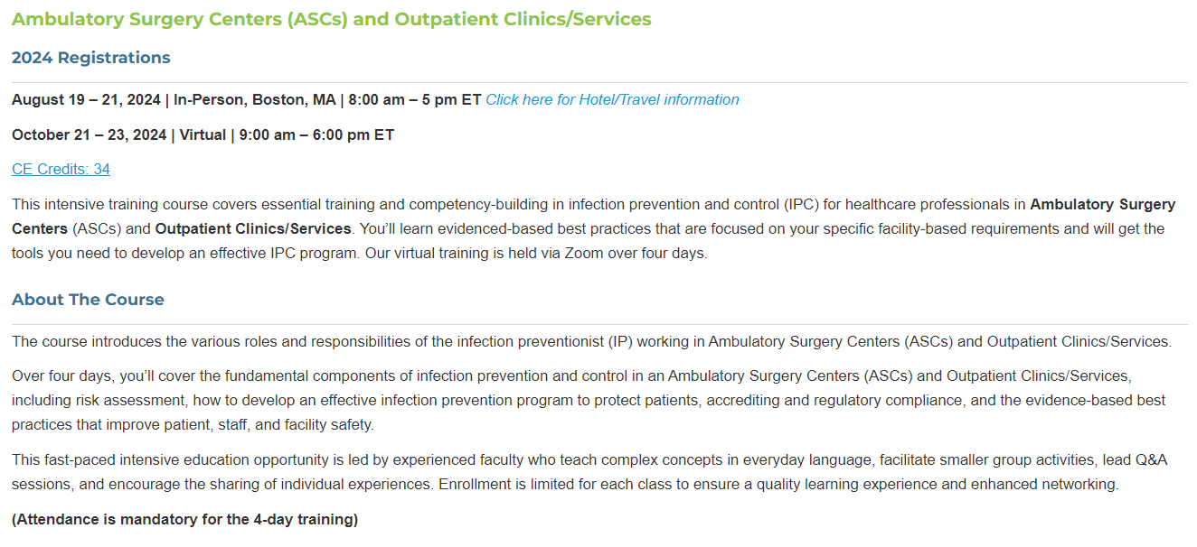
Education Report kai Bryant & Kyle Mataya
https://apic.org/course/ambulatory-surgery-centers/

Slide 25
Education Report kai Bryant & Kyle Mataya
https://kentuckyiptraining.com/?page_id=9239

Slide 26
Education Report kai Bryant & Kyle Mataya
https://www.avainfo.org/general/custom.asp?page=FutureEvents

Slide 27
Social Report Latrice Jackson-Washington, Heidi Campas-Higgins, Christian Andaya

Slide 28
HAI Liaison & Advisory Report Maggie Turner, Deweese Quigley

Slide 29
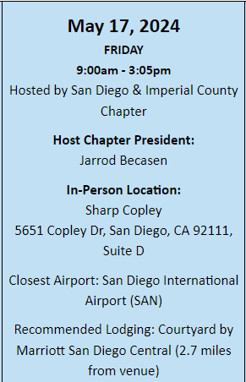
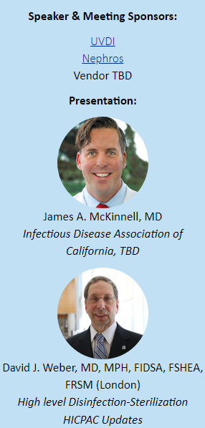
CA APIC Jessica Alicdan, Jarrod Becasen
Meeting schedule posted
https://community.apic.org/cacc/events/meetings
Joint Chapter Education Schedule
https://community.apic.org/cacc/events/jointchapter
Foundations Planning Committee
CA APIC – 4x $500, 2-3x $1,000

Slide 30
IDAC Report Lisa Kilgore
https://idac.org/
IDAC 38th Annual Southern California Symposium
July 13-14, 2024 7:30 AM Huntington Beach Hyatt Regency
$400.00++
Hospital Onset Bacteremia and Peripheral IV Surveillance - Jessica Alicdan, MPH, CIC

Slide 31
GERM Commission Report Frank Myers
San Diego County Medical Society Group to Eradicate Resistant Microorganisms Commission
http://www.sdcms.org/about-sdcms/committees-commissions/sdcms-germ-commission.aspx
Meets: Quarterly (February, May, August, November)

Slide 32
Long Term Care Lisa Kilgore
CMS Implements Enhanced Barrier Precautions Effective April 1, 2024
https://www.ahcancal.org/News-and-Communications/Blog/Pages/CMS-Implements-Enhanced-Barrier-Precautions-Effective-April-1-2024.aspx
https://www.cms.gov/files/document/qso-24-08-nh.pdf
CDC Train - TRAIN is a national learning network that provides thousands of quality training opportunities to more than 2 million professionals who protect and improve the public's health.
CDC Train – Take Action: New email processes take effect April 16, 2024
TRAIN is updating the email verification process to enhance identity confirmation, security, and protection from fraud and spam
Ensure the email address in your account profile is up to date so you can access TRAIN
This announcement includes instructions for accessing your profile
https://www.ahcancal.org/Pages/default.aspx American Health Care Association (AHCA) / National Center for Assisted Living (NCAL)
Home - CDC TRAIN -
About - CDC TRAIN -

Slide 33
Ambulatory Care Janessa Esteban

Slide 34
Pediatric Care Rady Children's

Slide 35
County Epidemiology Grace Kang & Mara Rauhauser

Slide 36
Announcements, Questions, & Comments
Survey preparedness, Survey experiences
Announcements
New Positions in San Diego or Imperial County
Questions/Round Table Discussion
Next Hybrid Meeting: May 8, 2024

