Slide 1

Welcome
August 13th 2025 – 12:00 pm PST

Slide 2





Online Participant Reminders
This meeting will be recorded
Presentation slides are available on our Meetings page
Please stay muted during the educational presentation and do not put us on hold if you are calling in on a phone line
Type in any questions or comments in the chat
CEUs will be provided after completion of speaker evaluation - a link will be shared at the end of the meeting

Slide 3



Meeting Sponsored by:

Slide 4
Introductions & Recognitions
New members
New certifications or re-certifications
First time attendees

Slide 5
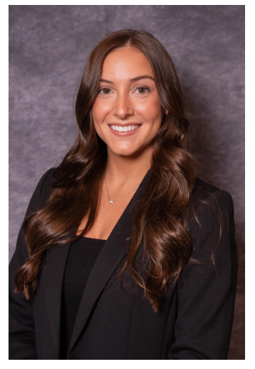

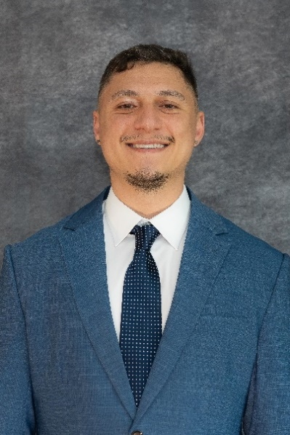
Early bird ends Sept 12

Slide 6
Old Business
April and May minutes approval

Slide 7
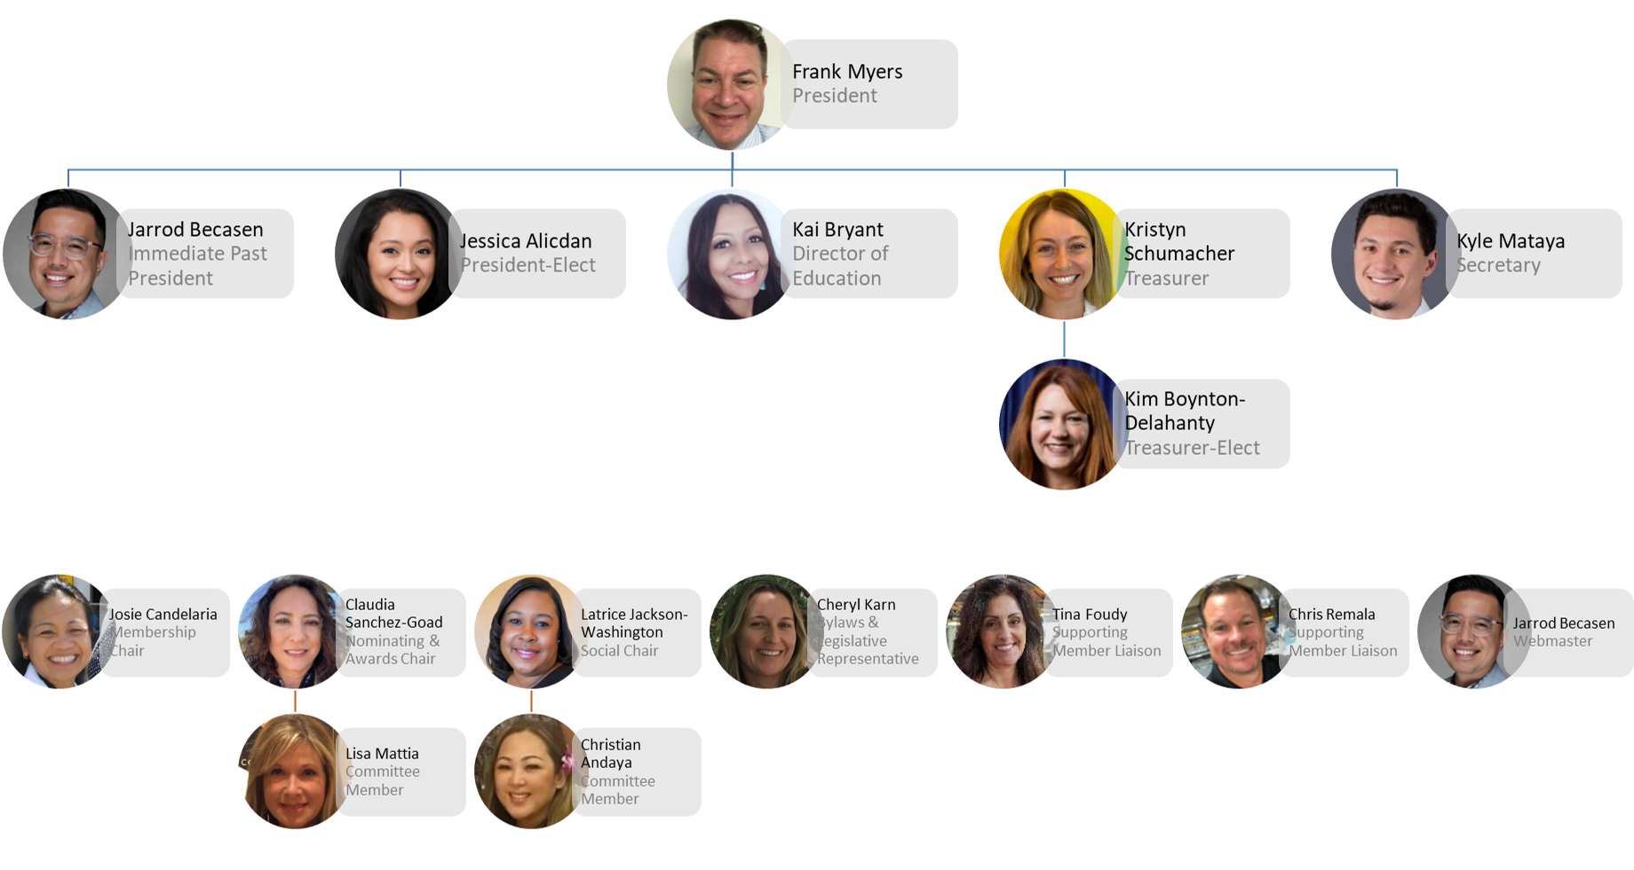

Slide 8
New Business
Frank Myers
Conference
  Vendor Support
  Register now
October Meeting-Yes
Bloodborne Pathogens- Jessica Alicdan
Sydney Hayward-Phigenics- Happy Birthday
Today’s Roundtable
Awards

Slide 9
Membership Report
Josie CandelariA
135 members as of 8/1/25
98 full/active members
37 associate/supporting members
49 members with CIC
2 members LTC-CIP

Slide 10
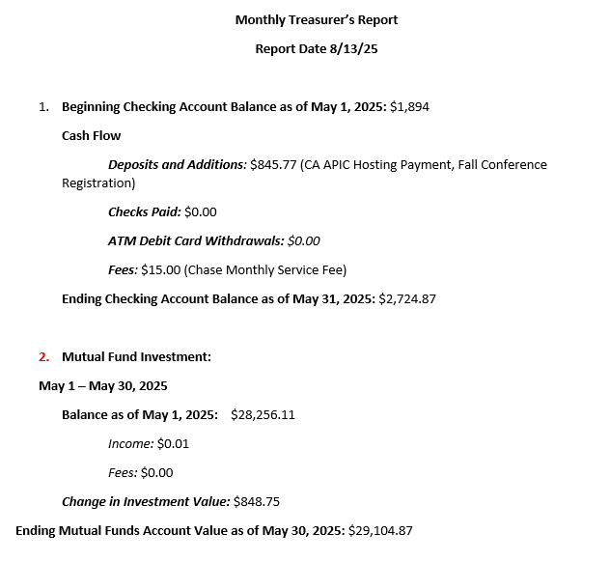
Treasurer Report
Kristyn Schumacher, Kim Delahanty

Slide 11
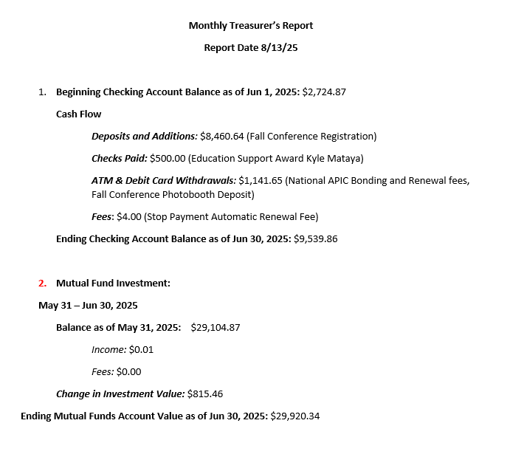
Treasurer Report
Kristyn Schumacher, Kim Delahanty

Slide 12
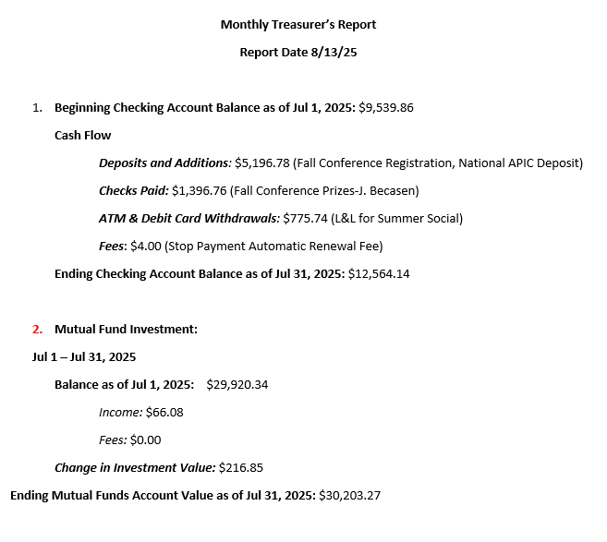
Treasurer Report
Kristyn Schumacher, Kim Delahanty

Slide 13



Nominating & Awards Report
Claudia Sanchez Goad & Lisa Mattia
IP Award Recognitions
&
2026 SD APIC Chapter BOD
Nominations and Voting
Start in August 2025
DUE BY November 19th.
Google form will be emailed with the link to the form for both
Please recommend an IP for Award/ and nominate if you are interested in serving on the 2026 BOD.

Slide 14
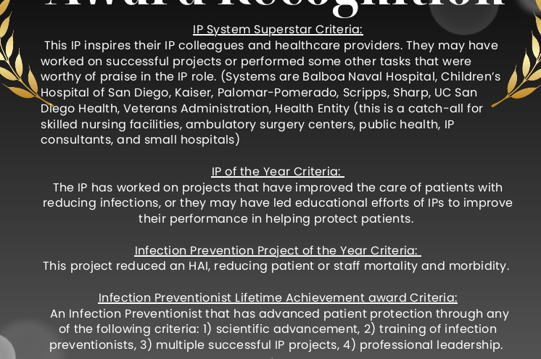

Nominating & Awards Report Claudia Sanchez Goad & Lisa Mattia
An email will be sent to Committee with the Google Form to start Nominations.
We encourage everyone to to nominate either a colleague or yourself ☺
Anticipated END date is NOV 19th.
Awards will be announced at our Winter Holiday Party

Slide 15
Nominating & Awards Report Claudia Sanchez Goad & Lisa Mattia
              NOMINATE
              2026 Chapter Board of Directors and Committees
              OPEN: Education Chair (1)
              Membership Chair (1)
              Social Chair (1)
              Nominating Chair (1)
              Committee Members for each are voluntary. Please complete the Nomination Form if you are interested in serving
              Please complete nomination forms by OCT 1, 2025
              VOTING will start OCT –NOV 2025

Slide 16
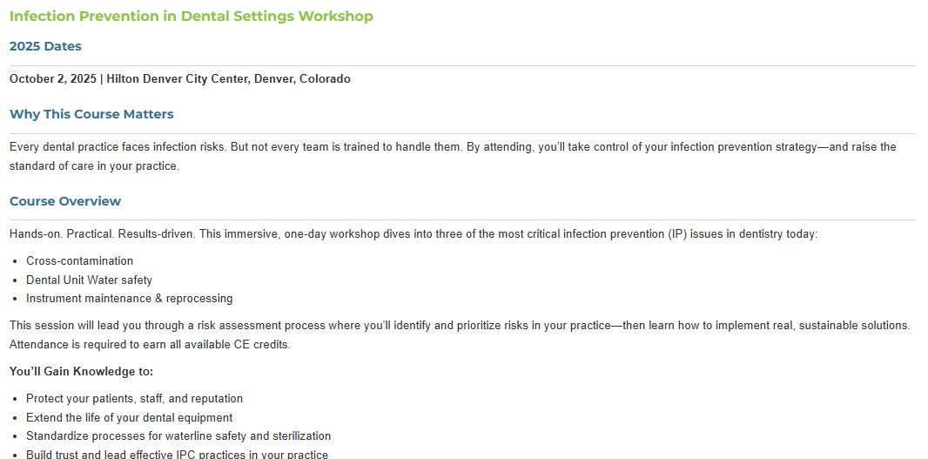

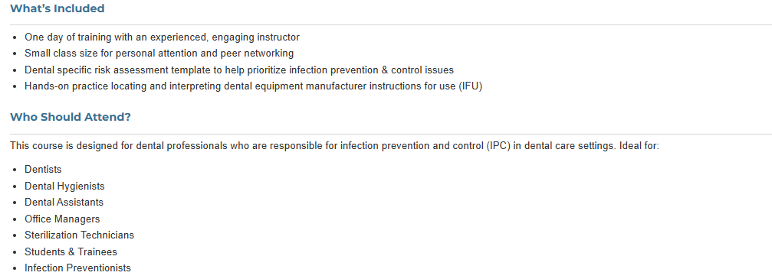
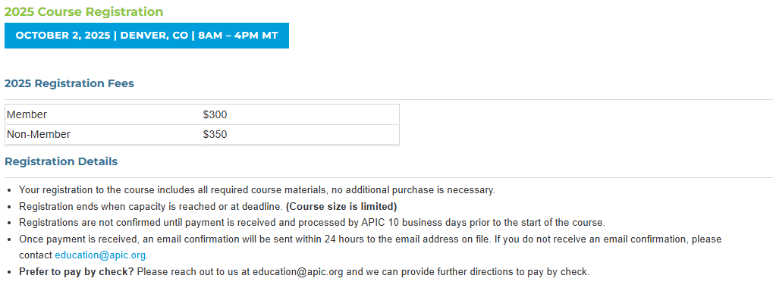
Education Report kai Bryant
https://apic.org/course/infection-prevention-in-dental-settings/

Slide 17
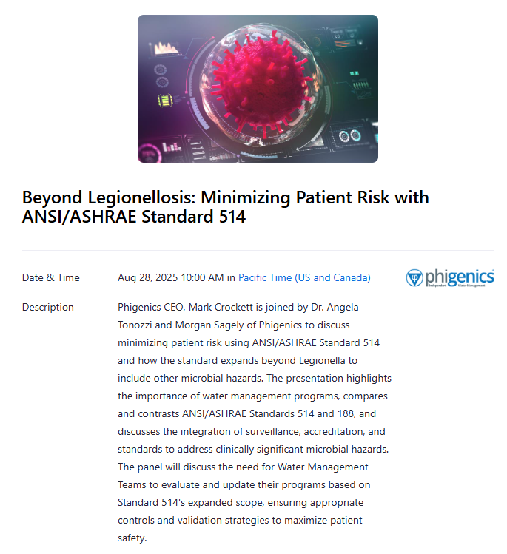
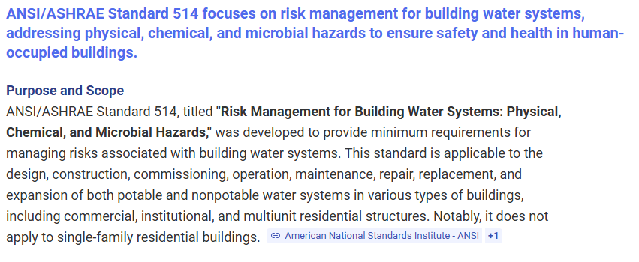
Education Report kai Bryant
https://phigenics.zoom.us/webinar/register/7917527912799/WN_ns2uM3NJS8e5VG7Gzxty2w#/registration

Slide 18

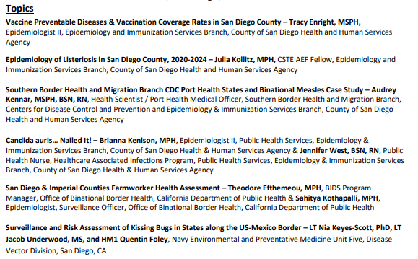
Education Report kai Bryant
RSVP for the 8th Annual Communicable Disease Meeting

Slide 19

Legislative Rep Report
Cheryl Karn

Slide 20

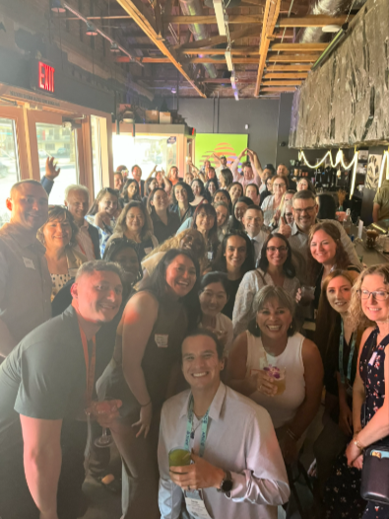
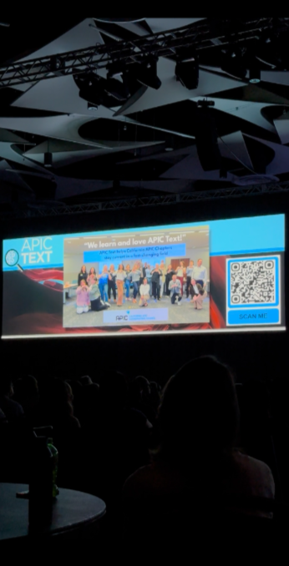
CA APIC Coordinating Council
Jessica Alicdan

Slide 21


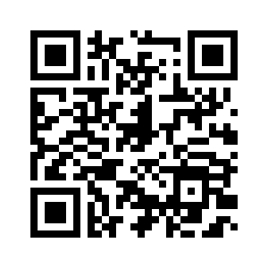
https://forms.gle/GDY4tTtfZtWBrUVQ7

Slide 22

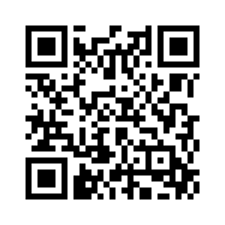

Board of Directors Open Positions
Starting January 2026:
Two Directors – 3 year commitment
Vendor Liaison – 2 year commitment
Now Accepting Applications: California APIC Board of Directors – Open Positions!
Deadline to apply: October 10, 2025

Slide 23

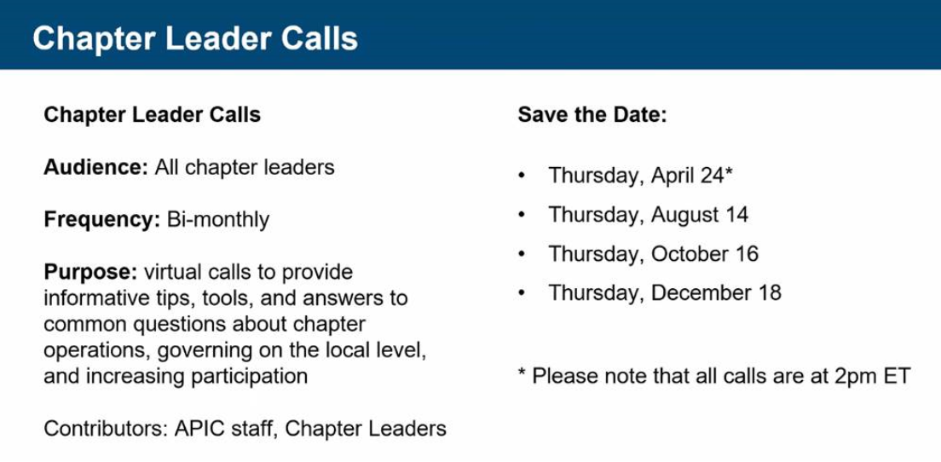
Alignment strategy Report
Jessica Alicdan
National APIC
Expect a voluntary survey soon for California Chapter Leaders to help communicate needs and challenges to National APIC

Slide 24


Pilot Mentorship Program
Total: 54 APIC members for cohort 1
18 Mentors and 36 Mentees
Notes:
Total enrollment: 72
37 confirmed
5 known IPs but no APIC number
34 are not APIC members or did not find in roster
Self validation to 25 candidates
18 mentors
36 mentees
1:2/1:3 Matching ratio
Total: 54 APIC members for cohort 1
Lessons Learned
Use CACC G-drive to create survey for board member access
Drop down selection for clean data
Require APIC number inclusion
Created a video overview of expectations

Slide 25
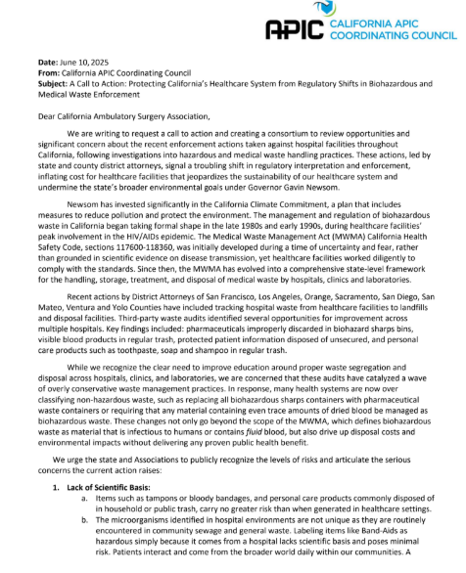
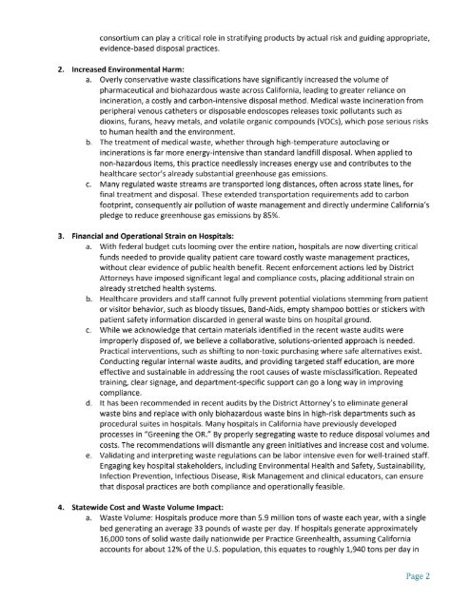
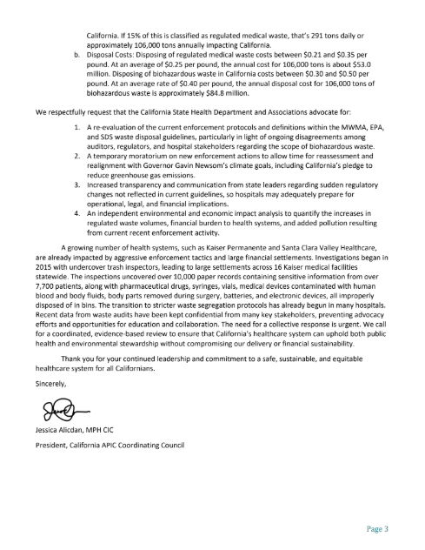
Red biohazard waste process letter
Sent to CDPH, CASA, CHA and APIC
Notes:
Next Steps:
Send to CACC BOD for review and approval via email (voting poll)
Schedule a meeting with Lisa Tomlinson and Nancy Hailpern. Send letter and problematic IFUs are being reviewed by the Public Policy Committee

Slide 26




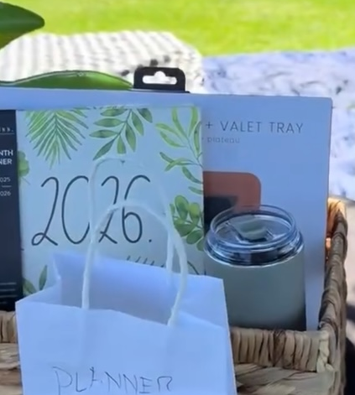
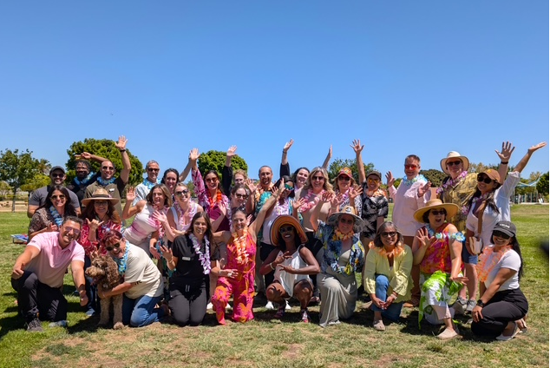
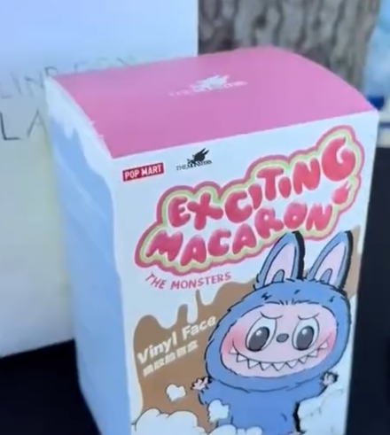
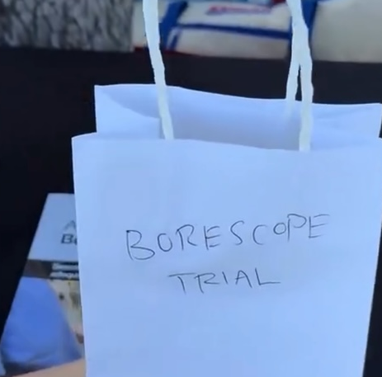
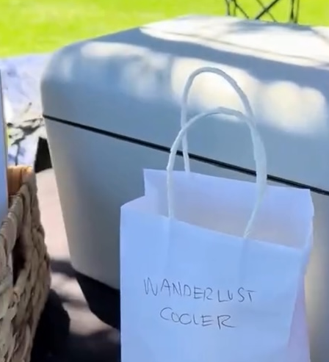
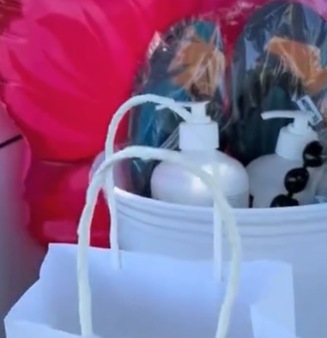
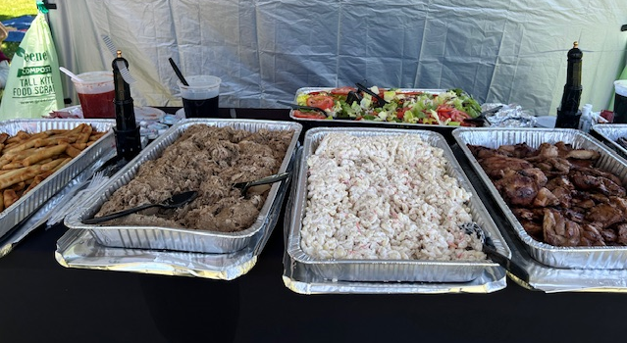
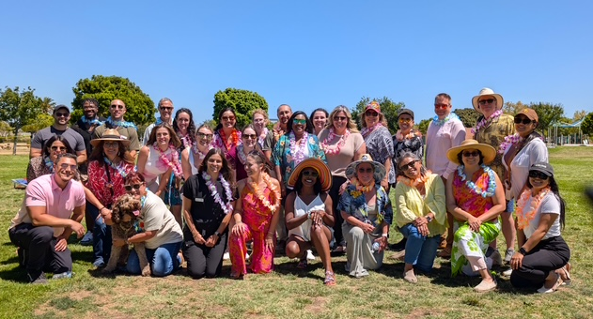
Social Report
Latrice Jackson-Washington, Christian Andaya
Summer Social 2025

Slide 27
HAI Liaison & Advisory Report
Maggie Turner, Deweese Quigley

Slide 28
Infectious Disease Association of CA

Slide 29
G.E.R.M. Commission
Frank Myers

Slide 30
Long Term Care
Lisa Kilgore

Slide 31
Ambulatory care
Janessa Esteban

Slide 32
Pediatric care
Rady Children's

Slide 33
County epidemiology
Grace Kang & Mara Rauhauser

Slide 34
Announcements/roundtable
Announcements
  Survey preparedness, Survey experiences
Questions/Round Table Discussion
Adjournment
Next Meeting: September 10

Slide 35

Train wreck of the month
Lessons learned, what worked?, what didn’t? Open, off-record, safe space, no-judgment discussion

