Slide 1

Welcome
November 12th 2025 – 12:00 pm PST

Slide 2





Online Participant Reminders
This meeting will be recorded
Presentation slides are available on our Meetings page
Please stay muted during the educational presentation and do not put us on hold if you are calling in on a phone line
Type in any questions or comments in the chat
CEUs will be provided after completion of speaker evaluation - a link will be shared at the end of the meeting

Slide 3



Meeting Sponsored by:

Slide 4
Introductions & Recognitions
New members
New certifications or re-certifications
First time attendees

Slide 5
Old Business
August and September minutes approval

Slide 6


Slide 7
New Business
Frank Myers
Holiday party

Slide 8



Nominating & Awards Report
Claudia Sanchez Goad & Lisa Mattia
IP Award Recognitions
&
2026 SD APIC Chapter BOD
Voting
DUE BY November 14th.

Slide 9

Nominating & Awards Report Claudia Sanchez Goad & Lisa Mattia

Slide 10
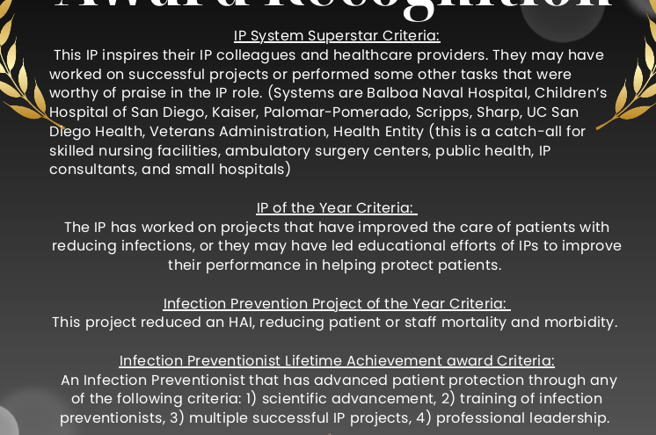

Nominating & Awards Report Claudia Sanchez Goad & Lisa Mattia
10/24/25 email sent to SDIC APIC Chapter with Google Form to VOTE
We encourage everyone to to nominate an IP
Anticipated END date is NOV 19th.
Awards will be announced at our Winter Holiday Party
2025 SD APIC IP Recognition Awards Nomination Form
2025 SD APIC IP Recognition Awards Nomination Form

Slide 11


Social Report
Latrice Jackson-Washington, Christian Andaya
Holiday Charity Event 2025

Slide 12
Treasurer Report
Kristyn Schumacher, Kim Delahanty

Slide 13
Treasurer Report
Kristyn Schumacher, Kim Delahanty

Slide 14
Membership Report
Josie CandelariA
132 full/active members as of 11/5/25
57 members with CIC
40 associate/supporting members
3 members LTC-CIP
2 members with a-IPC (Associate-Infection Prevention & Control

Slide 15

Legislative Rep Report
Cheryl Karn
Reporting Requirements​
  CA Senate Bill 504 – Enacted, last action 10/13/2025​
    HIV Reporting​
      Requires reporting agencies to comply with requests for additional information about HIV cases already reported to local / state health departments​
      Ensures knowledge of trends in current HIV epidemic and allows California to remain competitive for federal funding for HIV / AIDS​
APIC Action​
  Nothing new posted since last update​
  https://www.votervoice.net/APICorg/home

Slide 16
Ambulatory care
Janessa Esteban

Slide 17
HAI Liaison & Advisory Report
Maggie Turner, Deweese Quigley

Slide 18
Infectious Disease Association of CA

Slide 19
G.E.R.M. Commission
Frank Myers

Slide 20
Long Term Care

Slide 21
Pediatric care
Rady Children's

Slide 22
County epidemiology
Grace Kang & Mara Rauhauser

Slide 23
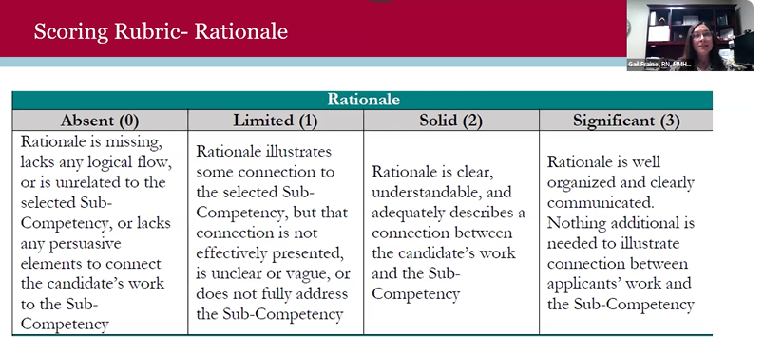
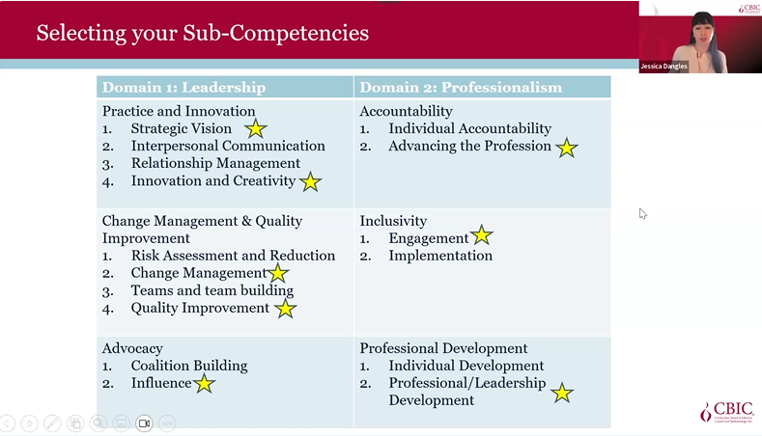
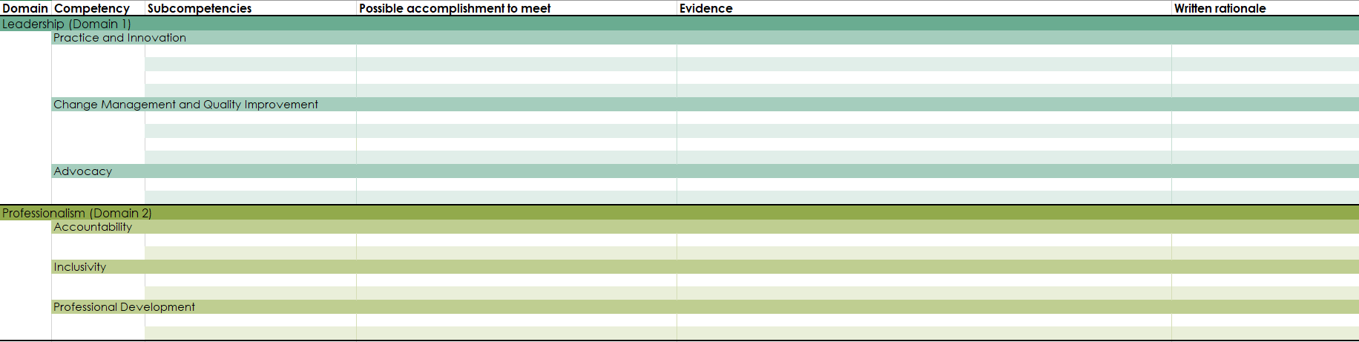
AL-CIP Guidance
Eligibility Requirements
1. Demonstrated positive impact on the profession: Active engagement and advanced infection prevention and control practice, leadership, education, research, policy and/or advocacy for a recommended minimum of 5-10 years
2. Active CIC® and/or LTC-CIP® certification
Role and Context:
Bullet
Bullet
Indicators Demonstrated:
Bullet
Bullet
Outcomes:
Bullet
Bullet
My Contributions:
Bullet
Bullet
Handbook review before starting:
https://www.cbic.org/CBIC/PDFs/AL-CIP-Candidate-Handbook_Corrected-6.27.2025.pdf
1,000 words minimum essay format for each sub-competency per domain. Submit min 6 and max 8 pieces of evidence in word, PDF, PPT format only.

Slide 24

CA APIC Coordinating Council
Jessica Alicdan
Elected Directors CACC Board 2026
Kristyn Schumacher, BSN, RN, PHN, CIC, VA-BC
San Diego & Imperial County Chapter

Slide 25


CA APIC Coordinating Council
Jessica Alicdan
For Chapter Leaders
10 minutes to complete

Slide 26


Education needs assessment 2026
CA APIC Coordinating Council
Jessica Alicdan

Slide 27



https://forms.gle/GDY4tTtfZtWBrUVQ7

Slide 28


Lessons Learned from legislative day events
Lessons learned over the years:
Representatives and senators may not be present on Fridays, which is why we propose visits on a Wednesday for high engagement
Start booking your appointment and call your representatives in advance for an in-person discussion so we are not randomly cold calling
Find your local representative in California: https://findyourrep.legislature.ca.gov/
Guidance: A file is being developed with tools and videos for new participants
    The VIP toolkit includes:
      Tips for planning a legislative visit
      Tips for deciding which legislators to meet with
      Tips for preparing materials
      Sample planning timeline
      Sample meeting request letters
      Sample talking points
      Sample follow-up letters

Slide 29

National APIC Chapter Leader Day
Jessica Alicdan

Slide 30
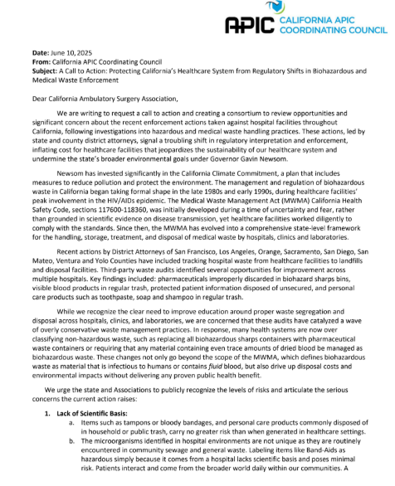
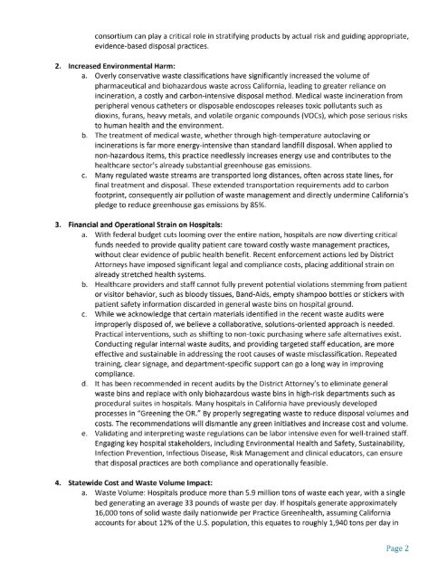
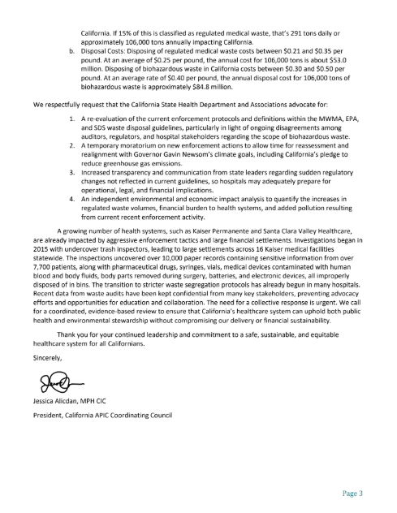
Red biohazard waste process letter
Sent to CDPH, CASA, CHA and APIC
Notes:
Next Steps:
Send to CACC BOD for review and approval via email (voting poll)
Schedule a meeting with Lisa Tomlinson and Nancy Hailpern. Send letter and problematic IFUs are being reviewed by the Public Policy Committee

Slide 31
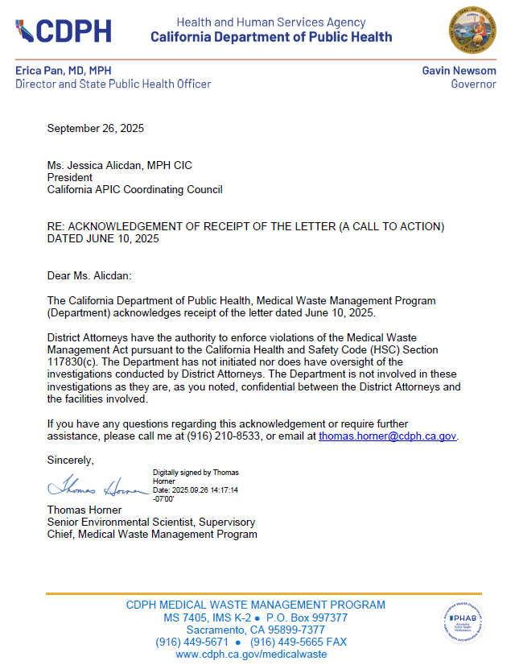
Red biohazard waste process letter
CDPH Response
Next Steps:
Continue discussions at your facility with:
Senior leaders
Environmental Health & Safety
Sustainability
Other facility leaders - Consortium
Notes:
Next Steps:
Send to CACC BOD for review and approval via email (voting poll)
Schedule a meeting with Lisa Tomlinson and Nancy Hailpern. Send letter and problematic IFUs are being reviewed by the Public Policy Committee

Slide 32
Announcements/roundtable
Announcements
  Survey preparedness, Survey experiences
Questions/Round Table Discussion
Does your facility have ST108 in your 2026 WMP?
  What is your bacteria testing frequency?
Adjournment
Next Meeting: October Conference

Slide 33
Announcements/roundtable
  Open positions
    Palomar Health Medical Group (not Palomar Health)
      IP-Practice Administration
      Part time
      Outpatient clinics
      Poway, California (but offices in Poway, Escondido, San Marcos)
    Palomar Health
      IP
      Part time
      Acute care hospital
      Escondido, California

Slide 34

Train wreck of the month
Lessons learned, what worked?, what didn’t? Open, off-record, safe space, no-judgment discussion

Slide 35
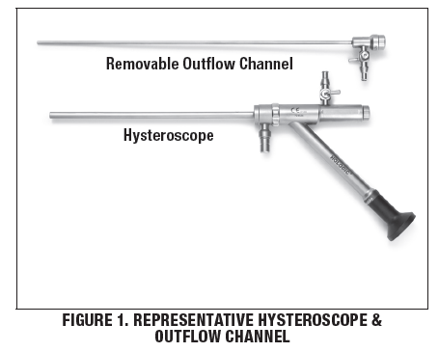
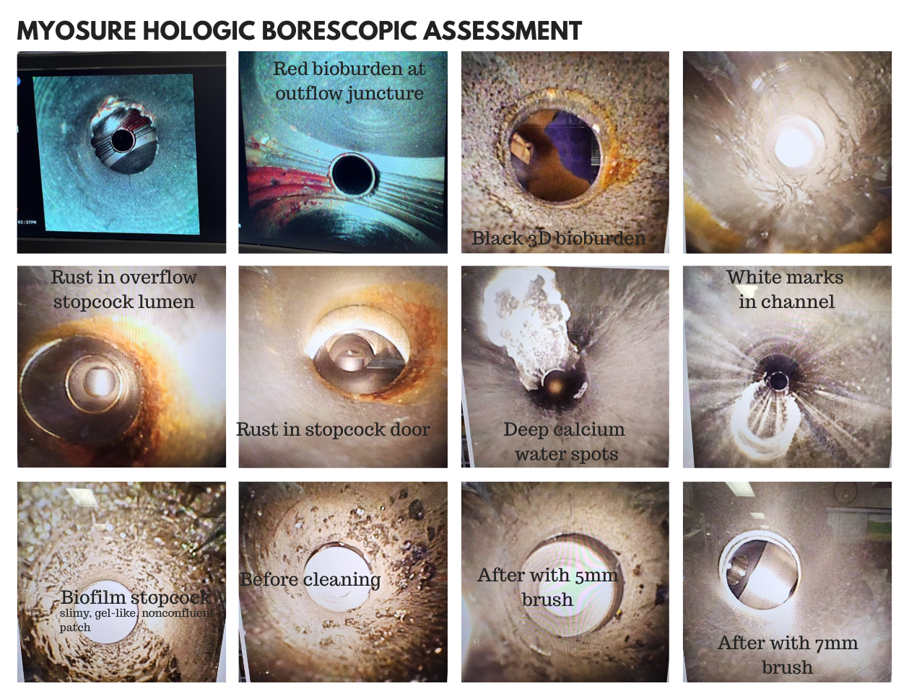
“All other lumens”
“Main lumen”
Per the Manufacturer’s Instruction-For-Use:
Requires a nylon-bristled brush sized to the lumen:
Main lumen cleaning: a brush with a 2-inch (50 mm) bristle area, bristle diameter of 0.236-inch (6 mm), and 14-inch (35cm) length
Other lumens (6.0, 5.5, 3.7, extra-large and regular outflow channel): a brush with a 2-inch (50mm), bristle diameter of 0197-inch (5mm), and 14-inch (35cm) length.
Stopcock flushing is emphasized during cleaning to clear internal cavities. All lumens should be flushed with warm water, then with an enzymatic, neutral pH cleaner at least 3x using the stopcocks to ensure no air remains. Components should be soaked in enzymatic cleaner per solution instructions, then rinsed and dried with lint-free cloth or filtered air.
The outflow channel (all other lumens) and hysteroscope (main channel) must be disassembled, seals removed, and all surfaces, including crevices, scrubbed without scratching optical surfaces. Must be soaked (no recommended time given, vendor suggests following hospital SPD protocols

Slide 36
What’s Your First Priority?
Examining the Evidence Behind Our Focus
Frank Myers, MA, CIC, FAPIC
Director Infection Prevention and Clinical Epidemiology
UC San Diego Health

Slide 37
Objectives
1) List 2 challenges around hand hygiene’s supremacy in priorities in infection prevention
2) Identify 3 HAIs rates that CHG treatments reduce.
3) Describe one fallacy that has caused hand hygiene to be common intervention in HAI reduction.

Slide 38
First a quiz!
How many of you did hand hygiene promotion for infection prevention week?
How many of you have a rate of hand hygiene compliance you report to your infection control committee?
How many of you have a rate of CHG treatment that you report to your infection prevention committee? Does it have the same level of detail as your hand hygiene report?

Slide 39
“Hand washing is the most important infection control method.”
This was taught as a mantra to new IPs in the 1970s to 1990s
Its source as determined by Marguerite Jackson was a 1920’s nursing text book
  About safe food handling

Slide 40

Nevertheless,
Semmelweis!

Slide 41

Semmelweis clearly was immensely important
Hand hygiene does save lives
The outbreak he interrupted did cause excess mortality in a population that we all see as important
YPLL
He was a martyr
The story resonates because we suffer from the same push back

Slide 42
BUT
https://www.youtube.com/watch?v=FaVFuX8z26c

Slide 43
Is healthcare the same as 1847?
Do care providers go from autopsy to delivery
Do we provide care with our bare hands
  NICU!?!
We have running water in our hospitals
  And our homes
Hand hygiene is a bit more ingrained than when we had no running water
Counterpoint
  With no antibiotics the cost of errors was clearer

Slide 44
In order for us to determine where hand hygiene improvement ranks we need to know
What they are being infected with:
What is the source of patient infections
  Other patients
  Own flora
What is the route of transmission of patient infections
  Airborne
  Foodborne (oral)
  Direct inoculation

Slide 45
A Caveat
Pre and post alcohol based hand rubs
A whole bounty of literature showing the move from hand washing to hand hygiene with alcohol based hand rubs prevented HAIs.
  The question today is what we prioritize.
Since most of us use alcohol based hand rubs we will not use that data showing improvement from pre alcohol handwashing to post alcohol hand rubs

Slide 46
Let’s focus on what we are evaluated on:
CLABSI
  (HOB)
CAUTI
C. difficile
MRSA bacteremia
SSI

Slide 47
In order for an intervention to top our list it has to deal with more than 1 of these areas
Two interventions do that:
  Hand hygiene
  CHG bathing

Slide 48

You may feel at a certain point the speaker is engaged in the activity below

Slide 49
Is it fair to compare CHG with 175 years of data behind it to CHG treatment which is new?
Not so new LOWBURY EJ. Symposium on epidemiological risks of antibiotics: hospital infection. Proc R Soc Med. 1958 Oct;51(10):807-10. Discussed CHG as promising at controlling Staphylococcus aureus.

Slide 50
So where do these infections come from?
Do we only carry E.coli on? our hands when handling foley catheters?

Slide 51
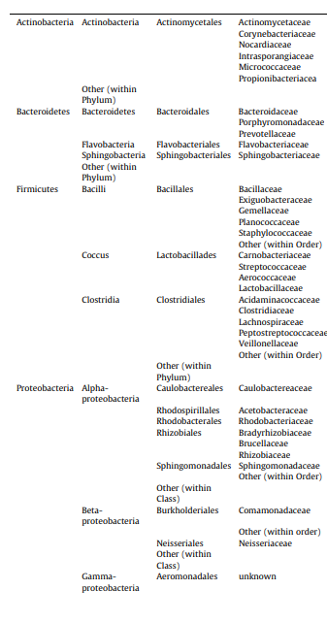
Where is E. coli?
Normal skin flora
S.L. Edmonds-Wilson, N.I. Nurinova, C.A. Zapka, N. Fierer, M. Wilson
Review of human hand microbiome research
J. Dermatol. Sci., 80 (1) (2015), pp. 3-12

Slide 52
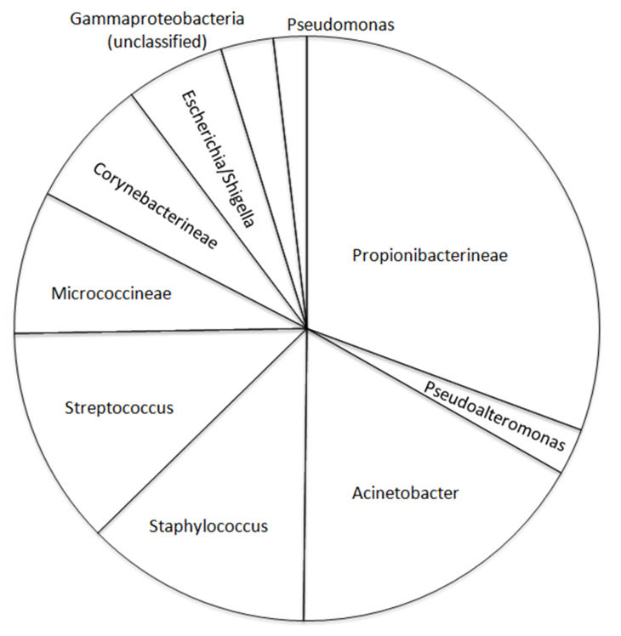
In HCW during their shift in an ICU E. coli is present
M. Rosenthal, A. Aiello, C. Chenoweth, D. Goldberg, E. Larson
Impact of technical sources of variation on the hand microbiome dynamics of healthcare workers
PLOS ONE, 9 (2014)

Slide 53
E. coli UTIs getting treated in healthcare
12% were genetically within 10 SNP differences
  Greater than that excludes transmission
  95 genetic similarities impacting 227 patients
Did not look at household or sexual contact
Did not look for temporal association
  Did they come in with it?
  Temporally what was the gap in their visits?
Someone was an index case (aka eliminating all transmission would not eliminate all of these cases) so 10.02% were potential transmission infected case
Mills, E.G., Martin, M.J., Luo, T.L. et al. A one-year genomic investigation of Escherichia coli epidemiology and nosocomial spread at a large US healthcare network. Genome Med 14, 147 (2022)

Slide 54
So if you had a CAUTI problem improving hand hygiene would……
If you got to 100% hand hygiene and all the cases in that previous study were true transmission you could reduce by 10% the number of UTIs
  Note these weren’t CAUTI and again not necessarily HAI
  10% best case for UTI
  Maybe underestimation if these involved CAUTI

Slide 55
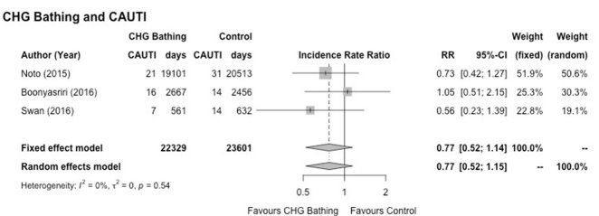
Case for CHG and CAUTI
Meta analysis of ICU studies showed a 23% reduction in CAUTI
Frost SA, Hou YC, Lombardo L, Metcalfe L, Lynch JM, Hunt L, Alexandrou E, Brennan K, Sanchez D, Aneman A, Christensen M. Evidence for the effectiveness of chlorhexidine bathing and health care-associated infections among adult intensive care patients: a trial sequential meta-analysis. BMC Infect Dis. 2018 Dec 19;18(1):679. doi: 10.1186/s12879-018-3521-y.

Slide 56
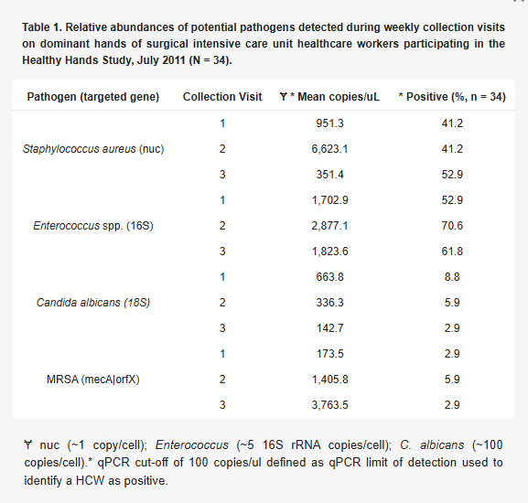
Healthcare worker’s hands during shift in an ICU
M. Rosenthal, A. Aiello, E. Larson, C. Chenoweth, B. Foxman
Healthcare workers’ hand microbiome may mediate carriage of hospital pathogens
Pathogens, 3 (2014), pp. 1-13

Slide 57
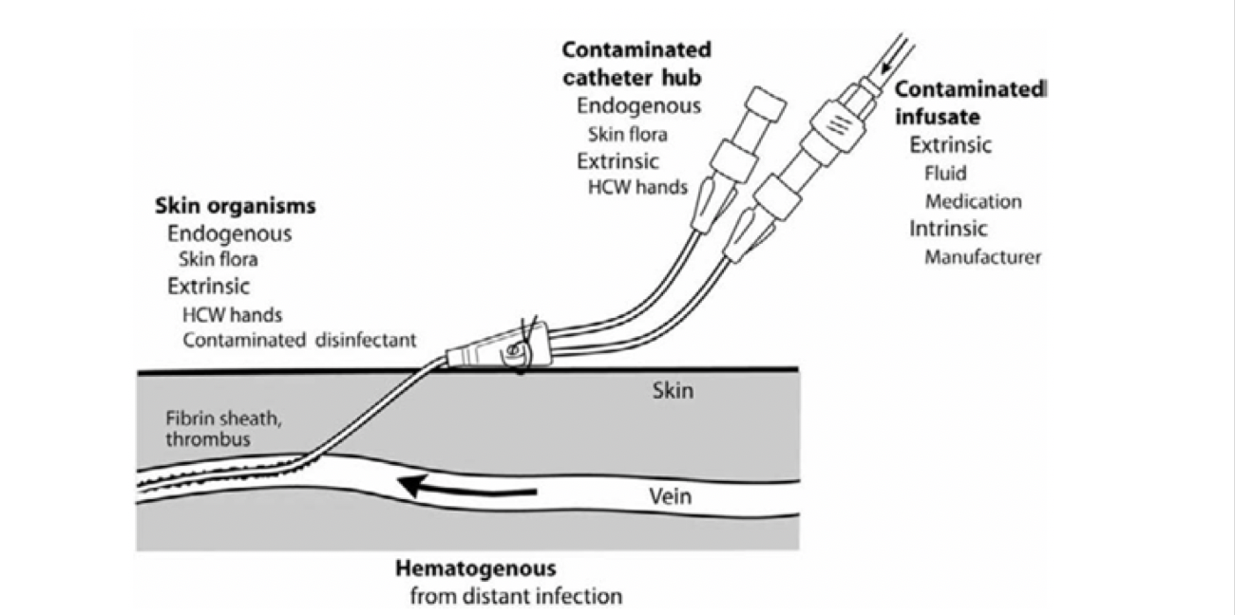
CLABSI sources of infection

Slide 58
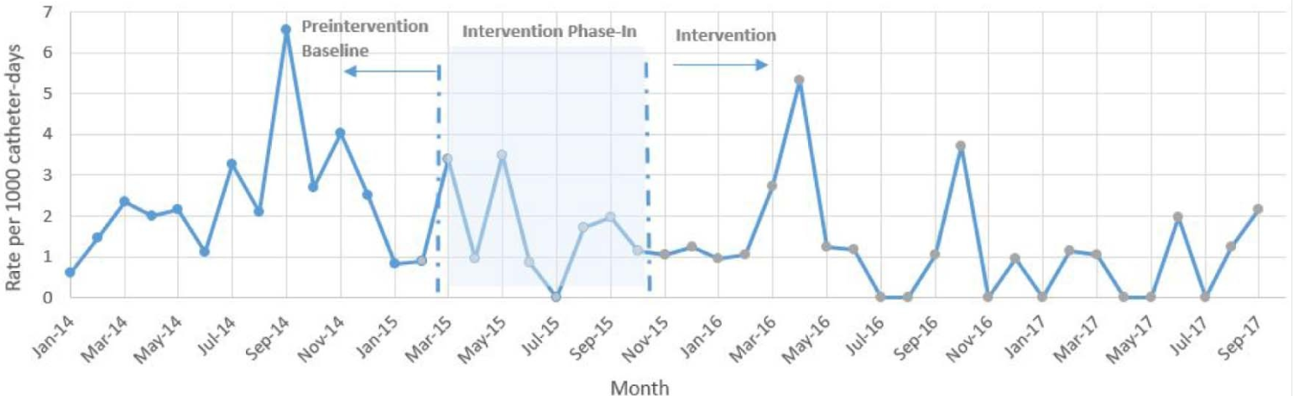
Hand hygiene improvement reduces CLABSI
Single paper, single hospital (not true hand hygiene improvement but a very reasonable marker)
Central line-associated bloodstream infection pre 1.43 post 0.64 0.45 (0.23-0.89)
McCalla S, Reilly M, Thomas R, McSpedon-Rai D, McMahon LA, Palumbo M, An automated hand hygiene compliance system is associated with decreased rates of health care-associated infections, AJIC, Volume 46, Issue 12, 2018, Pages 1381-1386,

Slide 59

CHG and CLABSI in the ICU
Frost, S.A., Alogso, MC., Metcalfe, L. et al. Chlorhexidine bathing and health care-associated infections among adult intensive care patients: a systematic review and meta-analysis. Crit Care 20, 379 (2016).

Slide 60
Outside the ICU and CLABSI
Results: We included 26 studies with 861,546 patient-days and 5259 HABSIs. CHG bathing markedly reduced the risk of HABSIs (IRR = 0.59, 95% confidence interval [CI]: 0.52–0.68). The effect of CHG bathing was consistent within subgroups: randomized (0.67, 95% CI: 0.53–0.85) vs. non-randomized studies (0.54, 95% CI: 0.44–0.65), bundled (0.66, 95% CI: 0.62–0.70) vs. non-bundled interventions (0.51, 95% CI: 0.39–0.68), CHG impregnated wipes (0.63, 95% CI: 0.55–0.73) vs. CHG solution (0.41, 95% CI: 0.26–0.64), and intensive care unit (ICU) (0.58, 95% CI: 0.49–0.68) vs. non-ICU settings (0.56, 95% CI: 0.38–0.83). Only three studies reported all five measures of fidelity, and ten studies did not report any patient-centered outcomes.
Conclusions: Patient bathing with CHG significantly reduced the incidence of HABSIs in both ICU and non-ICU settings. Many studies did not report fidelity to the intervention or patient-centered outcomes. For sustainability and replicability essential for effective implementation, fidelity assessment that goes beyond whether a patient received an intervention or not should be standard practice particularly for complex behavioral interventions such as CHG bathing.
Musuuza, J.S., Guru, P.K., O’Horo, J.C. et al. The impact of chlorhexidine bathing on hospital-acquired bloodstream infections: a systematic review and meta-analysis. BMC Infect Dis 19, 416 (2019).

Slide 61
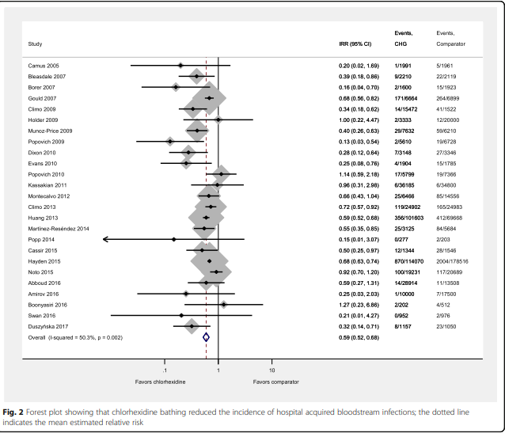
Musuuza, J.S., Guru, P.K., O’Horo, J.C. et al. The impact of chlorhexidine bathing on hospital-acquired bloodstream infections: a systematic review and meta-analysis. BMC Infect Dis 19, 416 (2019).

Slide 62
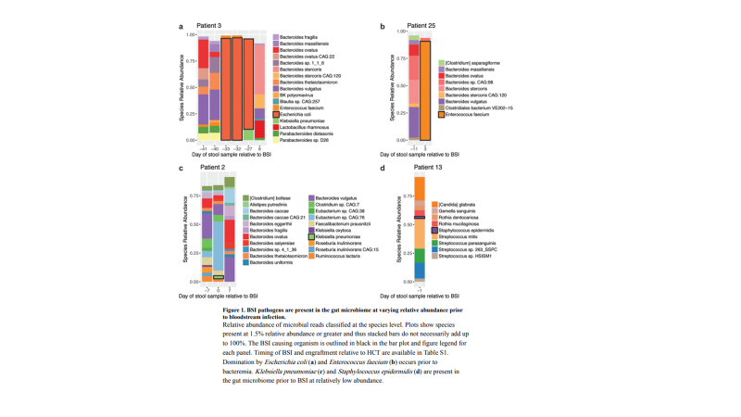
It just isn’t the skin
Tamburini, FB Precision Identification of Diverse Bloodstream Pathogens in the Gut Microbiome Nat Med. 2018 Dec; 24(12): 1809–1814 (Nature Medicine- Stanford)

Slide 63
What about MRSA?
Hand hygiene and MRSA reduction
“Conclusions: Appropriate hand hygiene during patient care is the primary means of reducing the spread of MRSA. However, further research is necessary to determine the quantitative association between increased hand hygiene compliance, ABHR use and MRSA reduction as well as the role of improving hand hygiene only, independent of contact precautions, for MRSA control.”
  Marimuthu, K., Pittet, D. & Harbarth, S. The effect of improved hand hygiene on nosocomial MRSA control. Antimicrob Resist Infect Control 3, 34 (2014)

Slide 64
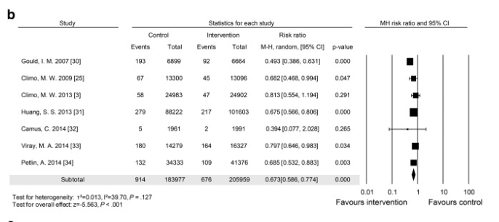
MRSA ICU setting
Kim HY, Lee WK, Na S, Roh YH, Shin CS, Kim J, The effects of chlorhexidine gluconate bathing on health care–associated infection in intensive care units: A meta-analysis,Journal of Critical Care, Volume 32,2016, Pages 126-137

Slide 65
Non ICU setting for MRSA
“Conclusions: Daily CHG skin application in non-ICU patients with central venous catheters is an effective strategy to prevent CLABSIs and MRSA infections. We observed a decrease in MRSA LabID and bacteremia rates despite discontinuation of contact precautions. These findings suggest that a horizontal prevention approach of daily CHG skin application may be an effective alternative to contact isolation to interrupt transmission of MRSA in hospitalized patients outside the ICU setting.”
  Dombecki C, Sweeney J, White J, et al. CHG Skin Application in Non-ICU Patients with Central Venous Catheters: Impact on CLABSI, MRSA Bacteremia, and LabID Rates. Infection Control & Hospital Epidemiology. 2020;41(S1):s164-s165. doi:10.1017/ice.2020.69
“Results.Daily bathing with CHG was associated with a 64% reduced risk of developing the primary outcome, namely, the composite incidence of MRSA and VRE HAIs (hazard ratio, 0.36 [95% CI, 0.2-0.8]; P = .01). There was no change in the incidence of C. difficile HAIs (P = .6). Colonization with MRSA was associated with an increased risk of developing a MRSA HAI (hazard ratio, 8 [95% CI, 3-19]; P < .001).
Conclusion.Daily CHG bathing was associated with a reduced HAI risk, using a composite endpoint of MRSA and VRE HAIs, in a general medical inpatient population.”
  Kassakian SZ, Mermel LA, Jefferson JA, Parenteau SL, Machan JT. Impact of Chlorhexidine Bathing on Hospital-Acquired Infections among General Medical Patients. Infection Control & Hospital Epidemiology. 2011;32(3):238-243.

Slide 66
Foundations for MRSA Infections
Sampled 198 health-care workers, 40 environmental locations, and 1854 patients (386 were positive, 357 of those on admission); 1819 isolates were sequenced. Median nasal carriage rate of S aureus in health-care workers at 4-weekly time points was 36.9% and 115 (58%) health-care workers had S aureus detected at least once during the study. S aureus was identified in 8–50% of environmental samples. 605 genetically distinct subtypes were identified at a rate of 38 (IQR 34–42) per 4-weekly cycle. Only 25 instances of transmission to patients (seven from health-care workers, two from the environment, and 16 from other patients) were detected. So only 8% of HAI cases were from other patients, 92% weren’t
Price JR Transmission of Staphylococcus aureus between health-care workers, the environment, and patients in an intensive care unit: a longitudinal cohort study based on whole-genome sequencing The Lancet Infectious Diseases VOLUME 17, ISSUE 2, P207-214, FEBRUARY 01, 2017
Notes:
FM

Slide 67
That Means…..
“In the presence of standard infection control measures, health-care workers were infrequently sources of transmission to patients. S aureus epidemiology in the ICU and HDU is characterised by continuous ingress of distinct subtypes rather than transmission of genetically related strains.”
“Many acquisitions might be attributable to recrudescence of cryptic carriage and should not be routinely ascribed to transmission and breached infection control.”
Notes:
FM

Slide 68
WGS again points to patients own flora
398 S. aureus isolates from sterile-site infections. The S. aureus strains were collected from four hospitals over a 6-month period. No evidence of transmission of S. aureus between patients with sterile-site infections. “The lack of intrahospital transmission may reflect a fundamental difference between day-to-day transmission events in the hospital setting and the more frequently studied outbreak scenarios.”
Long SW, Beres SB, Olsen RJ, Musser JM. 2014. Absence of patient-to-patient intrahospital transmission of Staphylococcus aureus as determined by whole-genome sequencing. mBio 5(5):e01692-14. doi:10.1128/mBio.01692-14
Notes:
FM

Slide 69
SSI prevention with CHG
“Results: All in all, 1108 publications were identified and 3 were included in the meta-analysis. OR of the 2 cohort studies was 0.25 [95%CI: 0.13–0.50] for use of CHG-cloths the evening and the morning before intervention versus non-compliance with preoperative washing. OR of the RCT was 0.12 [95%CI: 0.02–1.00] for use of CHG-cloths the evening and the morning before intervention versus a shower with antibacterial soap the evening before the intervention. Study quality was moderate.”
  V. Forget, O. Azzam, C. Khouri, C. Landelle, What is the benefit of preoperative washing with chlorhexidine gluconate-impregnated cloths on the incidence of surgical site infections? A systematic review and meta-analysis, Infectious Diseases Now, Volume 52, Issue 4, 2022, Pages 185-192

Slide 70
Hand Hygiene Improvement and SSI Reduction
RESULTS A total of 3,256 operating room environments and patients (1,620 control and 1,636 treatment) were enrolled. The mean (SD) provider hand decontamination event rate achieved was 4.3 (2.9) events per hour, an approximate 8-fold increase in hand decontamination events above that of conventional wall-mounted devices (0.57 events/hour); P<.001. Use of the hand hygiene system was not associated with a reduction in healthcare-associated infections (odds ratio, 1.07 [95% CI, 0.82–1.40], P=.626).
CONCLUSIONS The hand hygiene system evaluated in this study increased the frequency of hand decontamination events without reducing 30-day postoperative healthcare-associated infections. Future work is indicated to optimize the efficacy of this hand hygiene improvement strategy.
Koff MD, Brown JR, Marshall EJ, et al. Frequency of Hand Decontamination of Intraoperative Providers and Reduction of Postoperative Healthcare-Associated Infections: A Randomized Clinical Trial of a Novel Hand Hygiene System. Infection Control & Hospital Epidemiology. 2016;37(8):888-895.

Slide 71
Sure now Frank is going to tell us how great CHG is against C. difficile

Slide 72
CHG doesn’t work because C. difficile is not translocation of the patient’s own flora
Results……The prevalence of CDI was 3.7% (6 of 164) in the soap and water arm and 4.3% (7 of 161) in the chlorhexidine arm. Compared with daily soap and water bathing, 2% chlorhexidine bathing every other day was not associated with the prevention of hospital-acquired CDI (1.3% [2 of 152] soap and water versus 2.0% [3 of 148] chlorhexidine, P = 0.68).
Conclusions
It is inconclusive if there was an association between chlorhexidine bathing and incidence of CDI among surgical intensive care unit patients in this study as statistical power was limited. There are limited published data evaluating the association between chlorhexidine bathing and CDI, and this study provides data for future systematic reviews and meta-analyses.
Lan N. Bui, Joshua T. Swan, Beverly A. Shirkey, Randall J. Olsen, Scott W. Long, Edward A. Graviss,
Chlorhexidine bathing and Clostridium difficile infection in a surgical intensive care unit,
Journal of Surgical Research, Volume 228, 2018, Pages 107-111,

Slide 73
Single hospital study
Results
PHH opportunities improved significantly (P < .0001) after staff and patient education. CD SIRs deceased significantly for 6 months (P ≤ .05) after the PHH intervention.
Conclusions
PHH opportunities can be increased by providing education and opportunities for patients to clean their hands. PHH should be considered a relevant preventative measure for CDI in hospitalized patients.
Pokrywka M, Buraczewski M, Frank D, Dixon H, Ferrelli J, Shutt K, Yassin M, Can improving patient hand hygiene impact Clostridium difficile infection events at an academic medical center?, American Journal of Infection Control, Volume 45, Issue 9, 2017, Pages 959-963,

Slide 74
UK health system looks at C. difficile relatedness
Eyre DW et al. Diverse Sources of C. difficile Infection Identified on Whole-Genome Sequencing NEJM September 26, 2013 vol. 369 no. 13
1250 C. difficile cases that were evaluated, 1223 (98%) were successfully sequenced.
In a comparison of 957 samples obtained from April 2008 through March 2011 with those obtained from September 2007 onward, a total of 333 isolates (35%) had no more than 2 SNVs from at least 1 earlier case (definitive transmission), and 428 isolates (45%) had more than 10 SNVs from all previous cases (clearly unrelated).
Of the 333 patients with no more than 2 SNVs (consistent with transmission), 126 patients (38%) had close hospital contact with another patient, and 120 patients (36%) had no hospital or community contact with another patient. So of 1223 CDI cases sequences only 126 patients had some spatial relationship with another patient and a clear genetic link (10.3% of all cases)
Notes:
FM

Slide 75
But it’ll get better if we just don’t use alcohol hand rubs right?
BMD/BOWL/0416/0009

Slide 76
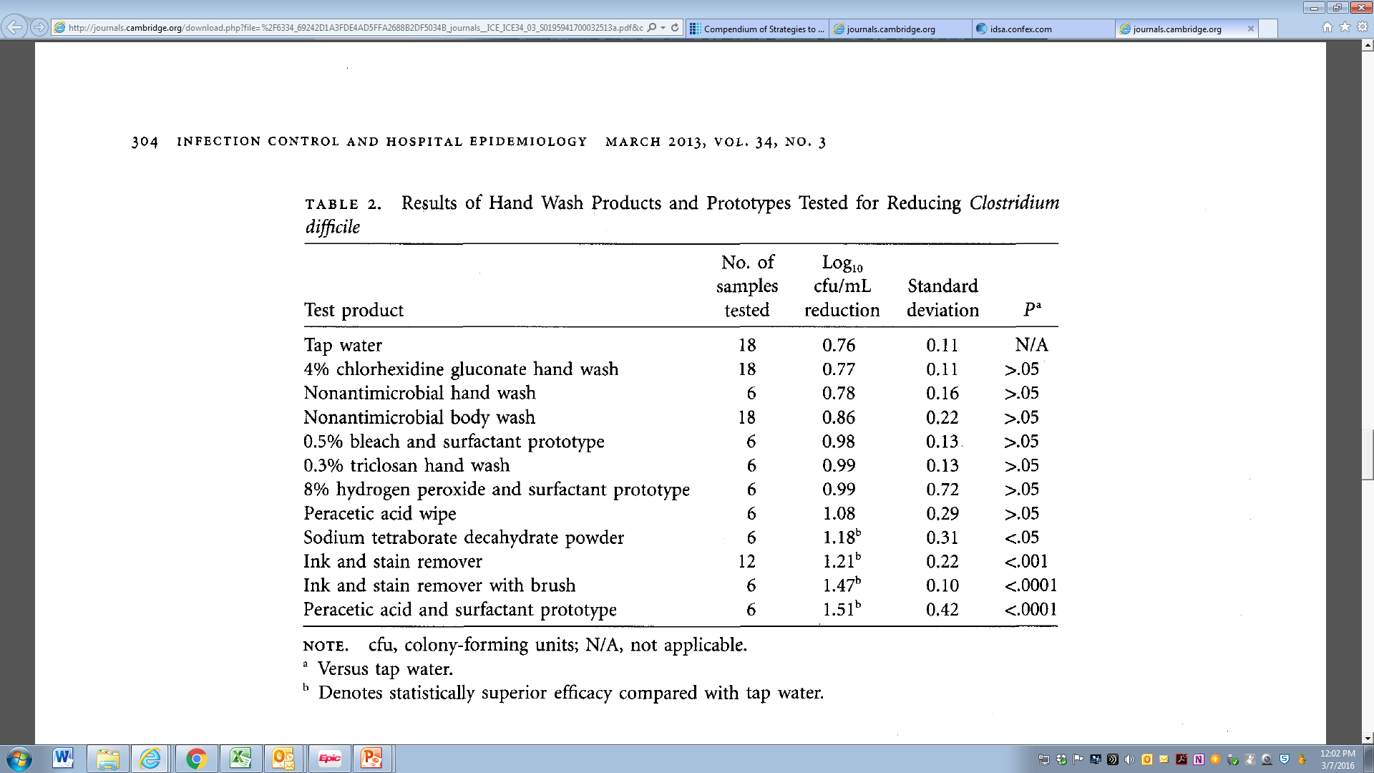
Handwashing doesn’t work for removal of C. difficile spores
Source: Effectiveness of Hand Hygiene for Removal of Clostridium difficile Spores from Hands
Sarah L. Edmonds, Carrie Zapka, Douglas Kasper, Robert Gerber, Robert McCormack, David Macinga, Stuart Johnson,
Susan Sambol, Christopher Fricker, James Arbogast and Dale N. Gerding
Infection Control & Hospital Epidemiology / Volume 34 / Issue 03 / March 2013, pp 302 - 305
BMD/BOWL/0416/0009
Notes:
Discussing the comparative results of different techniques for cleansing
Effectiveness of Hand Hygiene for Removal of Clostridium difcile Spores from Hands
Sarah L. Edmonds, Carrie Zapka, Douglas Kasper, Robert Gerber, Robert McCormack, David Macinga, Stuart Johnson,
Susan Sambol, Christopher Fricker, James Arbogast and Dale N. Gerding
Infection Control & Hospital Epidemiology / Volume 34 / Issue 03 / March 2013, pp 302 - 305

Slide 77
Maybe both approaches stink
But hand hygiene might have an edge with C. difficile

Slide 78


It comes down to where are the bacteria coming from
Or these hands?
The patient

Slide 79
But at least you know what your hand hygiene rate is!
(Honestly, do you?)
Observation bias (night shift, holidays?)
Hawthorne effect
Inter rater reliability between observers
Unit bias, profession bias

