Slide 1

Welcome
September 10th 2025 – 12:00 pm PST

Slide 2





Online Participant Reminders
This meeting will be recorded
Presentation slides are available on our Meetings page
Please stay muted during the educational presentation and do not put us on hold if you are calling in on a phone line
Type in any questions or comments in the chat
CEUs will be provided after completion of speaker evaluation - a link will be shared at the end of the meeting

Slide 3



Meeting Sponsored by:

Slide 4
Introductions & Recognitions
New members
New certifications or re-certifications
First time attendees

Slide 5
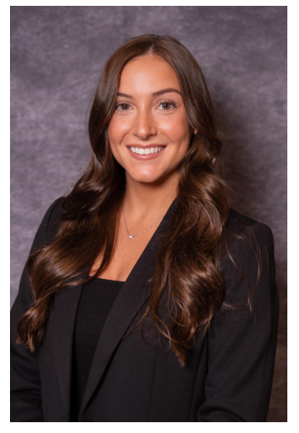

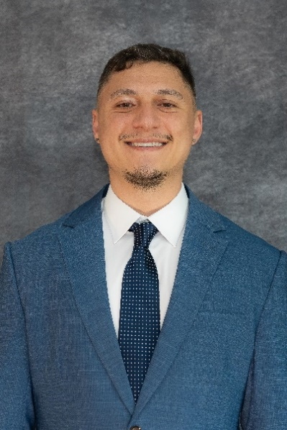
Early bird ends Sept 12

Slide 6
Old Business
August minutes approval

Slide 7
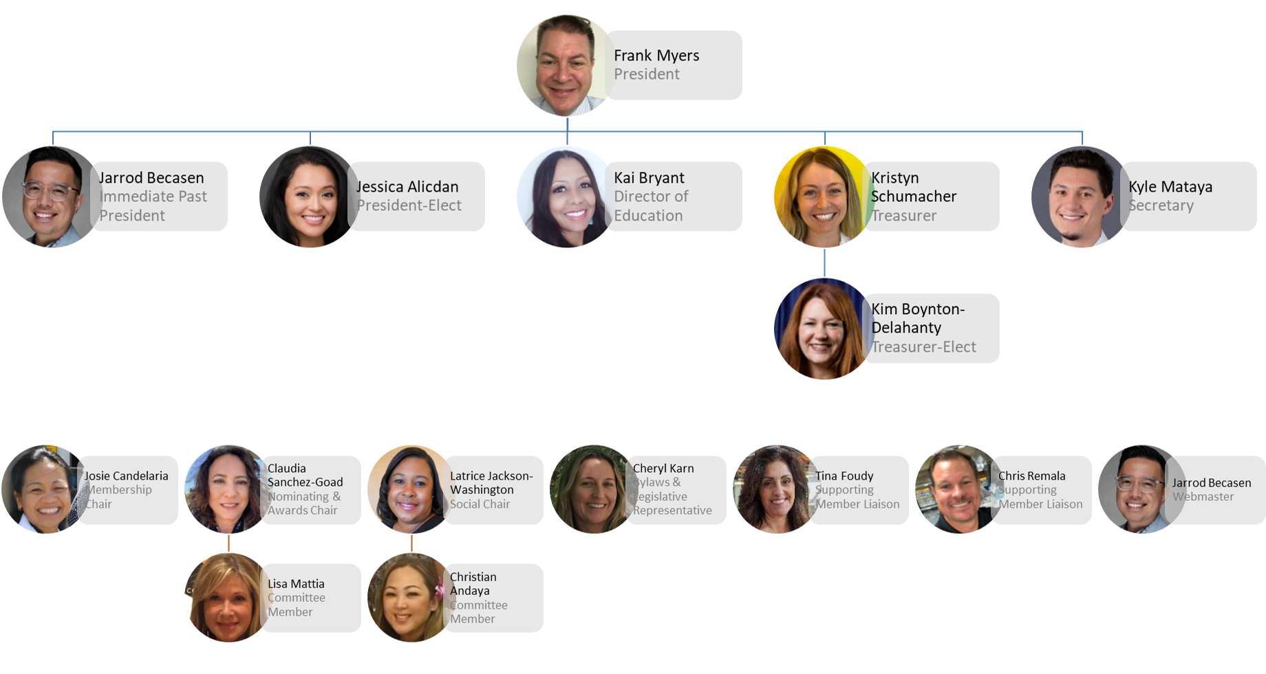

Slide 8
New Business Frank Myers
Conference
Holiday party
Nominations

Slide 9




Nominating & Awards Report Claudia Sanchez Goad & Lisa Mattia
IP Award Recognitions
&
2026 SD APIC Chapter BOD
Nominations and Voting
Start in August 2025
DUE BY November 19th.
Please recommend an IP

Slide 10
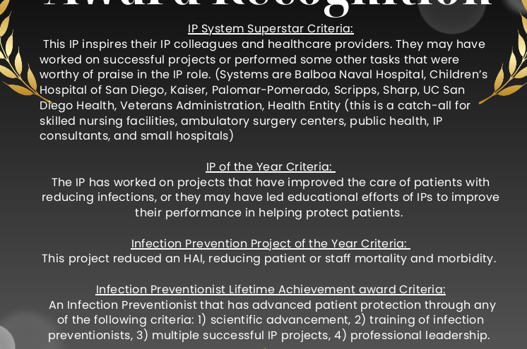
Nominating & Awards Report Claudia Sanchez Goad & Lisa Mattia
Aug 13, 2025 email sent to SDIC APIC Chapter Google Form for Nominations.
We encourage everyone to to nominate an IP
Anticipated END date is NOV 19th.
Awards will be announced at our Winter Holiday Party
2025 SD APIC IP Recognition Awards Nomination Form
2025 SD APIC IP Recognition Awards Nomination Form

Slide 11

Nominating & Awards Report Claudia Sanchez Goad & Lisa Mattia
SD APIC 2026 BOD Nominations
👆

Slide 12


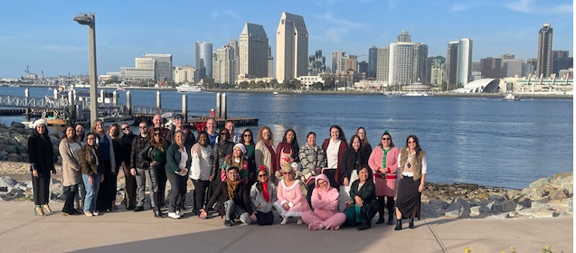
Social Report Latrice Jackson-Washington, Christian Andaya
Coming Soon!!!
Holiday Charity Event 2025
Location: Il Fornaio in Coronado
On September 2nd, 2025 - Holiday Party Planning 2025 Survey was emailed and includes:
Event date preference
Any recommendations you may have for this year’s Charity
https://forms.gle/sK3HpZhHhbsqpiF4A

Slide 13
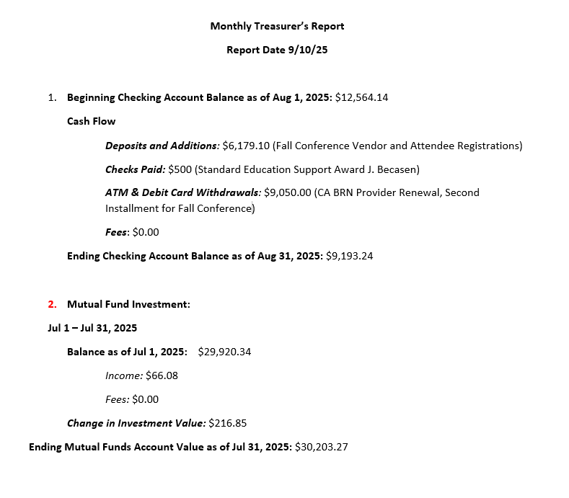
Treasurer Report Kristyn Schumacher, Kim Delahanty

Slide 14
Membership Report Josie CandelariA

Slide 15

Legislative Rep Report Cheryl Karn
Senate Bill 317 – Wastewater Surveillance
Passed first chamber
This bill would require the State Department of Public Health, in consultation with participating wastewater treatment facilities, local health departments, and other subject matter experts, to maintain the Cal-SuWers network to test, as appropriate for public health use, for pathogens, toxins, or other public health indicators in wastewater.
APIC Action Center (sign up for alerts)
https://www.votervoice.net/APICorg/home
APIC supporting efforts along with other health, medical, science, and public health organizations calling for Secretary Kennedy’s resignation after he removed CDC Director Dr. Susan Monarez from her position due to her refusal to endorse non-scientific vaccine recommendations
Send a letter to your Senators and Representatives from the Action Center.

Slide 16

Ambulatory care Janessa Esteban
Competencies
Who is considered the validator?
An individual with the educational background, experience, or knowledge related to the skills being reviewed assesses competence
A validated trainer:
Trained by the vendor and have gained the experience to validate others
Train-the-trainer model
Appropriate education, experience, or knowledge to assess the specific skill
Prevent a Survey Finding
Those performing validations are themselves trained and validated
Have a competency on file
Electronic or paper
Critical in high-risk activities like high-level disinfection, instruments, and procedural-based tasks.

Slide 17
HAI Liaison & Advisory Report Maggie Turner, Deweese Quigley

Slide 18
Infectious Disease Association of CA

Slide 19
G.E.R.M. Commission Frank Myers

Slide 20
Long Term Care Lisa Kilgore

Slide 21
Pediatric care Rady Children's

Slide 22
County epidemiology Grace Kang & Mara Rauhauser

Slide 23
Announcements/roundtable
Announcements
Survey preparedness, Survey experiences
Questions/Round Table Discussion
Adjournment
Next Meeting: October Conference

Slide 24

Train wreck of the month
Lessons learned, what worked?, what didn’t? Open, off-record, safe space, no-judgment discussion

