Slide 1

Welcome
January 14th, 2026 – 12:00 pm PST

Slide 2





Online Participant Reminders
This meeting will be recorded
Presentation slides are available on our Meetings page
Please stay muted during the educational presentation and do not put us on hold if you are calling in on a phone line
Type in any questions or comments in the chat
CEUs will be provided after completion of speaker evaluation - a link will be shared at the end of the meeting

Slide 3


Meeting Sponsored by:

Slide 4
Insert new org chart here

Slide 5
Introductions & Recognitions
New members
New certifications or re-certifications
First time attendees

Slide 6
Old Business
November minutes approval

Slide 7
New Business Frank Myers

Slide 8

Nominating & Awards Report Jarrod Becasen

Slide 9
Social Report Kristyn Schumacher, Josie Candelaria, Rajdeep Gill

Slide 10
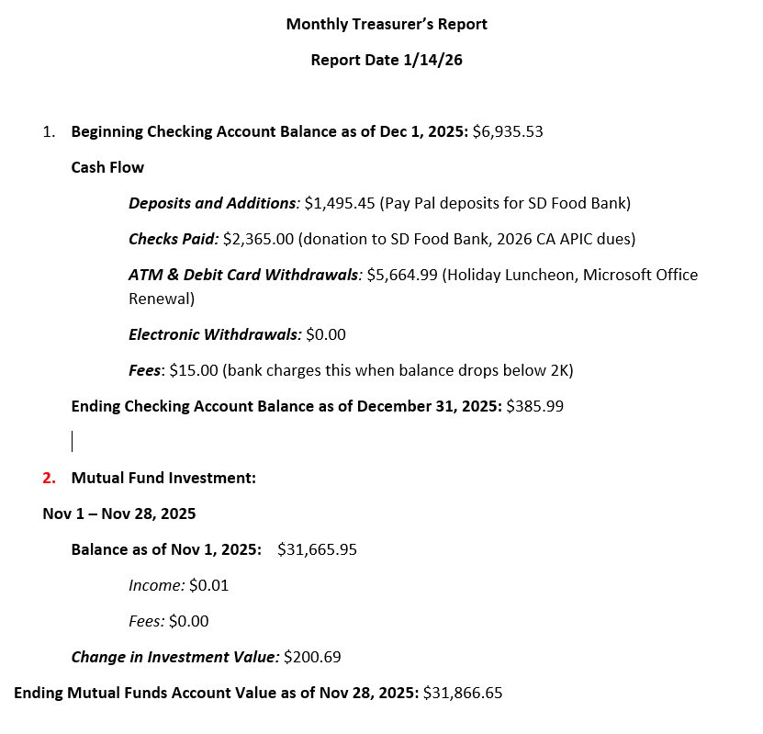
Treasurer Report Kim Delahanty

Slide 11
Membership Report Brianna Scott

Slide 12
Legislative Rep Report Cheryl Karn

Slide 13
Ambulatory care Janessa Esteban

Slide 14
HAI Liaison & Advisory Report Maggie Turner, Deweese Quigley

Slide 15
Infectious Disease Association of CA

Slide 16
G.E.R.M. Commission Frank Myers

Slide 17
Long Term Care

Slide 18
Pediatric care Rady Children's

Slide 19
County epidemiology Grace Kang & Mara Rauhauser

Slide 20
Announcements/roundtable
Announcements
Survey preparedness, Survey experiences
Questions/Round Table Discussion
Adjournment
Next Meetings:
FEBRUARY 11, 2026
MARCH 11, 2026
APRIL 8, 2026
MAY 13, 2026
JULY 8, 2026
AUGUST 13, 2026
SEPTEMBER 9, 2026

Slide 21

Train wreck of the month
Lessons learned, what worked?, what didn’t? Open, off-record, safe space, no-judgment discussion

