Slide 1
Making Heads or Tails of Uncertainties and Inconsistencies in Endoscope Reprocessing
Jessica Alicdan, MPH, AL-CIP, CIC
February 11, 2026
San Diego and Imperial County APIC

Slide 2
Overview
Comprehensive, evidence‑informed review of flexible endoscope reprocessing from point‑of‑use cleaning through final storage
Best practices for space design, workflow optimization, drying, transport, storage, and hang‑time management
Examination of conflicting guidance from AAMI, SGNA, and CDC on topics such as alcohol flushing, simethicone use, and human factors
Real‑world case studies to support clinical decision‑making
Live borescope demonstration highlighting retained debris, device damage, and early biofilm and how to integrate findings into quality assurance and regulatory compliance
Notes:
Read through overview

Slide 3
Outcome Statement
1. be able to verbalize the critical steps necessary for successful endoscope processing
2. be able to identify the various professional organizations and how to choose standards and guidelines to build their endoscope program
3. be able to identify potential internal and external components of compromised endoscopes
Notes:
Read through outcome statement

Slide 4
Objectives
Identify key perioperative responsibilities and understand the overall support of safe endoscope reprocessing lifecycle.
Evaluate and apply evidence‑based guidance by comparing society guidelines, addressing discrepancies and emerging evidence to manage high‑risk endoscope practices and regulatory expectations, including simethicone use, alcohol flushing, drying methods, hang-time, storage, and loaned endoscopes.
Describe human factors and system-based risks in endoscope reprocessing and interpret borescope findings to identify failures, assess internal channel conditions, and integrate results into quality assurance protocols.
Translate evidence into action by utilizing tools and resources for continuous improvement and develop a sustainable institutional endoscope reprocessing program .
Notes:
Read through objectives
In submitted abstract:
Overview of the Endoscope Reprocessing Lifecycle: Review the critical steps: point-of-use cleaning, manual
cleaning, high-level disinfection or sterilization, drying, transport, and storage; Highlight workflow efficiency
and space design considerations per ANSI/AAMI ST91:2021; Discuss the importance of drying and the role of
hang-time policies.
Discrepancies Across Guidelines and Emerging Evidence: Compare standards and guidance from AORN,
AAMI, SGNA, and CDC; Examine conflicting practices: alcohol flushing, simethicone use, drying methods, and
storage protocols; Review recent research findings and implications for practice.
Human Factors and System-Based Risks: Identify common points of failure due to workflow issues, training
gaps, and staffing limitations; Discuss the role of human factors in compliance and outcomes.
Borescope Demonstration and Interpretation: Introduce borescope technology and its function in internal
channel inspection; Conduct a live or recorded demonstration showing typical findings: retained debris,
channel damage, and biofilm indicators; Provide guidance on interpretation and integration into QA
protocols.
Translating Evidence into Action: Highlight tools and resources for ongoing improvement.

Slide 5
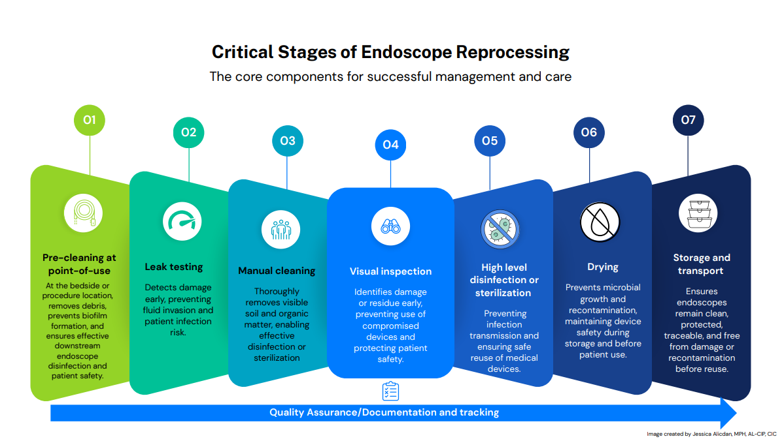
Notes:
Read through steps of Critical Stages of Endoscope Processing.

Slide 6
“Perioperative nurses are the first and last line of defense for patient safety because effective pre-cleaning at point-of-use directly determines the success of all downstream processing steps. Immediate removal of gross soil prevents drying and biofilm formation, reduces reprocessing failures, and protects patients from infection before the endoscope ever reaches sterile processing department”
Jeri Culbertson, DNP, RN, AL-CIP, CIC, LT-CIP, CRCST, CER
Tamara Behm, MSN, RN, AL-CIP, FAPIC, CER, CCSVP, CAIP
Jessica Alicdan, MPH, AL-CIP, CIC
Notes:
Read slide!

Slide 7


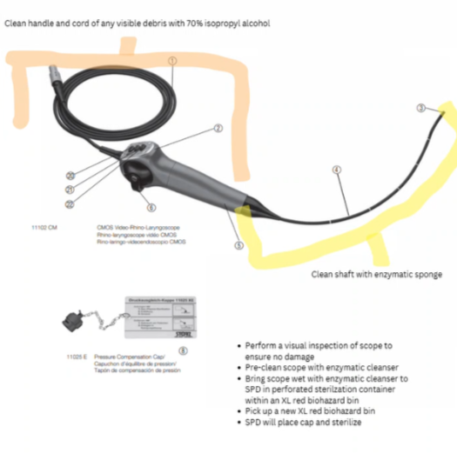
Point-of-Use Treatment
Why RNs and clinical staff are critical in the process
Must be performed immediately after endoscope removal
Biofilm formation begins within minutes
endoscope must remain moist (per MIFU)
Use of simethicone and its risks
Communicating to reprocessing staff
Transport in sealed, biohazard marked container
Notes:
Point of use treatment for scopes is a critical point in the process for perioperative nurses to participate in safe processing. It should be done immediately at the end of a procedure after removal from the patient. Biofilm development begins within minutes so it is important that the scope remain wet per the MIFU. Make sure to mix the point of use product or the volume of fluid being used according to the IFU for flushing through the scope and then document the time of completion to communicate to the SPD. If simethicone was used during the case the SPD should also be notified as this can be very difficult to remove during processing. Finally, transporting a contaminated scope in a sealed container, labeled biohazardous to a reprocessing space timely is the last step in point of use care.

Slide 8

Leak Testing
Detects internal damage or fluid invasion
Manual vs. automated testing
All scopes must pass before further processing
Scope failure = removal from service
Notes:
Leak testing will add the staff member who is processing to detect internal and external damage to a scope. It can be done manually or automated with a leak tester. All scopes even those without channels such as TEE or ENT scopes must have a leak test before moving on for further processing. If the scope fails, it must be removed from service for repair. Finding a leak shows that the scope could have internal damage or fluid invasion that may have impacted the patient. This information should be relayed back to the team and Infection Prevention so this can be investigated.

Slide 9

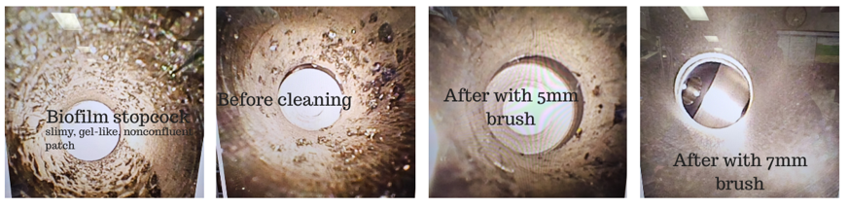
Manual Cleaning
The Foundation
Use of brushes
Enzymatic detergent
Remove visible debris, check buttons, valves, channels
Water temperature and dilution accuracy
Multiple steps that cannot be missed
Must align with MIFU
Per the MIFU:
·Requires a nylon-bristled brush sized to the lumen:
·Main lumen cleaning: a brush with a 2-inch (50 mm) bristle area, bristle diameter of 0.236-inch (6 mm), and 14-inch (35cm) length
·Other lumens (6.0, 5.5, 3.7, extra-large and regular outflow channel): a brush with a 2-inch (50mm), bristle diameter of 0197-inch (5mm), and 14-inch (35cm) length.
Conclusion: Borescopic assessment was a helpful tool to determine adequate cleaning of the lumen, following the MIFU and using a larger 7mm brush in addition.
Image provided and created by Jessica Alicdan of a lumened instrument commonly used in procedures
Notes:
Manual cleaning is the foundation to ensuring the scope is ready for HLD or sterilization. The proper brush sizes must be chosen for the channel being cleaned, mixing the enzymatic detergent with accuracy, correct temperature, and removing visible debris. All valves, channels and buttons should also be be brushed thoroughly. There are multiple steps, in upwards of 100, that cannot be missed and align with the MIFU. Some facilities choose to use disposable buttons or biopsy valves which should be disposed of at the end of the procedure. Disposable brushes are best practice for each scope to ensure cross contamination does not occur.

Slide 10
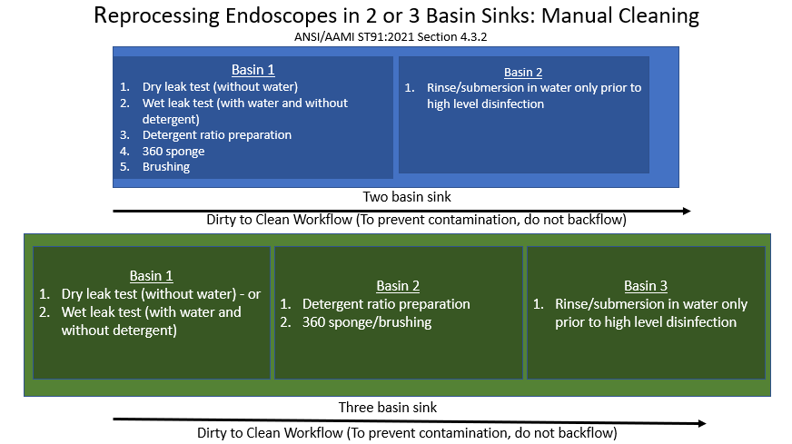
Manual Cleaning
Notes:
As you can see by the images above, the 2 bay and 3 bay sink options for cleaning of scopes. Ideally 3 bay is best practice so not to contaminate the scope. Most facilities have moved away from a single bay. Leak testing begins in that first bay either dry without water or wet leak test with water only and no detergent. Once the scope passes cleaning can begin by adding your detergent. Following the subsequent steps according to the manufacturer and the amount of basins you have. keep in mind when you are done cleaning a scope you should go back and clean the basins before preparing another scope. This will prevent contamination of one scope to the next.

Slide 11

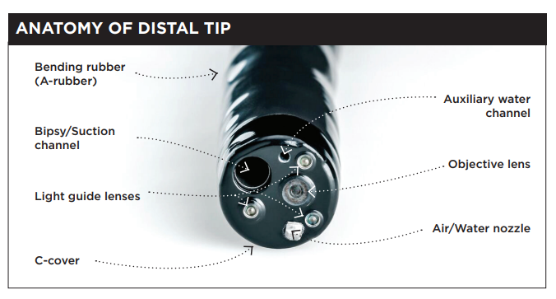
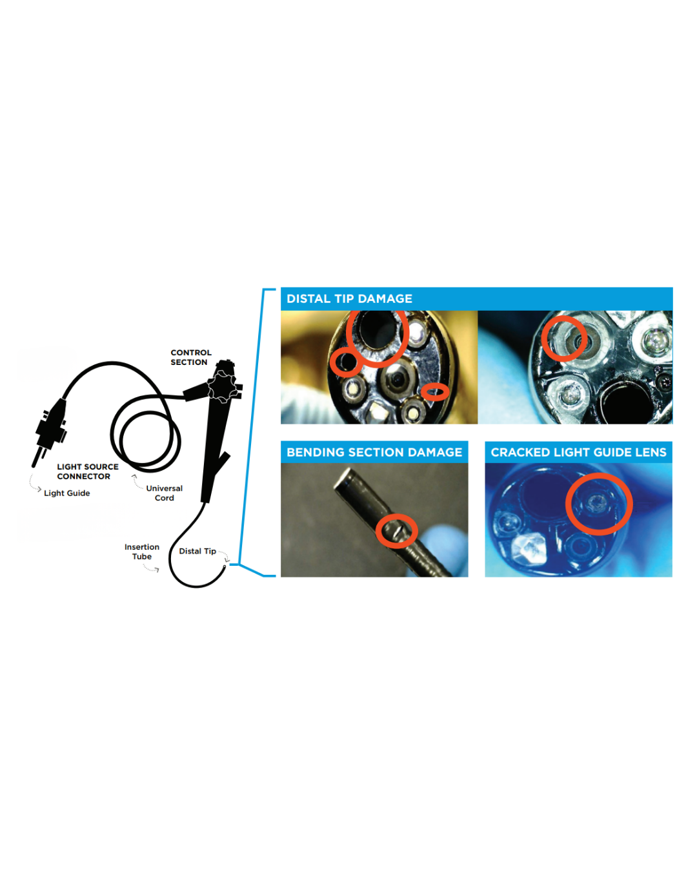
Visual Inspection
Endoscope damage can occur anytime
Proactive visual inspection during pre-cleaning, manual cleaning, storage, and transport reduces safety risks and supports safe reprocessing.
https://apic.org/wp-content/uploads/2025/02/APIC-Endoscope-Visual-Inspection-Infographic-2025-1.pdf
Notes:
Visual inspection is key for both the endoscopist processing a scope and the perioperative nurse. Prior to processing for HLD or sterilization or use in the operating room, visual inspection protects the scope and patient. Endoscope damage can occur at anytime such as during transport, or even if leak testing was done incorrectly. Being proactive with visual inspection during pre-cleaning, manual cleaning, storage, and transport reduces safety risks and supports safe reprocessing. As you can see by the images above in the anatomy of a distal tip what a scope should look like. Then in the images below distal tip damage such as a cracked lens, bending section damage, and general distal tip damage. But not all processing or OR staff can see the images with the naked eye.

Slide 12
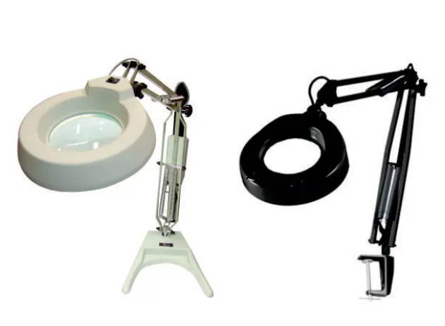
Visual Inspection cont.
Hands free lighted magnification needed
MIFU
Lumens
This will allow staff to see
Items unable to be seen with
the naked eye
Notes:
Endoscope processing spaces should have hands free lighted magnification. This allows staff to hold these longs scopes in their hands while inspecting the long insertion tubes, tiny distal tips, and large handles thoroughly with magnified light. Reading the MIFU to see if there are directions for the amount of light needed is important to ensure staff are able to see any and all issues that may arise. This is an important tool to have in a reprocessing space. Ensuring staff have the tools they need to make sure a scope is safe to use is essential.

Slide 13
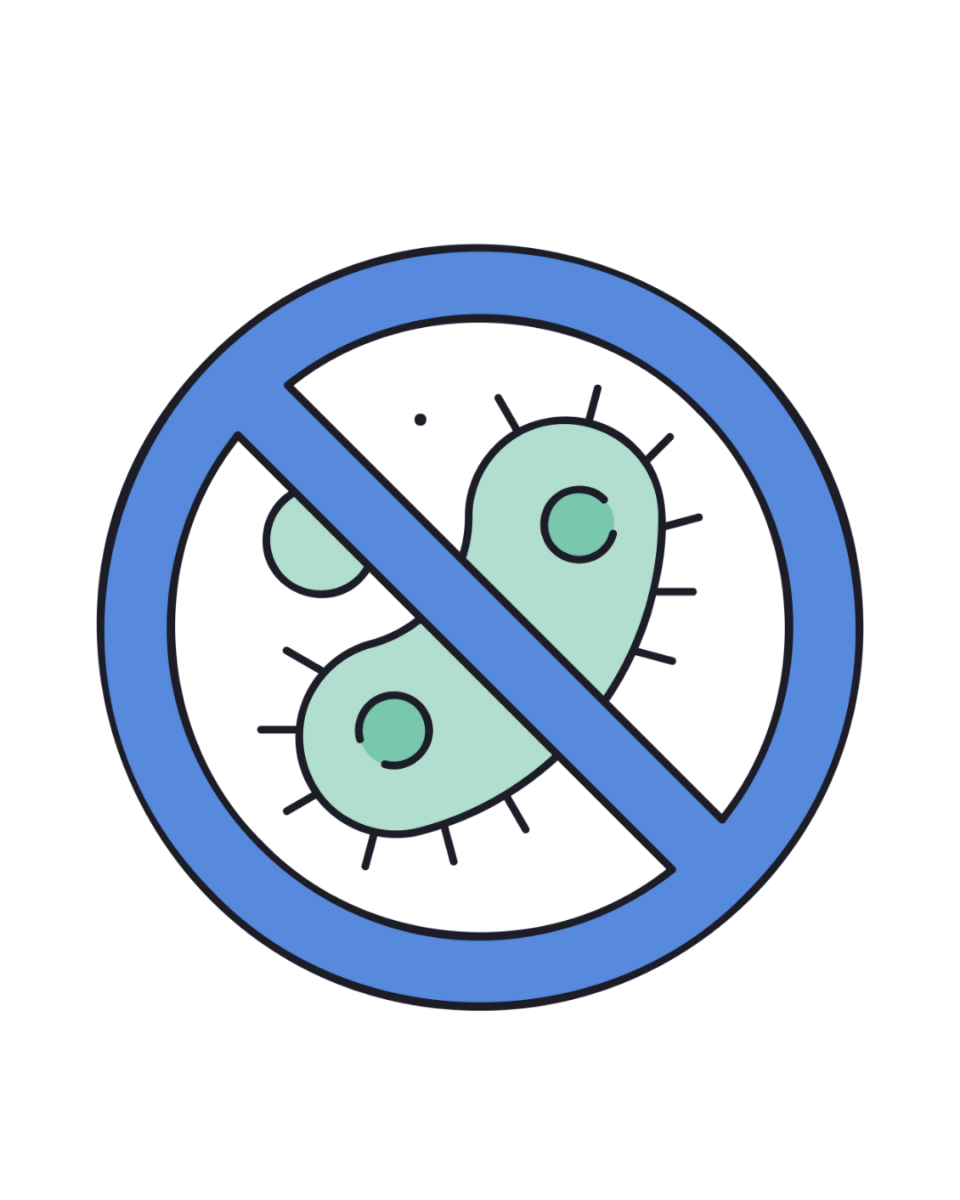
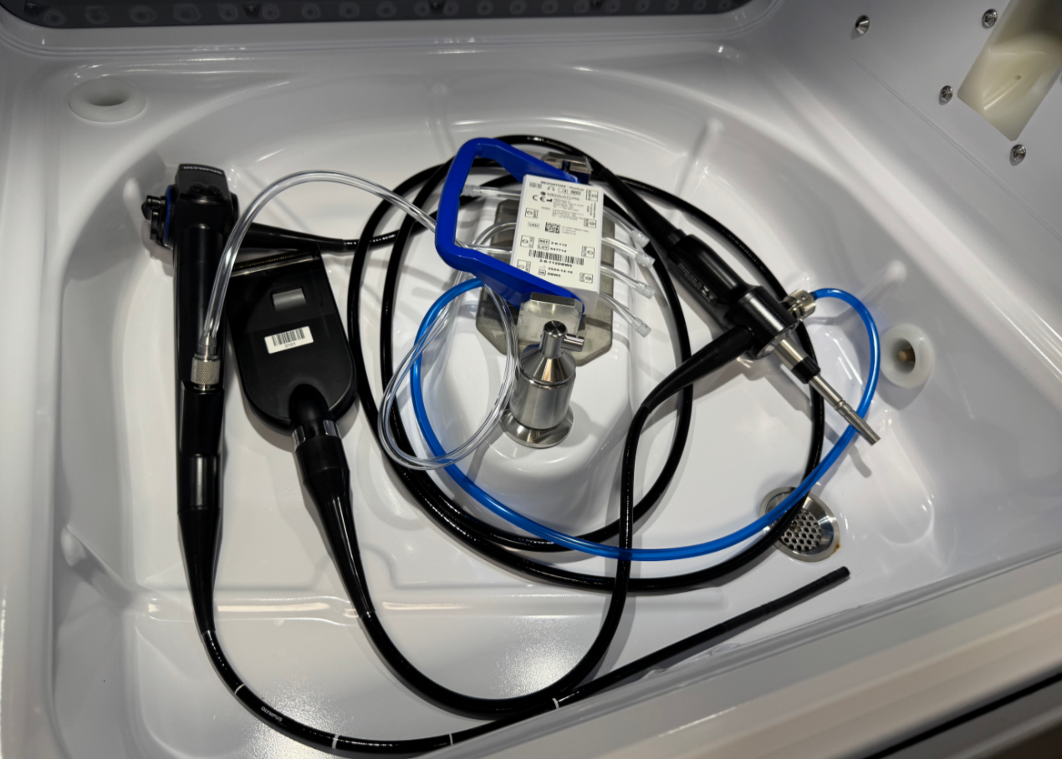
High Level Disinfection or Sterilization
High risk endoscopes per AAMI ST91
Depends on scope type (e.g., bronchoscopes = sterilization preferred)
ST91 and FDA recommend sterilization when possible
Compatibility with low-temp sterilants
Soaking is no longer recommended
Disposable Scopes
Notes:
In the ANSI/AAMI ST91 2021 Standards, high risk endoscopes to consider were listed. Some of those were Duodenoscopes, ureteroscopes, and bronchoscopes. These scopes were suggested not just by AAMI but also by the FDA to be sterilized if possible each time they are being prepared for use. Many scopes are compatible with low temperature sterilants or liquid chemical sterilants. All flexible scopes cannot tolerate the high heat of steam sterilization or it would damage the scope. Processing endoscopes via the soaking method is no longer recommended by many organizations including AAMI. Automated reprocessing is recommended and recognized as the safest process currently. Some organizations have moved to disposable endoscopes in situations where they may be unable to perform these types of reprocessing steps safely for HLD or sterilization or they don’t have the safety or staffing means to process. This can be done by performing a risk assessment for the situation and space along with the type of scopes on hand.

Slide 14

Drying
Critical and Often Missed
Residual moisture = microbial growth
Use of medical-grade compressed air
Alcohol flush: conflicting guidance from manufacturers
Must be followed by drying, not replaced by it
Drying is also an important step for low temperature sterilization
Notes:
The most critical and most often missed step in processing is scope drying. While cleaning a scope uses water, and if that water sits inside the channels for a prolonged period of time, that residual moisture may lead to microbial growth. Using medical-grade compressed air, filtered, without oil to dry the scope for 10 min or more as pre-determined by either the manufacturer or the facility is best practice. The end of an automated endoscope processor cycle does an “air purge” this is NOT a drying cycle. Also contrary to what may believe the alcohol flush does not dry the scope. There is conflicting guidance from manufacturers on alcohol flushing whether to do this step or not. Many have left this to the facility to decide. In all circumstances, an alcohol flush MUST be followed by drying, it does not replace the drying step. If a facility chooses to low temperature sterilize their scope with vaporized hydrogen peroxide, drying is an important step to prevent damage to the scope prior to this type of sterilization.

Slide 15
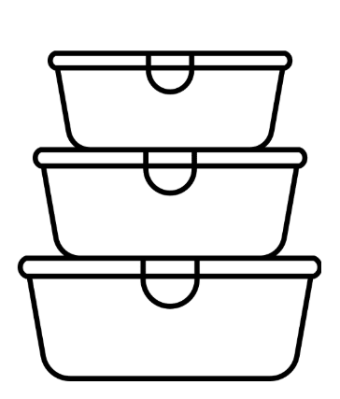
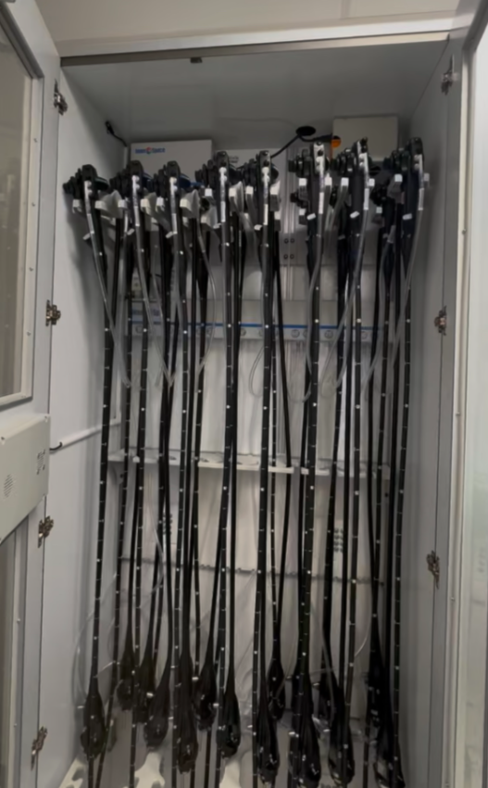
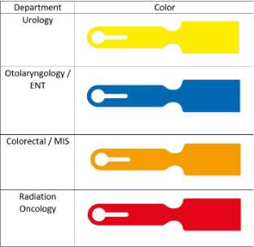
Storage, Transport and Hang Time
Drying cabinets or HEPA-filtered cabinets preferred
Hang time policies: from 7 to 30 days (depending on guidance and risk assessments)
ST91 (2021): No evidence supports extended storage unless microbiological testing is done
Scope reprocessing required after expiration
Transport in clean sealed containers and always manage with clean gloves
Notes:
Most facilities follow best practices by storing endoscopes in drying or HEPA-filtered cabinets, which help ensure channels are dry and ready for the next patient after processing. Hang times vary by facility—typically 7 to 30 days—based on risk assessments by infection prevention and departmental leadership. AAMI ST91 currently indicates there is no clear evidence to support extended storage without microbiological testing. Once a scope’s hang time has expired, it must be reprocessed before reuse. When transporting scopes to a procedure area, retrieve them with clean gloves and place them in a clean, sealed container. Storage areas should be separate from reprocessing rooms and patient procedure rooms.

Slide 16

Quality Assurance and Documentation
Tracking system (digital or manual)
Scope ID, user, patient, procedure
Visual inspection logs
Routine internal inspections (e.g., borescope program)
Risks when bringing in loaned scopes, not knowing how they were handled
Culture of Accountability
Notes:
There continues to be quality assurance challenges in endoscope processing. Studies continue to show residual contamination and biofilm formation in patient-ready, reprocessed scopes. Manual cleaning remains labor-intensive and vulnerable to human error. Even with automation, critical steps like drying and visual inspection are often inadequately performed or omitted.
Technological Integration and Data-Driven Decision Making should be implemented. Facilities can use digital traceability systems to document each reprocessing step, linking endoscope use, staff, equipment, and patient data. Decision makers have access to dashboards and analytics to identify trends, noncompliance, or equipment issues early. Investing in emerging technologies (e.g., single-use scopes, AI-enhanced inspection) is based on value analysis and infection prevention metrics.
Creating a culture of accountability and interdisciplinary collaboration can drive patient safety. Perioperative partners, GI, infection prevention, and sterile processing teams operate in alignment, with clearly defined roles and responsibilities. Leadership prioritizes endoscope safety in budgeting, staffing, and strategic planning. There is a just culture that encourages reporting, feedback, and iterative system improvement.

Slide 17
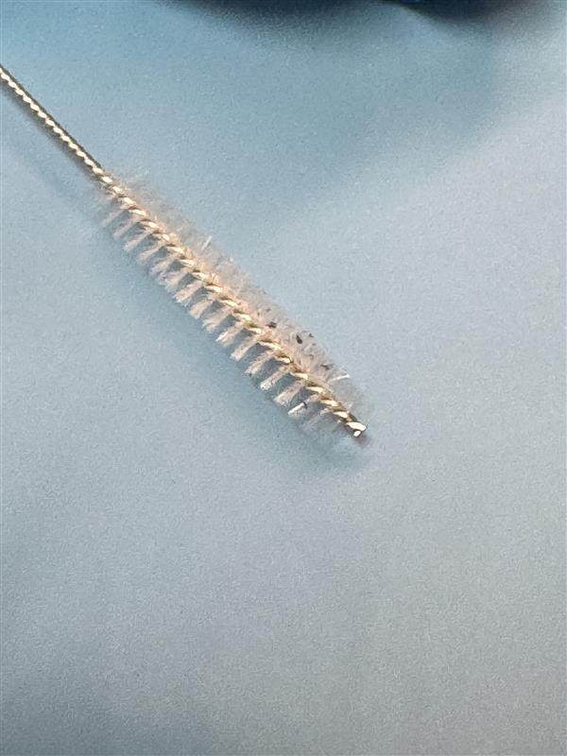
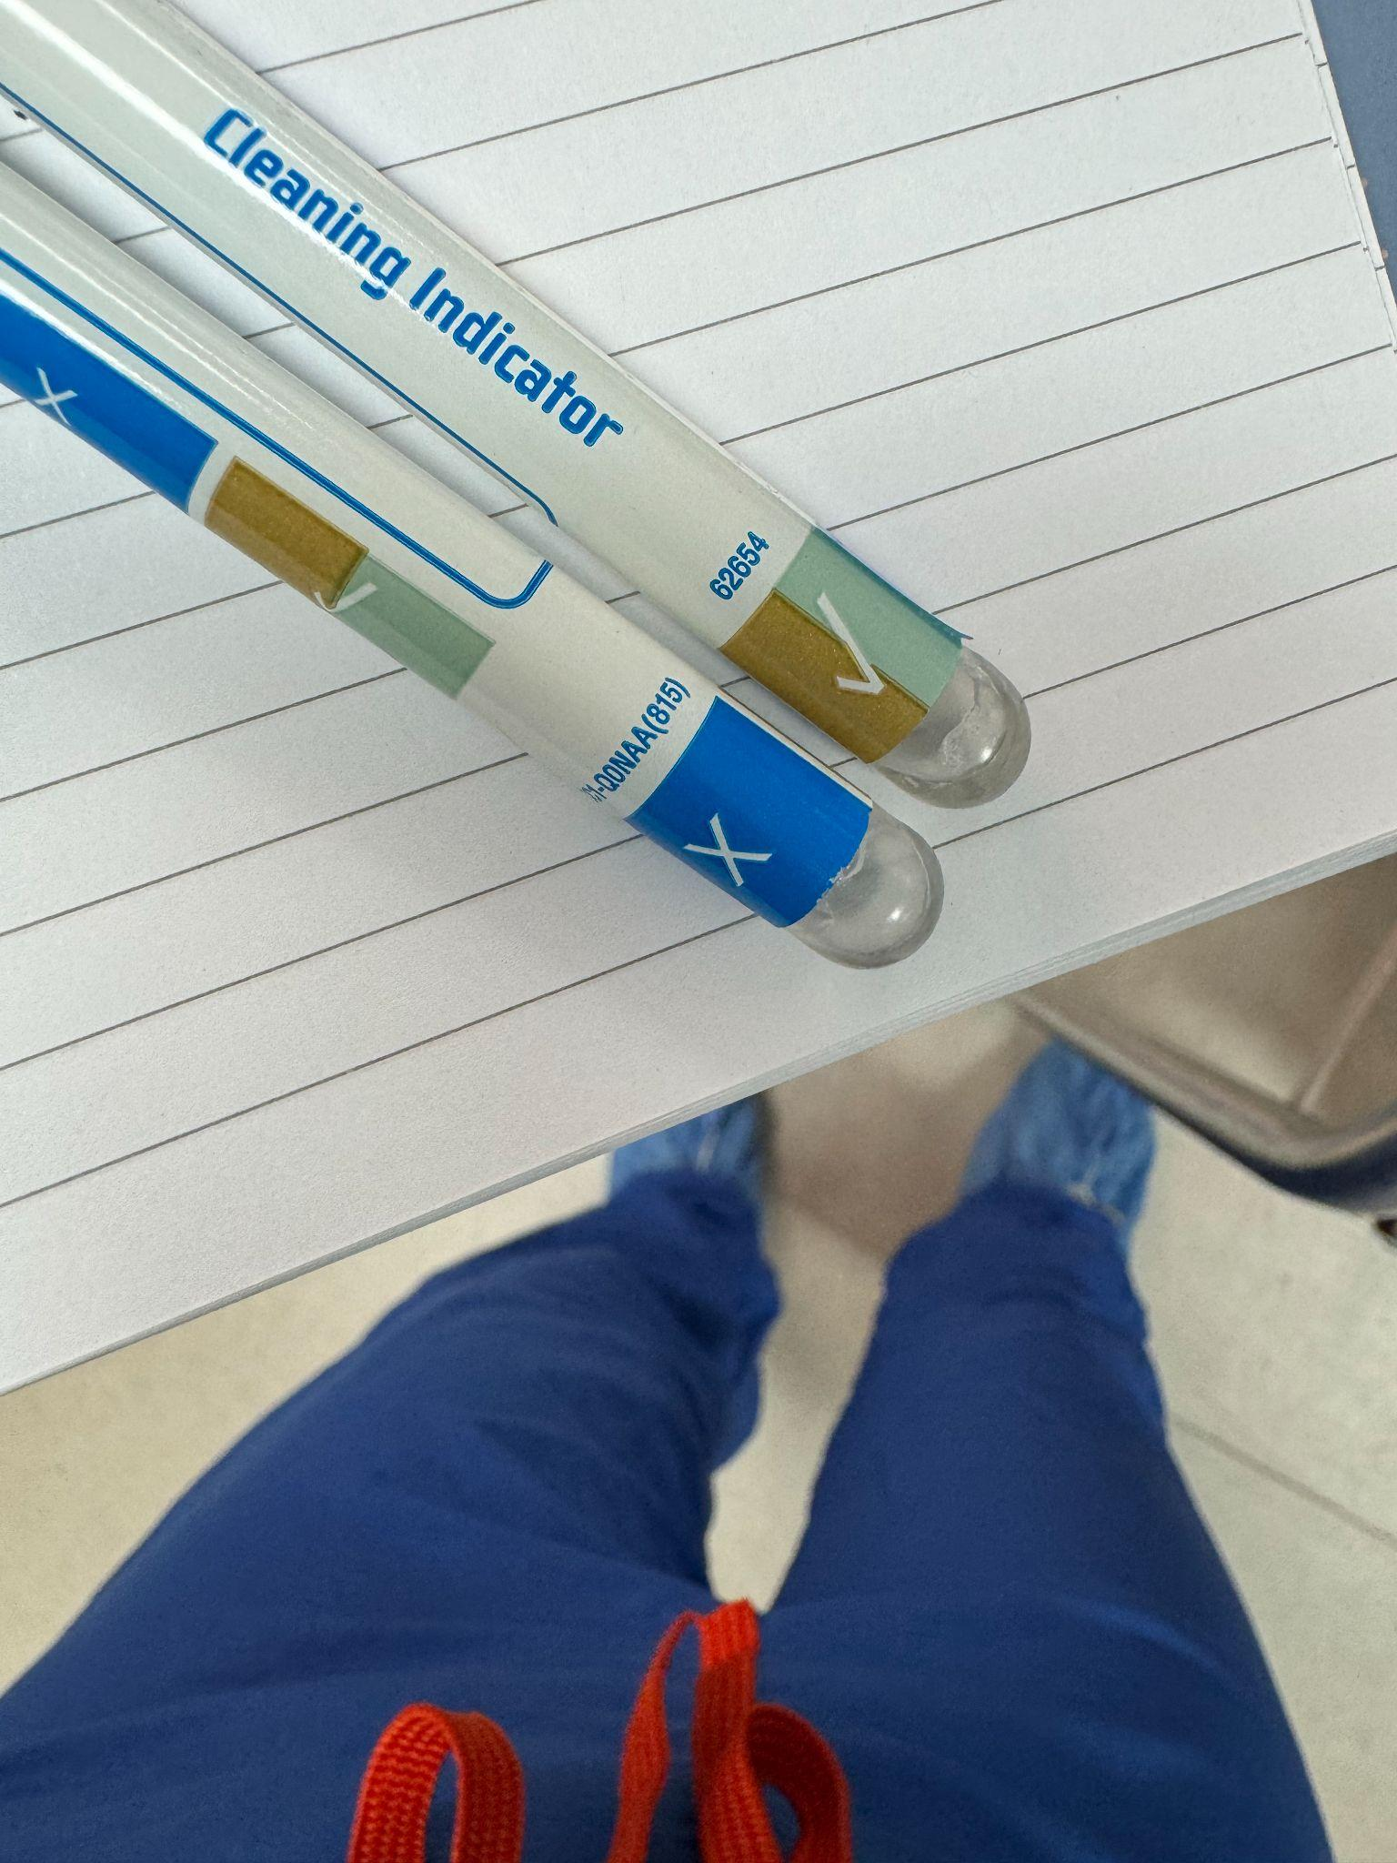
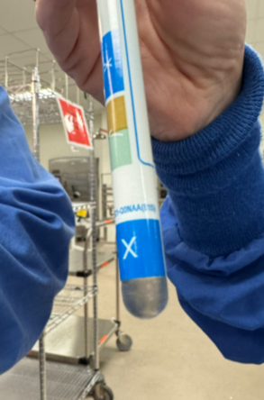
Supplemental Tools:
Chemical Verification and Residual soil
Chemical verification test
ATP (adenosine triphosphate) testing: detects organic residues
Protein tests
Not a replacement for manual cleaning
Notes:
Some great supplemental tools to have on hand for a great program are chemical and residual soil marker testing. These chemical verification tests allow staff to see if their cleaning steps were done properly. Some facilities perform these verifications on a percentage of scopes while others may choose to test all their scopes. You will have to determine what is best for your program. There are various tests that all do different things such as ATP for organic residue and protein tests that look for blood or body fluid. Of course they are not a replacement for manual cleaning but another layer of protection and quality checks.

Slide 18
Loaned Endoscopes
Coordinate with SPD in advance when loaned endoscopes
are expected. Ensure:
Policy for lending or borrowing endoscopes should be developed with stakeholders
Information is entered into the facility system and equipments (i.e., Automated Endoscope Reprocessor (AER) and drying cabinet systems, and other RF IDs)
Confirm accessories and connection adapters are available
Reprocess before patient use
Quality assurance (borescopic assessment and chemical verification)
Inspect for damage upon receiving before use
If damage is suspected upon receipt, document the condition and return
Obtain, save, review MIFU for compliance with reprocessing
Notes:
Coordination with your SPD department on any loaned endoscopes the MD may need for cases is important. This ensures that staff have the competencies to process the scope, the tools necessary, the scopes ID has been entered into the facilities tracking system if needed, accessories or adapters are available, it has time to be processed before use, and the MIFUs are on hand. This timing is important as well to ensure there is no damage to the loaned scope upon receipt. If it is found damaged, it would be documented and returned. Ensuring the automated endoscope reprocessor also has attachments for the model of scope or the drying cabinet also has the correct attachment to ensure there is a safe storage location is important. There are many factors that come into play bringing in a scope from the outside.

Slide 19

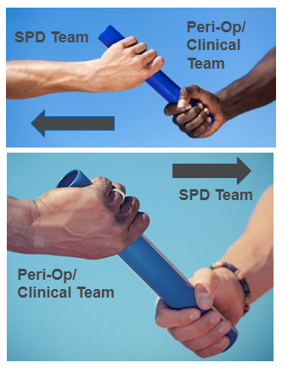
Communication
Volume of endoscopes needed for procedure
If new service lines will be added
Plan to purchase new medical devices before acquiring
Need to prepare reprocessing teams with training for cleaning and HLD/sterilization and IFU
Review workflow and product compatibility
Medical device trials
Medical device and product recalls
Notes:
Communication is key between the perioperative staff and the SPD. Think of this as a baton handoff during a race, that if it is dropped, something gets missed and that impacts everything downstream including the next patient who has a procedure done. Some of the communication that is important are the volume of procedures and scopes that may be needed for each procedure during the day, or if new service lines are being added. This will increase or decrease the amount of need in the processing space. Anytime there is a plan to purchase new equipment for the department or the OR, work with your SPD and endoscopists to ensure they have the equipment needed to process the scope safely. Compatibility with the AER, and even the chemistries is all very important. If MDs want to perform medical device trials this needs to be a multidisciplinary discussion that must include OR, SPD, endoscopists, and even your Infection preventionists to ensure the medical device can be safely processed. Having a clear way to communicate recalls as well on scopes can be a challenge. Work with your risk department and your Infection Preventionist to communicate all vendor and medical device recalls for scopes.

Slide 20
Communication
Clinical Team Expectations for Case Set-Up
Preparation Protocols
All equipment is ready and functional
Coordination with SPD for urgent needs
Accountability and Readiness
Role clarity between OR staff and SPD
Communication & Collaboration
Between Clinical Team, Peri-Op, and SPD
Standardized communication channels
Escalation pathways for urgent issues < 24 hours
Tools for Collaboration
Shared checklists
Real-time updates via digital platforms
Notes:
Communication is key between the perioperative staff for case set up. Making sure all the equipment is ready and functional as well as items needed for urgent cases. Establishing clear expectations of roles between OR staff and the SPD. The collaboration with the clinical team, perioperative team, and SPD can be done through standardized communication channels with escalation pathways for issues that are less than 24 hours prior to a case. Some tools for example to use for collaboration are shared checklists or real time updates through digital platforms, cell type phones, and other communication devices for clear communication.

Slide 21
Discrepancies Across Guidelines and Emerging Evidence

Slide 22
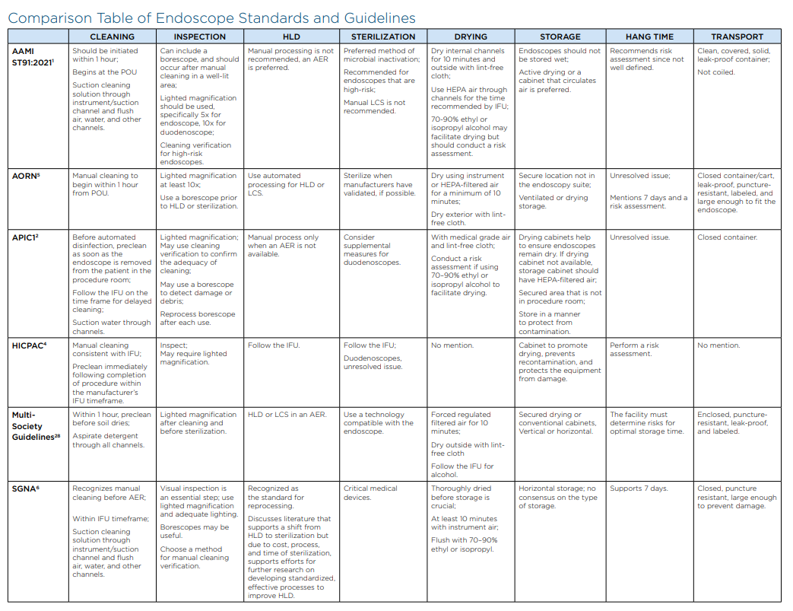
Conflicting Guidelines
Navigating the Maze
FDA and manufacturers
CDC
SHEA
https://apic.org/wp-content/uploads/2025/08/2025-APIC-Endoscope-Issue-Brief-02.pdf
Notes:
The above chart shows the conflicting guidelines. It is truly like navigating a maze when determining how to choose what standards or guidelines to follow when building a departments practice. This table was pulled from the APIC Endoscope Brief that was published in 2025 to aid facilities in having a reference to use to quickly see in one place what these professional organizations recommend on the various steps in processing from cleaning all the way through storage and transport. It would be ideal for all the organizations to agree but in many cases they have varying opinions and evidence to support their stance one way or the other. The FDA, manufacturers, CDC, and SHEA conflict with what these standards and guidelines all say. Again, no one organization agrees with another.

Slide 23
Emerging Evidence: Alcohol
Helpful or Harmful?
Some IFUs prohibit use (e.g., damage to seals)
Others recommend for drying
Ofstead study: drying, not alcohol, was most effective step
Alcohol must not replace mechanical drying
Notes:
So is alcohol helpful or harmful? Well we know it drys our skin out so imagine what is can do to an endoscope. Some IFUs prohibit the use of alcohol because of the damage that it does to internal seals, drying them out to the point where they crack causing damage. Other manufacturers recommend alcohol to aid in drying. There is an Ofstead study, that shows drying, not alcohol, was the most effective step. Alcohol must not replace mechanical drying…and wiping the outside of a scope with alcohol is NOT a step in processing. AAMI ST91 and APIC says a risk assessment should be done for the use of alcohol whereas the Multi society guidelines says to follow the IFU.

Slide 24
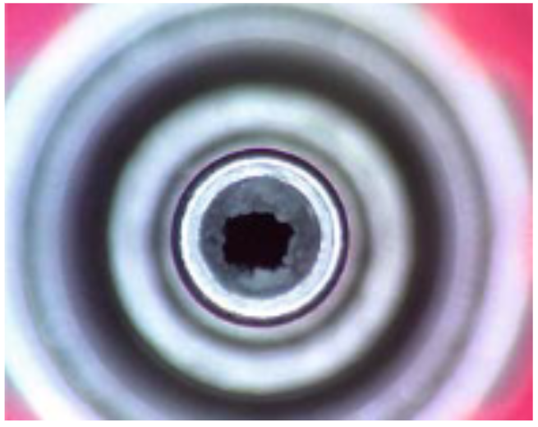
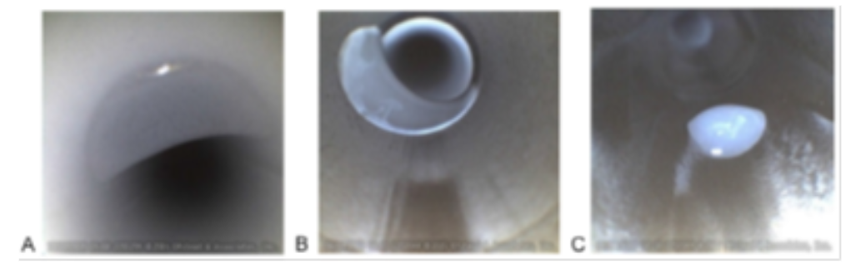
Simethicone and Risks
Why RNs and clinical staff are critical in the process
Simethicone may persist inside endoscopes after cleaning, reducing reprocessing effectiveness
Increasing the risk of microbial biofilm formation
Unable to be removed prior to HLD or sterilization which has been proven in studies
May carry over to the next patient
Netherlands Water-Jet Channel Study
16/16 facilities had crystallized simethicone in endoscope water-jet channels
Residue could not be removed with standard detergents or disinfectants
Ofstead "Call to Action" Study
69 fully reprocessed scopes from 4 hospitals were borescoped
When simethicone and/or fluid was visible, 71% tested positive for pathogens
Pathogens included E. coli, Citrobacter, Stenotrophomonas, and mold
van Stiphout SH, Laros IF, van Wezel RA, Gilissen LP. Crystallization in the waterjet channel in colonoscopes due to simethicone. Endoscopy. 2016 0;48(S 01):E394-E395. doi: 10.1055/s-0042-120261. Epub 2016 Dec 2. PMID: 27912222.
Ofstead CL, Hopkins KM, Eiland JE, Wetzler HP. Widespread clinical use of simethicone, insoluble lubricants, and tissue glue during endoscopy: A call to action for infection preventionists. Am J Infect Control. 2019 Jun;47(6):666-670. doi: 10.1016/j.ajic.2019.02.012. Epub 2019 Mar 26. PMID: 30922624.
Notes:
Nursing should communicate when simethicone was used during a procedure due to the risks. These risks include reducing the effectiveness of cleaning and reprocessing, increasing the risk of microbial growth, or damage to channels over time. Recent studies have shown that simethicone has been unable to be removed prior to HLD or sterilization. This is concerning because something could be carried over to the next patient. The first image on the top left shows the crystallization of simethicone over time in the water jet channel. The residue could not be removed with regular detergents or disinfectants. The bottom images were from a study by Cori Ofstead where 71% of the scopes looked into with a borescope showed residual fluid including Simethicone along with other pathogens leading us to believe that simethicone contributes to harboring organisms.

Slide 25

Emerging Evidence: Simethicone
Use with caution
Non-water soluble, clogged channels
Detected even after HLD in scopes
Not removed effectively by standard cleaning
Should only be used if IFU permits and dose is communicated
Notes:
The controversy of the use of Simethicone has been ongoing for several year. Many are leaning towards use with caution. It is important to understand that it is a non-water soluble substance. This means it can clog channels and cannot be removed with brushes and AER’s. It has been detected even after HLD as mentioned previously with visualization which we will discuss more in just a bit. Standard cleaning does not remove this substance and it should only be used if the IFU of the scope permits. When the scope goes back for processing, communication is key to the endoscopist. let them know the dose that was used for the procedure.

Slide 26
Biofilm Formation and Risks
Forms within minutes to hours if debris remains
Resistant to HLD and sterilization
Prevention = complete mechanical cleaning and drying
Once established, cannot be removed with HLD or sterilization
Image provided and created by Jessica Alicdan of a lumened instrument commonly used in procedures
Notes:
Simethicone may have a role in biofilm development. Biofilm can develop very quickly within minutes to as quickly as an hour. This is why when point of use care has been done, it needs to be documented when it is completed so processing can begin within an hour. Biofilm once fully formed is surrounded by proteins that become like a cement that are resistant to all types of HLD or sterilization and they cannot be removed. How do we prevent biofilms you might ask? Well, we need to complete mechanical cleaning and drying fully following MIFUs in a timely fashion. The images you see above is where a lumen was cleaned with a brush the size the manufacturer said to use according to the IFU. With a borescope you could see the channel was still not clean. So, another larger brush was used and you could see through subsequent cleaning the channel became cleaner…but ultimately the biofilm was still there.

Slide 27
Human Based Factors and
System-Based Risk

Slide 28
Human Factors and Training Gaps
Less than 15% of staff formally trained
Confidence often higher than actual competency
Staff may not recognize scope damage or failed cleaning
Routine education and competency validation are essential
Time constraints around turnover and staffing
Notes:
Human Factors and Education Gaps: Human factors, such as workflow inefficiencies, staffing shortages, lack of training, and cognitive overload, contribute to deviations from protocol. Education programs are often inconsistent or not competency-based, leading to misunderstandings about the risks of improper reprocessing. Confidence is key but it must be supported with actual competency in each model of scope in the department. Most staff are not able to recognize damage or failed cleaning especially with the naked eye. New hire, yearly, and with each new scope purchase; competency validation is essential along with routine education for all staff that will process. Another barrier is time constraints that staff may face. Endoscopy cases may be brief pressing staff to be quick to turn over scopes. That pressure can lead to missed steps with time constraints. Creating a culture of safety to ensure safe processing is paramount.

Slide 29

Volume, Time, and Turnover
Workflow impact depends on
Volume
Number of endoscopes/models for procedures
Disinfection techniques (e.g., HLD, liquid chemical sterilization, sterilization in SPD)
Number of reprocessing technicians to support
Turnaround time and staffing support
Full-time dedicated reprocessing technician or SPT versus none
If a shared reprocessing space, the number of departments to share sinks and AERs
Notes:
Workflow definitely impacts the safety of scopes. The sheer volume of procedures and how many scopes the proceduralist decides to use can be very overwhelming depending on the size of the processing space and the equipment in use. Some facilities use two scopes for every procedure but don’t use them both. In this case, keep in mind, both scope must be processed because they were both in the room. This puts undue stress on the staff, equipment, and the time it takes to turn over scope possibly needed for another case or two that day. The amount of FTEs to process scopes for the amount of scopes can vary depending on volume. The departments must also taken into account the disinfection choices of HLD or sterilization for time and turnover. Having full time staff who are experienced versus staff that fill in on occasion, you need consistencies. Also, if this is a shared space such as an SPD the sinks may be used for something other than scopes and volume will dictate priorities OR versus scopes for example. Keep all these in mind for scope safety.

Slide 30
Polling Question
Does your facility have and use borescopes to inspect the internal channels of endoscopes?
Yes
No
I don’t know
We have a plan to bring them In
I don’t know what that is
Notes:
So now we would like for you to participate with a polling question. Does your facility have and use borescopes to inspect the internal channels of endoscopes?

Slide 31
Borescope Demonstration and Interpretation- Inspection of scopes
Notes:
So we would like to show you now where the future of scope processing is going to ensure they are safe to use.

Slide 32
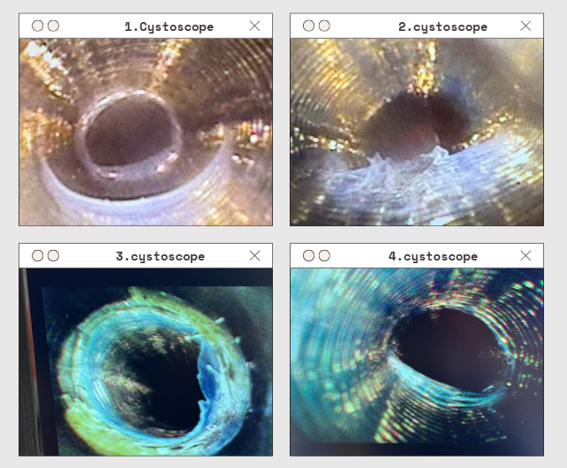
Supplemental Tools: Borescopes
Borescope: internal channel inspection
Finds damage, retained debris, scratches, residual fluids, biofilm
Artificial intelligence integration
Image provided and created by Jessica Alicdan.
Blue light endoscopic imaging is an enhanced diagnostic procedure for bladder cancer. It uses a specialized contrast agent that is preferentially taken up by rapidly growing cells, such as cancer cells. Under blue light illumination, these cancerous cells fluoresce bright pink or red, improving visualization and detection compared to standard white light cystoscopy.
Notes:
The supplemental tool that is changing safety in scope processing is the us of borescopes and integrating AI. The internal channel inspection is key to safety in processing. You can see ripples, tears, shedding, water, residual debris, pieces of brushes, simethicone, bioburden, and even biofilm with borescopes. Newer borescopes have AI integration which helps the end user understand what they are seeing helping with training programs.

Slide 33
Scope Damage
Causes and Consequences
Excessive angulation, improper insertion, dropping
Improper processing and handling
Internal tears or abrasions often go unnoticed
Leak testing is the first sign
Borescope inspection reveals hidden damage
Visual Inspection prior to use is Key!
Notes:
Scope damage can be caused by a multitude of reasons. Sometimes during a procedure the proceduralist can use excessive angulation, improper insertion, or may even drop the scope. During transport many scopes become damage if they are over coiled during transport. The department processing the scope may incorrectly leak test or handle the scope in the sink which could damage the scope. Internal tear and abrasions often go unnoticed but if a leak test is done correctly this will be caught! Borescope inspection reveals may key hidden damage such as crush injuries and interior tears. Visual inspection with the lighted magnificiation we previously spoke about is key.

Slide 34

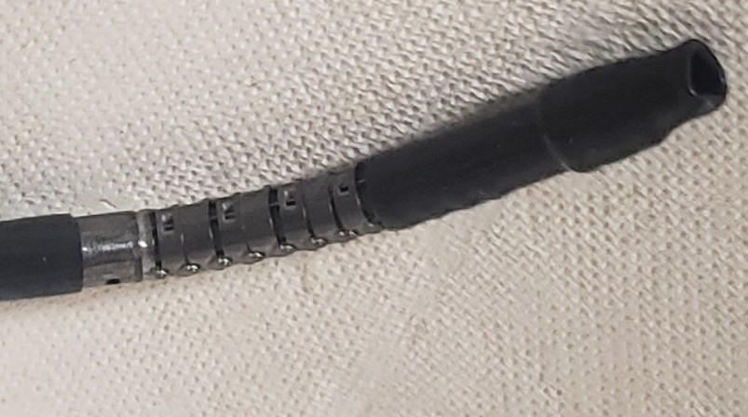
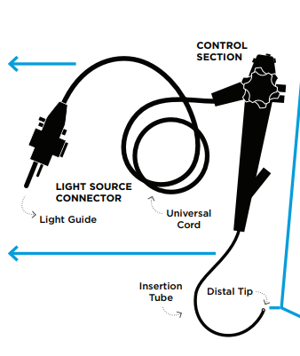
Damaged- ENT scope
Notes:
This was an ENT scope used on a patient and the MD said on the damage ticket, “I can’t see the images”
You can clearly see the reason why he is unable to see images. This shows the importance of checking for damage to a scope prior to its use.

Slide 35
Building Your Program- Translating Evidence into Action

Slide 36

Building Your Institutional Program
Use MIFU + AAMI ST91 + AORN + CDC
Implement Steering Committee and Endoscope/Medical Device Committee to include all stakeholders, decision making and effective communication
Root cause analysis of gaps and challenges
Customize program to equipment and staffing
Include job shadowing between OR and SPD
Create job aids for staff
Routine audits and feedback loops
Notes:
So you may be asking by now, how do I build a solid program? First and foremost all MIFUs need to be available in the processing space and then whatever guidelines or standards your policies and practices are built on such as AAMI ST91, AORN, or CDC. Having a good steering committee or Endoscope medical device committee with multidisciplinary stakeholders to effectively make decisions and communicate those to front line staff is valuable to the safety of all patients. When situations or opportunities arise, having a solid root cause analysis of gaps and challenges should occur possibly looping in quality and risk to guide you. Customize your program with the equipment and staffing to ensure the needs of the department are met daily. You may want to consider the use of disposable scopes in places that are high risk where scopes cannot be processed safely. A risk assessment can aid in determining the need for this type of scope. Job shadowing can be a valuable tool between the OR and SPD where the scopes may be processed. a Better understanding of what occurs can create a great bond between departments. Creating job aids and SOPs for staff ensure everyone is doing the same steps each time along with routine audits and feedback loops so staff understands expectations in the department. Building a great endoscope program doesn’t happen overnight, but with great leadership and due diligence it can happen!

Slide 37
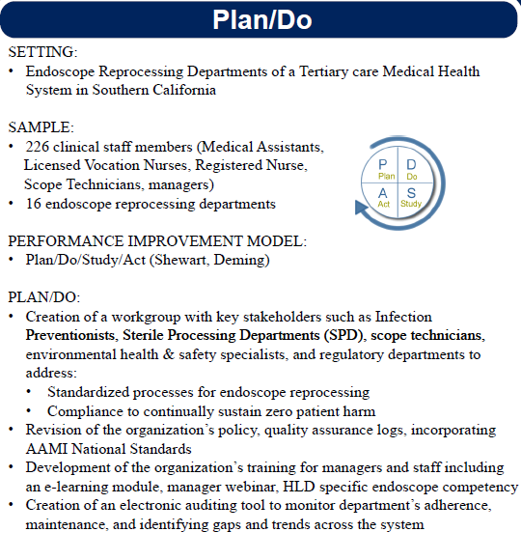
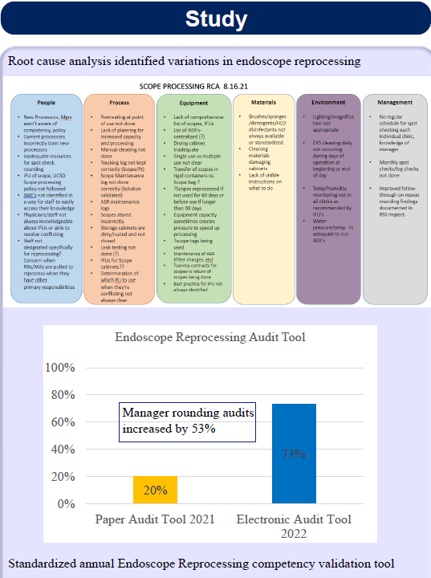
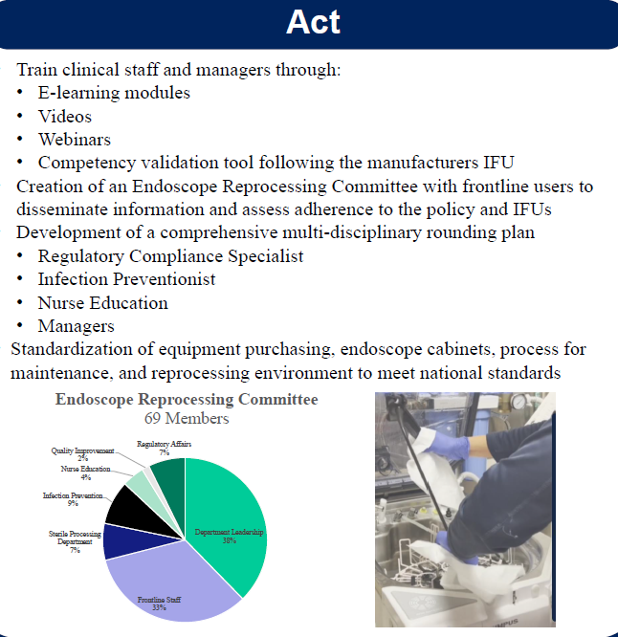
Building Your Institutional Program
https://library.aaacn.org/p/s/under-the-scope-a-multidisciplinary-approach-to-improve-endoscope-reprocessing-13799
Notes:
At any point in your program, it’s important to start with a baseline assessment of your current inventory, service lines and departments utilizing endoscopes. From there, you can build and understand the gaps and challenges for each department in a healthcare facility. A PDSA model was used in Jessica Alicdan’s approach. Steering committee with leaders and stakeholders were formed to make team work decisions and monthly information was shared to frontline staff involved in endoscope management revolving around survey prep, monthly round and opportunities uncovered. Electronic competencies were created and audit tools to provide real-time feedback and data tracking. Job aids were created after vendor trainings to assist with learned experiences.

Slide 38
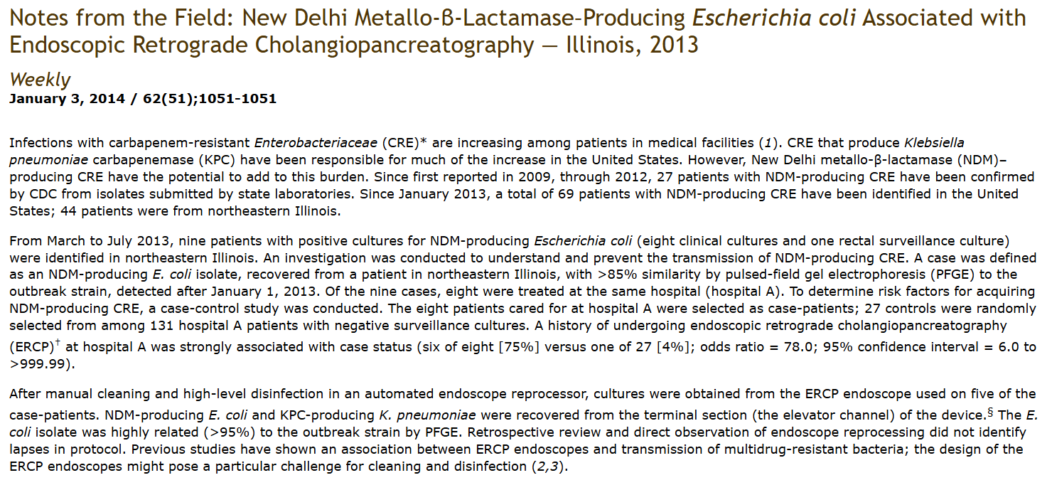
Real World Case Study
Notes:
Over a period of five months in 2013, nine patients became positive for NDM Escherichia coli (New Delhi metallo-β-lactamase producing) resistant to carbapenems. All samples were identified with greater than 85% similarity to another outbreak strain in the same area of Illinois recently identified. Eight of these patients were seen at the same hospital recently and an investigation ensued to determine how these patients were infected with this similar organism.
It was determined that six out of eight patients had a procedure done called an endoscopic retrograde cholangiopancreatography (ERCP) with a high-level disinfected endoscope that had been reprocessed in an automated processor. Five endoscopes tested for the organisms in question came back positive with the same highly related strain (>95% confidence interval = 6.0 to >999.99).
Based on the information, it was determined there was an outbreak related to the endoscopes used in the ERCP procedures. In addition to the original nine patients, an additional 90 patients were notified of the potential exposure. Of those patients, 50 came back to the facility to be tested. The patients underwent rectal swabs and of those, 46% were positive with the same organism. Later, an additional twelve patients were also tested, which brought the total count infected to 44 known patients.
Once the severity was realized, the facility changed their processing techniques. Deciding that high-level disinfection was not working for their ERCP endoscope, they decided to move to sterilization with ethylene oxide (ETO). After implementing sterilization, there have been no further outbreaks or infections in their patients.
These real world examples show us that processing scopes is a risky endeavor that even back to 2013 scopes were transmitting infections. This shows that in healthcare we need to bridge evidence and practice in supporting effective clinical decision-making.

Slide 39
Summary and Takeaways
Endoscope reprocessing is high risk, high responsibility
RNs play a crucial role in early and final inspection
IPs are key partners with PeriOp and SPD
Consistency, education, and QA = safer outcomes
When in doubt: reprocess, report, remove from service
Notes:
To summarize, endoscope processing is a very high risk, high responsibility task. It takes training, competencies, verification, constant supervision, and ensuring you have a strong multidisciplinary group to oversee a quality program. Nurses play a crucial role in early and final inspection prior to scopes being used on patients. Consistency in education will lead to safer outcomes. Creating a culture of safety so when in doubt, reprocess the scope, report issues, and remove from service.

Slide 40
References
Association for the Advancement of Medical Instrumentation. (2017). ANSI/AAMI ST79:2017/(R)2022: Comprehensive guide to steam sterilization and sterility assurance in health care facilities. AAMI. https://doi.org/10.2345/9781570208027
Association for the Advancement of Medical Instrumentation. (2022). ANSI/AAMI ST91:2021: Flexible and semi-rigid endoscope processing in health care facilities. AAMI. https://doi.org/10.2345/9781570208300
Centers for Disease Control and Prevention. (2008). Guideline for disinfection and sterilization in healthcare facilities, 2008 (Update: June 2024) [PDF]. https://www.cdc.gov/infection-control/media/pdfs/GuidelineDisinfection-H.pdf
Day, L. W., Muthusamy, V., Collins, J., Kushnir, V. M., Sawhney, M. S., Thosani, N. C., & Wani, S. (2021). Multisociety guideline on reprocessing flexible GI endoscopes and accessories. Gastrointestinal Endoscopy, 93(1), 11–33.e6. https://doi.org/10.1016/j.gie.2020.09.048
Day, M. (2024). Endoscopy. In R. Dean & S. Popescu (Eds.), APIC text. APIC. https://text.apic.org/
FDA/CDC/ASM. (2018). Duodenoscope surveillance sampling & culturing: Reducing the risks of infection [PDF]. U.S. Food and Drug Administration. https://www.fda.gov/media/111081/download GI Societies Joint Statement. (2022).
GI societies joint statement on ANSI/AAMI ST91: GI societies vote no on AAMI revisions on endoscopic processing. Gastrointestinal Endoscopy, 96(4), 571–575. https://doi.org/10.1016/j.gie.2022.02.004
Healthcare Infection Control Practices Advisory Committee. (2016). Essential elements of a reprocessing program for flexible endoscopes - The recommendations of the healthcare infection control practices advisory committee (HICPAC) [PDF]. Centers for Disease Control and Prevention. https://www.cdc.gov/hicpac/media/pdfs/essential-elements-508.pdf
Ofstead, C. L., Smart, A. G., Hopkins, K. M., & Wetzler, H. P. (2023). The utility of lighted magnification and borescopes for visual inspection of flexible endoscopes. American Journal of Infection Control, 51(1), 2–10. https://doi.org/10.1016/j.ajic.2022.08.026
Centers for Disease Control and Prevention (CDC). Notes from the Field: New Delhi metallo-β-lactamase-producing Escherichia coli associated with endoscopic retrograde cholangiopancreatography - Illinois, 2013. MMWR Morb Mortal Wkly Rep. 2014;62(51-52):1051
Pineau, L., Alfa, M., & Radix, C. (2024). Endoscope sampling and culturing methods. Journal of Hospital Infection, 149, 36–45. https://doi.org/10.1016/j.jhin.2024.03.017
Ribeiro, M. M., Graziano, K. U., Olson, N., França, R., & Alfa, M. J. (2020). The polytetrafluoroethylene (PTFE) channel model of cyclic-buildup biofilm and traditional biofilm: The impact of friction, and detergent on cleaning and subsequent high-level disinfection. Infection Control & Hospital Epidemiology, 41(2), 172–180. https://doi.org/10.1017/ice.2019.306
Shenoy, E. S., Weber, D. J., McMullen, K., Rubin, Z., Sampathkumar, P., Schaffzin, J. K., Sickbert-Bennett, E., Washer, L., Yokoe, D. S., Calderwood, A. H., Chinn, R., Day, M., Garcia-Houchins, S., Javaid, W., Klacik, S., Kyle, E., Murthy, R. K., Wood, A., & Rutala, W. A. (2025). Multisociety guidance for sterilization and high-level disinfection. Infection Control & Hospital Epidemiology, 1–23. https://doi.org/10.1017/ice.2025.41
Society of Gastroenterology Nurses and Associates, Inc. (2023). Standards of infection prevention in reprocessing flexible gastrointestinal endoscopes. https://www.sgna.org

