Slide 1



Welcome
Feb 11th, 2026 – 12:00 pm PST

Slide 2





Online Participant Reminders
This meeting will be recorded
Presentation slides are available on our Meetings page
Please stay muted during the educational presentation and do not put us on hold if you are calling in on a phone line
Type in any questions or comments in the chat
CEUs will be provided after completion of speaker evaluation - a link will be shared at the end of the meeting

Slide 3



Today’s Meeting Sponsor

Slide 4
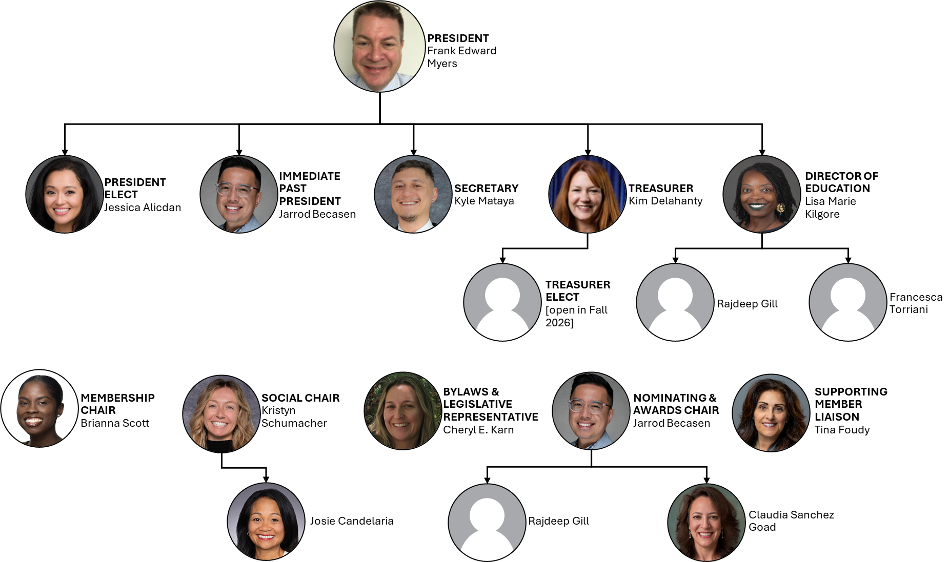

Slide 5
Introductions & Recognitions
New members
New certifications or re-certifications
First time attendees

Slide 6
Old Business
November minutes approval

Slide 7
New Business Frank Myers
Kahoot agreement

Slide 8
Membership Report Josie CandelariA/Brianna Scott
127 full/active members as of 2/9/2026
51 members with CIC
30 associate/supporting members
1 members LTC-CIP
2 members with a-IPC (Associate-Infection Prevention & Control

Slide 9
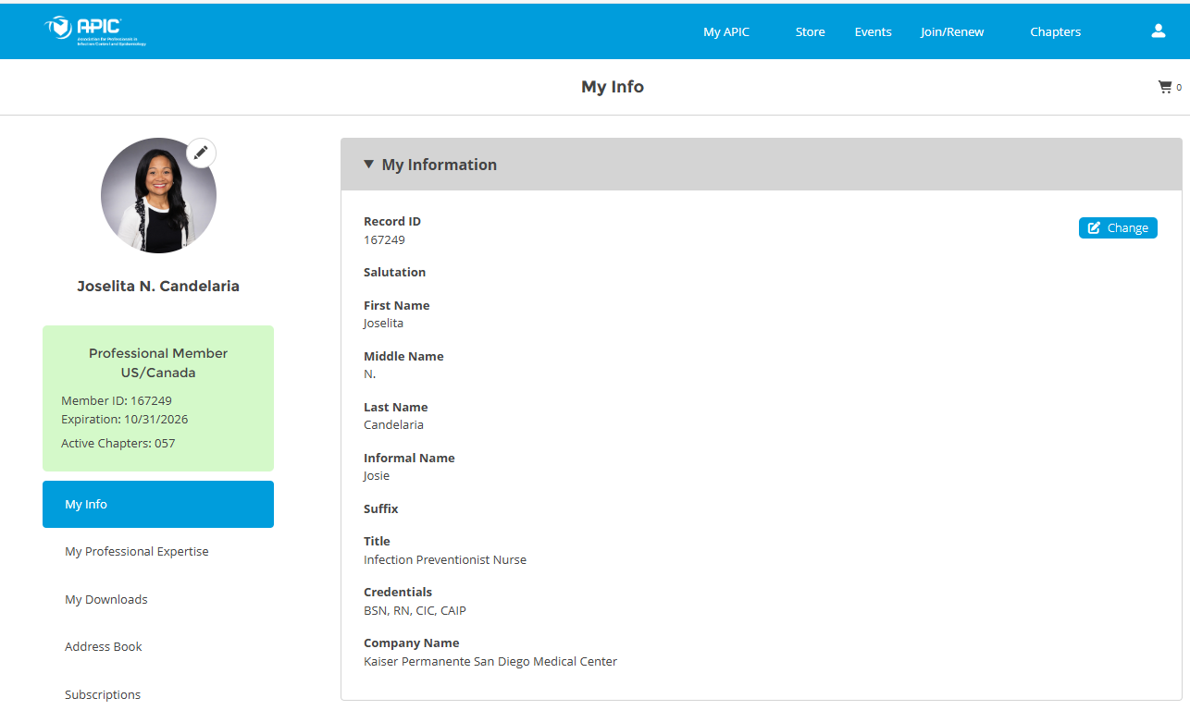
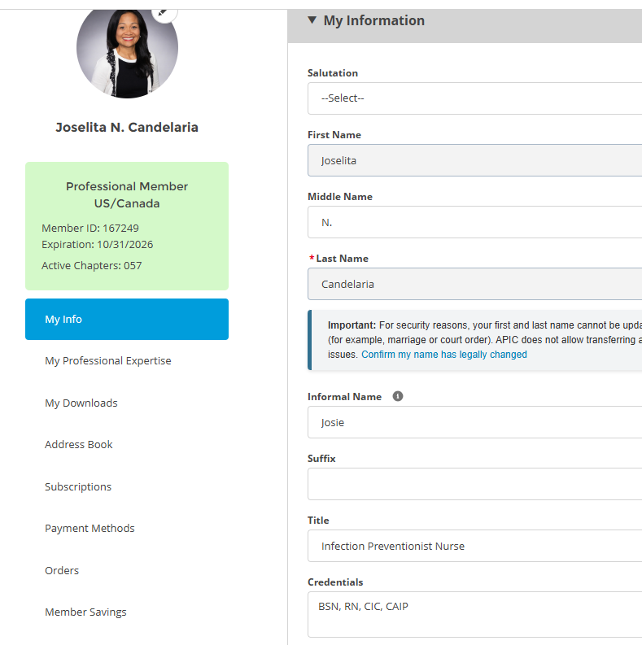
Membership Report Josie CandelariA/Brianna Scott Adding your Credentials to your profile
Notes:
In order to capture everyone who has a credentials, we need to add it our profile

Slide 10

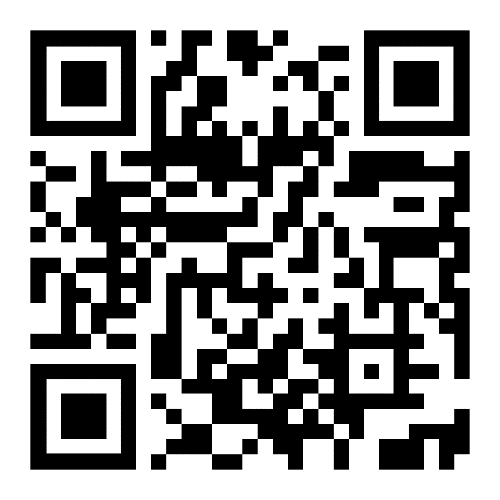
Nominating & Awards Jarrod Becasen, Claudia Sanchez GOAD, Raj Gill
"National APIC Conference" Award
Term of award: APIC Annual Conference 2026, June 15-17, Nashville, TN https://apic.org/apic2026/
Award Amount: $2000.00
Number of awards: 1
Application due date: May 6, 2026
"Standard APIC" Award
Term of award: January 1, 2026 to December 31, 2026
Award Amount: $500.00
Number of awards: 3
Application due date: May 6, 2026

Slide 11

Social Report Kristyn Schumacher, Josie Candelaria
No Updates

Slide 12
Treasurer Report February 2026 Kim Delahanty
Monthly Treasurer Report:
Beginning Balance: January 30, 2026: $870.99
Cash Flow:
Deposits: Jarrod $500.00 ($480 +$20)?
Checks paid: 0
ATM & Debit Card Withdrawals: 0
Electronic Withdrawals: 0
Bank Fees: $15.00
Ending Account Balance: 870.99
Mutual Fund: 31,866.65 as of Novemeber 28,2025

Slide 13

Legislative Rep Report Cheryl Karn
Lessons learned over the years:
Representatives and senators may not be present on Fridays, which is why we propose visits on a Wednesday for high engagement
Start booking your appointments between 0900-1130am and call your representatives in advance for an in-person discussion so we are not randomly cold calling
Find your local representative in California: https://findyourrep.legislature.ca.gov
Guidance: A file has been developed with tools and videos for new participants
https://apic.org/advocacy-toolkit/
The VIP toolkit includes:
Tips for planning a legislative visit
Tips for deciding which legislators to meet with
Tips for preparing materials
Sample planning timeline
Sample meeting request letters
Sample talking points
Sample follow-up letters

Slide 14
Ambulatory care Janessa Esteban

Slide 15
HAI Liaison & Advisory Report TBD

Slide 16
Infectious Disease Association of CA

Slide 17
G.E.R.M. Commission Frank Myers

Slide 18

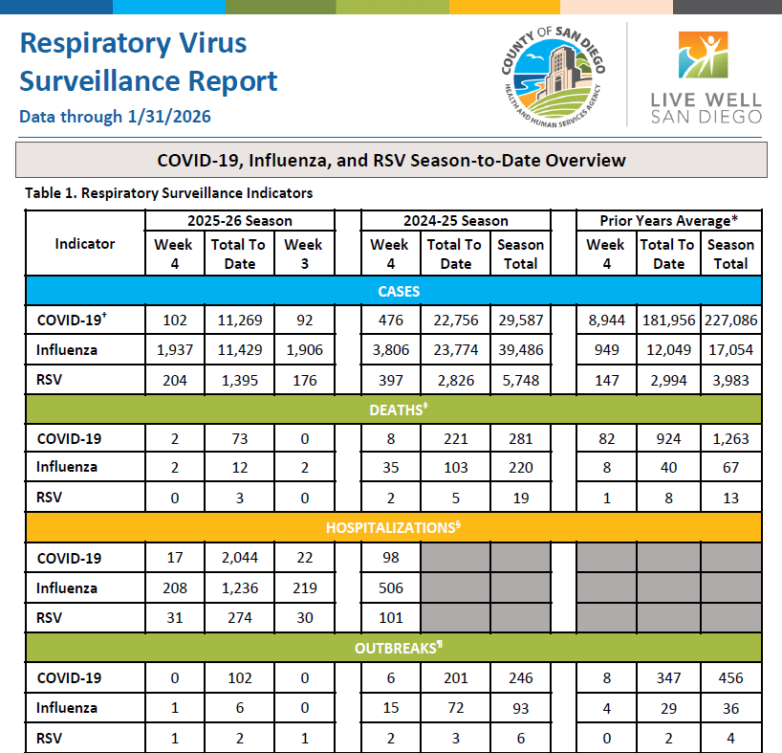

Don’t forget to subscribe to the Respiratory Virus Report – now updated weekly
https://www.sandiegocounty.gov/content/sdc/hhsa/programs/phs/community_epidemiology/dc/respiratoryviruses/surveillance.html
SANDIEGOCOUNTY.GOV/HHSA

Slide 19
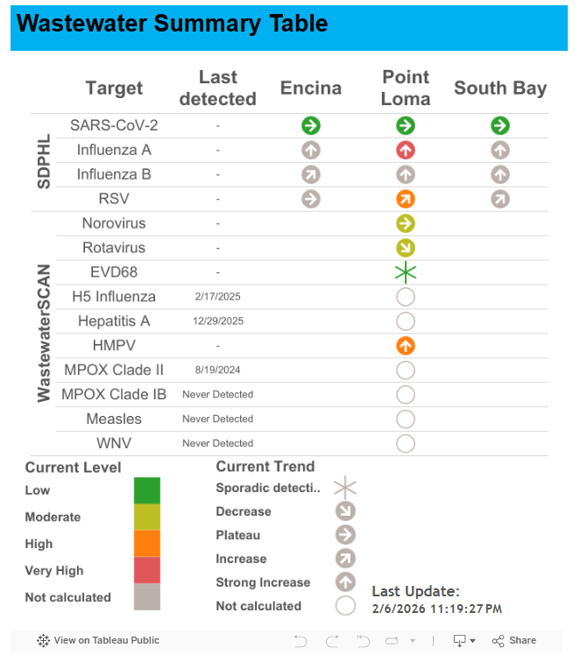
County of San Diego
Wastewater Surveillance Dashboard
SANDIEGOCOUNTY.GOV/HHSA
https://www.sandiegocounty.gov/content/sdc/hhsa/programs/phs/phs_laboratory/WastewaterDashboard.html

Slide 20
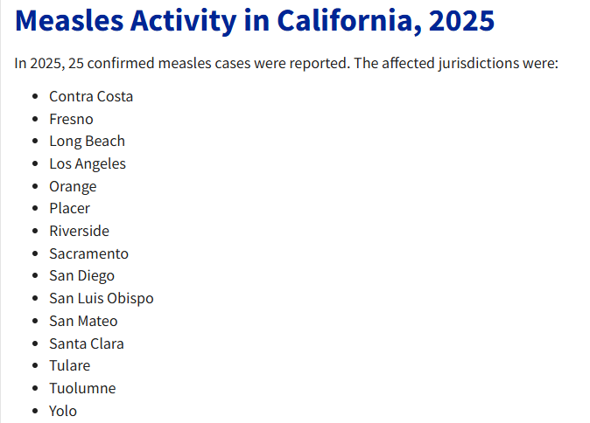
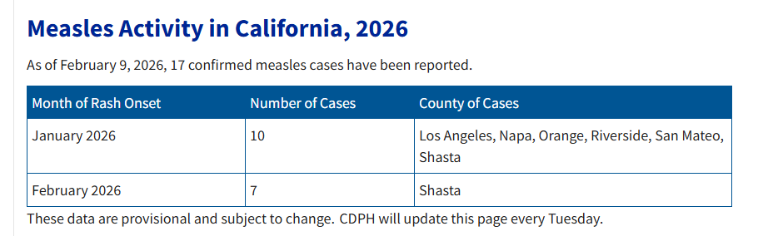
MEASLES IN CALIFORNIA
SANDIEGOCOUNTY.GOV/HHSA
Source: https://www.cdph.ca.gov/Programs/CID/DCDC/Pages/Immunization/measles.aspx

Slide 21
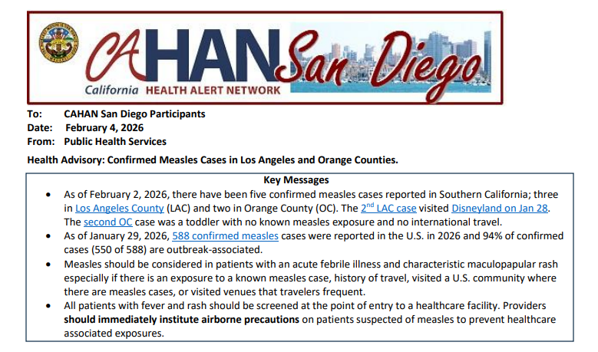
Measles in Southern California
Recent CAHAN posted on Wednesday, February 4th
Notification of 5 confirmed measles cases in Southern California; three in Los Angeles County and two in Orange County
One of the LA cases was infectious at Disneyland on 1/28
Since the release of CAHAN, Riverside county has reported their first confirmed case of 2026
SANDIEGOCOUNTY.GOV/HHSA

Slide 22
SAN DIEGO CURRENT SITUATION
As of February 10th, 2026:
0 confirmed measles cases
Last measles case was in August 2025. 341 contacts exposed – no secondary cases
Investigated 18 suspect cases since January 1, 2026
Investigated 9 contacts exposed on flights or in other states/jurisdictions including those recently at Disneyland when the exposure occurred on 1/28
SANDIEGOCOUNTY.GOV/HHSA

Slide 23
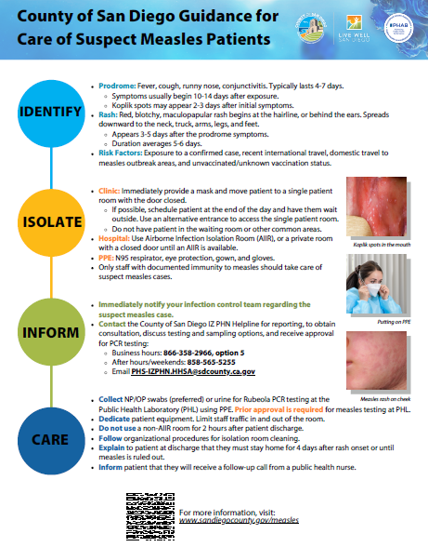
MEASLES REMINDERS
Provide travel vaccination recommendations:
Ask patients about upcoming travel
Early MMR dose infants 6-11 months of age
Consider measles diagnosis for patients with an acute febrile illness and characteristic maculopapular rash especially if there is a known measles exposure, history of travel, or if patient visited a U.S. community where there are measles cases or venues that travelers frequent
Screen patients at entrance of facility for fever and rash, institute airborne precautions to prevent healthcare associated exposures
Know vaccination status of your staff!
Identify shared air spaces in your facility.

Slide 24
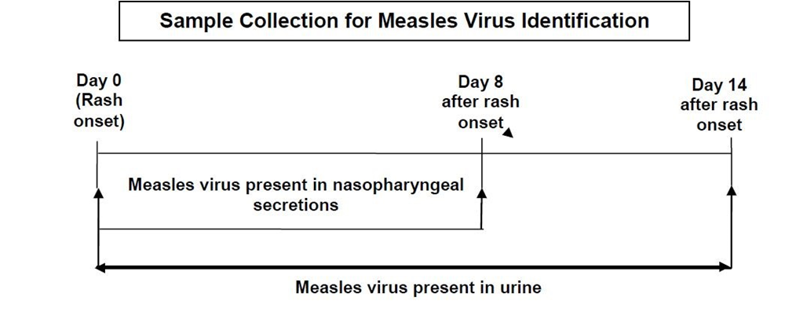
MEASLES REMINDERS
Measles Testing:
RT-PCR has the greatest diagnostic sensitivity
Uses nasopharyngeal, throat swabs, and urine specimens
Report suspected measles cases immediately to the County Immunization Program during office hours by calling (866) 358-2966, select option press 5, Monday-Friday 8AM-5PM and (858) 565-5255 after hours, weekends, and holidays
Visit the SD County measles webpage for additional resources/CAHAN alerts
CAHAN alerts: https://www.sandiegocounty.gov/content/sdc/hhsa/programs/phs/cahan_san_diego.html

Slide 25


Contact Info
If you suspect measles report to IZ PHN’s ASAP:
Email: PHS-IZPHN.HHSA@sdcounty.ca.gov
IZ PHN Line: 866-358-2966 option 5
Afterhours & Weekends: 858-565-5255
Website: www.sdiz.org
SANDIEGOCOUNTY.GOV/HHSA
Notes:
Contact Info

Slide 26
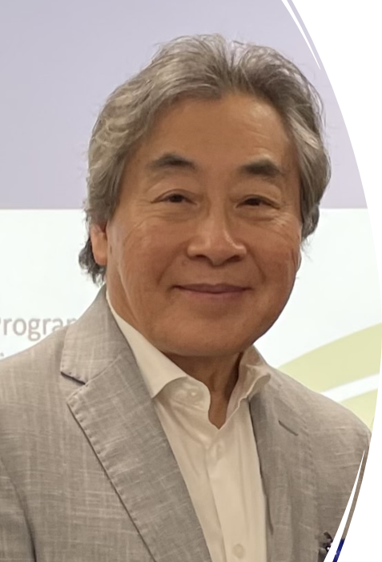
Dr Raymond Chinn will be retiring next month after years of service with the county and decades of work in the field. We want to thank him for the depth of knowledge, heart for mentorship and kind spirit he has brought to our team. He will be deeply missed.
If you would like to write him a note, please give it to our team at the APIC meeting next month so we can pass it along.
SANDIEGOCOUNTY.GOV/HHSA
Notes:
Contact Info

Slide 27

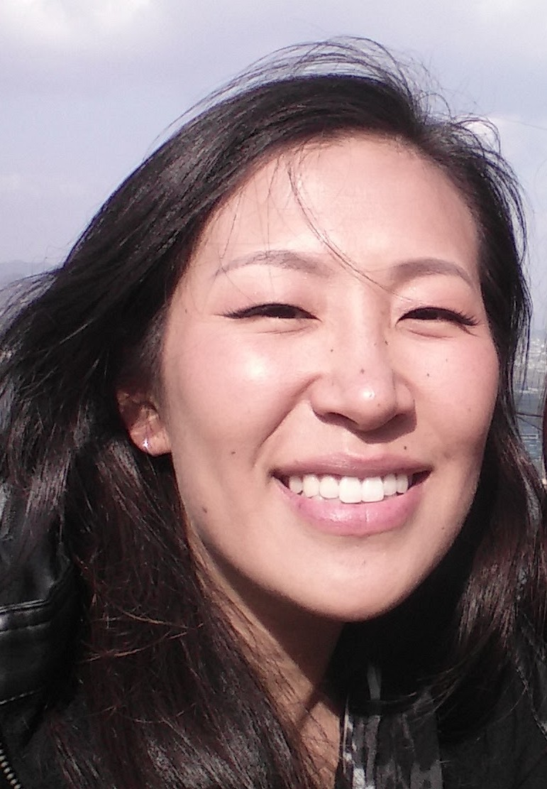
Grace Kang will also be retiring next month. We want to take a moment with this group to express our love and appreciation to Grace. She is a brilliant and thoughtful powerhouse. The legacy she leaves behind will impact people for decades to come.
SANDIEGOCOUNTY.GOV/HHSA
Notes:
Contact Info

Slide 28
Long Term Care

Slide 29
Pediatric care Rady Children's

Slide 30

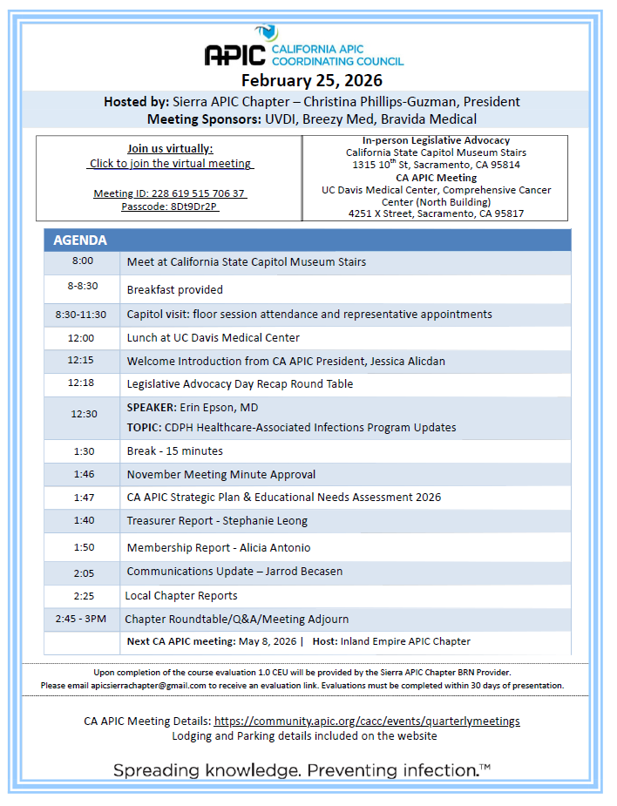
California APIC Coordinating COuncil
Foundations 2026
3‑day virtual course will be spread across 3 weeks, with 1 session per week to better support IPs’ valuable time and dedicated learning hours.
We are targeting late September through the first week of October to avoid conflicts with upcoming holidays.
ROI is high for a course like this, don’t miss it!

Slide 31
California APIC Coordinating COuncil

Slide 32
National APIC

Slide 33
Announcements/roundtable

Slide 34


Train wreck of the month
Lessons learned, what worked?, what didn’t? Open, off-record, safe space, no-judgment discussion

Slide 35

Evaluation link for CEU today
CEU Evaluation

