Slide 1
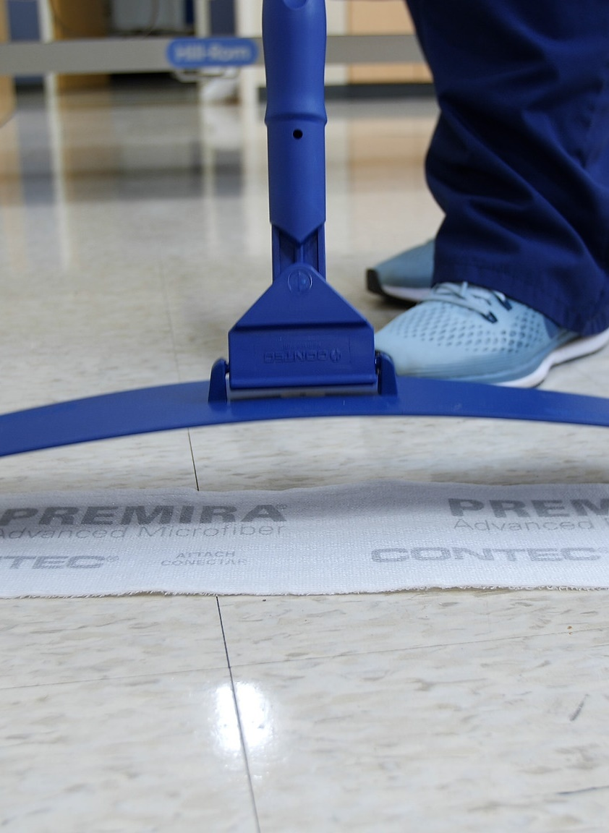
Bugs in the Bucket
How the Hygiene of Cleaning Tools can Impact the Environment of Care
Mark Wiencek, Ph.D.
Principal Microbiologist
Contec Professional

Slide 2
Learner Objectives
Demonstrate risks of cross-contamination from cleaning tools.
Describe microbial contamination found in relaundered microfiber cleaning towels and mop pads.
Explain how cleaning tools can bind and neutralize disinfectants.
Notes:
mark

Slide 3
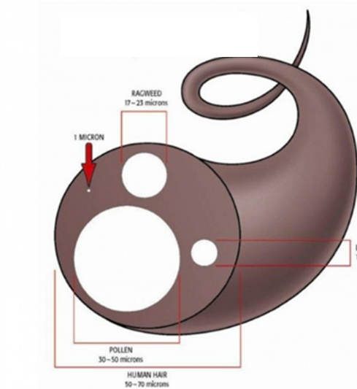

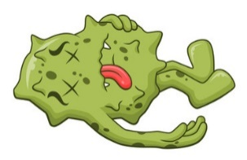

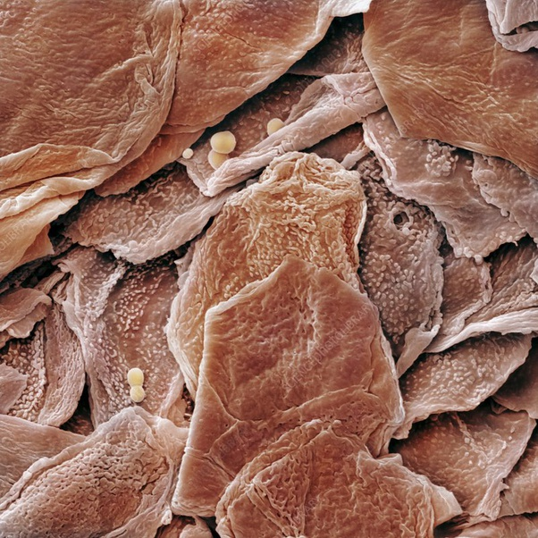

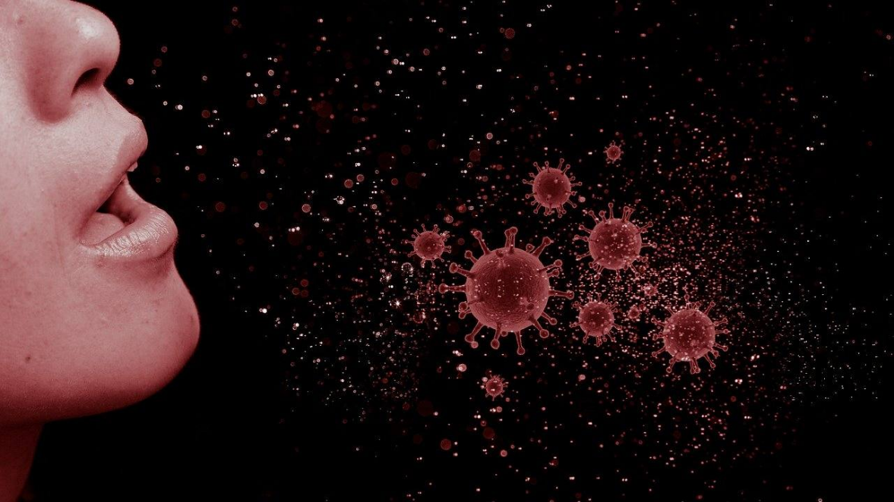
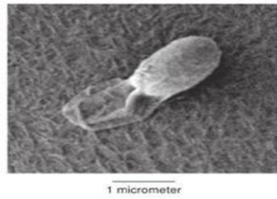
Cooties Prefer to Uber
Germs are tiny and don’t need much food or water to survive.
Yet their most likely fate is to die of thirst (desiccation) or hunger.
Ubering on particles and surfaces increases chance for moisture and nutrients.
Best when the vehicle also is edible: Uber Eats!
Notes:
mark

Slide 4
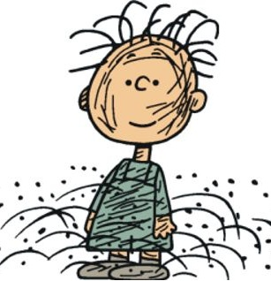



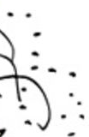

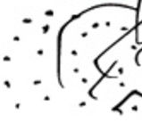
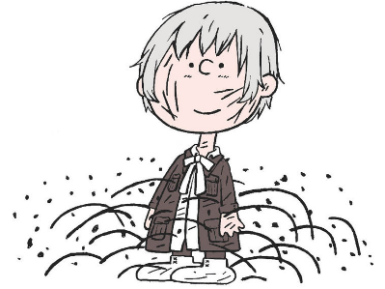
Pig Pen & Pig Penny
Cleaning Up after People and Particles
Hair (head, eyebrows, eyelashes, ear hair)
Makeup, lipstick
Spit
Dandruff
Tears
Eye gunk
Vomitus
Sweat
Ear wax
Boogers/Snot/Mucus
Phlegm & Sputum (loogies)
Zits/Puss
Sweat
Blood
Fingernails and toenails
Urine
Dirt, etc. from shoes, clothes
Lint, threads from clothes
Semen
Hair from various body parts
Menses
Zits/Puss
Feces
Notes:
Ron

Slide 5
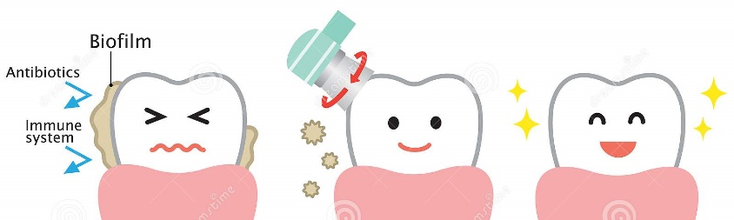
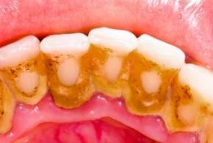
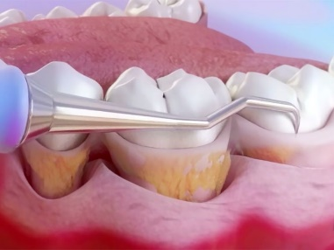
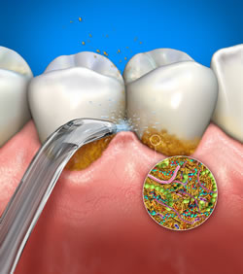
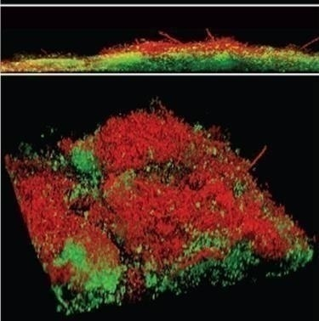
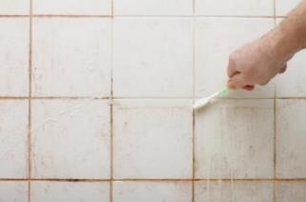

Cleaning What You Can’t See
  Disinfectants/sanitizers are reactive, but can’t tell difference between dirt and germs.
  Microbes + Food + Moisture →
  Mechanical action of cleaning removes dirt and some germs.
Biofilm
Side View →
Biofilm after disinfectant, but no mechanical disruption red = dead cells
green = live cells
Confocal microscopy of biofilm by Center for Biofilm Engineering
Notes:
Mark

Slide 6
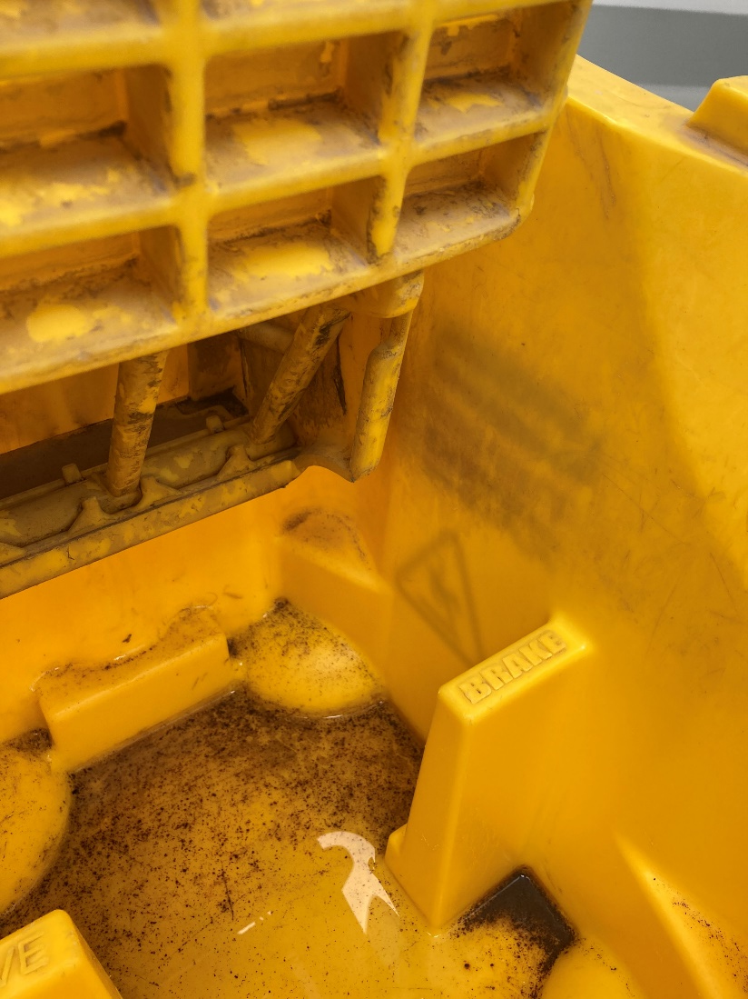
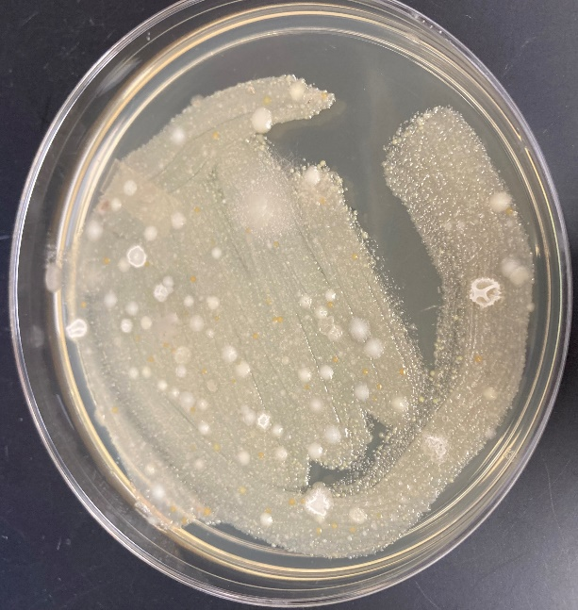
Don’t let the Cleaning Tools turn into Fomites
A “fomite” is an inanimate object that can transfer germs
Re-using cleaning tools (buckets, dispensers, mop frames, mops, towels) for too long or without proper cleaning/disinfection can:
  Make the tool difficult to use
  Degrade disinfectants/sanitizers
  Lead to outbreaks

Slide 7
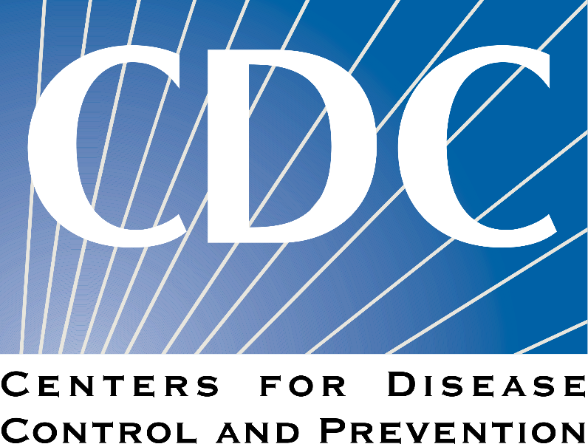
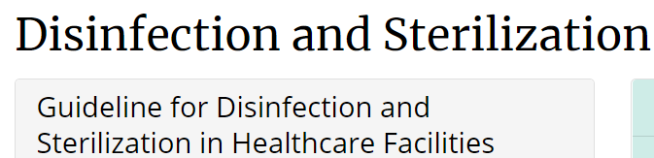
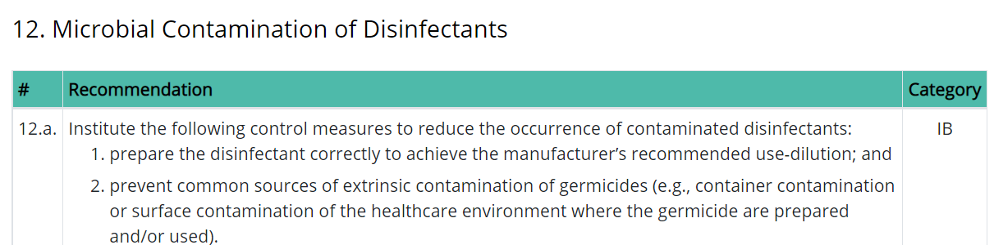
Don’t Let the Cleaning Tools/Solutions Turn into Fomites

Slide 8
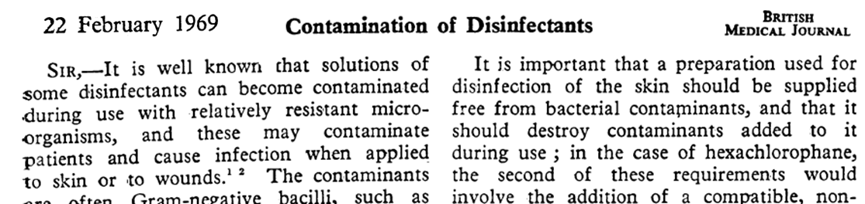
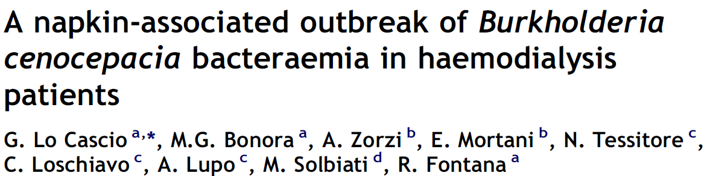

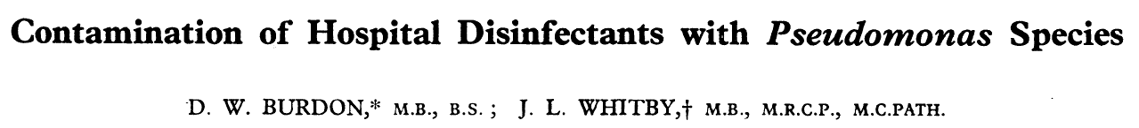


Is this Really an Issue?
Published accounts from 1967 to 2022 of bacteria growing in antiseptic, disinfectant dispensers/containers.
How is this possible if the chemicals kill germs?
      Biofilm, aided by soaps and detergents left behind
      Adaptation of germs to the chemical agent

Slide 9
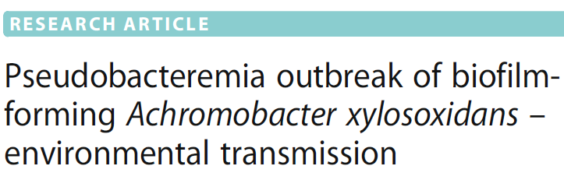
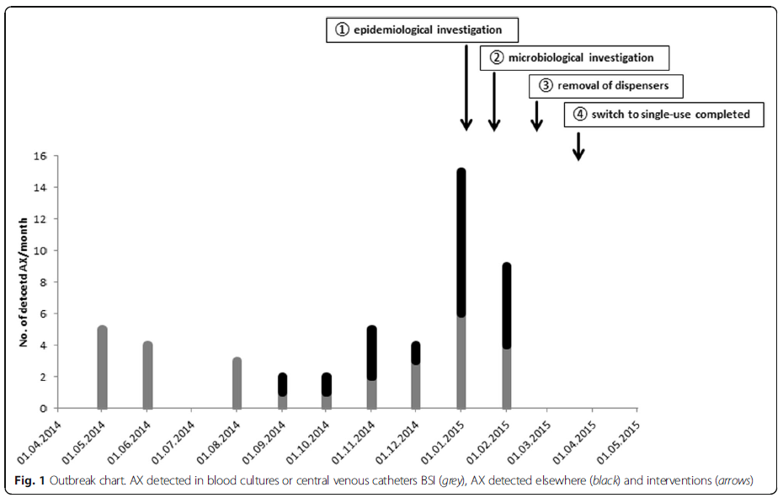
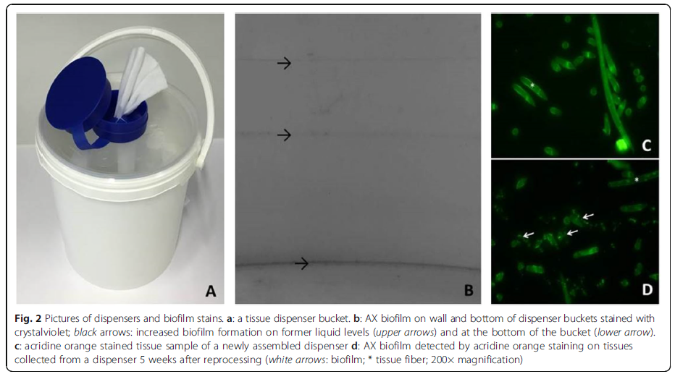
Outbreak from “Bugs in the Bucket”, “Pathogens in the Pail”
Ax elsewhere
Ax in blood cultures, CVCs
Günther, Frank, et al. "Pseudobacteremia outbreak of biofilm-forming Achromobacter xylosoxidans –environmental transmission." BMC infectious diseases 16.1 (2016): 1-5.
Notes:
Add reference

Slide 10
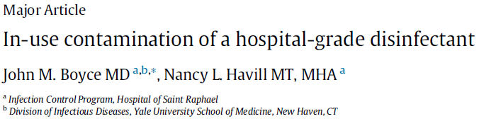
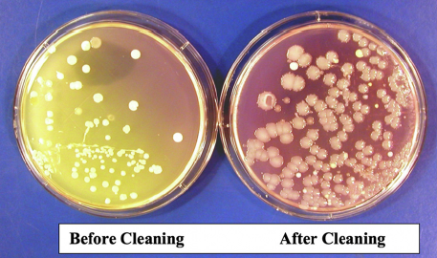
Outbreak from “Bugs in the Bucket”, “Pathogens in the Pail”
Same bucket used for months
      Topped off daily with fresh quat
      Never cleaned bucket
      Serratia marcescens, A. xylosoxidans
      Contaminated quat 100x less effective
Boyce, John M., and Nancy L. Havill. "In-use contamination of a hospital-grade disinfectant." American Journal of Infection Control (2022).

Slide 11




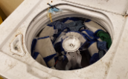




Options for Mechanical Cleaning
Relaundered cotton towels, string-mops
  (Really) Old School
Re-laundered microfiber towels, mops
  Launder inside facility
  Contract with outside vendor
Non-relaundered (disposable) microfiber

Slide 12
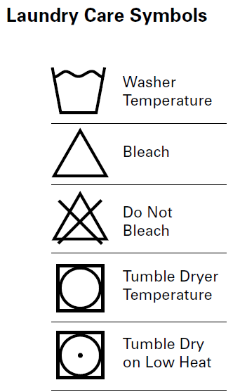
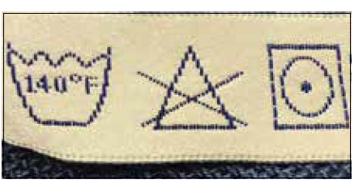
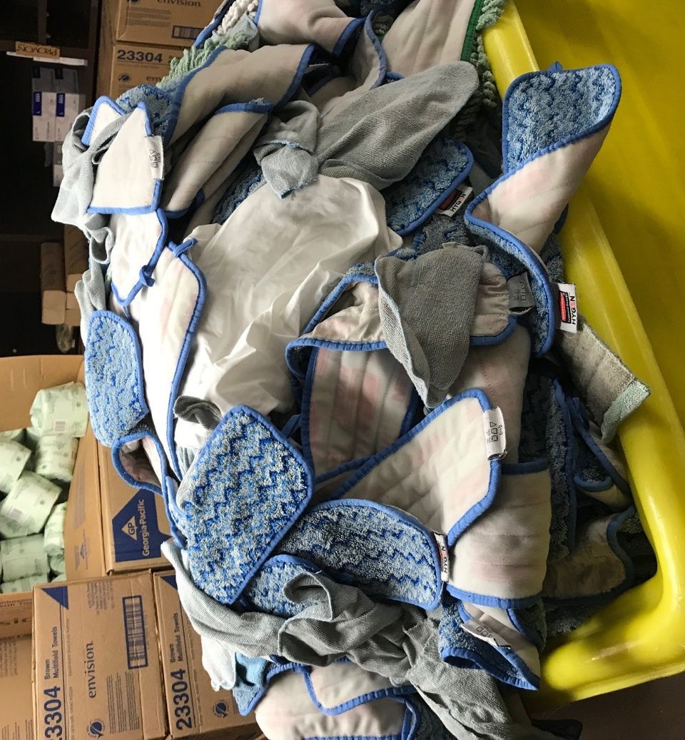
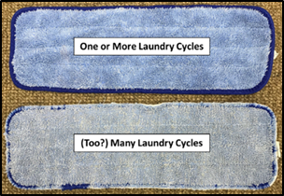
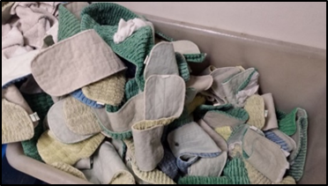
Does Laundering Produce Effective Tools?
CDC: Launder healthcare textiles at >160°F
But many microfiber mop pads and towels indicate to avoid high temperatures and bleach
Because effective laundering is harsh, the mop pads and towels start to look like this…

Slide 13
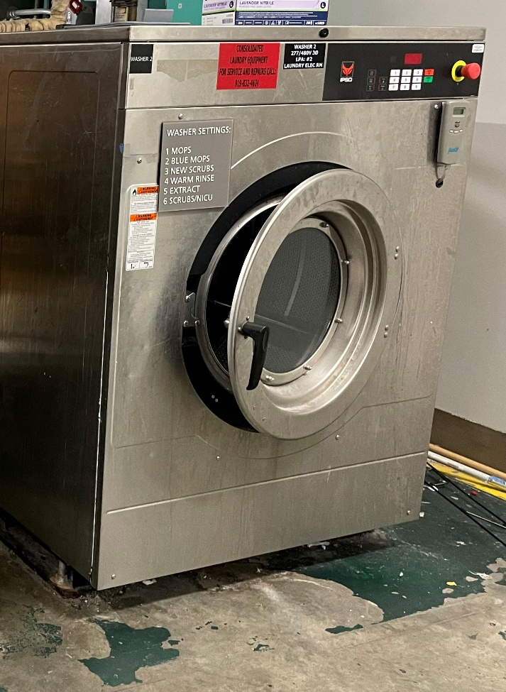

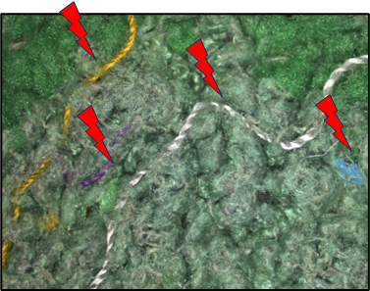
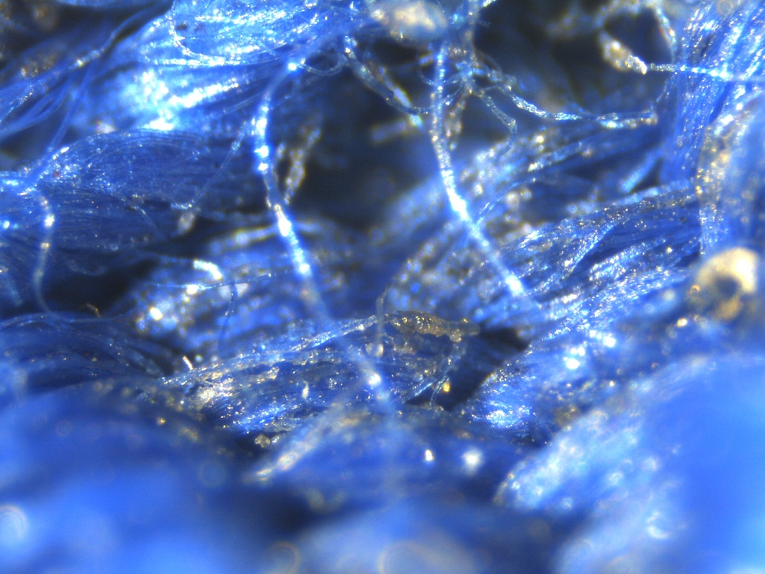
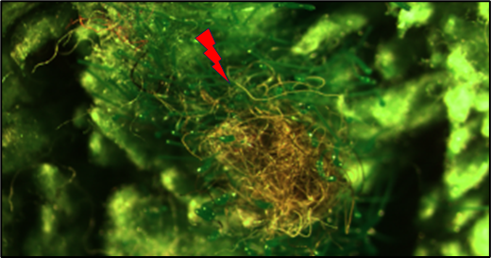
Does Laundering Produce Clean Tools?
Microfiber is designed to grab and hold dirt & debris (including germs)
Gentle laundering is incomplete cleaning
Launder in-house?
  Washing machines also require periodic cleaning!
Debris “left behind”: loose fibers, dirt, hair, lint, body bits…

Slide 14

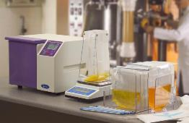

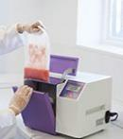
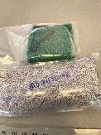
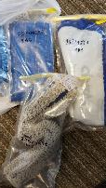

What is Left Behind after Laundering?
Bioburden:
USP
Collect mop or towel in sterile bag with gloved hands
“Shake and Plate”
CFU per Mop or Towel

Slide 15

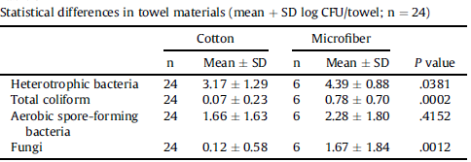
Bioburden on Laundered Mops and Towels
More microbes recovered from synthetic microfiber than cotton
Laundry conditions harsher for white cotton then synthetics
Microfiber better at holding onto particles
*Sifuentes, Laura Y., et al. "Microbial contamination of hospital reusable cleaning towels." AJIC 41 (2013): 912-915.
Notes:
8/21 = 38%

Slide 16
Bioburden on Laundered Mops and Towels
*Unpublished data from Contec, Inc.

Slide 17
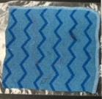
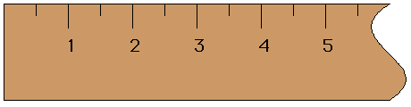
The Microbiome of Laundered Mops and Towels
1/4th of a 9” x 9” Re-laundered Hand Towel
41 unique DNA sequence reads
Families (in yellow) & Genera (in red) contain species that can cause HAIs
Many more Gram-negatives than expected
Microbiome analysis by InstantLabs

Slide 18
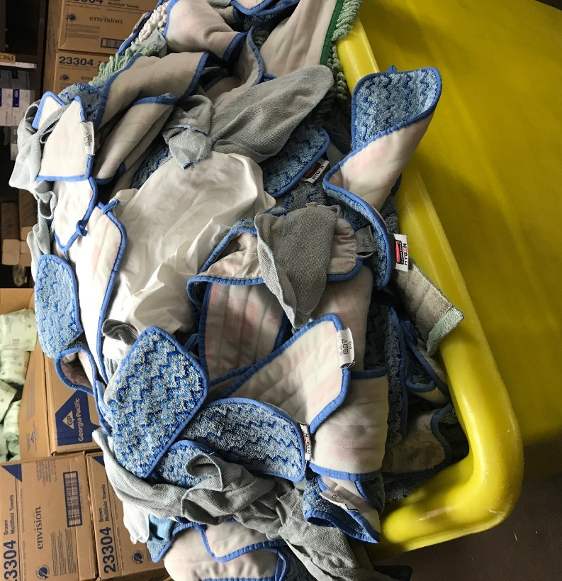
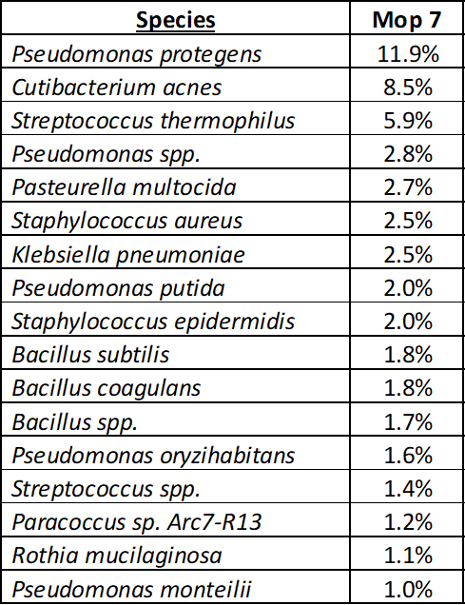
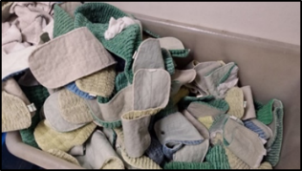
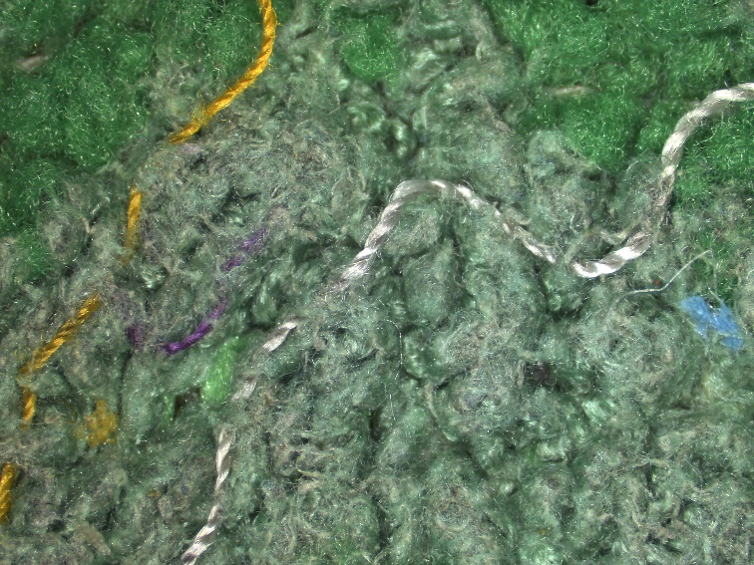
Microbiome of Laundered Mops
Mop Pad #1
199 species
11 species make up 78%
Mop Pad #7
459 species
17 species make up 52%
Microbiome analysis by InstantLabs

Slide 19



Biofilm in a Laundered Towel
Sample moistened with sterile water and incubated at 30°C for 2 days
Confocal microscopy by Center for Biofilm Engineering, Montana State University

Slide 20






Wet Contact/Dwell Time
“Contact Time: Allow surface to remain wet for 5 minutes...”
“…Treated surface must remain visibly wet for one 1 minute to achieve complete disinfection…
The max. time the EPA allows for surface disinfection is 10 min.

Slide 21






Two Knobs for Dialing in Disinfection
Notes:
Examples of kill times vs. concentration from actual labels

Slide 22





Dilution of Disinfectant Concentrates
Quats
How to “measure” concentration?
  Trust the vendor and their machine, but VERIFY!
  Odor, color, suds
  Test strips, paper for active ingredient(s) or pH
    Match to the ingredient and concentration range
    See instructions for use!
    Test strips can expire too…
Peracetic Acid
But could your wipers also signal that something’s wrong?

Slide 23









What is Quat Binding?
M
Disinfectant Quats ( )
Germs

Slide 24


Residual Dirt and Detergents in Laundered Microfiber
Can Bind and Neutralize Disinfectants
Quaternary Ammonium Compounds (“Quats”)
Quat Remaining after Soaking (Virex® 256)
Notes:
Different data?

Slide 25


Some Disinfectants are Very Sensitive
Hypochlorous Acid
Hypochlorous acid disinfectant (500 ppm) made from electrolytic process

Slide 26
Take “Home” Summary Statements
Manual cleaning and disinfection is required to remove particles and their “passengers”.
Spraying disinfectants or using UV lights should be used only to supplement mechanical cleaning.
High levels of bacteria and fungi can be recovered from mop pads and towels after improper laundering.
Audit your in-house or contract laundry facilities with greater scrutiny to verify that textiles are hygienically-clean.

Slide 27
Take “Home” Summary Statements
Cleaning tools can contain biofilm and diverse populations of bacteria, including species that can cause HAIs.
Work with EVS on a maintenance plan for cleaning mops frames, carts and buckets.
Contaminated cleaning tools and cleaning/disinfectant solutions can spread pathogens across the environment of care.
Consider the risk of contaminated disinfectants or neutral cleaners to disperse microbes over large areas.
Weigh replacement of broken/ ineffective items against HAIs or costs regarding EVS health and performance.

Slide 28






mwiencek@contecinc.com

