Slide 1


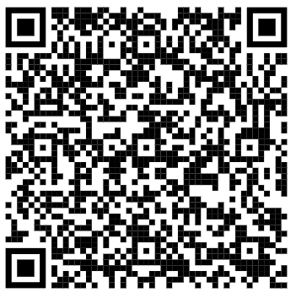

Welcome
April 8th, 2026 – 12:00 pm PST

Slide 2





Online Participant Reminders
This meeting will be recorded
Presentation slides are available on our Meetings page
Please stay muted during the educational presentation and do not put us on hold if you are calling in on a phone line
Type in any questions or comments in the chat
CEUs will be provided after completion of speaker evaluation - a link will be shared at the end of the meeting

Slide 3



Today’s Lunch Sponsor

Slide 4

Today’s Education Sponsor

Slide 5
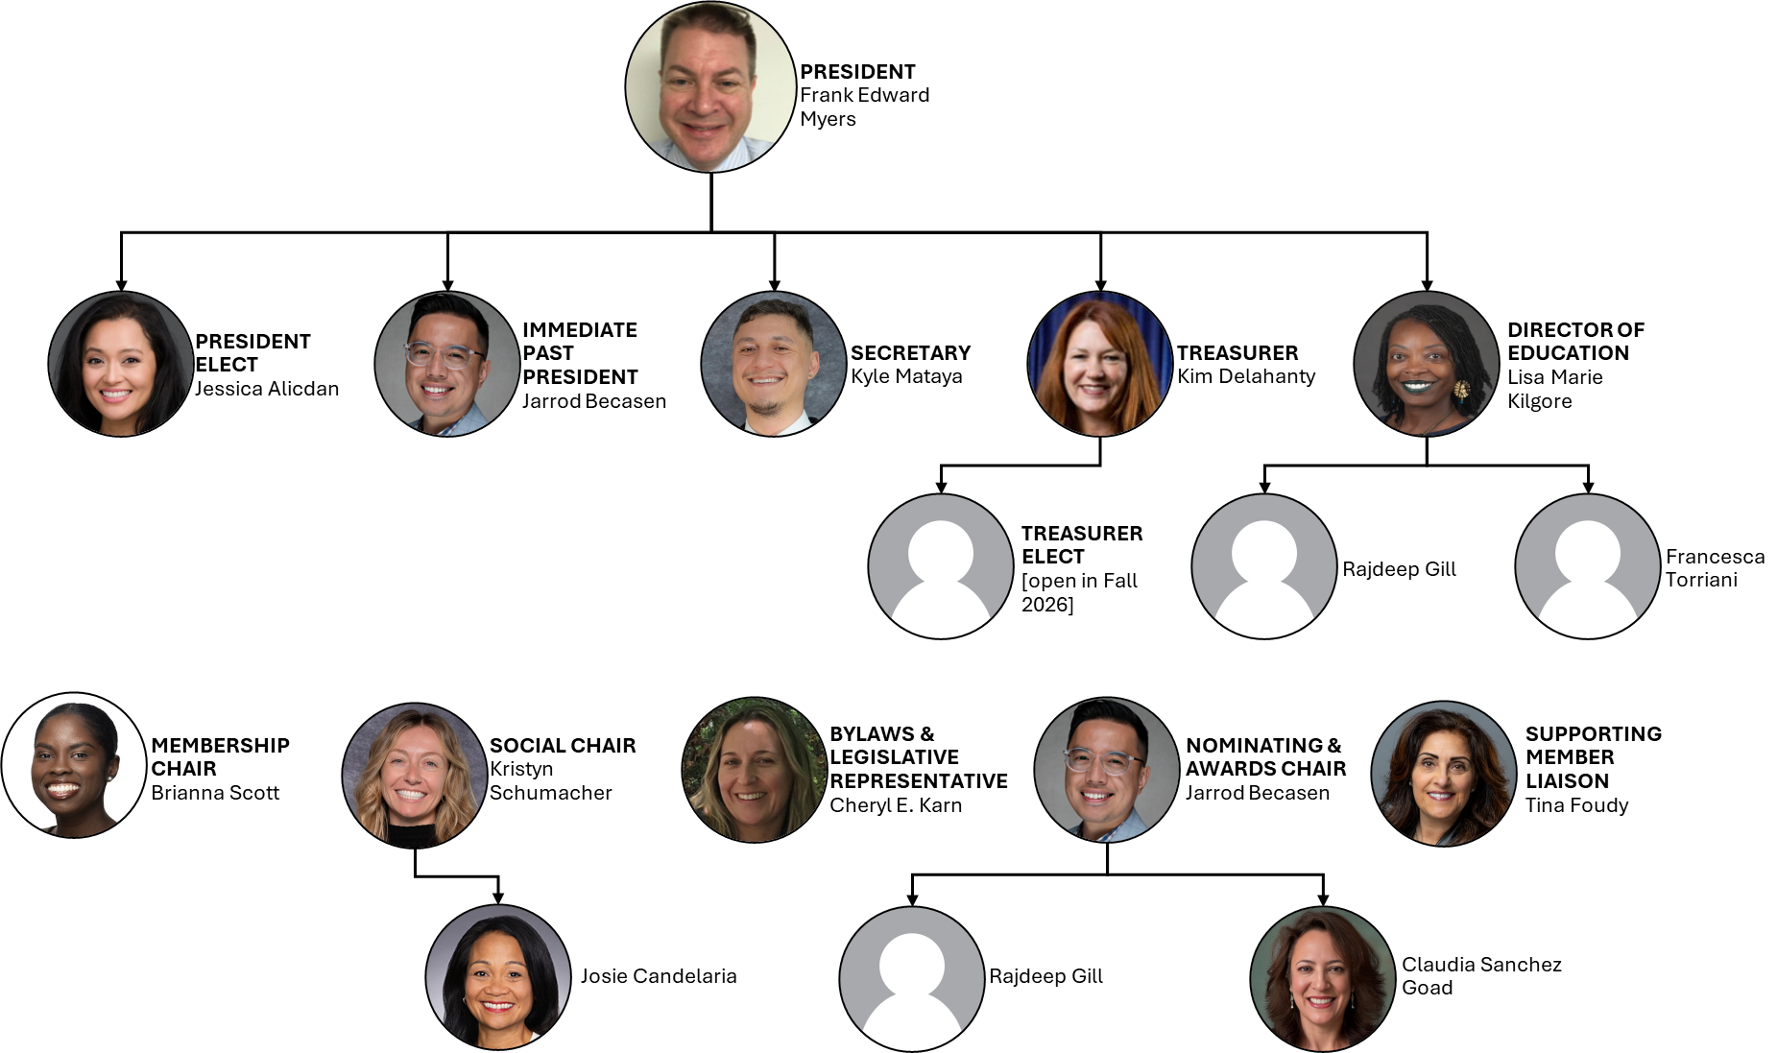

Slide 6
Introductions & Recognitions
New members
New certifications or re-certifications
First time attendees

Slide 7
Old Business
Last meeting’s minutes approval

Slide 8
New Business
Frank Myers

Slide 9
EDUCATION REPORT
LISA KILGORE

Slide 10
Membership Report
Josie CandelariA/Brianna Scott

Slide 11


Nominating & Awards
Jarrod Becasen, Claudia Sanchez GOAD, Raj Gill
"National APIC Conference" Award
  Term of award: APIC Annual Conference 2026, June 15-17, Nashville, TN https://apic.org/apic2026/
  Award Amount: $2000.00
  Number of awards: 1
  Application due date: May 6, 2026
"Standard APIC" Award
  Term of award: January 1, 2026 to December 31, 2026
  Award Amount: $500.00
  Number of awards: 3
  Application due date: May 6, 2026

Slide 12

Social Report
Kristyn Schumacher, Josie Candelaria
No Updates

Slide 13
Treasurer Report April 2026
Kim Delahanty
Monthly Treasurer Report:
  Beginning Balance: March 31, 2026: $834.45
  Cash Flow:
Deposits: 0
Checks paid: 0
ATM & Debit Card Withdrawals: 0
Electronic Withdrawals: $19.99 for Paypal 3/16/26
Bank Fees: $15.00
Ending Account Balance: $799.46
Mutual Fund: 31,866.65 as of November 28,2025

Slide 14
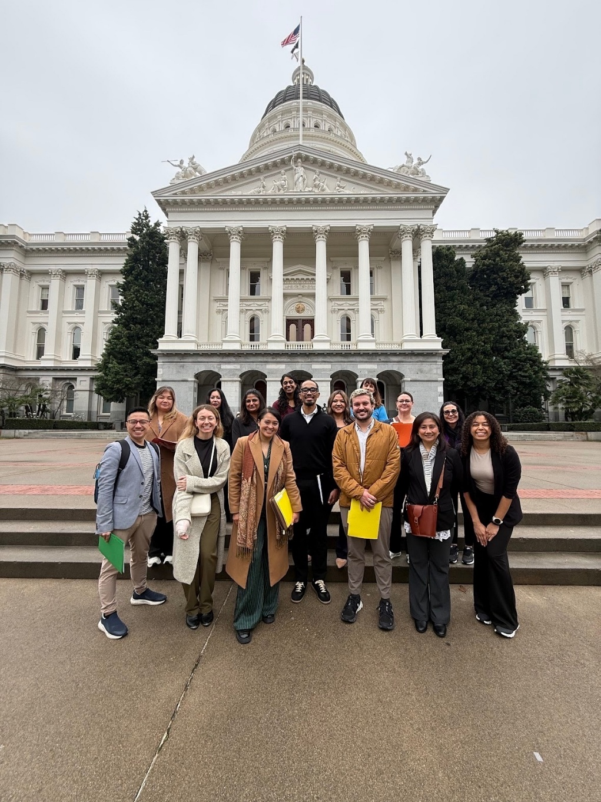
Legislative Rep Report
Cheryl Karn

Slide 15
Ambulatory care
Janessa Esteban

Slide 16
HAI Liaison & Advisory Report

Slide 17
Infectious Disease Association of CA

Slide 18
G.E.R.M. Commission
Frank Myers

Slide 19
Long Term Care

Slide 20
Pediatric care
Rady Children's

Slide 21
County epidemiology
Mara Rauhauser

Slide 22
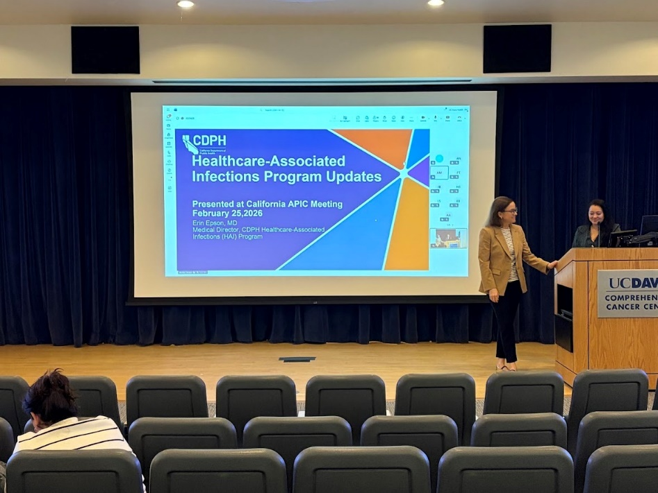
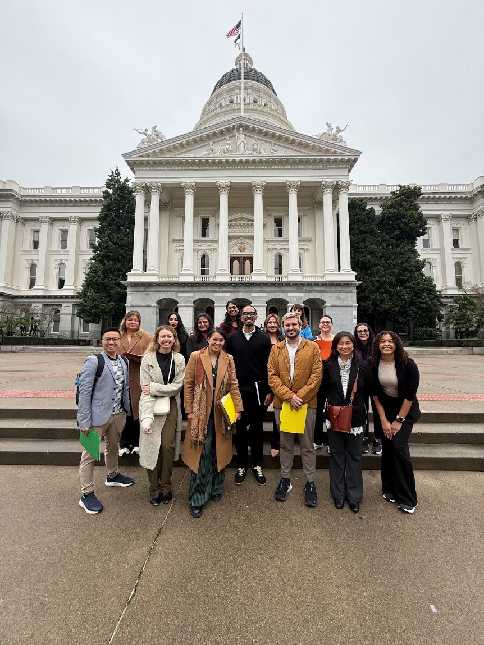
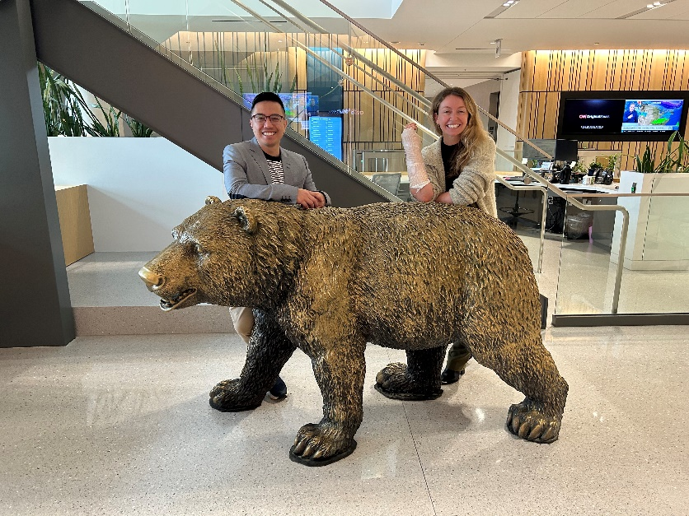

California APIC Coordinating COuncil
October 2025, Newsom vetoed SB 317, which sought to codify and expand the "California Surveillance of Wastewaters" (CalSuWers) network, citing General Fund cost pressures.
Post Questions for IPs from Dr. Erin Epson, CDPH
Complete now
Legislative Advocacy Day 2026

Slide 23


California APIC Coordinating COuncil
Next CA APIC Event in Palm Springs
May 8, 2026

Slide 24

California APIC Coordinating COuncil

Slide 25
Announcements/roundtable

Slide 26


Train wreck of the month
Lessons learned, what worked?, what didn’t? Open, off-record, safe space, no-judgment discussion

Slide 27

Eloquest Game

Slide 28
Contec
ContecClean Cloth Demonstration _ Infection Prevention

Slide 29

Evaluation link for CEU today

