Slide 1


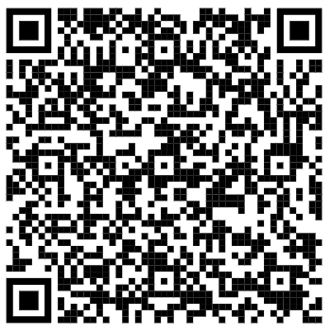

Welcome
May 13th, 2026 – 12:00 pm PST

Slide 2





Online Participant Reminders
This meeting will be recorded
Presentation slides are available on our Meetings page
Please stay muted during the educational presentation and do not put us on hold if you are calling in on a phone line
Type in any questions or comments in the chat
CEUs will be provided after completion of speaker evaluation - a link will be shared at the end of the meeting

Slide 3



Today’s Sponsor

Slide 4
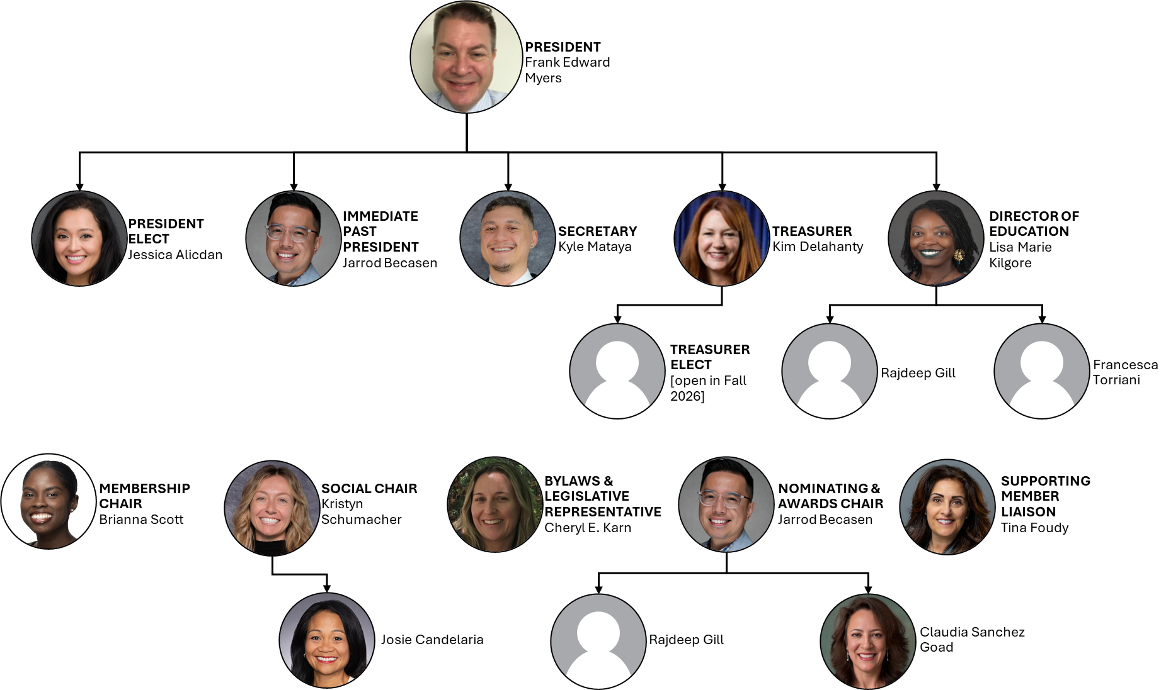

Slide 5
Introductions & Recognitions
New members
New certifications or re-certifications
First time attendees

Slide 6
Old Business
Last meeting’s minutes approval
  April, March

Slide 7
New Business
Frank Myers

Slide 8
EDUCATION REPORT
LISA KILGORE

Slide 9
Membership Report
Josie CandelariA/Brianna Scott

Slide 10
Nominating & Awards Report jarrod Becasen, Claudia Sanchez Goad, & Raj Gill
National APIC Award $2000
  7 eligible applicants
  Rank-choice voted by eligible board members
  Award goes to Alex Massey
Standard APIC Award $500 (3 awards)
  6 rollover applicants from National Award
  12 eligible applicants
  Rank-choice voted by eligible board members [IN PROGRESS]

Slide 11

Social Report
Kristyn Schumacher, Josie Candelaria
No Updates

Slide 12
Treasurer Report May 2026
Kim Delahanty
Monthly Treasurer Report:
  Beginning Balance: April 2026: $799.46
  Cash Flow:
Deposits: $740.00 (National APIC 3631 Chapter dues)
Checks paid: 0.00
ATM & Debit Card Withdrawals: 0.00
Electronic Withdrawals: 0.00
Bank Fees: $15.00
Ending Account Balance April 30, 2026: $1524.46
Mutual Fund: $31,866.65 as of November 28,2025

Slide 13
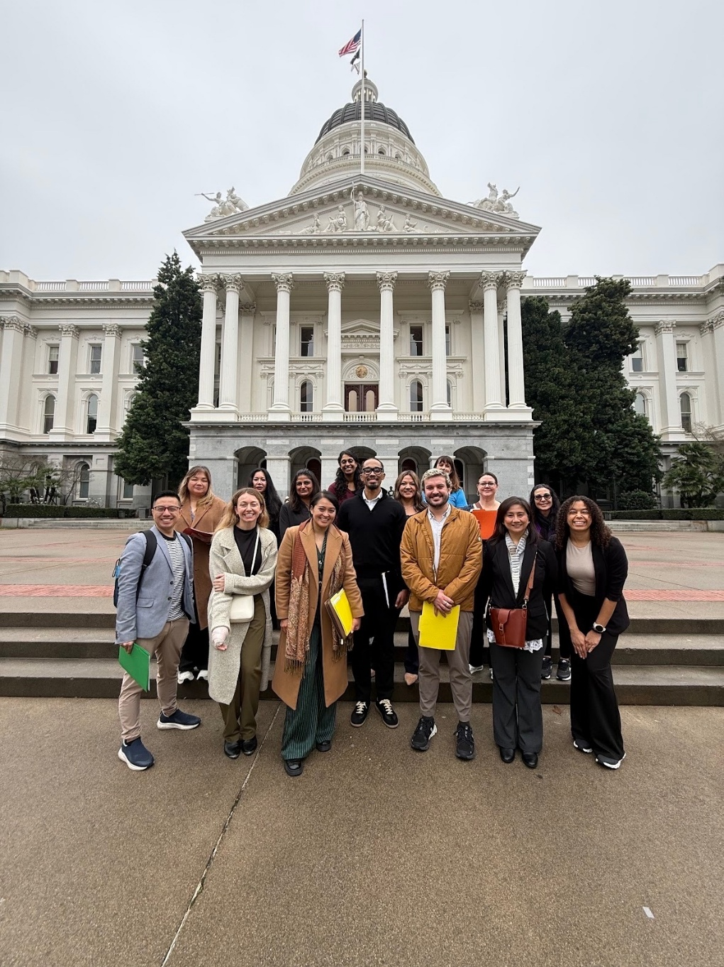
Legislative Rep Report
Cheryl Karn
Invite Your U.S. Representatives to an APIC Congressional Briefing
  On Thursday, May 14, APIC and Nozin are hosting a congressional briefing in the U.S. House of Representatives to educate Representatives and congressional staff about who IPs are, what they do, the basics about IPC, the tools you need (such as NHSN), and broad policy recommendations for congressional action supporting infection prevention and control.
  Go to APIC Action Center to send a pre-filled letter to your US Representatives
Sign up for alerts through APIC Action Center:
  https://www.votervoice.net/APICorg/home

Slide 14
Ambulatory care
Janessa Esteban

Slide 15
HAI Liaison & Advisory Report

Slide 16
Infectious Disease Association of CA

Slide 17
G.E.R.M. Commission
Frank Myers

Slide 18
Long Term Care

Slide 19
Pediatric care
Rady Children's

Slide 20
County epidemiology
Mara Rauhauser

Slide 21

California APIC Coordinating COuncil
APIC26 Conference
CA APIC Photo Opportunity:
If you are attending National APIC, meet on Day 1 (Monday, June 15) after keynote speaker for a CA APIC photo under APIC26 sign on stage
CA APIC Networking Event:
Before the Clorox Party, swing by our CACC social event. Location TBD.

Slide 22


California APIC Coordinating COuncil

Slide 23

California APIC Coordinating COuncil
https://community.apic.org/cacc/events/quarterlymeetings

Slide 24
Announcements/roundtable

Slide 25


Train wreck of the month
Lessons learned, what worked?, what didn’t? Open, off-record, safe space, no-judgment discussion

Slide 26

Evaluation link for CEU today

