Slide 1


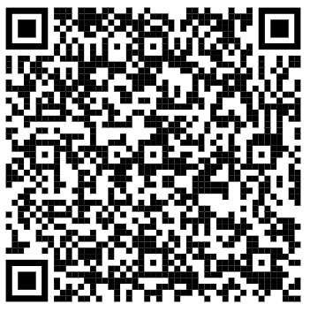

Welcome
Sept 9th, 2026 – 12:00 pm PST

Slide 2





Online Participant Reminders
This meeting will be recorded
Presentation slides are available on our Meetings page
Please stay muted during the educational presentation and do not put us on hold if you are calling in on a phone line
Type in any questions or comments in the chat
CEUs will be provided after completion of speaker evaluation - a link will be shared at the end of the meeting

Slide 3




Today’s Sponsor

Slide 4
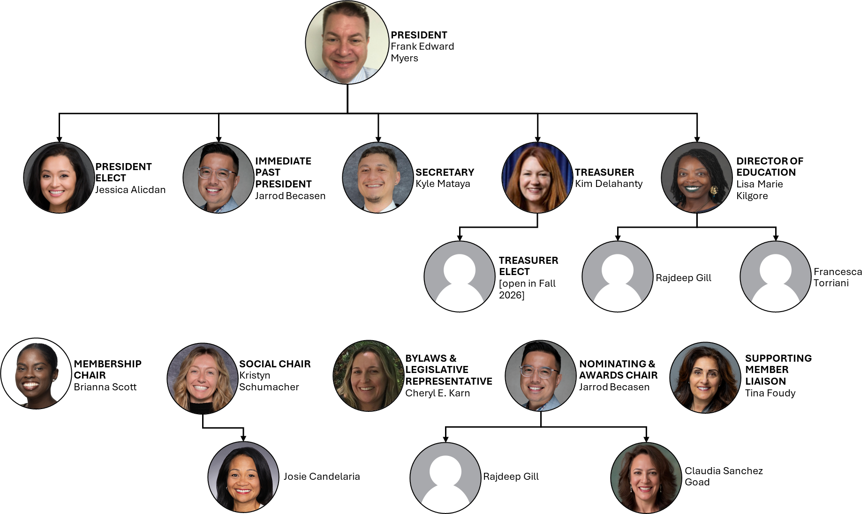

Slide 5
Introductions & Recognitions
New members
New certifications or re-certifications
First time attendees

Slide 6
Treasurer Report June 2026
Kim Delahanty
Monthly Treasurer Report:
  Beginning Balance: May 2026: $ 1524.46
  Cash Flow:
Deposits: $0.00
Checks paid: $500.00 (Check 1756)
ATM & Debit Card Withdrawals: 0.00
Electronic Withdrawals: 0.00
Bank Fees: $15.00
Ending Account Balance May 29, 2026: $1009.46
Mutual Fund: $31,866.65 as of November 28,2025

Slide 7
Treasurer Report July 2026
Kim Delahanty
Monthly Treasurer Report:
  Beginning Balance: June 2026: $ 1009.46
  Cash Flow:
Deposits: $0.00
Checks paid: $0.00
ATM & Debit Card Withdrawals: 0.00
Electronic Withdrawals: 0.00
Bank Fees: $19.00 ($15.00 + $4.00 stop payment fee check 1758 sent out NSF: check sent accidentally)
Ending Account Balance June 30, 2026: $990.46
Mutual Fund: $31,866.65 as of November 28,2025

Slide 8
Treasurer Report August 2026
Kim Delahanty
Monthly Treasurer Report:
  Beginning Balance: July 2026: $ 990.46
  Cash Flow:
Deposits: $10,139.19.00 (Paypal deposits for 2026 fall and LTC conference )
Checks paid: $0.00
ATM & Debit Card Withdrawals: $362.95 ( $103.00 on 7/2/26 Taquizas Joe’s summer social+ $259.95 on 7/3/26 SD Park and Rec license for summer social)
Electronic Withdrawals: 0.00
Bank Fees: $0.00
Ending Account Balance July 29, 2026: $10766.70
Mutual Fund: $31,866.65 as of November 28,2025

Slide 9
Treasurer Report September 2026
Kim Delahanty
Monthly Treasurer Report:
  Beginning Balance: August 2026: $ 10,766.70
  Cash Flow:
Deposits: $8824.77. (PayPal deposits for 2026 fall and LTC conference )
Checks paid:
$2,275.19 (Check 1757: Paid for President couldn’t attend: Secretary went instead to National APIC 2026: approved by the board)
$2,000.00 (Check 1759: Paid for SD APIC Chapter awardee to attend National APIC 2026)
$4,720.00 (Check 1760: Loan paid to President of SD APIC for down payment for Fall 2026 conference venue: approved by the board)
Check 1758 was voided
ATM & Debit Card Withdrawals: 0.00
Electronic Withdrawals: 0.00
Bank Fees: $0.00
Ending Account Balance August 29, 2026: $10,596.28
Mutual Fund: $31,866.65 as of November 28,2025

Slide 10
Old Business

Slide 11
New Business
Frank Myers

Slide 12
EDUCATION REPORT
LISA KILGORE

Slide 13
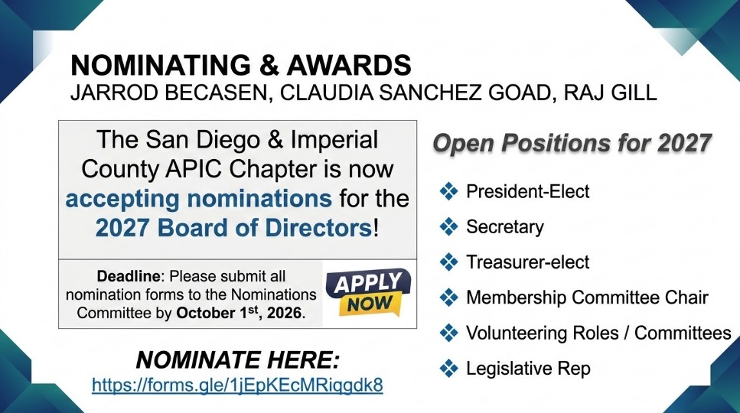

Nominating & Awards
Jarrod Becasen, Claudia Sanchez GOAD, Raj Gill

Slide 14
Membership Report
Josie CandelariA/Brianna Scott

Slide 15
Social Report
Kristyn Schumacher, Josie Candelaria

Slide 16
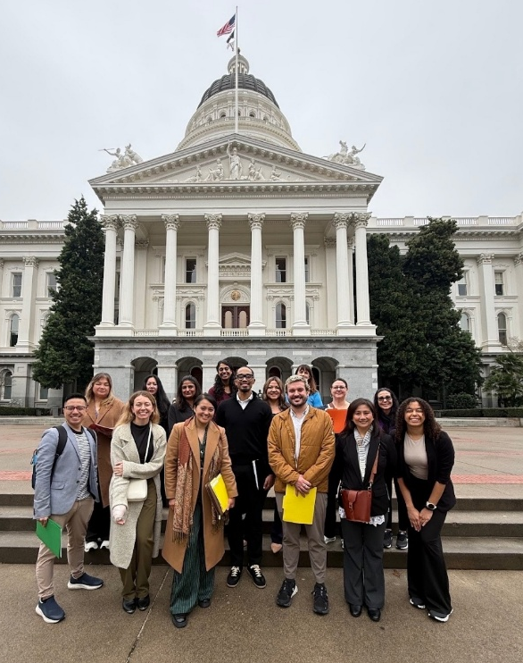
Legislative Rep Report
Cheryl Karn
Several Public policy updates since last meeting:
  https://apic.org/public-policy-updates/
    New FDA Administrator nomination
      Still needs to be approved by Senate
      Dr. Heidi Overton – board certified in public health and general preventative medicine
    Executive order (EO) for revised Childhood vaccine schedule
      Reduces childhood vaccines from 18 to 11
      MMR to be administered in three separate single disease shots
      All childhood vaccines should be administered at separate medical visits
      Also challenges state mandate vaccine laws
      APIC / SHEA statement in response to EO:
        Does not reflect current scientific evidence and does not represent the “gold standard” in vaccine research
        https://apic.org/news/apic-and-shea-release-joint-statement-in-response-to-presidents-executive-order-on-vaccines/
    Senate confirms new CDC Director
      Dr. Erica Schwartz – retired rear admiral in the US Public Health Service Commissioned Corps
        Also served as deputy surgeon general from Jan 2019 through April 2021

Slide 17
Ambulatory care
Janessa Esteban

Slide 18
HAI Liaison & Advisory Report

Slide 19
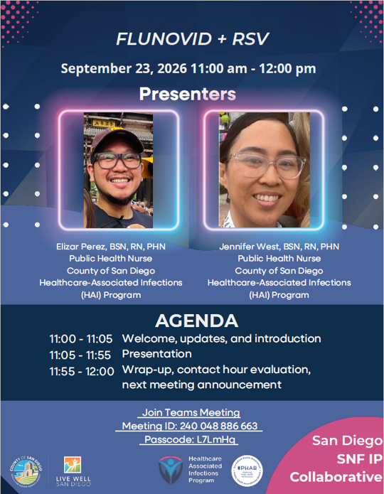
County epidemiology
Catherine Blaser
COVID outbreaks
Ebola
Coming Soon:
  Measles preparedness checklist for acute care
  Updated MDRO tiers document
  6th GACH Report
Upcoming Events:
  9th Annual Communicable Disease Meeting –
      Wednesday, October 7, 2026, 8:30 AM - 12:30 PM
      Chambers Room at 5520 Overland Avenue, SD
  September SNF IP Collaborative –
    Flunovid+RSV
    September 23, 2026, 11:00 AM – 12:00 PM

Slide 20
Infectious Disease Association of CA

Slide 21
G.E.R.M. Commission
Frank Myers

Slide 22
Long Term Care

Slide 23
Pediatric care
Rady Children's

Slide 24
County epidemiology
Mara Rauhauser

Slide 25

California APIC Coordinating COuncil
Are you passionate about infection prevention and ready to help shape the future of our profession in California? Now’s your chance! CACC is seeking dedicated and dynamic APIC members to serve on our Board of Directors.
This is a great opportunity to:
️ Expand your leadership skills
️ Influence statewide infection prevention initiatives
️ Collaborate with peers and drive meaningful change
️ Earn IPUs
Open positions available now
Deadline to apply: Friday, September 25, 2026
Whether you're a seasoned professional or an emerging leader, we encourage you to step forward and make a difference! Use this survey to self-nominate or nominate a colleague for a Board of Director or Committee position.
Please consider serving on the CA APIC board. CA APIC serves as an outreach and support coordinating body for all California APIC chapters. While we have our own mission and goals, they are directly aligned to promote and strengthen the network among chapters, and to provide opportunities for professional development at a chapter-level. See our mission and goals: https://community.apic.org/cacc/home/mission.
Nominate here: https://forms.gle/C8tinGtgTdxGy4sA7

Slide 26

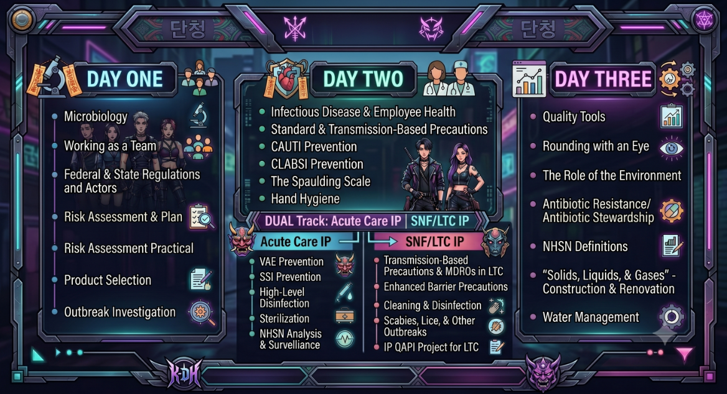

California APIC Coordinating COuncil
Due to scheduling conflicts among some of the Foundations faculty, this educational program will be moved to early next year (see new dates below). If you’ve already registered, you have the option for a refund or to keep your registration for the 2027 program.
If you are a developing Infection Preventionist looking to build a strong foundation, join CA APIC’s “Foundations in Infection Prevention: K-POP: Infection Hunters” Course. This is a dynamic 3-part live virtual experience.
Key Details & Benefits:
Dates: Jan 22, Jan 29, & Feb 5, 2027 (3 Live Virtual Sessions)
CEUs: Earn 23 continuing education contract hours or IPUs
Impact: Practical strategies to protect patients, staff, and your facility
Practical knowledge and real-world strategies to California-specific regulations (e.g., Cal/OSHA standards and CDPH mandates)
Directly connect you with local California peers and mentors
Financial Support Available: Apply for one of eight $500 Educational Awards to cover your participation!
🏆 Award Deadline: September 4, 2026 — Apply for the Award
👉 Click here to register and view full course details

Slide 27

California APIC Coordinating COuncil
Last Alignment Strategy meeting October
Mentorship Program Early 2027
Legislative Advocacy Day Planning

Slide 28
Announcements/roundtable

Slide 29

Train wreck of the month
Lessons learned, what worked?, what didn’t? Open, off-record, safe space, no-judgment discussion

Slide 30
Pending Evaluation link for CEU today

